Slide 1
Representing Disciplinary Reform in Introductory Research Methods Textbooks
Dr. Catherine D. Rawn, cdrawn@psych.ubc.ca @cdrawn
Preet Pandher
University of British Columbia

Slide 2
What does a typical research methods course do to our students?

Slide 3
Research methods aren’t dead
Stagnant
Idle
Lifeless
Static
Passive
Dormant

Slide 4
Recent Reform: Some Key Triggers
APS “State of our Science” symposia
Special Issues of Perspectives
2011
Massive Diederik Stapel fraud case
Bem’s article on ESP (admits omitted failed studies)
Wicherts: colleagues unwilling to share published data for reanalysis
Questionable Research Practices (QRPs) can lead to “statistically significant” differences without real effects
2012
Self-reports of QRPs are high
p-curves of published literature show too many p = .04, suggesting QRPs influencing literature
Trouble replicating some well-known social cognition effects
Pashler & Wagenmakers (2012)

Slide 5
Recent Reform: Some Recent Recommendations
Replication
Encourage direct/exact replications
Developing standards for direct replication attempts
Encourage many labs’ involvement
Registered Replication Reports and other outlets
Transparency
Pre-registering methods and data analysis plans
Fully report methods and decisions
Posting datasets after publication when possible
Statistics
Increase power
Supplement NHST with effect sizes, confidence intervals
Prepare your MS for inclusion in meta-analysis
Cesario (2014), Cumming (2014), Eich (2014), LeBel et al. (2013), Nosek et al.,… others

Slide 6
How are disciplinary reform topics represented in introductory research methods textbooks?

Slide 7
Finding Textbooks to Include
Publishing representatives
Major competitors, bestsellers
Send 2 copies
Quantitative research methods focus
Introductory level
1-2 statistics chapters, but not fully combo book
Final sample = 9 books

Slide 8
Textbooks Included
Authors | Title | Publisher | Year
Cozby & Rawn | Methods in Behavioural Research (1CE) | McGraw-Hill Ryerson | 2012
Graziano & Raulin | Research Methods: A Process of Inquiry (8th) | Pearson | 2013
Jackson | Research Methods and Statistics: A Critical Thinking Approach (4th) | Wadsworth, Cengage Learning | 2012
Leary | Introduction to Behavioural Research Methods (6th) | Pearson | 2012
Stangor | Research Methods for the Behavioural Sciences (5th) | Cengage Learning | 2015
White & McBurney | Research Methods (9th) | Cengage Learning | 2013
Morling | Research Methods in Psychology - Evaluating a World of Information (2nd) | Norton | 2015
Goodwin & Goodwin | Research Methods in Psychology - Methods and Design (7th) | Wiley | 2013
Gravetter & Forzano | Research Methods for the Behavioural Sciences (5th) | Cengage Learning | 2016

Slide 9
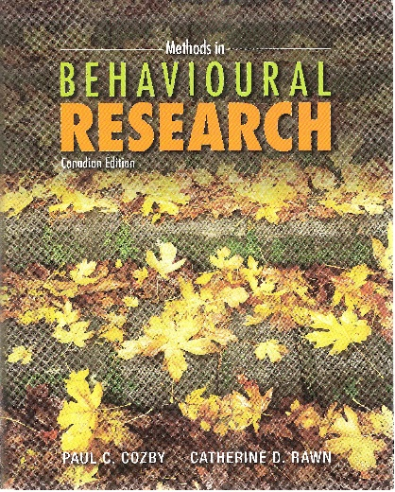
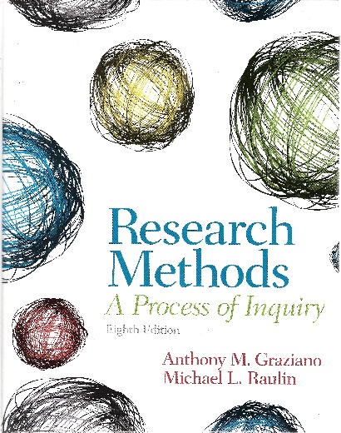
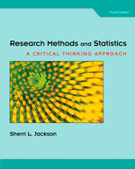
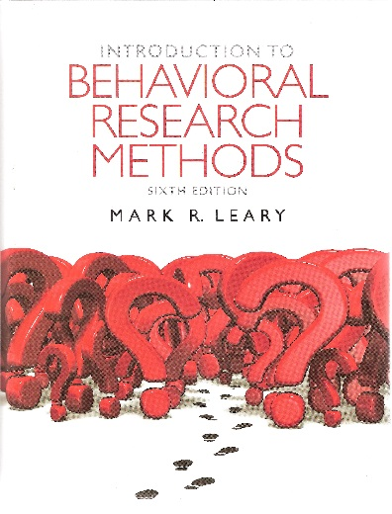
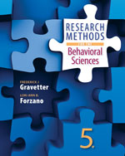

Slide 10
Concepts Representing Areas of Major Reform Efforts
 | Replication | Ethics | Statistics
Reform | Exact Direct | Plagiarism Fraud Fabrication Data Analysis | Effect Sizes Confidence Interval Meta-analysis
Control | Conceptual Systematic | Participant(s) | Null Hypothesis Sampling Distribution Alpha
(Cumming, 2013, Eich, 2013)

Slide 11
How much emphasis is placed on reform-related concepts versus control-related concepts?

Slide 12
Operationally Defining Emphasis
Phase 1
Number of pages concept appears
Number of chapters mentioned
Appearance in header
Bolded term
Glossary definition
Used index, table of contents, skimming pages
Two Research Assistants
Discussed boundaries together

Slide 13
Operationally Defining Emphasis
Manually typed sections identified in Phase 1
Phase 2
Word count
Number of mentions of key terms
ANTCONC for corpus analysis http://www.laurenceanthony.net/software.html

Slide 14
Overall Results: Ethics
d | 2.88 | .20 | -1.43 | -1.63 | -1.36
.95CI | no calc if >2 | -.73, 1.12 | -2.55, -.25 | -2.82, -.39 | -2.46, -.20
*
*
*
*

Slide 15
Overall Results: Statistics
d | -.19 | -1.89 | -.26 | -.12 | .22
.95CI | -1.05, .68 | -3.19, -.52 | -1.16, .65 | -.52, .30 | -.42, .84
*

Slide 16
Overall Results: Replication
d | .41 | .32 | -.24 | .16 | -.21
.95CI | -.61, 1.41 | -.74, 1.36 | -.71, .25 | -.42, .73 | -.63, .22

Slide 17
Overall Results: Word Count
d | .31 | 1.89 | -.47
.95CI | -.58, 1.19 | .53, 3.18 | -1.23, .32
*

Slide 18
Overall
Participant ethics
Large emphasis (number of pages, words, percent of pages, word uses)
Very little emphasis on fraud, fabrication, plagiarism, ethics in data analysis
When reform issues appear, get attention (headers, terms)
Statistical concepts
Evenly balanced
Reform concepts tend to appear in multiple chapters; control concepts in just one
Replication
Very little emphasis on distinguishing types
Very little emphasis relative to participant ethics, statistics
Variability across textbooks…

Slide 19
Variability across Texts: Percent of Pages

Slide 20
Potential strategies to incorporate reform topics into Research Methods Courses
Students debate merits/uses of exact replication and conceptual replication
Describe process of science from researcher’s perspective, students generate all opportunities for ethical decision making
Students present cases of fraud and ensuing debate
Students investigate & summarize attempts to replicate a phenomenon, draw from Registered Replication Reports
Students attempt to replicate a phenomenon, discuss challenges and conclusions
Students compare policies about plagiarism from APA/journal with campus academic honesty policies
Students describe results of an article, including interpreting both statistical significance and effect size
…

Slide 21
Research methods aren’t dead

Slide 22
Some Articles to Supplement Your Text, Trigger Discussion: Replication
Algona, V. K., Attaya, M. K., Aucoin, P., Bahnik, S., Birch, S., Birt, A. R., … Zwaan, R. A. (2014). Registered replication report: Schooler & Engstler-Schooler (1990). Perspectives on Psychological Science, 9, 556-578.
Bargh, J. A., Chen, M. A., & Burrows, L. (1996). Automaticity of social behaviour: Direct effects of trait construct and stereotype activation on action. Journal of Personality and Social Psychology, 71, 230-244.
Barrus, I., & Rabier, V. (2013). Failure to replicate retrocausal recall. Psychology of Consciousness: Theory, Research, and Practice, 1, 82-91.
Bem, D. J. (2011). Feeling the future: Experimental evidence for anomalous retroactive influences on cognition and affect. Journal of Personality and Social psychology, 100, 407-425.
Bonnett, D. G. (2012). Replication-extension studies. Current Directions in Psychological Science, 21, 409-412.
Brandt, M. J., Ijzerman, H., Dijksterhuis, A., Farach, F. J., Geller, J., Giner-Sorolla, R., Grange, J. A., Perugini, M., Spies, J. R., & van’t Veer, A. (2014). The Replication Recipe: What makes for a convincing replication? Journal of Experimental Social Psychology, 50, 217-224.
Braver, S. L., Thoemmes, F. J, & Rosenthal, R. (2014). Continuously cumulating meta-analysis and replicability. Perspectives on Psychological Science, 9, 333-342.
Cesario, J. (2014). Priming, replication, and the hardest science. Perspectives on Psychological Science, 9, 40-48.
Doyen, S., Klein, O., Pichon, C.-L., & Cleeremans, A. (2012). Behavioral priming: It’s all in the mind, but whose mind? PLoS ONE, 7, e29081.
Earp, B. D., Everett, J. A. C., Madva, E. N., & Hamlin, J. K. (2014). Out, damned spot: Can the “Macbeth Effect” be replicated? Basic and Applied Social Psychology, 36, 91-98.
Earp, B. D., & Trafimow, D. (2015). Replication, falsification, and the crisis of confidence in social psychology. Frontiers in Psychology, 6(621), 1-11. Available at http://journal.frontiersin.org/article/10.3389/fpsyg.2015.00621/abstract

Slide 23
Some Articles to Supplement Your Text, Trigger Discussion: Replication
Harris, C. R., Coburn, N., Rohrer, D., & Pashler, H. (2013). Two failures to replicate high-performance-goal priming effects. PLOSONE, 8, e72467.
Klein, O., Doyen, S., Leys, C., Magalhães de Saldanha da Gama, P. A., Miller, S., Questienne, L., & Cleeremans, A. (2012). Low hopes, high expectations: Expectancy effects and the replicability of behavioural experiments. Perspectives on Psychological Science, 7, 572-584.
Levelt Committee, Noort Committee, Drenth Committee (28 November 2012). Flawed science: The fraudulent research practices of social psychologist Diederik Stapel [English translation]. Retrieved July 31, 2014 https://www.commissielevelt.nl/wp-content/uploads_per_blog/commissielevelt/2013/01/finalreportLevelt1.pdf
Pashler, H., Coburn, N., & Harris, C. R. (2012). Priming of social distance? Failure to replicate effects on social and food judgments. PLOS ONE, 7, e29081.
Pashler, H., & Wagenmakers, E.-J. (2012). Editors’ introduction to the special section on replicability in psychological science: A crisis of confidence? Perspectives on Psychological Science, 7, 528-530.
Schmidt, S. (2009). Shall we really do it again? The powerful concept of replication is neglected in the social sciences. Review of General Psychology, 13, 90-100.
Schooler, J. W. (2014). Turning the lens of science on itself: Verbal overshadowing, replication, and metascience. Perspectives on Psychological Science, 9, 579-584.
Simons, D. J. (2014). The value of direct replication. Perspectives on Psychological Science, 9, 76-80.
Simons, D. J., Holcombe, A. O., & Spellman, B. A. (2014). An introduction to Registered Replication Reports at Perspectives on Psychological Science, 9, 552-555.
Stanley, D. J., & Spence, J. R. (2014). Expectations for replications: Are yours realistic? Perspectives on Psychological Science, 9, 305-318.
Yong, E. (2012, May 17). Replication studies: Bad copy. Nature [News Feature], 485, 298-300.

Slide 24
Some Articles to Supplement Your Text, Trigger Discussion: Ethics
Bakker, M., & Wicherts, J. M. (2011). The (mis)reporting of statistical results in psychology journals. Behavior Research Methods, 43, 666-678.
Bhattacharjee, Y. (28 June 2013). Stapel gets community service for fabricating studies. Science News. Retrieved July 31, 2014 from http://news.sciencemag.org/europe/2013/06/stapel-gets-community-service-fabricating-studies
Eich, E. (2014). Business not as usual. [Editorial]. Psychological Science, 25, 3-6.
Finkel, E. J., Eastwick, P. W., & Reis, H. T. (2015). Best research practices in psychology: Illustrating epistemological and pragmatic considerations with the case of relationship science. Journal of Personality and Social Psychology, 108, 257-297.
John, L. K., Loewenstein, G., & Prelec, D. (2012). Measuring the prevalence of questionable research practices with incentives for truth telling. Psychological Science, 23, 524-532.
LeBel, E. P., Borsboom, D., Giner-Sorolla, R., Hasselman, F., Peters, K. R., Ratliff, K. A. & Smith, C. T. (2013). PsychDisclosure.org: Grassroots support for reforming reporting standards in psychology. Perspectives on Psychological Science, 8, 424-432.
Madigan, R., Johnson, S., & Linton, P. (1995). The language of psychology: APA style as epistemology. American Psychologist, 50, 428-436.
Miguel, E., Camerer, C., Casey, K., Cohen, J., Esterling, K. M., Gerber, A., et al. (2014). Promoting transparency in social science research. Science, 343, 30-31.
Nosek, B. A., Spies, J. R., & Motyl, M. (2012). Scientific utopia II. Restructuring incentives and practices to promote truth over publishability. Perspectives on Psychological Science, 7, 615-631.
Report of the Smeesters follow-up investigation committee. (2014). Retrieved July 31, 2014 from http://www.rsm.nl/fileadmin/Images_NEW/News_Images/2014/Report_Smeesters_follow-up_investigation_committee.final.pdf
Richards, N. M., & King, J. H. (2014). Big data ethics. Wake Forest Law Review, 49, 393-432.
Simmons, J. P., Nelson, L. D., & Simonsohn, U. (2011). False-positive psychology: Undisclosed flexibility in data collection and analysis allows presenting anything as significant. Psychological Science, 22, 1359-1366.
Simonsohn, U. (2013). Just post it: The lesson from two cases of fabricated data detected by statistics alone. Psychological Science, 24, 1875-1888.
Stroebe, W., Postmes, T., & Spears, R. (2012). Scientific misconduct and the myth of self-correction in science. Perspectives on Psychological Science, 7, 670-688.

Slide 25
Some Articles to Supplement Your Text, Trigger Discussion: Statistics
Bakker, M., van Dijk, A., & Wicherts, J. M. (2012). The rules of the game called psychological science. Perspectives on Psychological Science, 7, 543-554.
Chan, M. E., & Arvey, R. D. (2012). Meta-analysis and the development of knowledge. Perspectives on Psychological Science, 7, 79-92.
Cumming, G. (2014). The new statistics: Why and how. Psychological Science, 25, 7-29.
Fanelli, D. (2012). Negative results are disappearing from most disciplines and countries. Scientometrics, 90, 891-904.
Ioannidis, J. P. (2005). Why most published research findings are false. PLoS Medicine, 2, 0696-0701.
Kühberger, A., Fritz, A., & Scherndl, T. (2014). Publication bias in psychology: A diagnosis based on the correlation between effect size and sample size. PLoS ONE, 9, e105825.
Simmons, J. P., Nelson, L. D., Simonsohn, U, (2013). Life after p-hacking. Meeting of the Society for Personality and Social Psychology, New Orleans, LA, 17-19 January 2013. Available at SSRN: http://ssrn.com/abstract=2205186 or http://dx.doi.org/10.2139/ssrn.2205186.
Simonsohn, U., Nelson, L. D., & Simmons, J. P. (2014). P-curve: A key to the file drawer. Journal of Experimental Psychology: General, 143, 534-547.

Slide 26
Thank you
Dr. Catherine D. Rawn
cdrawn@psych.ubc.ca
@cdrawn

Slide 27
Extra slides if needed

Slide 28
Overall Results: Percent of Pages
d | .36 | 2.45 | -.12
.95CI | -.55, 1.24 | no calc > 2 | -.85, .62
*

Slide 29
Overall Results: Number of Key Term Uses in the Relevant Section
d | -.33 | 1.62 | -.28
.95CI | -1.05, .41 | .37, 2.81 | -.78, .23
*

Slide 30
Variability across Texts: Percent of Pages

Slide 31
Variability across Texts: Percent of Pages

