Slide 1
ML AGENTS Introduction

Slide 2
What is ML AGENTS?
Easy to use machine learning toolkit for Unity
Key idea: train agents to act in an environment using reinforcement learning

Slide 3
Reinforcement Learning
One of the 3 basic machine learning paradigms
Supervised (Require data sets with inputs/outputs and correct labels)
These are what we have been looking at in class
Unsupervised (Data sets with no labelled outputs)
Tries to group data based on similarities in input
Reinforcement Learning
Used when there is no example data set for training
Rewards/Punishments given for actions
Agent takes actions, measures given reward, use back propagation to maximize cumulative reward

Slide 4
General steps
Develop the environment (this will usually be done for you)
Set up the agent and configurations:
[Unity] Specify behavior parameters for the agent
[VS Code] Implement functions in the agent script for getting observations from the environment, taking actions, and getting rewards
[VS Code] Set up the hyperparameters for training in the config file

Slide 5
General steps
[Terminal/Unity] Run the training to develop a model for the agent
[Results Folder/Unity] Get the model from the training and put it in the agent to see how it does
[Terminal/TensorBoard] Visualize the training progress over time

Slide 6
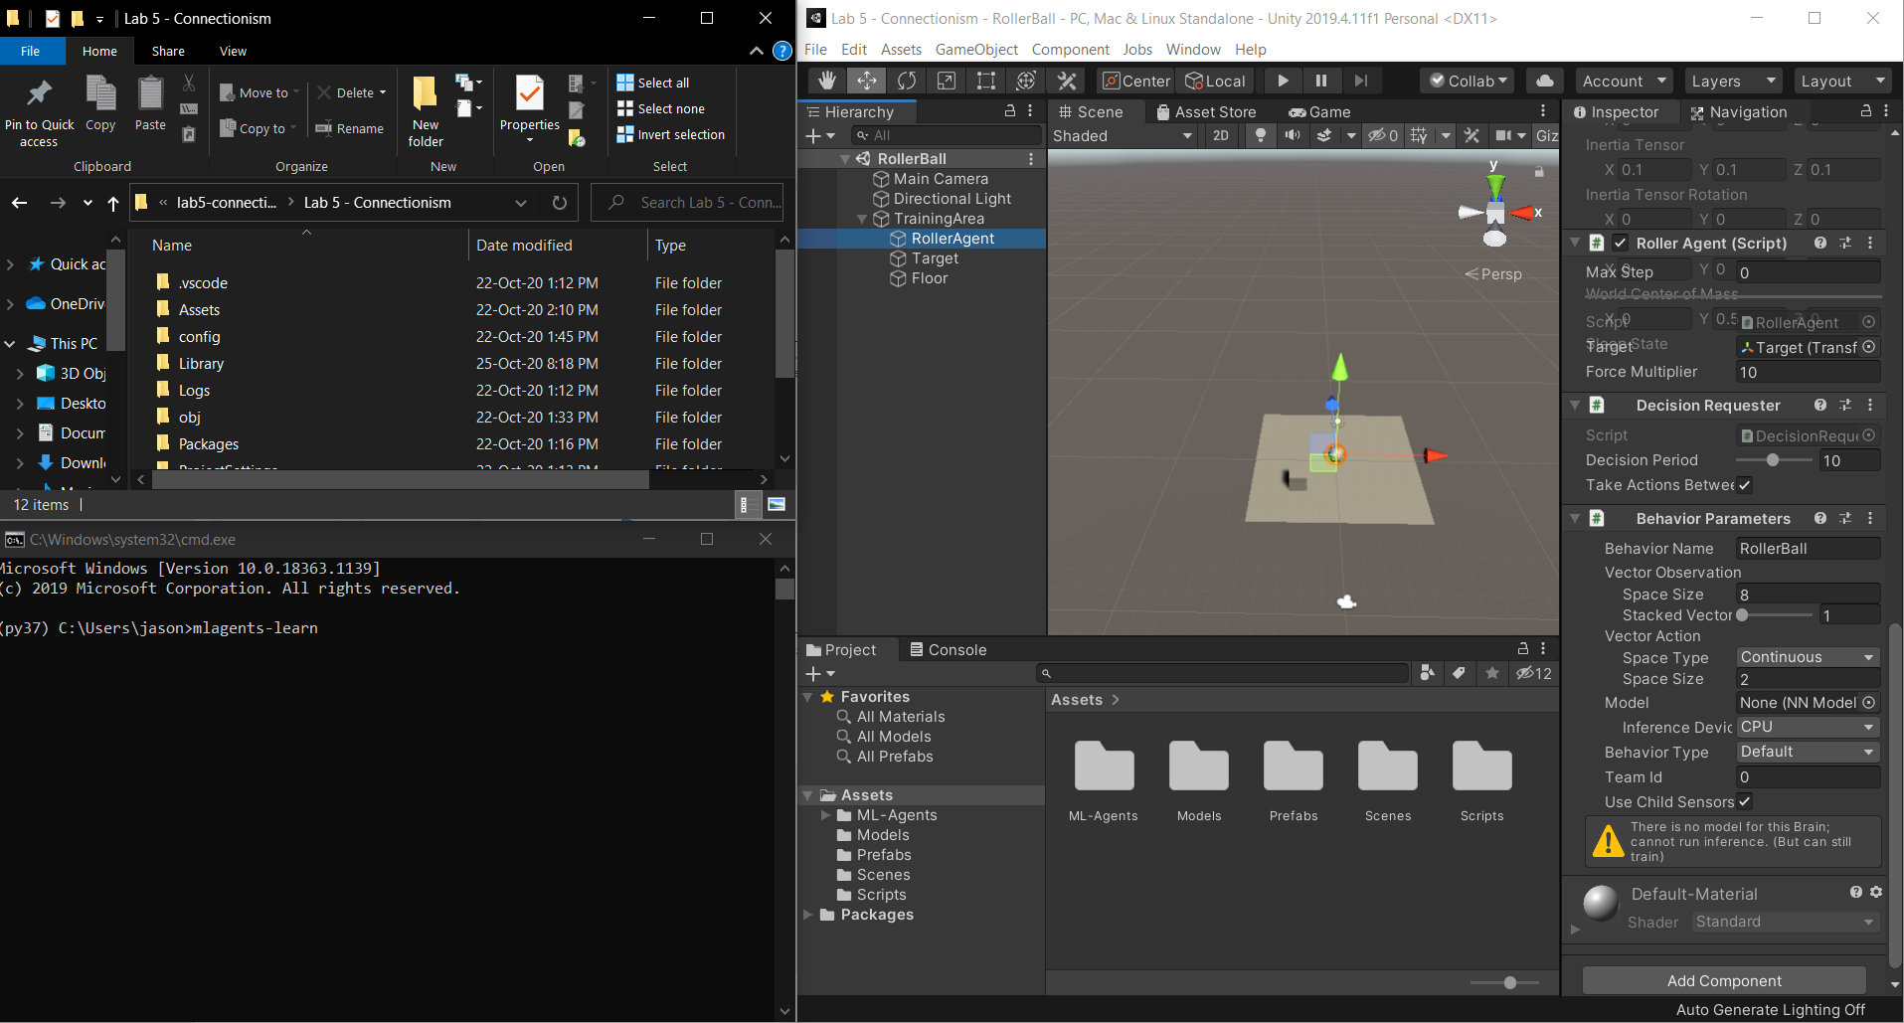

Slide 7
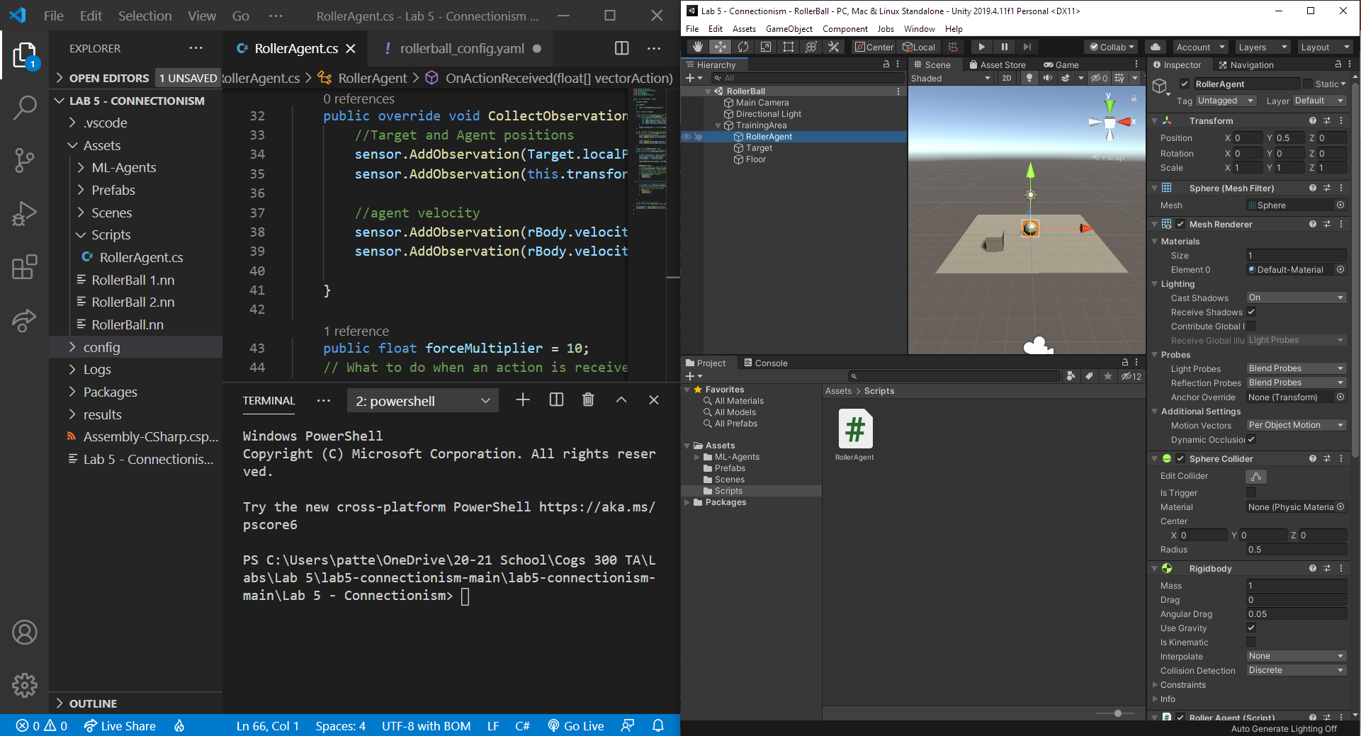

Slide 8
Behavior parameters
Vector Observation:
Space Size
Stacked Vectors
Vector Action:
Space Type: Discrete / Continuous
Space Size
Behavior type: Default / Heuristic / Inference

Slide 9
Agent Functions
Training an agent involves running multiple episodes:
Each episode is like a trial where the agent attempts to solve a task
An episode ends when the agent succeeds, fails, or times out
OnEpisodeBegin(): set up the environment for a new episode
CollectObservations(): get information from the environment as a vector of floats to feed to the network
OnActionReceived(): perform actions to attempt to solve the task, assigning rewards to improve accuracy

Slide 10
training hyperparameters
Different settings for the training
Example: network_settings:
hidden_units: number of hidden units in the network
num_layers: number of layers in the network
More settings here (warning: highly technical!)

Slide 11
Running the training
Open terminal (directly, from VS Code, or from Anaconda)
Navigate to the main project folder (the one containing the Assets folder)
Put in the mlagents-learn command with a unique id to start the training
The id will be the name the session is saved under in the results folder
Go back to Unity and hit play to start training
The training progress will be periodically updated in the terminal

Slide 12
Useful terminal commands
Navigate to the lab folder: cd “…lab-name/Lab # - Name”
Run a new training session: mlagents-learn config/configfilename_config.yaml --run-id=UniqueSessionID
Open TensorBoard: tensorboard --logdir results --port 6006
Go to localhost:6006 in your browser afterwards to see the results
Use Ctrl+C to forcefully cancel a process running in the terminal

Slide 13
Getting the trained model
The trained model can be found under the results folder in the main project folder (i.e. the same folder as the Assets folder)
It will be in the folder with the session id
The model file is a .nn file
Drag the .nn file to the Unity Editor project screen, then assign the model to the agent so the model can be viewed when played

