Slide 1
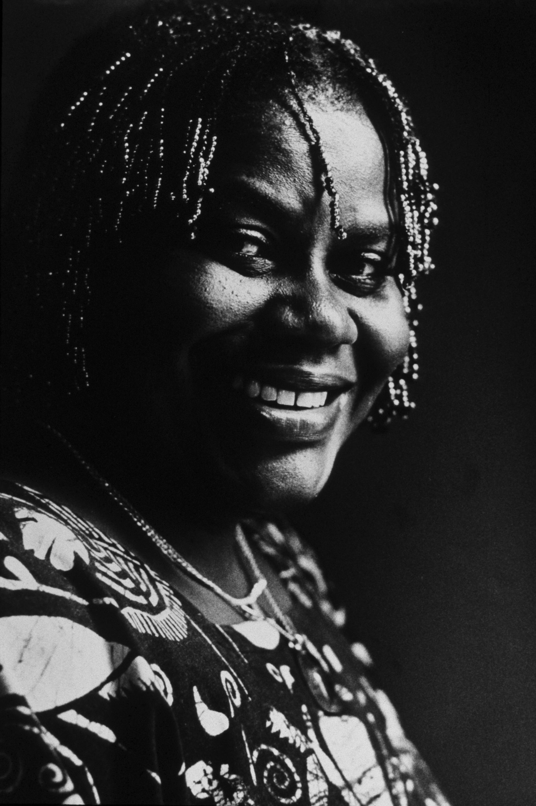

Slide 2
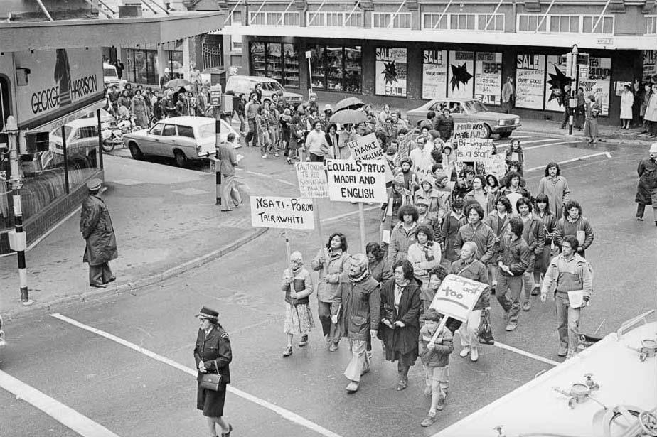

Slide 3
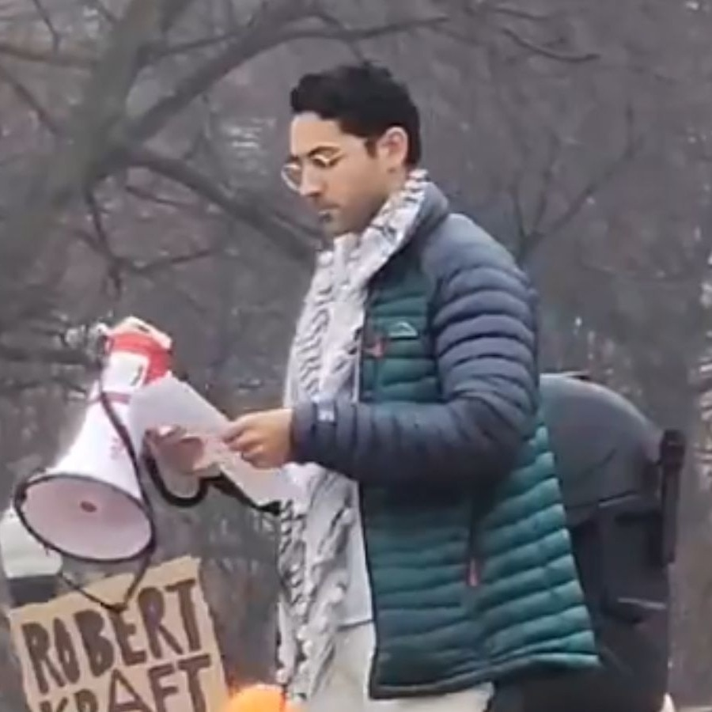
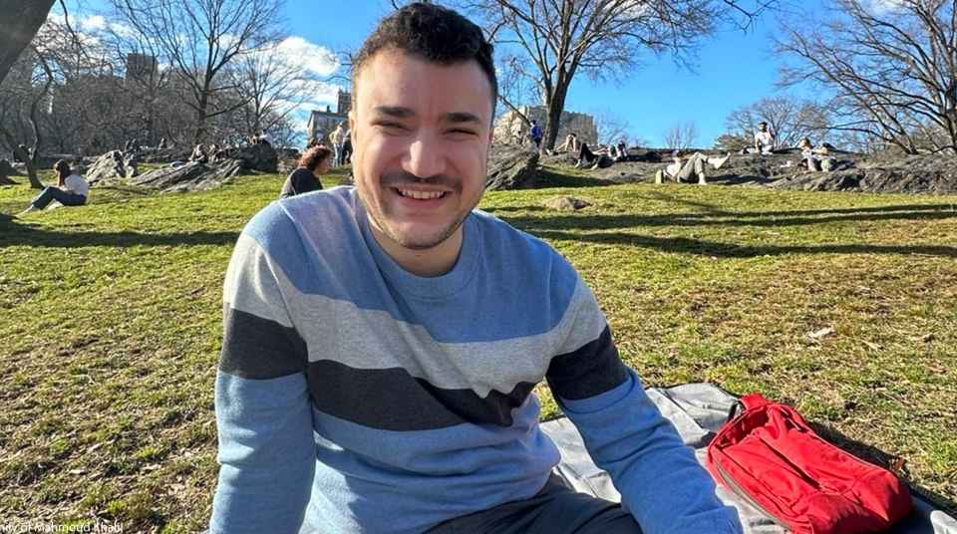

Slide 4
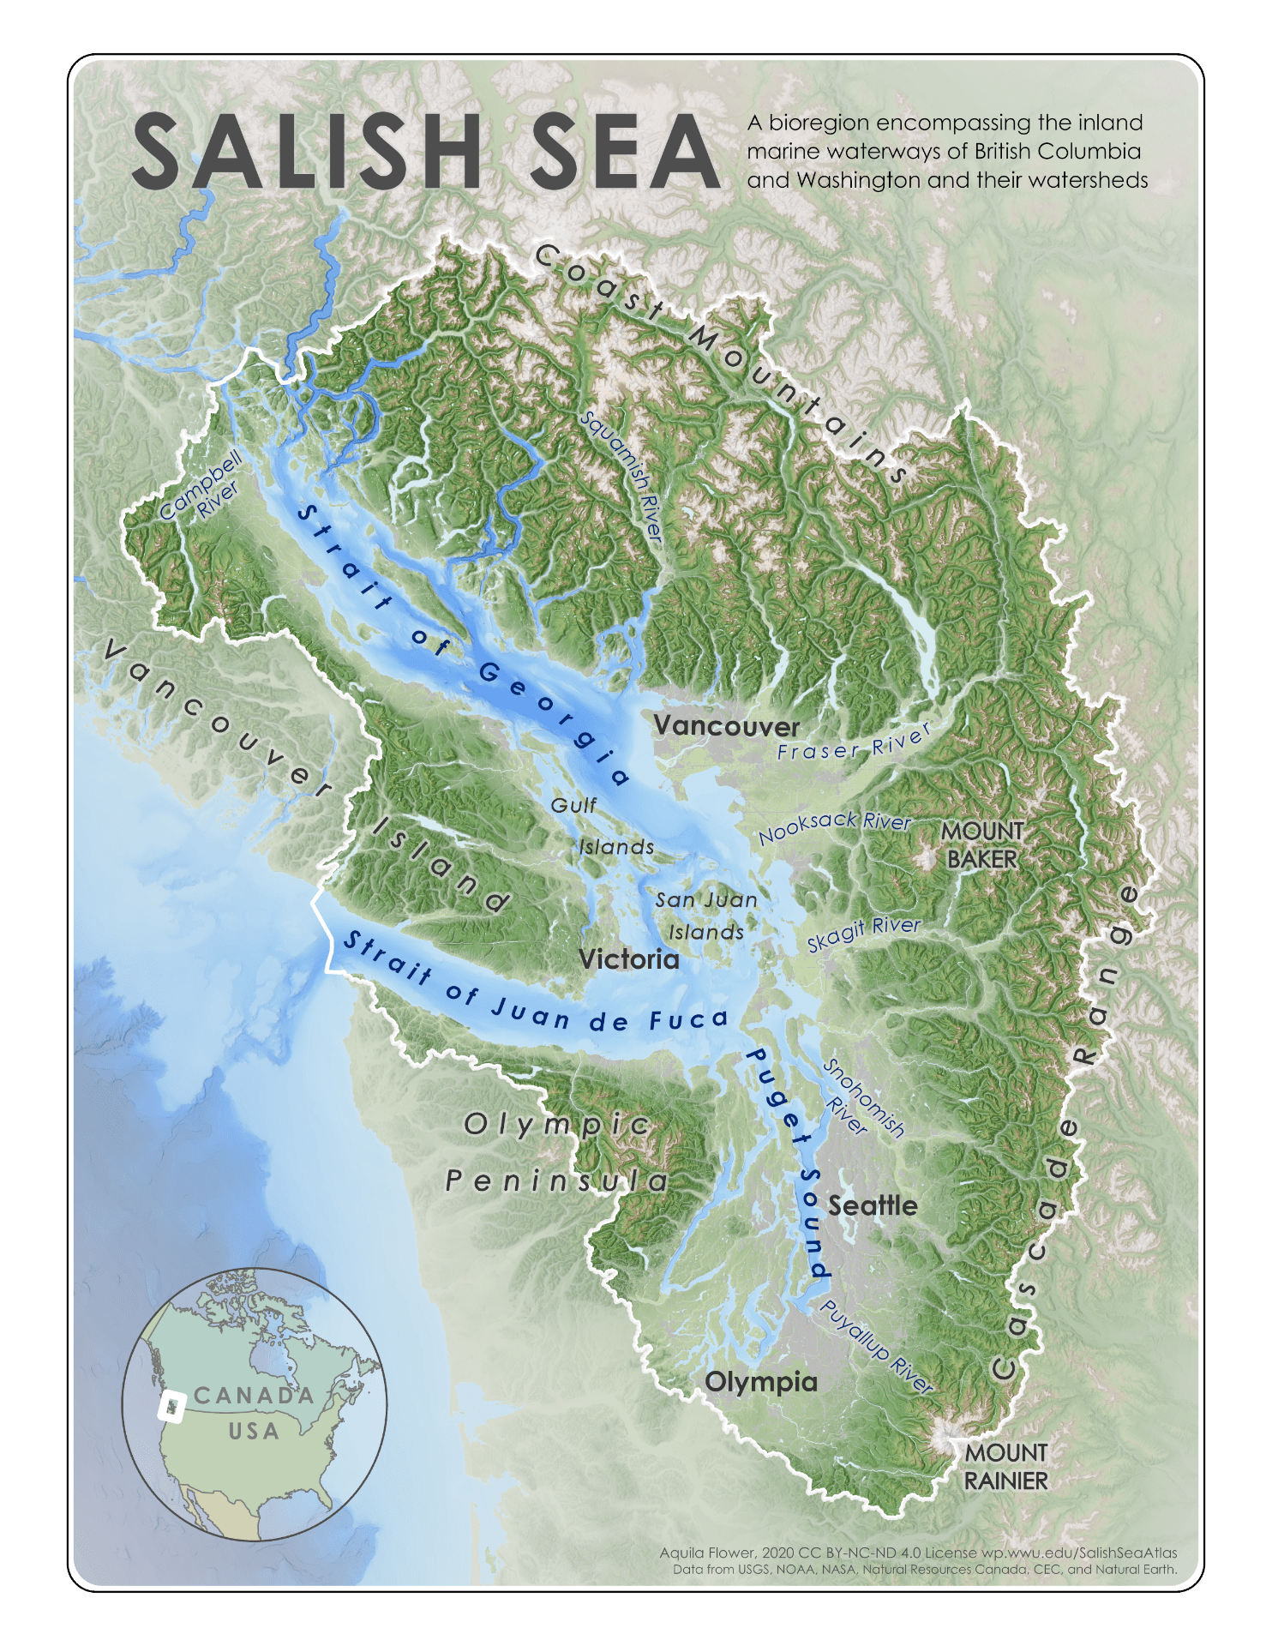
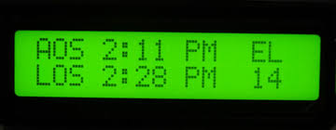
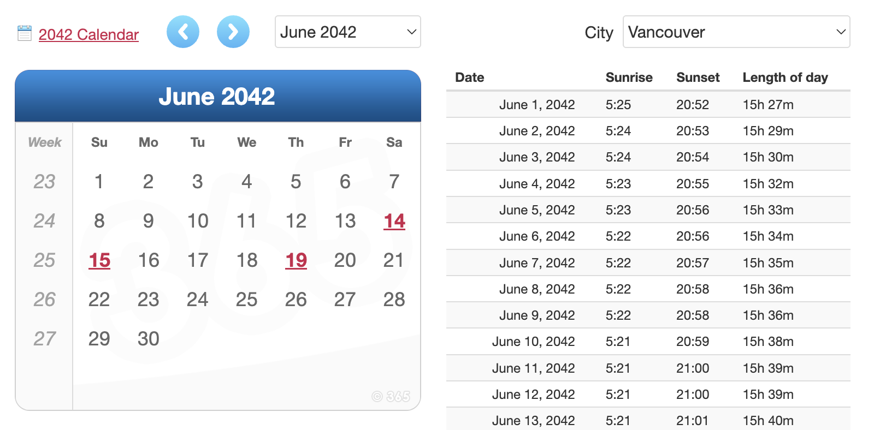
The future:

Slide 7
أشلاء
ashlaa’
Nadera Shaloub-Kevorkian (2024)

Slide 8
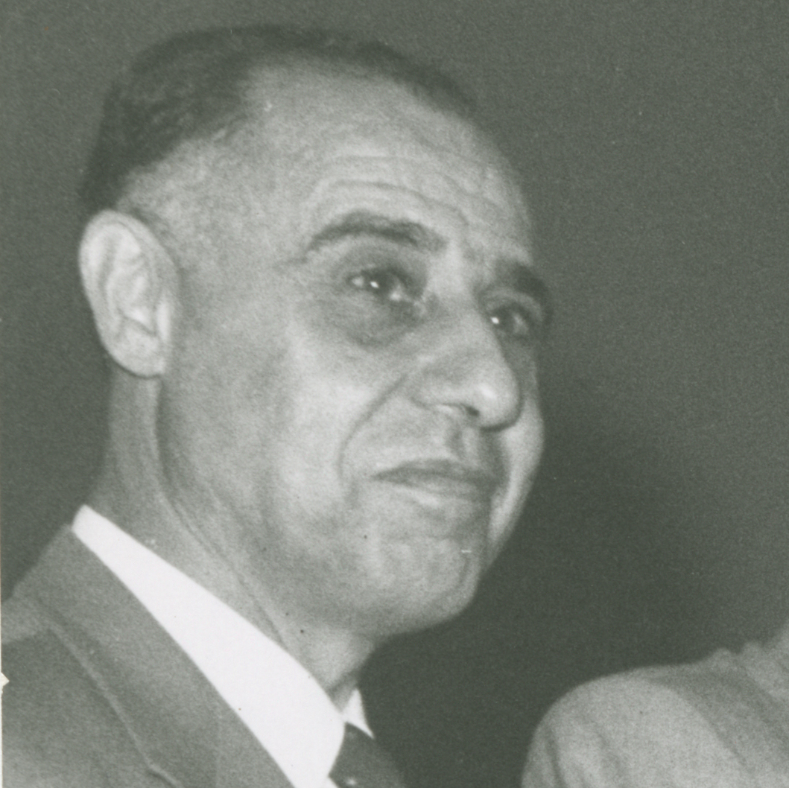
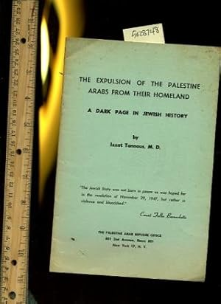

Slide 9
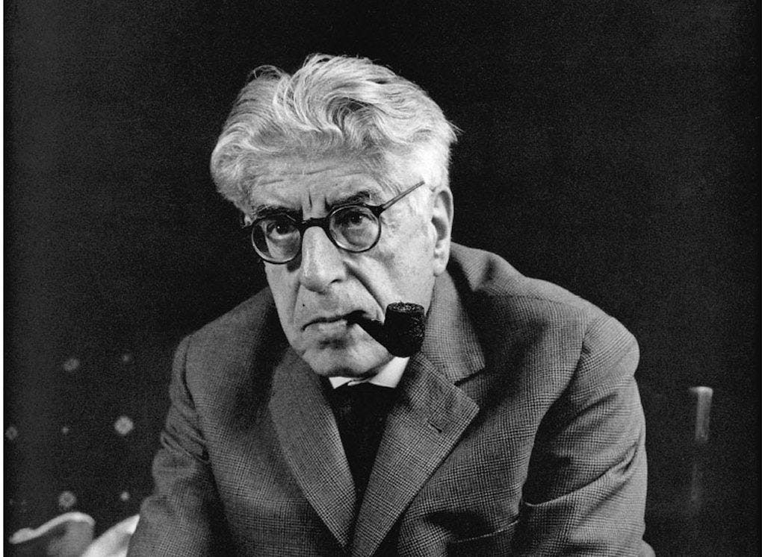
Das noch nicht bewusste
Wissen
Vorschein / Vorfrieden

Slide 11
Sweet Honey in the Rock, “Good News”, Breath (1988).
Public Service Broadcasting, “The Other Side”.
Nadera Shaloub-Kevorkian, “Ashlaa’ and the Genocide in Gaza: Livability against Fragmented Flesh.” Society for Cultural Anthropology, 2024.
Ilana Feldman, “Untimely Optimism: International Attention, Palestinian Disappointment, and the Persistence of Commitment.” Anthropological Quarterly, Vol. 96, No.3, p. 461–486 (2023).
Doumani, Beshara. 2007. “Palestine versus the Palestinians? The iron laws and ironies of a people denied.” Journal of Palestine Studies 36(4):49-64.
Rachel Greenwald Smith. 2016. “Six Propositions on Compromise Aesthetics.” The Account.
Jack Zipes. Ernst Bloch The Pugnacious Philosopher of Hope. Springer 2019.

