Slide 1
RWL Roundtable Presentation
Giessen, 24-26 July, 2019
Balancing Work and University Studies
Alison Taylor Milosh Raykov
University of British Columbia University of Malta
Bob Sweet
Lakehead University
Notes:
I’m presenting today, but Milosh is the main person behind the analysis and Bob Sweet (who couldn’t be here today) has been actively involved in the quantitative side of this study.

Slide 2
Our topic
1st phase of mixed-methods study of Canadian university students and their term time work.
Our interests include a focus on:
How students are balancing work and school
What kind of work they’re doing and how much
Why they work, and
Socio-demographic differences
Also, what difference does WIL make to students’ experiences and outcomes?

Slide 3
Background
Balancing work and university studies has become increasingly common globally. A recent thematic review based on European data suggests that slightly more than half of all undergraduate and graduate students in higher education were combining studies and a paid job (Eurostudent, 2018). In Canada, 57% of students aged 15 to 24 were engaged in paid work in 2017 (Wade, 2018).
Most students in Europe reported working at paid jobs for financial reasons and to gain labour market experience (Eurostudent, 2018), findings that are echoed in Canada (Bristow & Nestico-Semianiw, 2014).
Notes:
Most young people are aware they will face a competitive labour market and that a degree is often not enough to secure rewarding work.

Slide 4
Literature highlights
There has been growing pressure on universities to increase work-integrated learning (WIL) opportunities for students.
WIL is widely viewed as a way to enhance students’ learning outcomes and may also be used to differentiate undergraduates in a competitive graduate labour market (Jackson, 2015).
Notes:
WIL is described as including short-term work placements, cooperative education programs, internships, practicums, project-based learning, and community-based learning (Drysdale et al., 2016).

Slide 5
The relationship between students’ work and their other activities impacts their well-being and academic outcomes (Burston, 2017). “Time poverty” results from the availability of free time and when it’s available (Chatzitheochari & Arber, 2012).
Butler’s (2007) job quality framework: examines the mechanisms through which term-time work benefits or harms school performance.
“Work-study conflict” occurs when the student’s work role demands and responsibilities interfere with their school role. But a role in one domain may offer resources in another.
“Work-study facilitation” is thus defined as improvement in the quality of the school role that results from participation in work.
Notes:
“Work-study conflict” occurs when the student’s work role demands and responsibilities interfere with their school role. But a role in one domain may offer resources in another. “Work-study facilitation” is thus defined as improvement in the quality of the school role that results from participation in work.

Slide 6
Research Questions
What are undergraduate students’ term-time work patterns (including intensity and types of work) and how do they vary by student demographics (e.g. international, first generation)?
How are students’ work experiences related to academic and other outcomes (e.g., grades, campus engagement, sense of well-being, aspirations)?
Notes:
Q1 is partly about whether different groups of students have equal access to “good jobs.” The particular groups we named in our grant proposal are first generation (neither parent has a university degree) and international students.
In this paper, we focus mostly on grades but in our qualitative part, we’ll look more carefully at other outcomes.

Slide 7
Methods and Data Sources
This paper draws on preliminary quantitative findings from a mixed methods study of undergraduates at a large Canadian university. Our survey module was attached to an online institutional survey.
Respondents to this institutional survey (7,080) were invited to participate in our survey module on their work and study experiences.
Our response rate was 1,733 (24%).
Notes:
This is the first phase of a mixed methodology study at two Canadian universities.
In addition to the 2018 survey, we have repeated a scaled down version of our module in 2019 and Milosh and an RA are analyzing results right now.
Also, our qualitative data collection last year involved focus group interviews with 37 students followed by Life maps and Audio diaries. We want to keep following this group.

Slide 8
Representativeness of sample
 | UBC - V Statistics 2017/18 | HWS Survey 2018
Number of undergraduate students | 44,400 (Approximately) | 1733
Full time | 39,461 (89%) | 1,515 (89%)
Part time | 4939 (11%) | 181 (11%)
Female | 24,864 (56%) | 1,073 (62%)
Male | 19,536 (44%) | 659 (38%)
Domestic | 33,169 (75%) | 1,422 (82%)
International | 11,209 (25%) | 285 (17%)

Slide 9
Survey Results

Slide 10
Socio-Demographic Profile of Participants by Work Status
Socio-demographic Characteristics | N | Non-Working (%) | Working (%)
Employment status (Total) | 1,733 | 775 (45%) | 933 (55%)
Gender (Chi-sq= 24.482 p< .001)
Male | 651 | 53 | 47
Female | 1056 | 41 | 59
SES (parents' occupation) (Chi-sq= 12.411 p< .002)
Upper Mid/High | 918 | 48 | 52
Middle | 135 | 44 | 56
Lower Mid/Low | 448 | 38 | 62
Parents' Education (Chi-sq= 9.257 p< .002)
Neither parent completed university | 438 | 39 | 61
One/both parents completed university | 1204 | 47 | 53
Combined Student Status* (Chi-sq= 8.219 p< .001)
Born in Canada | 972 | 43.6% | 56.4%
Immigrant | 427 | 43.3% | 56.7%
International | 282 | 52.8% | 47.2%
Notes:
As you can see, almost 60% of females work compared to less than half of males. A higher proportion of first gen students work compared to those with university educated parents. A lower proportion of international students work than Canadian-born.
When we looked at hours of work, we found several statistically significant differences. Although male students are less often involved in term-time paid work, they worked more hours than females. In addition, international students and immigrant students work more hours than domestic students.
Also, while international students were more likely to work on campus first generation students were less likely.

Slide 11
Students’ Employment Status
Notes:
More than half are working and close to 2/3 are either working or would like to work.

Slide 12
Hours of Work and Learning
In a TYPICAL week during the current academic year (September 2017 to now), how much time do you spend doing the following actives? | N | Mean (hours)
Paid work [Students involved in paid work] | 933 | 14.3
Unpaid or volunteer work | 1708 | 2.95
Social and leisure activities (e.g. meet with friends, …) | 1707 | 9.2
Attending classes, tutorials, or labs | 1707 | 16.8
Studying and other academic activities outside of class | 1707 | 16.5
Notes:
So about 33 hours on academics compared to 14 hours working on average.
We found in FGs that commute time for students to and from work can also be substantial and varies widely. The university is located in the most expensive housing market in Canada and students often can’t afford to live on campus or close by.

Slide 13
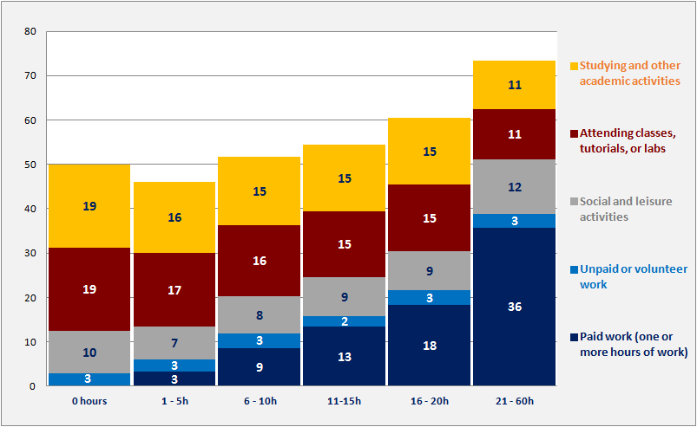
Students’ Time Use
Notes:
First note the increase in hours overall as work hours increase.
Second, increasing the number of work hours has a negative influence on students’ academic activities. Our correlational analysis shows a relatively low but statistically significant negative correlation between students' class attendance and work hours, as well as studying and other academic activities and work hours.
Qual data: we’ve noticed that activities are not clearly demarcated…e.g., students social activities are sometimes at work.

Slide 14
Reasons for Working
Two broad categories: 1) for financial reasons, and 2) for experience or social reasons.
The most common financial motivation involved working for additional spending money (74% VI or SI) while the most common non-financial reason involved gaining work experience (70% VI or SI).
Among more pressing financial motivations for work is the need to meet basic needs like food and shelter (57% VI or SI).
The strongest statistically significant correlation is between students’ hours of work and their financial needs.
Notes:
The strongest statistically significant correlation is between students’ hours of work and their financial needs –to cover their rent, to afford studies, to meet basic needs, to pay tuition, and to help their parents reduce expenses for their education.
Qual data: It’s clear that students are in quite different positions re. the degree to which they have to support themselves or not. Few are totally self-supporting.

Slide 15
Where Students Work
The top three sectors overall were retail (18%); accommodation, food or beverage services (18%); and teaching (16%).
Almost one-quarter of respondents participated in WIL: cooperative education (10%), the Work Learn Program (10%), and internships (3%).
Term-time WIL disproportionately involves work in Research and Development (38%) and Entertainment and Recreation (18%).
Non-WIL disproportionately involves work in Accommodations or Food Service (24%) and Retail or Sales (24%).
Notes:
Most Work Learn is on campus.

Slide 16
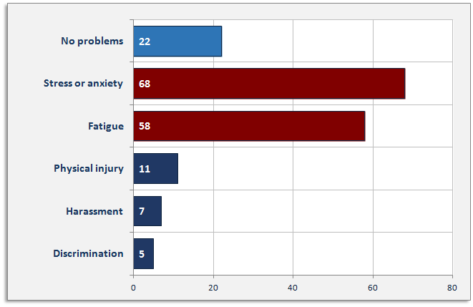
Students’ experiences at work
Notes:
Least stressful work was in: Research or development; Teaching, tutoring, or education; Entertainment or recreation (ie. WIL)
Most stressful work was in off-campus work and health services, retail and accommodation

Slide 17
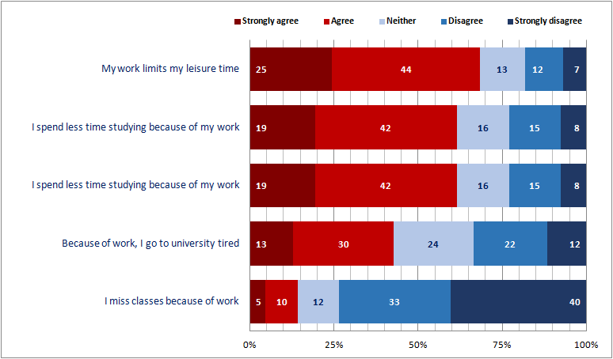
Impact of work on studies

Slide 18
Impact of Different Types of Work on Studies (SA)
Because of work,.. | ... I go to university tired | ... I spend less time studying | ... I miss classes because of work | ... my work limits my leisure time
Research or development | 9 | 16 | 4 | 21
Retail or sales | 17 | 22 | 3 | 33
Accommodation or food services | 19 | 28 | 6 | 32
Teaching or tutoring, | 7 | 10 | 4 | 14
Health services | 10 | 15 | 4 | 25
Entertainment or recreation | 10 | 16 | 6 | 12
Other | 12 | 21 | 5 | 24
TOTAL | 13 | 19 | 4 | 24
Chi-square | 48.740** | 63.305*** | 32.952^{ns} | 61.562**
Notes:
students working in Accommodation or Food Services were most likely to say it impacts their energy levels and study time. In contrast, those working in Teaching and Tutoring indicated the least impact on these areas.

Slide 19
Logistic Regression : WIL and GPA
 | Model #1 |  | Model #2
 | p | Adj. odds | p | Adj. odds
WIL(Int/W-L) vs NVIL | .016 | 1.662 | .009 | 1.832
Female vs Male |  |  | .494 | 1.124
SES: Lower Mid/Low |  |  | .121 | 1
Middle |  |  | .127 | 1.571
Upper Mid/High |  |  | .066 | 1.384
I Status: Born in Canada |  |  | .003 | 1
Immigrant |  |  | .263 | .807
International |  |  | .001 | .430
Year of study: 1st year |  |  | .379 | 1
2nd year |  |  | .315 | .783
3rd year |  |  | .769 | .934
4/5th year |  |  | .549 | 1.144
With significant debt |  |  | .094
With some debt |  |  | .825 | 1.071
With no debt |  |  | .050 | 1.527

Slide 20
The Effects of Term-Time Work
A logistic regression was undertaken to test the importance of different factors associated with a high GPA for working students.
Model 1 examined the relationship between WIL and other term-time work (NWIL) on grades. From this analysis, we learn that students involved in WIL are 60% more likely to achieve a high GPA than others.
This finding is no doubt partly due to selection factors (high achieving students are more likely to attain WIL positions) but also may be due to the fact that WIL is more regulated and often more flexible than NWIL.
Notes:
Milosh: I’m still not sure what we can say from Regression and am not sure this is what we want to end with. Let’s discuss.
What to say about models 3 and 4?

Slide 21
Effects, cont’d
Model 2 added a number of socio-demographic factors into the mix. Findings show middle and upper-middle/high SES, domestic students, those with no debt, and those involved in WIL are more likely to achieve a high GPA.
While SES and international student status were used as controls in our regression analysis, they deserve further analysis, as do student motivations for different work types.

Slide 22
Summary and next steps
We’re interested in what difference it makes for students (in terms of well being and academic outcomes) when they’re engaged in WIL or other highly regulated and perhaps more flexible work connected to their studies.
Since term-time work is likely to impact students’ prospects after studies, we wonder if they feel they have choices about TT work (and if this differs by student demographics) as well as how they make these choices.
In short, how do they juggle school and work over time?

