Slide 1
Socio-economics
Designing the research
John Janmaat
i.k. barber school of arts and sciences
The University of British Columbia

Slide 2
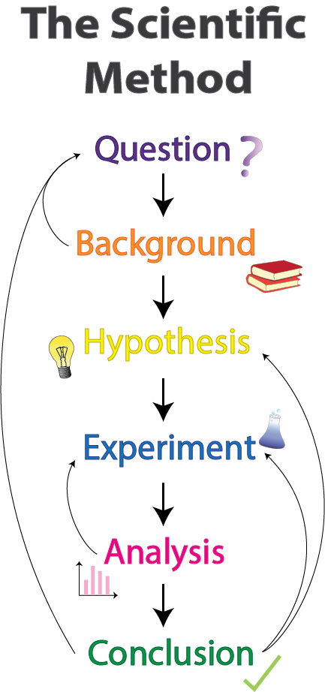
Scientific method
Question How can the uptake of BMPs be increased? Has Living Lab program increased BMP uptake?
Background Previous work: Financial, knowledge, attitudes, norms, …
Hypothesis Uptake influenced by financials, awareness, attitudes, norms, …
Experiment Use survey to assess BMP uptake experience or intention, as influenced by financial, awareness, attitudes, norms, …
Analysis Use statistics to assess influence of financial, awareness, attitudes, norms on BMP uptake experience or intention.
Conclusion

Slide 3
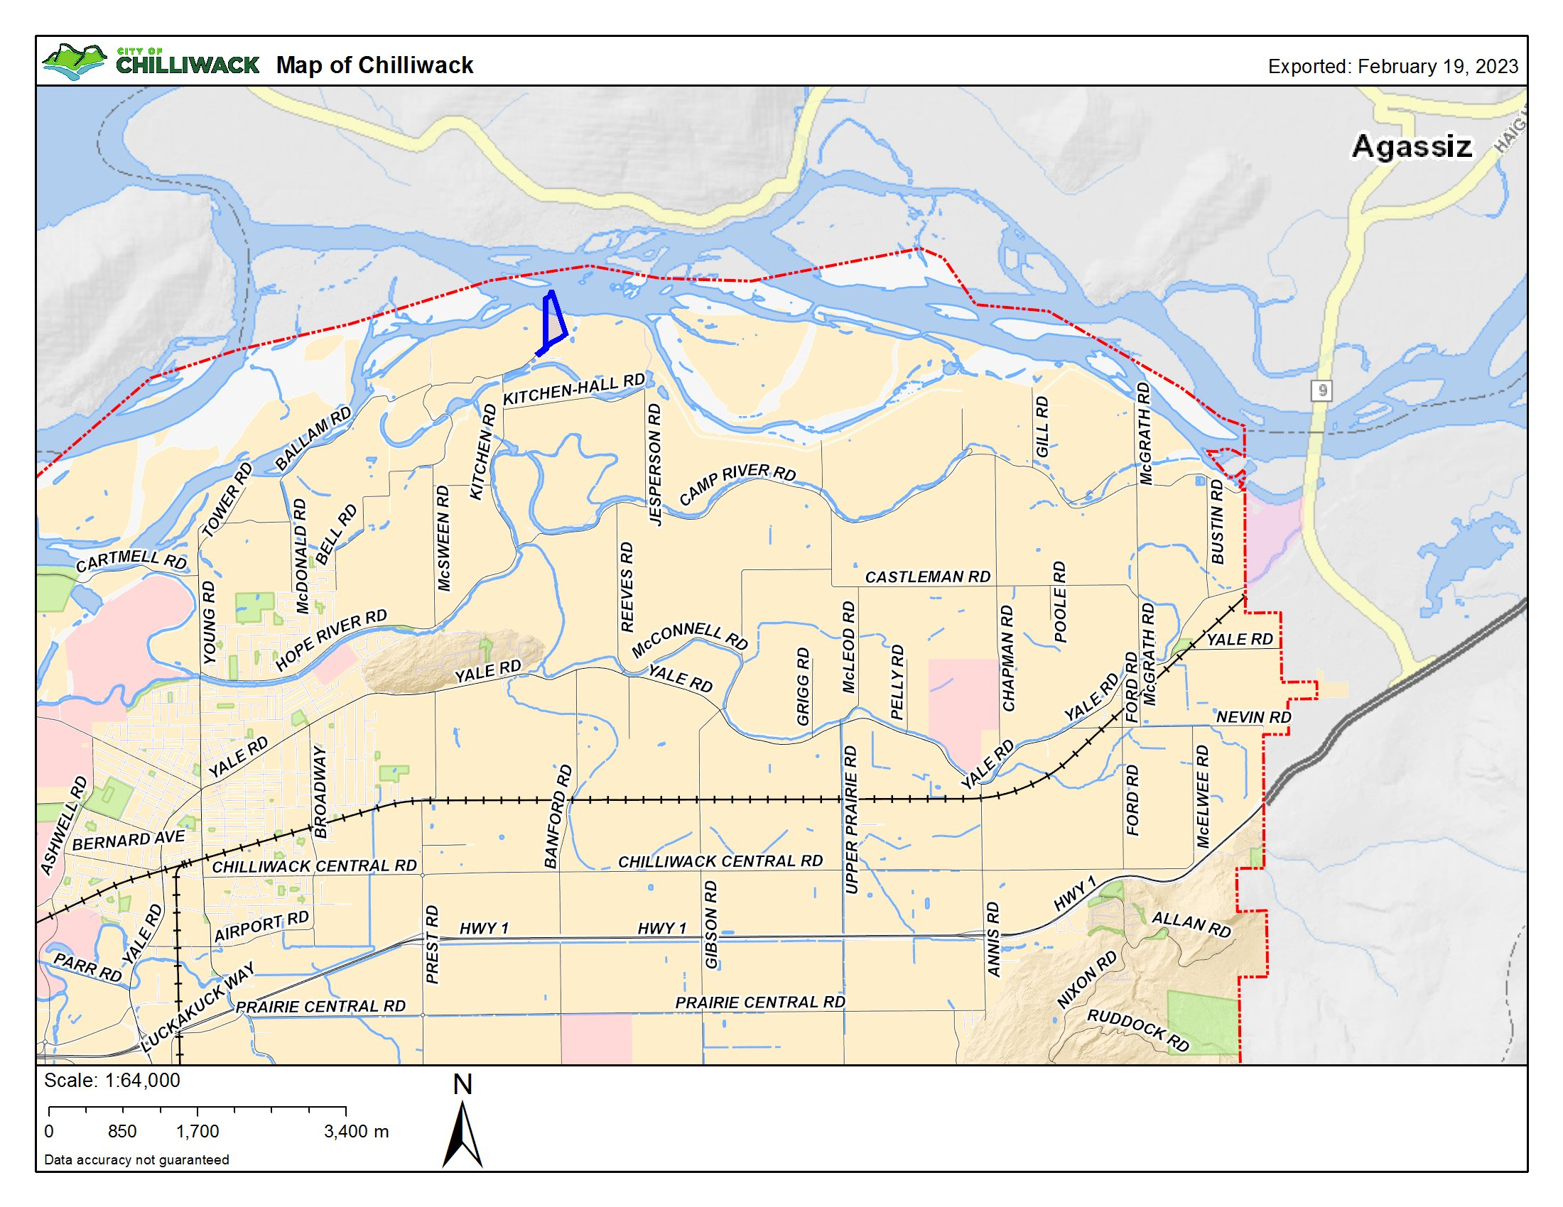
example

Slide 4
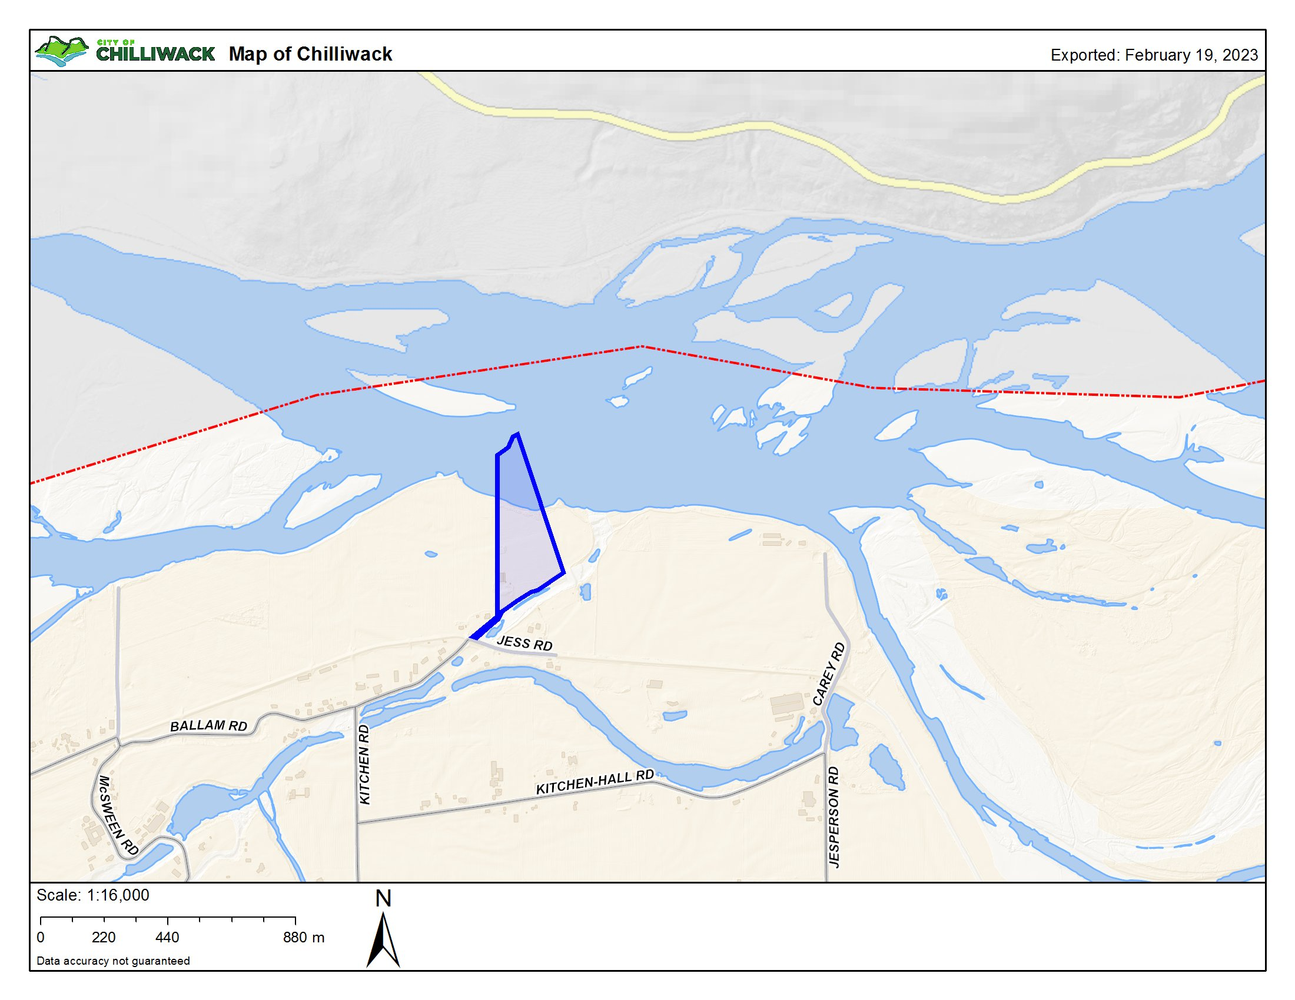
example

Slide 5
example
1990’s, trialed pea and winter wheat cover crop after silage corn on family farm near Chilliwack.
Promise:
Green manure, easy to integrate before next crop, contributes nitrogen.
Reduce erosion and capture nutrients with spring manure spreading.
High quality silage crop harvested before corn planted.
Increased soil carbon not part of conversation in 1990’s.
Experience:
Winter arctic blast when cover crop not dormant, serious winter kill.
Information gathering time, cost of soil preparation, seeding seed not commonly used, …
Result:
Return to fall rye.
Lower feed quality, harder to work in, but dependable in climate.

Slide 6
Prediction
Attitudes:
Does it work?
Are outcomes things I care about?
…
Enablers:
Financial aid
Insurance
Equipment loans
…
Characteristics:
Age
Education
Values
Beliefs
Income (farm and other)
…
Norms:
Views of my peers
Social values
Family and friends
…
Pea and Wheat Cover Crop
Intention to adopt BMP
Constraints:
Time
Cost of adoption
Equipment needs.
…
Control:
Do I know how?
If it doesn’t work?
Have time and $$$?
…

Slide 7
Dynamics
Producer Population
Fringe
Fringe
Intention
BMP
Intention
BMP
Interested
Interested
Intention
BMP
Intention to adopt BMP
Intention
BMP
BMP
Participants
Participants
Intention
BMP
Intention
BMP

Slide 8
Prediction
Background Previous work shows stuff in all boxes matters, but importance varies based on commodity, geography, local culture, …
Attitudes:
Does it work?
Are outcomes things I care about?
…
Enablers:
Financial aid
Insurance
Equipment loans
…
Characteristics:
Age
Education
Values
Beliefs
Income (farm and other)
…
Norms:
Views of my peers
Social values
Family and friends
…
Pea and Wheat Cover Crop
Intention to adopt BMP
Control:
Do I know how?
If it doesn’t work?
Have time and $$$?
…
Constraints:
Time
Cost of adoption
Equipment needs.
…

Slide 9
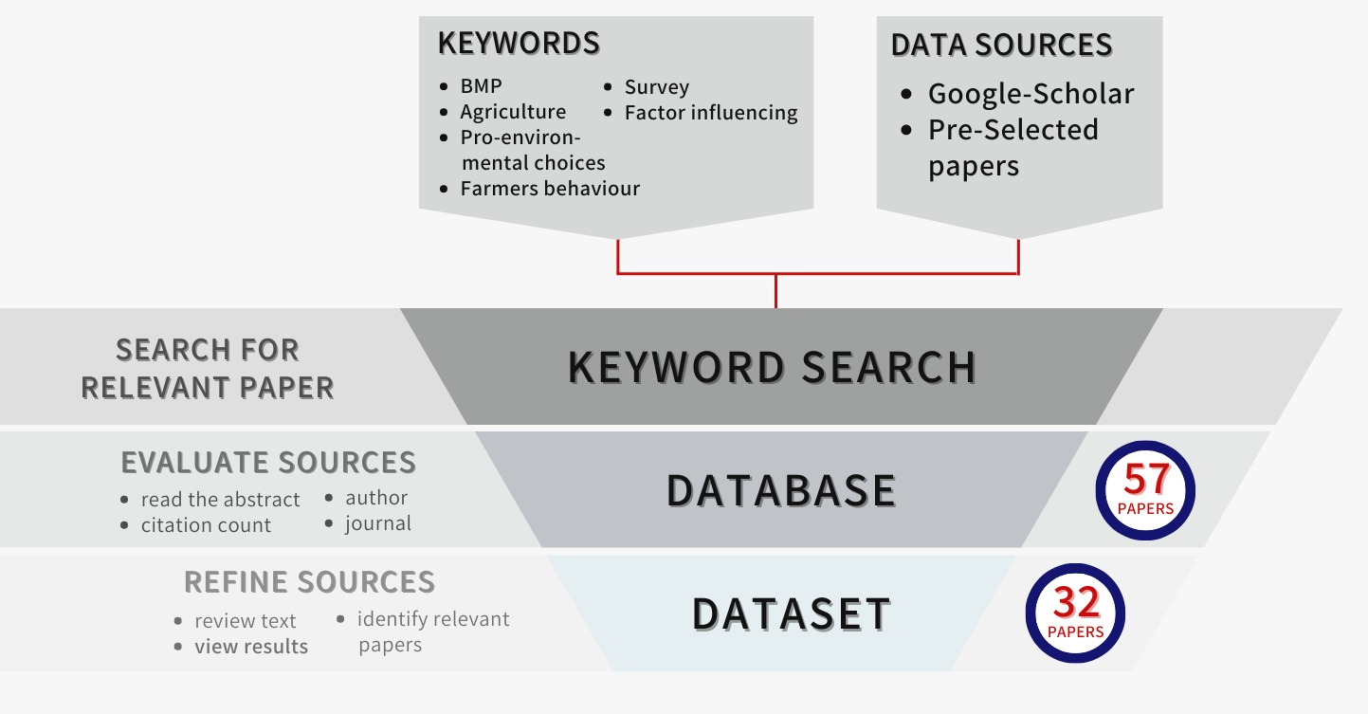
Prediction
Background Previous work shows stuff in all boxes matters, but importance varies based on commodity, geography, local culture, …
Attitudes:
Does it work?
Are outcomes things I care about?
…
Enablers:
Financial aid
Insurance
Equipment loans
…
Characteristics:
Age
Education
Values
Beliefs
Income (farm and other)
…
Norms:
Views of my peers
Social values
Family and friends
…
Pea and Wheat Cover Crop
Intention to adopt BMP
Control:
Do I know how?
If it doesn’t work?
Have time and $$$?
…
Constraints:
Time
Cost of adoption
Equipment needs.
…

Slide 10
Prediction
Hypothesis
Features represented by all boxes will matter.
Role of features will differ by commodity.
Role of features will differ by individual.
Attitudes:
Does it work?
Are outcomes things I care about?
…
Enablers:
Financial aid
Insurance
Equipment loans
…
Characteristics:
Age
Education
Values
Beliefs
Income (farm and other)
…
Norms:
Views of my peers
Social values
Family and friends
…
Pea and Wheat Cover Crop
Intention to adopt BMP
Control:
Do I know how?
If it doesn’t work?
Have time and $$$?
…
Constraints:
Time
Cost of adoption
Equipment needs.
…

Slide 11
Prediction
Experiment
Construct measures to capture aspects of each feature.
Use common measures across commodities to detect different influences.
Design measures so unique commodity factors captured.
Survey across diversity of producers.
Attitudes:
Does it work?
Are outcomes things I care about?
…
Enablers:
Financial aid
Insurance
Equipment loans
…
Characteristics:
Age
Education
Values
Beliefs
Income (farm and other)
…
Norms:
Views of my peers
Social values
Family and friends
…
Pea and Wheat Cover Crop
Intention to adopt BMP
Control:
Do I know how?
If it doesn’t work?
Have time and $$$?
…
Constraints:
Time
Cost of adoption
Equipment needs.
…

Slide 12
RESPECT
Some producers (and other data contributors) may consider some of this information private.
Survey data must be securely stored.
All involved in data collection and analysis must have committed to respecting confidentiality and privacy of people contributing data.
Primary data not shared unless those shared with have made same commitment.
Data CANNOT be archived and made public.
Following university research ethics process facilitates satisfaction of requirements.

