Slide 1
UBC Knowledge Map
Community Knowledge Mapping Project

Slide 2
What is the UBC Knowledge Map?
An interactive and searchable visual interface
Identifies the interactions of community partners
Finds joint partnerships, research, teaching, student learning, consulting and volunteering

Slide 3
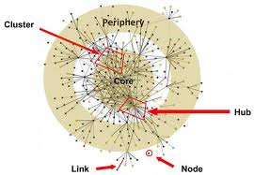
Social Network Analysis

Slide 4
Who is involved
UBC Community Learning Initiative (CLI)
Irving K. Barber Learning Center
School of Community and Regional Planning (SCARP)

Slide 5
Why is the UBC Knowledge Map useful?
A survey will capture a profile and interactions with your partners.
- find partners
- identify connections to advance your organizations goals when working with and beyond UBC.
- go to guide when collaborating with UBC and its broader network.

Slide 6
How the GSS can help!
Spread the word once the Survey goes out
We are looking for a new PI with Social Network Analysis skills
We are looking for a programmer to develop the new interface

Slide 7
Additional Resources
Project Website
UBC Report Article
YouTube Clip

Slide 8
Thank you
Questions & Answers
Luedert@interchange.ubc.ca

