Slide 1
The Plains People and Canadian Expansion
Ss10 – Day 2

Slide 2
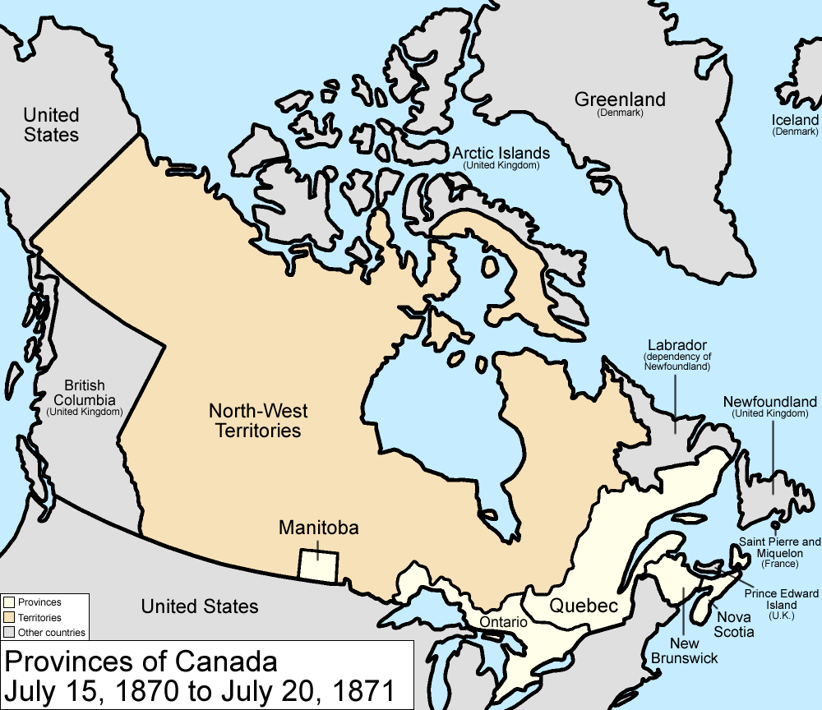
The Northwest in 1870
During the 1870s, control over the Northwest Territories transferred from the HBC to Canada
But the region was simply too large for Canada to fully control it at the time
Most of the population at the time was still First Nations people, the Plains peoples
The largest groups were the Cree, Blackfeet, Salteaux, Ojibwa, Assiniboine, Stoney, and Sarcee
In particular, the Cree, Assiniboine, Salteaux, and Stoney had formed an alliance called the Iron Confederacy

Slide 3
The Scourge of the Whiskey Traders
In the late 19th century, American fur traders in the Northwest would freely cross the border in order to trade with the Plains People
Their home base was Fort Whoop-Up, near modern day Lethbridge, Alberta
At first, they traded standard goods like guns, blankets, and cooking utensils
But they soon turned to trading cheap whiskey, because it was extremely profitable due to it being easy to make and leading to addiction and alcoholism amongst the Plains People who they traded with
Even though the sale of whiskey was illegal in the territory and that the traders were in Canada illegally as well, there was no police to enforce Canadian law

Slide 4
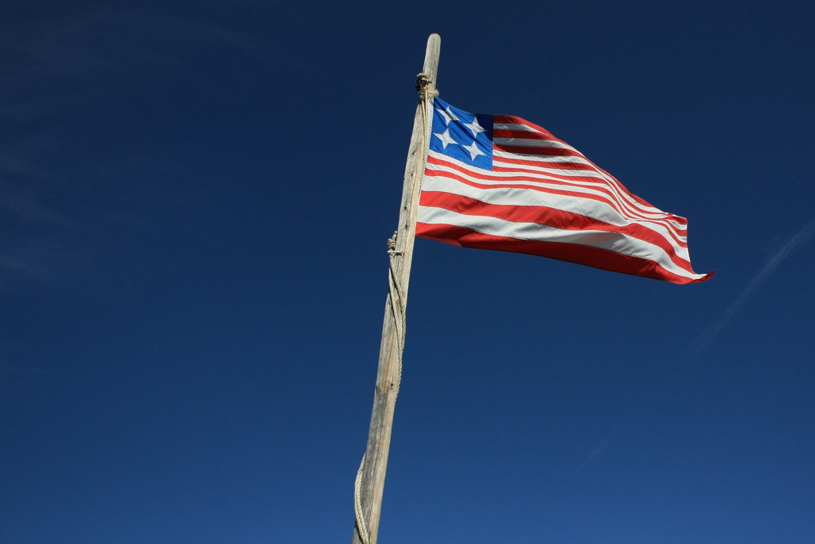
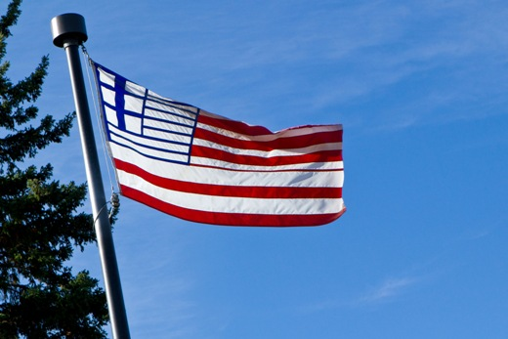
Flag of Fort Whoop-Up
Flag of Lethbridge

Slide 5
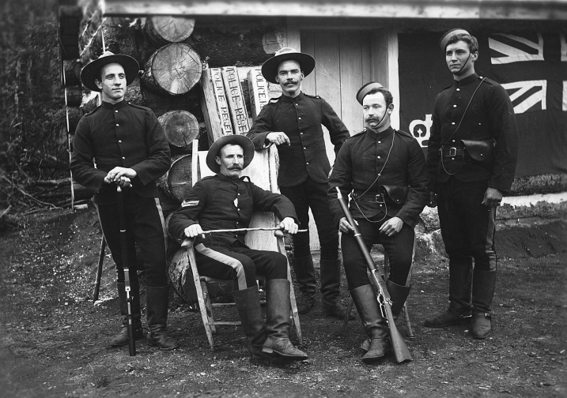
The Mounties are Born
To handle the traders, Canada established the North West Mounted Police, the ancestor to today’s RCMP
They acted as both law enforcement and a semi-military, or paramilitary force
Upon arriving in the North-West territories, they established a fort and cracked down on the whisky traders in the region
This meant that whisky trading was severely reduced and that Canadian sovereignty was re-established in the area

Slide 6
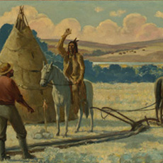
The Treaty System begins
The NWMP was initially welcomed by the Native peoples in the area due to ending the lawlessness of the whisky traders
But the arrival of the NWMP also represented the Canadian government’s goal to fully open up the west to settlement by white Canadians and Europeans
In 1870, the Selkirk Settlement was the only part of the Northwest not controlled by First Nations people
To begin opening up the west for settlement, the government began negotiating treaties with the various tribes

Slide 7
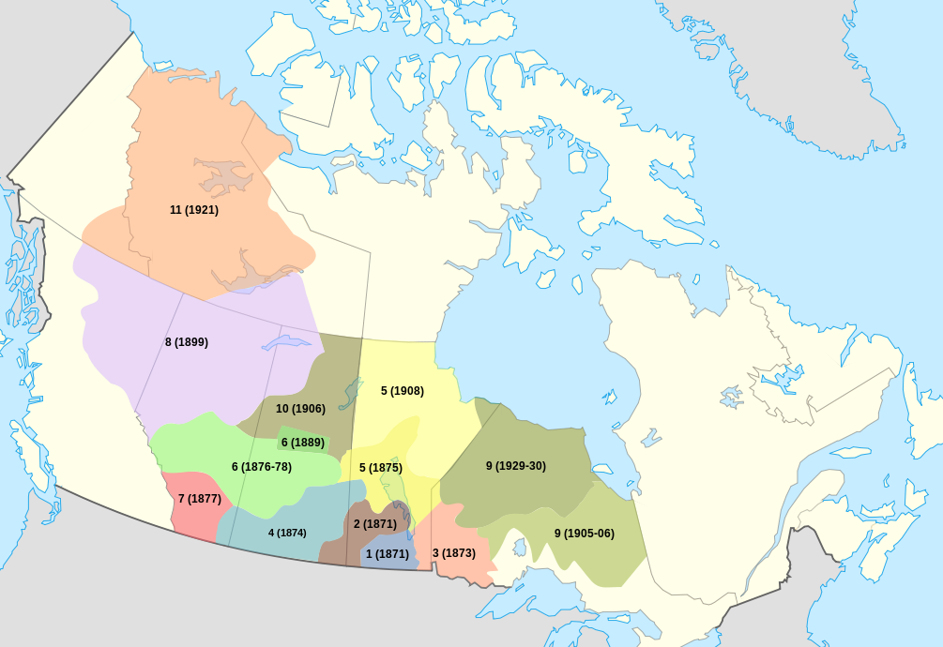
The Numbered Treaties
The goal of the treaty system was to move various Native groups in the area off their lands and onto reserves
This would open up their former lands for settlement by Canadian and European settlers
In return, the Natives would receive cash payments, schools, and the reserve land
In many cases, they were also promised farm equipment, seeds, and the right to fish and hunt freely within their reserves
The first treaties, Treaties Number 1 and 2, were signed in August 1871 and dealt with the Anishinabe and Swampy Cree peoples of southern Manitoba
The last one was signed in 1921 and dealt with the peoples living in the modern Northwest Territories and Yukon

Slide 8
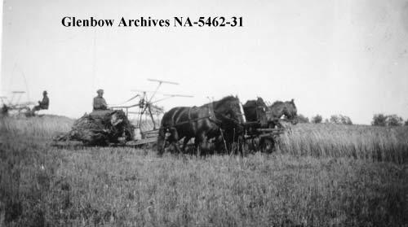
Effects of the Treaties
Many Native peoples had a very negative view of the treaty process
They felt like they were being forced into signing them instead of participating as partners
Why do you think they felt this way?
Disease, the whisky traders, and the mass slaughter of the buffalo caused many Natives to believe that signing these treaties was the only way to guarantee their survival
Since they could no longer survive by hunting buffalo, they believed the treaties would help them becoming farmers
However, many of the promises made by the government in the treaties were broken

Slide 9
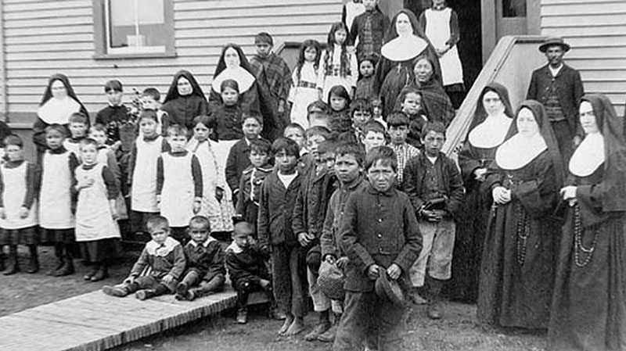
The Treaties in Action
Much of the promised farm equipment and tools was never arrived
The government ended up blaming the Natives, claiming that it was unnatural for them to use modern farm equipment
In reality, the government did not want Native farmers to compete with white Canadian/European farmers
This caused most, if not all Native peoples under treaty to abandon farming completely, making them completely dependent on the government
In 1876, the Indian Act was introduced, which required Natives to live on their reserves and introduced residential schools
After each treaty, the NWMP would be brought in to take peoples to their reservation

Slide 10
Debate: To Sign or Not to Sign?
The class will be divided into two groups; one side will represent Native people who wish to sign the treaties and the other will represent those who believe they should not
First, discuss amongst your groups how you plan to argue your case against the other group
When I give the signal, gather in your groups and prepare to debate respectfully!

