Slide 1
Assignment 1
Investigating biases and blind spots in Artificial Intelligence
Notes:
Hello and thank you for listening in to this brief video presentation.
The goal for this first assignment was to demonstrate how biases and blind spots can occur when utilizing artificial intelligence.

Slide 2
The Platforms
Notes:
To do this, I worked with 2 platforms Prezi AI and Claude AI and..

Slide 3
The Prompts
What does a nurse look like?
Include what a nurse does and how nurses are educated
Create a presentation that explores the history of nursing
Notes:
I asked each of them to create a presentation exploring the history of nursing, what a nurse looks like, what a nurse does and how they are educated. I then compared the results between the two tools

Slide 4
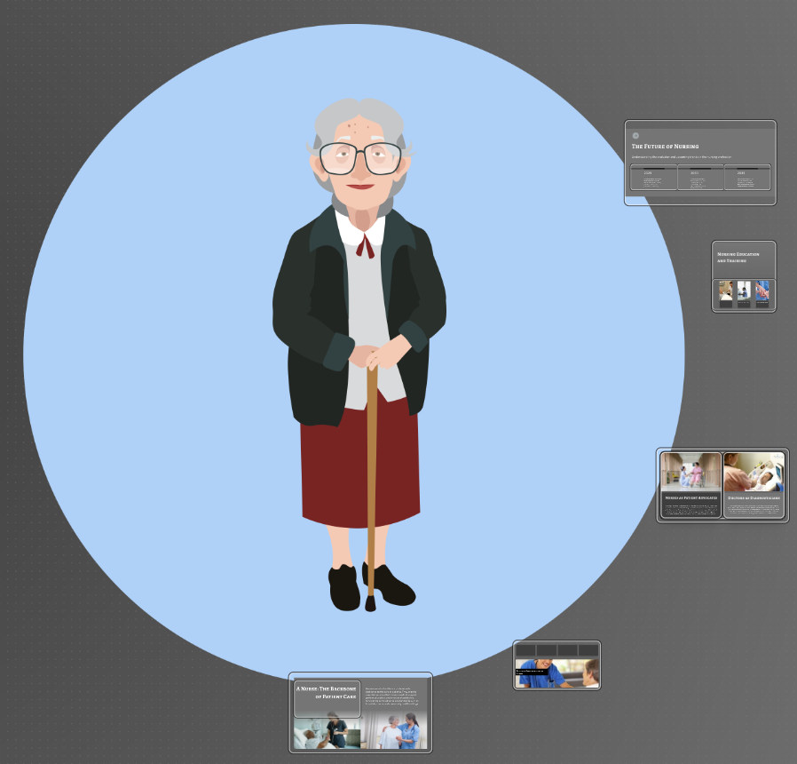
Prezi AI
Notes:
The goal of this assignment was to reflect on biases and blind spots
Let’s start with Prezi. The first thing you will might about the Prezi presentations is that every nurse is female
The first visual that came up was the young white female in blue scrubs. I was given the option to search for more templates which provided the image of the nurse in heels and a short skirt, as well as the contrasting image of the elderly woman with a cane.
After a few more attempts, the only image of a person of colour was provided; however, upon closer inspection, it became clear that this female was likely a patient, not a nurse, as she was taking her blood sugar.

Slide 5
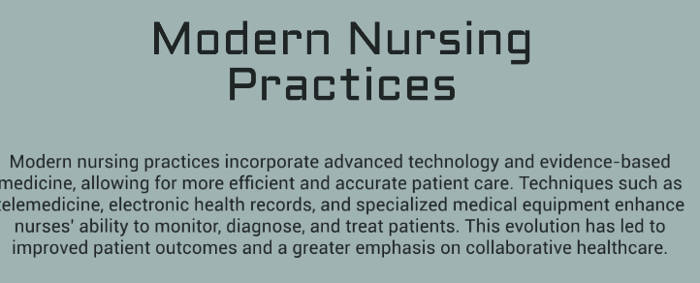
Prezi
Notes:
The next thing I reflected on was the contradiction between the content and the images.
As you can see, in the “diversity slide” generated, all three nurses are white, young females. The irony of the text is almost comical. The slide reads “diversity in nursing is reflected in the wide range of ethnicities, genders and backgrounds.”
I also noted that despite the prompt asking “what a nurse looks like” and “what a nurse does,” the primary focus of content is on technology in healthcare versus the role nurses play in making clinical decisions and in patient care.

Slide 6
Claude
Notes:
The Claude presentation provided contrasting information as well as images.
This presentation highlighted images of white males and males of color, even when the slide was describing the history of nursing and referencing Florence Nightingale.
My prompt did not ask about demographics or stereotypes, yet the presentation highlights the stereotypes and the diverse roles nurses play in varying workplaces

Slide 7
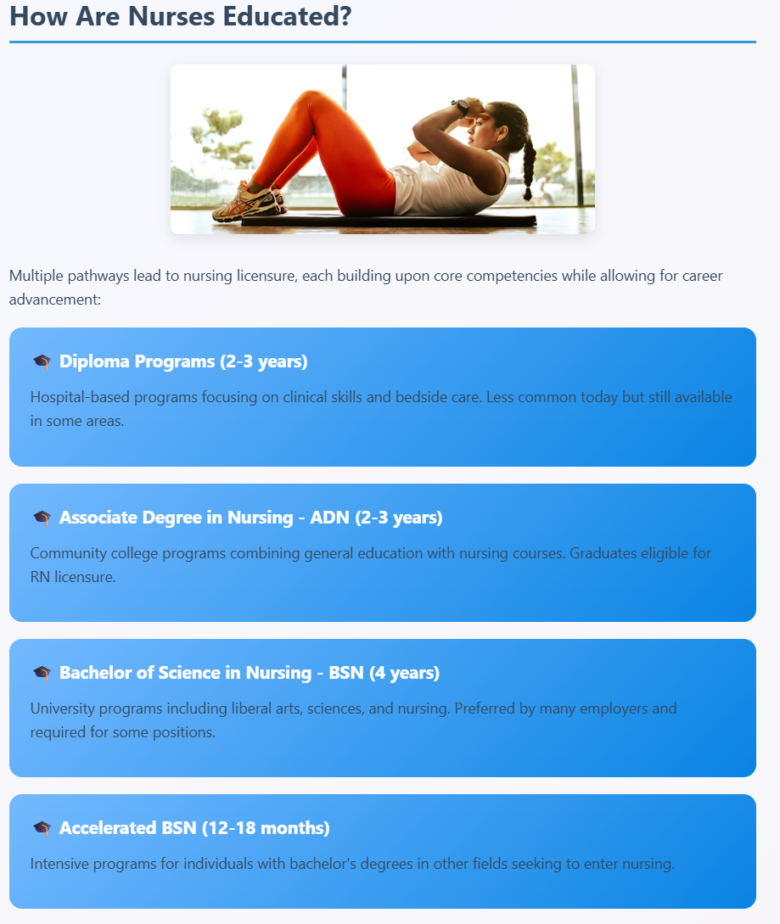
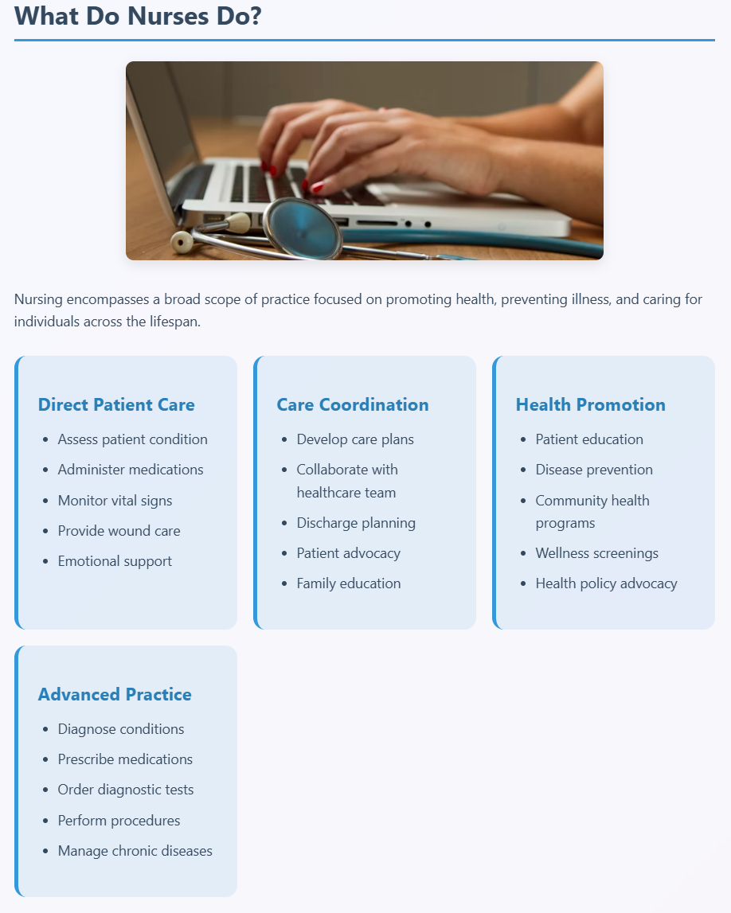
Claude
Notes:
Despite the content of Claude being more current and relevant, the images still did not align.
For example, here you can see a woman doing sit-ups on the slide that discusses nursing education.

Slide 8
Prezi versus Claude
PREZI AI | CLAUDE AI
“THIRD PARTY SERVICE PROVIDER” | TRAINING DATA January 2025 Acknowledges that anything beyond January 2025 will access the internet Encourages fact-checking information
Notes:
When using AI, it is essential to not only think critically about the content being provided, but to also look at the specifics of the platform.
Prezi provides little detail about its training data. Their website only states that Prezi uses “third party service providers to provide AI products” I was unable to find any other details about their data training
Claude acknowledges that their training data has a reliable knowledge cu of January 2025 and explains that any data sourced after that will utilize the World Wide Web. A question I am left with, is whether the training of Claude impacted its output?
Were the images of males and people of color there because of how Claude was “trained”.

Slide 9
Claude. (2025, June 20). Response to question about unsupervised learning in Claude AI [AI-generated response]. Anthropic. https://claude.ai
Notes:
When I asked Claude if they used unsupervised learning, they explained it was used as part of their training process. As stated by Coleman (2021), unsupervised learning leaves data unclassified, and the task of the machine is to find relations.
Although unsupervised learning still relies on the data it is fed, perhaps if the data isn’t categorizing woman as nurses and men as doctors, there is a better chance of authentic representation. The reality is that the profession of nursing is predominantly female; however by continuing to replicate this through web searches, media or artificial intelligence, there is less likelihood of this statistic equalizing.

Slide 10
Strategies to Identify and Address
Awareness (Kantayya, 2020)
AI is not intelligence; AI is math
Algorithms use historical information
Data is a reflection of our history, not our future and highlights pre-existing inequities
Skewed data = skewed results
Notes:
The film CODE of Bias (Kantayya, 2020) highlights the importance of approaching AI with a critical lens. The film emphasizes that the decisions made by AI are mathematical, not ethical, and that the machine can only replicate the world as it has historically existed. If data is skewed, the results will be skewed as well.

Slide 11
Strategies to Identify and Address
SIFT University of British Columbia Library. (n.d.). Guidelines for evaluating sources. UBC Library Research Guides https://guides.library.ubc.ca/EvaluatingSources/Guidelines#s-lg-box-16579377
S – stop, pause and think about information critically
I – investigate the source
F – Find better coverage
T - trace claims, quotes, and media to the original context
Notes:
The acronym SIFT is a tool that can be used when working with AI. This acronym really just speaks to critical thinking – something a mathematical algorithm is unable to do. With AI we may move away from being the author of content; however, we need to always be the editor and a critical one at that.
SIFT recommends
S – we must always be thinking critically about where information is coming from – we need to use our actual intelligence to ensure the math of the machine is not simply propagating misinformation and pre-existing bias
I – meaning we need to critically analyze the source of the content as well as the training of the machine learning
F – we need to verify information with alternate sources
T – if information is cited, we need to vet that information to ensure that it is a reliable source
By using the following strategies, we can help to ensure that the content created by machine algorithms is less biased and authentic. The real question I am left with, however, is how do we create a less biased, less racist and less sexist world for machines to draw information from?

Slide 12
References
Claude. (2025, June 20). Response to question about unsupervised learning in Claude AI [AI-generated response]. Anthropic. https://claude.ai
Coleman, B. (2021). Technology of The Surround. Catalyst: Feminism, Theory, Technoscience, 7(2), 1–21.
Kantayya, S. (Director & Producer). (2020). Coded bias [Film]. 7th Empire Media.
University of British Columbia Library. (n.d.). Guidelines for evaluating sources. UBC Library Research Guides. https://guides.library.ubc.ca/EvaluatingSources/Guidelines#s-lg-box-16579377

