Slide 1
Ecosystem: Conceptual Questions
Elementary Grade 7: Life Sciences
Created by Kshamta Hunter
EDCP 349 Section 401 Winter 2011

Slide 2
In this lesson
Ecosystem Vocab
Parts of the ecosystem
Abiotic/Biotic parts of the ecosystem
Food chain and its affects

Slide 3
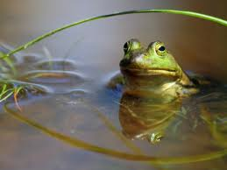
What is an ecosystem?
It is both the living and the non-living part of the earth
It is both the living and the non-living part of a particular area
It is only the living part of a particular area
It is the interaction of living and non-living parts with the environment
Only I
Only II
Both II and IV
Both I and IV
Notes:
Correct answer: C

Slide 4
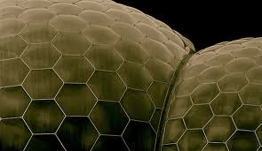
How is a biome different from an ecosystem?
There is no difference between a biome and an ecosystem
Biome is just a smaller version of an ecosystem
Biome is a group of several similar ecosystems
Biome can only include plants and animals
Notes:
Correct answer: C

Slide 5
Which of the following is not one of the four main biomes of Canada?
How would you improve this question? What might be a problem in phrasing it?
Tundra
Boreal Forest or Taiga
Temperate Deciduous Forest
Grassland
None of the above
Notes:
Correct answer: E

Slide 6
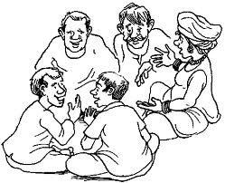
Group Activity
Given the geographical locations of Canada’s Biomes:
How do the four abiotic factors influence its biotic factors?
Temperature
Precipitation
Soil
Sunlight

Slide 7
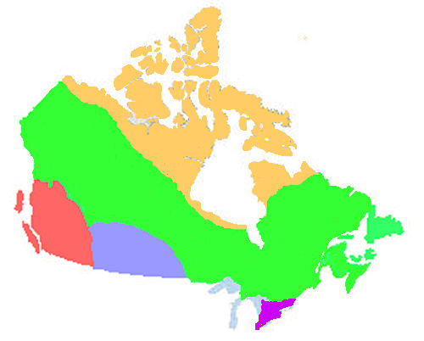
Canada’s Biomes
Tundra
Mountain Forest
Grassland
Boreal Forest
Temperate Deciduous

Slide 8
Which of the following triangles is a best representation of these parts.
Biome
Biosphere
Ecosystem
Community
Population
Habitat
B
Habitat
Population
Community
Ecosystem
Biome
Biosphere
A
C
Biosphere
Biome
Ecosystem
Habitat
Community
Population
D
Biome
Ecosystem
Community
Population
Biosphere
Habitat
Notes:
Correct: C

Slide 9
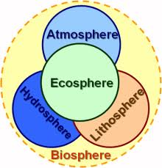
Biosphere

Slide 10
Which of the following statements about biotic and abiotic is true?
Biotic is the living part of an ecosystem
Biotic is the non-living part of an ecosystem
Abiotic is the living part of an ecosystem
Abiotic is the non-living part of an ecosystem
None of the statements are true
Only I
Both I and IV
Both II and III
Only V
Notice new vocabulary!
Notes:
Correct answer: B

Slide 11
What is the best description of a Food Chain?
It’s the transfer of food from one organism to the other
It’s the movement of food through the ecosystem from one trophic level to another trophic level
It’s a chain of interconnected but different food webs
It’s a connection between all organisms and their nutrition

Slide 12
What is a trophic level?
Division of organisms based on how they get their nutrition
Division of plants and animals based on how they get energy from the sun
Level of nutrition an organism gets compared to other organisms
None of the above

Slide 13
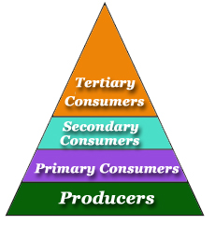
Trophic Levels
Notes:
Why is it depicted using a triangle?
less of top predators
Less energy at each trophic level as you go up energy is lost

Slide 14
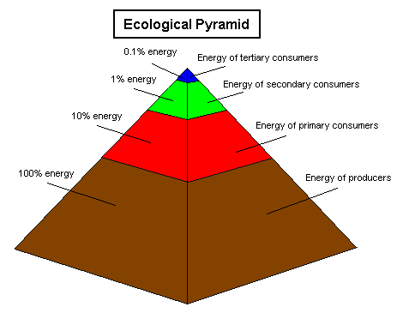
Energy at the trophic levels
Notes:
90% of energy is lost at each trophic level

Slide 15
What is a difference between a producer and a consumer?
Producers cannot produce their own food but consumer can produce their own food
Producers can only use nutrients from the soil whereas consumers get their nutrients from the soil, air, water and the sun
Producers produce their own food using sunlight, air, water, and nutrients from the soil, whereas consumers cannot produce their own food
Producers can get their food from other organisms whereas consumers cannot get their food from other organisms
Notes:
Correct answer: C

Slide 16
Find the most complete match for the following terms
Terms: Biotic, Abiotic, Producer, Consumer
Plants, lichens, moss, trees
Wolf, dogs, butterflies, insects
Sunlight, soil, water, air
List I is both biotic and producers
List II is both biotic and consumers
Lists I and III are biotic, lists I and II is consumers, list III is abiotic
List I and II are biotic, list I is producers, list II is consumers, list III is abiotic
Vocabulary!
Notes:
Correct answer: D

Slide 17
What is the trophic level of each organism, from bottom up?
Secondary consumer, tertiary consumer, quaternary consumer
Primary consumer, secondary consumer, tertiary consumer
Primary producer, primary consumer, tertiary consumer
Primary producer, secondary consumer, tertiary consumer
Primary producer, primary consumer, secondary consumer
Gray Wolf
Caribou
Lichen
Notes:
Correct answer: C

Slide 18
If wetland forests were cleared for agricultural development, what kind of affect would it have on this food chain, if any?
Decrease in lichen will reduce caribou population, which will consequently decrease grey wolf population
Caribou will thrive on the agricultural land, which will consequently increase grey wolf population
Increase in lichen available for caribou will also increase grey wolf population
It will not have any significant affect on this food chain
Gray Wolf
Caribou
Lichen
Notes:
Correct answer: A

Slide 19
Activities!
Abiotic/biotic Outside
Make a food chain or a food web and assign trophic levels
Build a mini ecosystem
http://www.enchantedlearning.com/biomes/
http://www.blueplanetbiomes.org/world_biomes.htm

Slide 20
Mini ecosystem
Tundra ecosystem can be made using lichen, moss, and small alpine plants
Northern coniferous forest ecosystem can be shown with small plants
Decidious forest ecosystem can incorporate violets, wintergreens, strawberries and small ferns
Grasslands ecosystems can be demonstrated with wildflowers and grasses
Desert ecosystems can be displayed with cacti or aloe vera plants
Tropical rain forest ecosystems can include African violet, creeping charlies or aluminum plants.
To make a mini ecosystem you will need:
An aquarium
Potting soil
Sand
Charcoal
House plants
http://www.recyclingfactsguide.com/fun-ecosystem-activities/

Slide 21
Pointers for making effective conceptual questions
Start with simple factual questions, but don’t use it too often
Use ‘none of the above’, ‘all of the above’ or multiple answer (A and B)choices
Use plausible wrong answers that may reveal student confusion
Use about 4-5 choices for each question
Use diagrams, charts, or graphs as answers
Suggested approach to using clickers:
Stage 1: Pose question
Stage 2: Individual answers using clickers
Stage 3: Peer discussion
Stage 4: Vote again using clickers
Stage 5: whole class discussion
Listen to student discussions
CWSEI Clicker Resource Guide, 2009

