Slide 1

An International Study of Technology Use in Mathematics and Science Teacher Education
Proudly supported by TLEF
Proudly supported by TLEF
Marina Milner-Bolotin, Jeongho Daniel Cha, Svetlana Bolotin-Chachashvili, Latika Raisinghani
Friday, July 12, 2013
IPTEL 2013, UBC
Notes:
Do we have a major question or theme to pose to the audience that summarizes our talk to engage them in the process?
2 pronged:
To talk about the resource that we have developed
To talk about how it is being used in classrooms at UBC
Consider it in two capacities at all times (teacher and student)

Slide 2


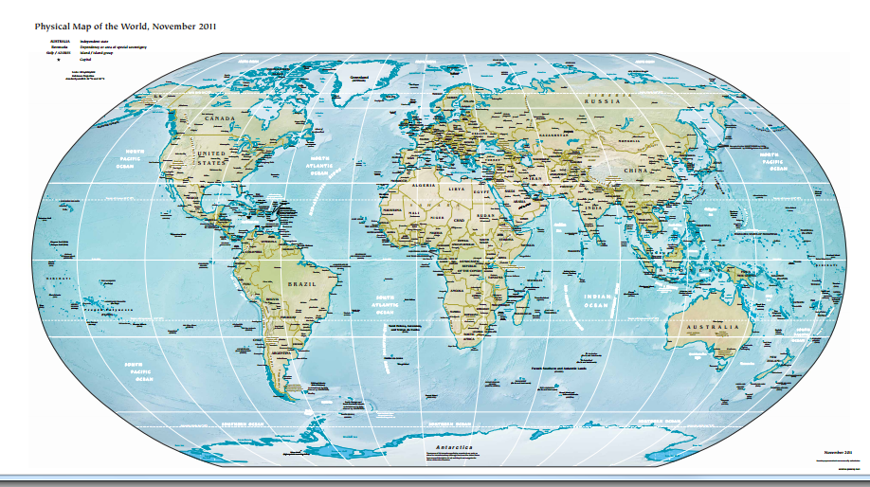

Research Team
Notes:
Here we will say a few words about having people from different countries on the team and we will say a few words how Daniel and I came up with the idea of looking on the use of technology in South Korean and in Canadian teacher education….

Slide 3
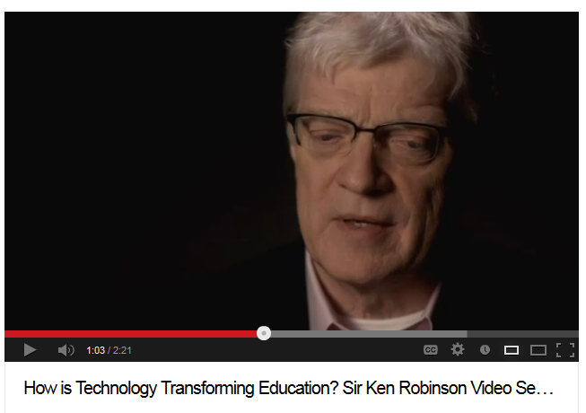
Why We and Why Now?
Notes:
Sir. Ken Robinson here talks about the importance of technology in schools – we cannot ignore it, and it is a great Segway to why we have to prepare teachers to use technology effectively… It is especially relevant in teacher education as teachers will be ALWAYS BEHIND THEIR STUDENTS in terms of technology… The kids are born into technology that we as adults have to learn – but we invented it…

Slide 4
Teacher Education in Canada and S. Korea
 | Canada | South Korea
Level | Post-Graduate Concurrent (B.Sc.+B.Ed.) | B.Ed. (elem. and sec.) M.Ed. (only for secondary)
Length | 4-5 years (B.Sc.) + (8 months to 2 years) | 4 years (B.Ed.) 2-3 years (M.Ed.)
Certification | Provincial | National
Math & Sci. | Secondary (2 subjects) | Elementary & Secondary (2 subjects)
Admission requirements | Depends on the province (65% GPA UBC) | University Entrance Exam & Graduation req. 75% GPA
Bar exams | Do not exist | Teacher Selection Test (529 for math, 461 for science)
Job guarantee | Depends on the province | National exam for public school

Slide 5
Technology & Teacher Education
Teacher-candidates will teach 30+ years
Technology change is exponential
Availability of technology is not enough
Kids struggle with math and science
Technology is changing the world, should it change our schools?
Should we prepare teacher-candidates for it?

Slide 6
Paradox of 21st Century Teacher Education
Teacher educators many of whom were born BC (Before Computers) prepare future teachers…
It is a big challenge to keep up with the technological developments. It is also impossible to envision the technologies of the future, so how do we prepare teachers?

Slide 7
Goals of the Study
To investigate the extent of technology integration in relevant methods courses in TEPs in Canada and South Korea
To examine Math and Science teacher-educators’ attitudes about technology integration and their relationship to teacher-educators’ use of technology.

Slide 8
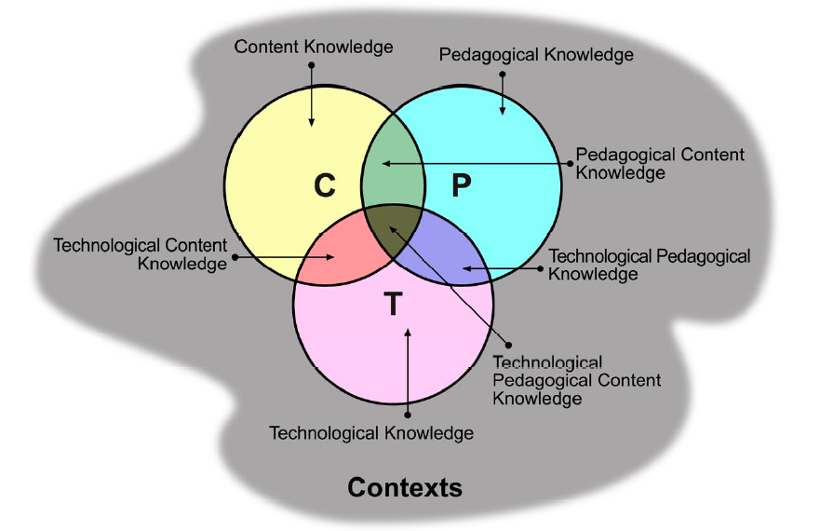
Theoretical Framework
Mishra & Koehler, 2007

Slide 9
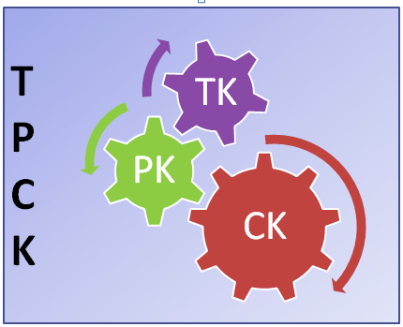
Theoretical Framework
Modified Technological-Pedagogical Content Knowledge Framework

Slide 10
Methods
Countries: Canada and South Korea
Online survey to math & science TEP instructors
Instructors were contacted via e-mail
 | Canada | South Korea
Participants | N _{Canada}= 28 | N _{S. Korea}= 27
Estimated % of total population | 22% | 21%

Slide 11
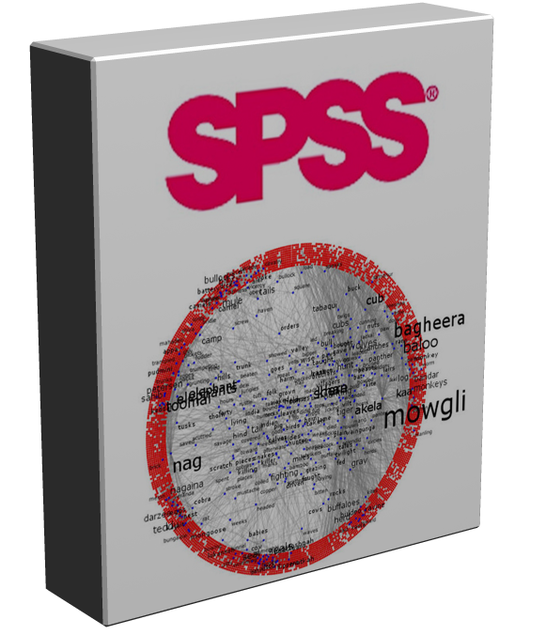

Survey - Development
Validated by a team of experts
Internal consistency checked (Cronbach's alpha = 0.88)
Reliability checked - pilot
Online survey: Survey Qualtrics software used
SPSS used to analyze data
Notes:
Study independent variables were divided into two groups: demographic and teaching background variables. The dependent variables were defined as Uses of educational technology and Attitudes about the educational technology use (Table 1).
Cronbach’s test for internal instrument consistency was used to evaluate the internal consistency of the survey with regard to teacher-educators’ attitudes about technology. The Cronbach’s alpha was calculated to be (good internal consistency).

Slide 12
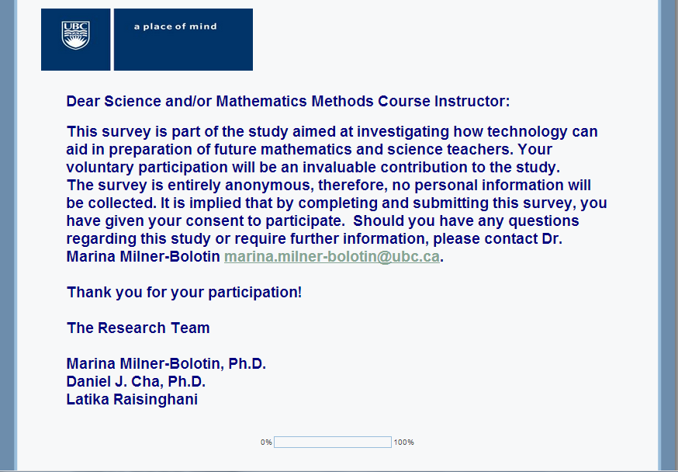
Survey - I

Slide 13
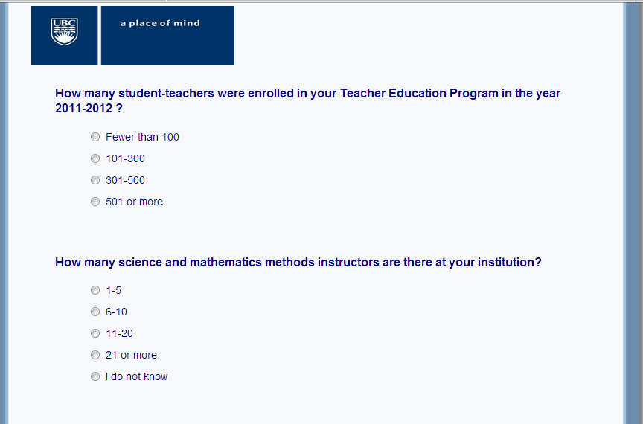
Survey - II

Slide 14
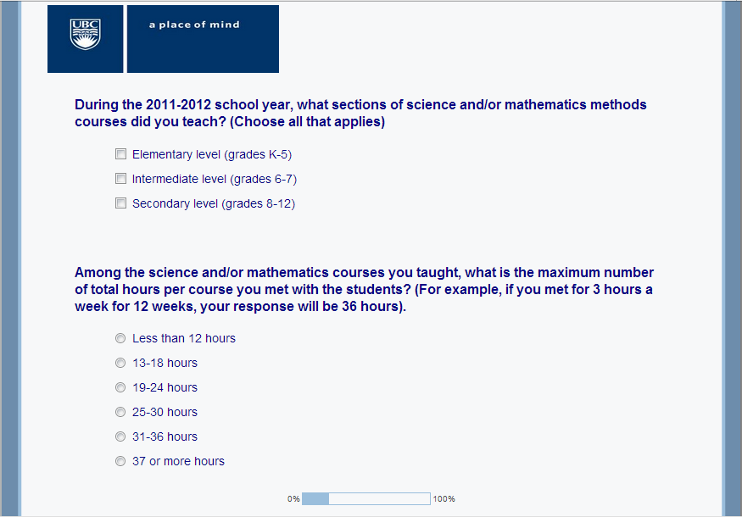
Survey - III

Slide 15
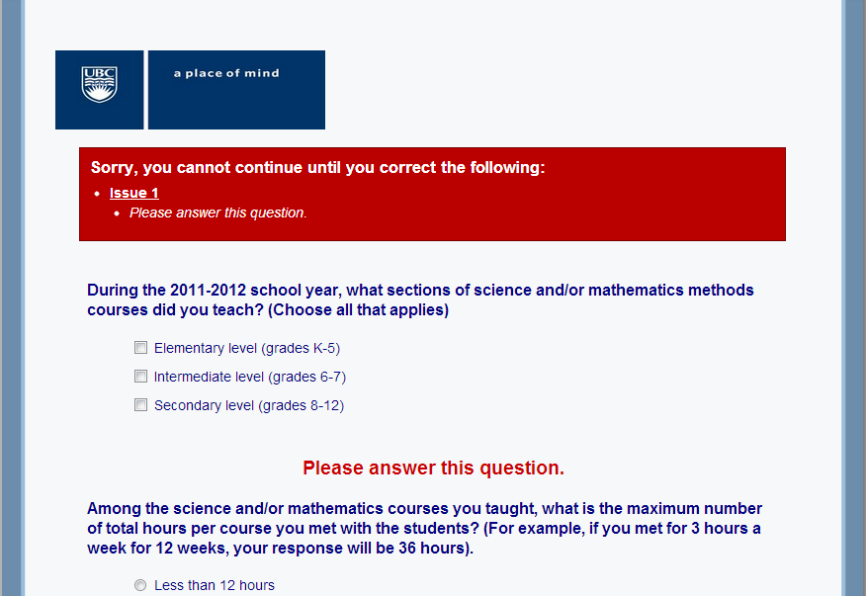
Survey - IV

Slide 16
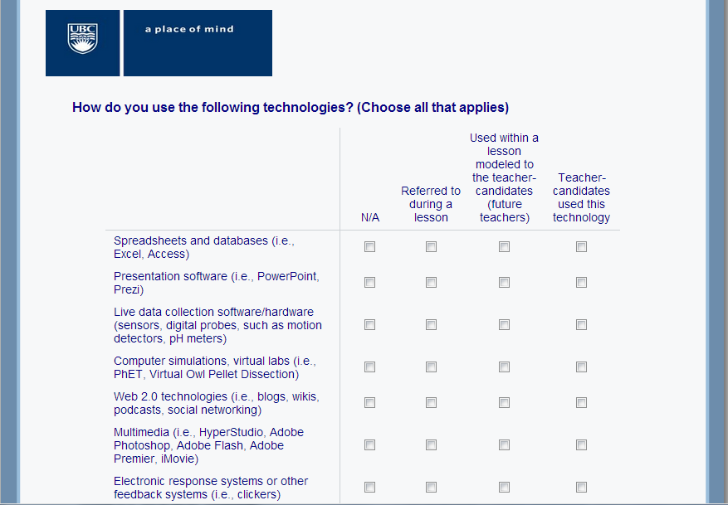
Survey - V

Slide 17
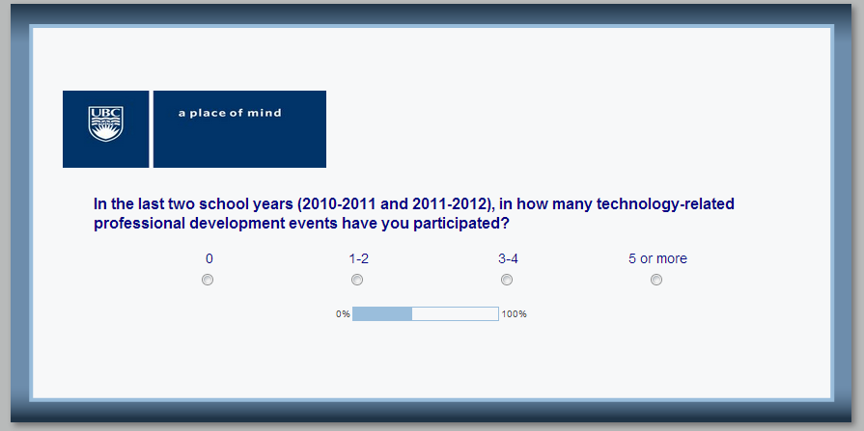
Survey - VI

Slide 18
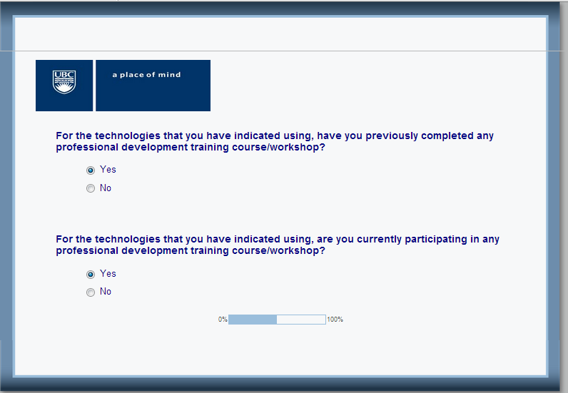
Survey - VII

Slide 19
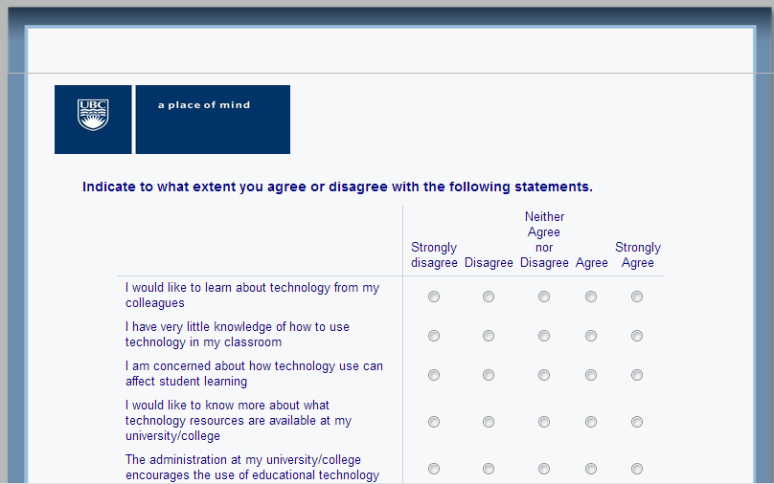
Survey - VIII

Slide 20
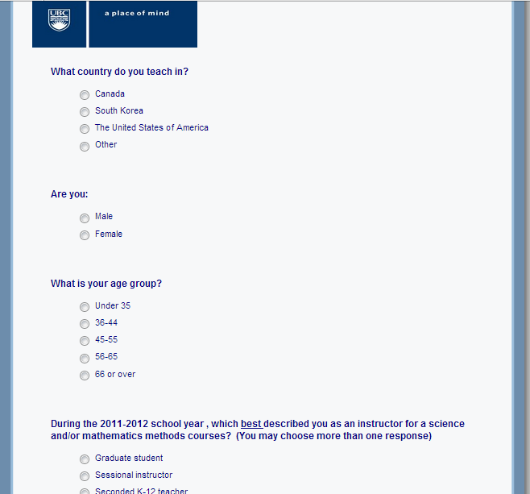
Survey - IX

Slide 21
Survey - VI

Slide 22
Study Variables
Independent variables:
  Demographic variables
  Teaching background variables
Dependent variables:
  Uses of educational technologies
  Attitudes about educational technologies

Slide 23
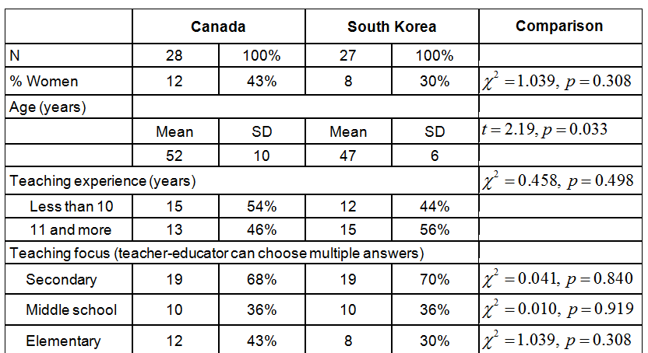
Results and Discussion

Slide 24

Teaching Experience

Slide 25
Results and Discussion

Slide 26
Main Findings
No significant differences were found between the countries
Teacher educators are interested in using technology and exhibit positive attitudes about it
They are interested in Pro-D opportunities
Positive correlation between attitudes towards technology and its use (r=0.355, p=0.008)
Extensive use of technology doesn’t lead to the disappointment with it…
Notes:
Relationship between the dependent variables was explored through correlation analysis. We investigated the correlation between the Uses of educational technology and Attitudes about its use variables using Pearson correlation test. We found a statistically significant positive correlation between these variables . In other words, M&S teacher-educators who extensively use educational technology exhibit on average more positive attitudes about technology than their counterparts who use educational technology less frequently. One important interpretation of these findings is that extensive use of technology does not lead to teacher-educators’ disappointment with it. In this context it is important to emphasize that the existence of the correlation does not imply causation. This effect can be explained both ways: either teacher-educators who have more positive attitudes about technology are more open to try different technologies, using it more extensively, or teacher-educators who use technology more frequently and who see its effect on student learning, consequently develop more positive attitudes about it. While we cannot establish the causation from this study, it is clear that teacher-educators’ attitudes about technology and their openness to use it are correlated. Therefore, if we want to improve how technology is used in TEPs, it is worth constructing a deeper understanding of this relationship.

Slide 27
Conclusions
Focus on the use of technology within the subjects
Examine the implications of technology use in Math and Science
Teacher-educators’ attitudes should be taken seriously
Support for teacher-educators is crucial
Technology implementation across different subject areas should be explored
Notes:
The use of educational technology in M&S TEPs should continue, but we have to focus on the use of technology within the subjects, rather than in general educational technology courses.
We need to examine more carefully the implications of technology use in M&S methods courses and provide examples of successful technology integration that can be emulated by teacher-educators.
Teacher-educators’ attitudes about technologies are related to their use, thus we have to examine these factors.
As educational technologies are continuously evolving, it is important to support teacher-educators in their exploration. Therefore both teachers and teacher-educators should be provided with relevant ongoing professional support.
While technology should not drive teacher education, it is a powerful tool that can help teacher-candidates develop a deeper understanding of their subject and its pedagogies. Therefore, technology implementation in different subject areas should be explored in depth in 21st century TEPs.
Relationship between the dependent variables was explored through correlation analysis. We investigated the correlation between the Uses of educational technology and Attitudes about its use variables using Pearson correlation test. We found a statistically significant positive correlation between these variables . In other words, M&S teacher-educators who extensively use educational technology exhibit on average more positive attitudes about technology than their counterparts who use educational technology less frequently. One important interpretation of these findings is that extensive use of technology does not lead to teacher-educators’ disappointment with it. In this context it is important to emphasize that the existence of the correlation does not imply causation. This effect can be explained both ways: either teacher-educators who have more positive attitudes about technology are more open to try different technologies, using it more extensively, or teacher-educators who use technology more frequently and who see its effect on student learning, consequently develop more positive attitudes about it. While we cannot establish the causation from this study, it is clear that teacher-educators’ attitudes about technology and their openness to use it are correlated. Therefore, if we want to improve how technology is used in TEPs, it is worth constructing a deeper understanding of this relationship.

Slide 28
Resources
Mishra, P., & Koehler, M. J. (2007). Technological pedagogical content knowledge (TPCK): Confronting the wicked problems of teaching with technology. In Society for Information Technology & Teacher Education International Conference (Vol. 2007, pp. 2214–2226). Retrieved from http://www.editlib.org/p/24919/

Slide 29
Results and Discussion
Teaching Experience

Slide 30
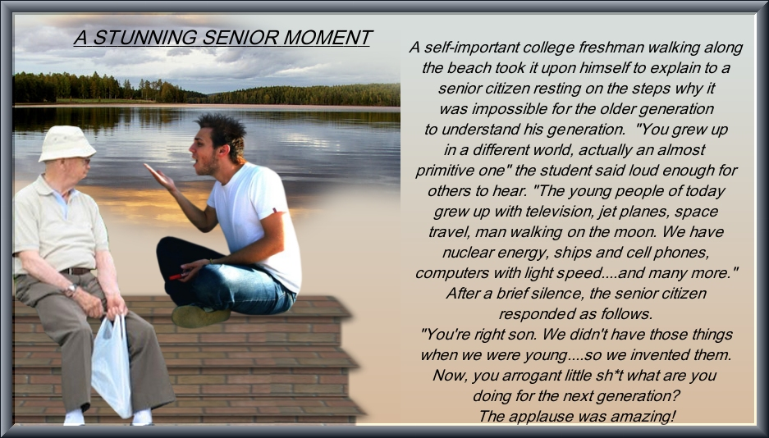
The Generation Gap: Teachers & Students

