Slide 1
Using Educational Technologies to Promote Inquiry & the Nature of Science in Teacher Education
Proudly supported by TLEF
Proudly supported by TLEF
Dr. Marina Milner-Bolotin
Korean Association for Science Education International Conference Daegu University at Gyeongsan, Gyeongbuk, Korea
February 13-15, 2014
Notes:
Invited Speech #9
Friday, February 14, 2014
16:50 – 17:30
Dr. Marina Milner-Bolotin
Assistant Professor in Science Education, the University of British Columbia, Vancouver, Canada
Department of Curriculum and Pedagogy
e-mail: marina.milner-bolotin@ubc.ca
Web site: http://blogs.ubc.ca/mmilner/
http://scienceres-edcp-educ.sites.olt.ubc.ca/

Slide 2
Dr. Marina Milner-Bolotin
Assistant Professor in Science Education, the University of British Columbia, Vancouver, Canada
Department of Curriculum and Pedagogy
e-mail: marina.milner-bolotin@ubc.ca
Web site: http://blogs.ubc.ca/mmilner/
Notes:
Contact information

Slide 3
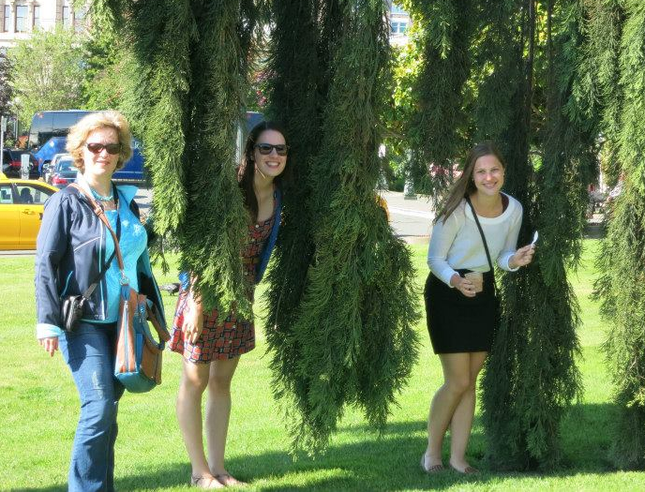
Research Team
Marina Milner-Bolotin, Ph.D. (Assistant Professor)
Heather Fisher & Alex MacDonald – Graduate M.A. Students
With the financial support of the UBC Teaching and Learning Enhancement Fund (TLEF 2012-2014)

Slide 4
Broadening the Horizon of Science Education: Synergetic Collaborations across Disciplinary Boundaries
Notes:
Most respected conference organizers, Dr. Namhwa Kang, Dr. Daniel Cha, Dr. Seoung-Hey Paik, dear colleagues, faculty, teachers, and students. It is an honour to be invited to present in South Korea at the conference that challenges us to reconsider the disciplinary boundaries and rethink the interdisciplinary collaborations in order to improve science education in our countries. For me, high quality education starts with high quality teacher preparation. Therefore, it is even more exciting to be able to share with you our research on science teacher education and at the same time to learn from our esteemed Korean colleagues and conference participants about how you prepare future science teachers. I think such international conferences are crucial for helping us move forward in science teacher education.

Slide 5
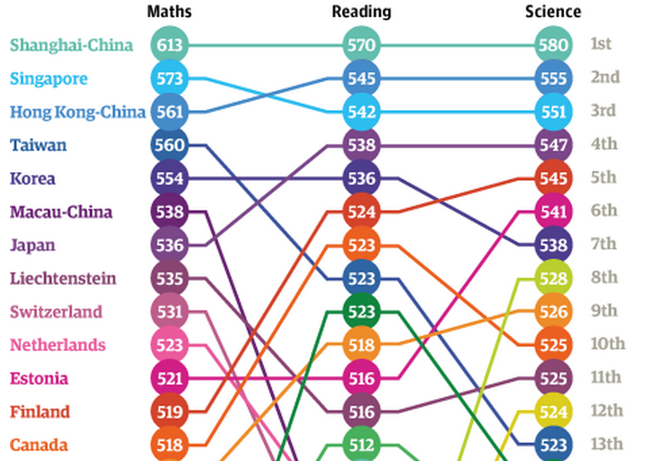
PISA 2012 Results
Maths 5th
13th
[OECD, PISA 2012 Results]
Notes:
Based on my knowledge about South Korean educational system (and most of it comes not only from the papers I have read but also from the Korean colleagues I had an opportunity to collaborate with, like Prof. Daniel Cha from Daegu University), South Korea is the country where teacher education is taken very seriously. International tests, such as PISA, show that this is the right approach to teacher education. Korean students consistently come on top: 5th in maths, 5th in reading and 7th in science in PISA 2012. While Canadian students in 2012 came 13th in maths, 7th in reading and 10th in science, which is obviously not what we had expected. However, PISA results had some very positive consequences for Canadian educators. PISA challenges us to think about how we might reconsider science teacher education and how technology can assist us in this process. Thus, challenging teacher-educators to cross the technological boundaries in teacher education was one of the unintended positive consequences of the PISA 2012 results for Canadian teacher educators.

Slide 6
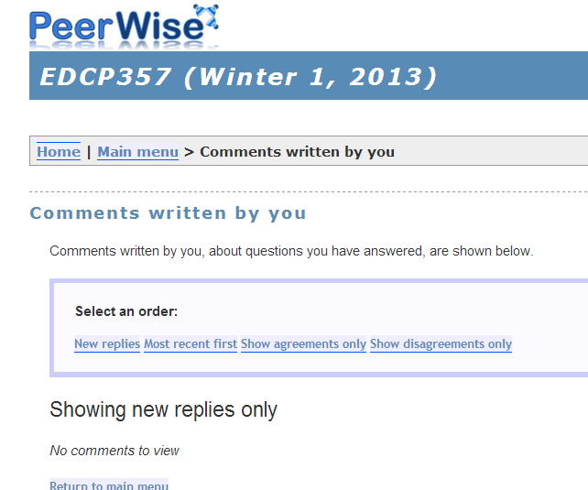
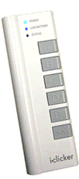
Presentation Overview
Research on the effects of technology-enhanced Active Engagement (AE) on science teacher-candidates
Clickers
Notes:
In today’s presentation I would like to share with you our research on the effects of technology-enhanced Active Engagement pedagogies on science (physics) teacher-candidates (prospective teachers). By active engagement I mean student-centered learning environments where students, or in our case, physics teacher-candidates, are actively engaged in their own learning – both as future teachers, and as students. In these learning environments technology is used to facilitate student engagement with the science content and with science pedagogy.
One of the most commonly explored technologies in contemporary STEM educational research is electronic response systems (clickers). Benefits of clicker-enhanced pedagogy include: encouraging active student participation, reducing anxiety, supporting formative assessment, and promoting conceptual understanding. Most studies, however, investigate the effects of these technologies in large undergraduate STEM courses. The role of clicker-enhanced pedagogy in small secondary or post-secondary classrooms is still relatively unexplored, especially in the context of teacher education programs. This is what I am going to focus on. (I have heard that Prof. Cha recently started using clickers in his science teacher education courses at Daegu University.)
Another technology we will explore today is PeerWise. It is an online system that allows students to author multiple-choice questions, share them with their peers, comment on the questions designed by others and edit their own questions. This is an excellent free resource for science teacher educators as it allows creating a collaboration between future teachers and the instructor thus creating a community of educators working together on the design of educational resources.
Both system are excellent for creating active learning environments in teacher education. However, to take full advantage of these technologies in science classrooms, teachers must have experience with technology-enhanced active learning pedagogies. In my view, one of the main goals of science teacher education should be helping prospective teachers acquire necessary pedagogical skills. This cannot be done by lecturing to future teachers on the educational technology. I am convinced that the only way to help them acquire these skills and become interested in using AE pedagogies with their future students is to model these pedagogies in the teacher education classrooms.
The studies I will share with you today investigated whether clicker-enhanced pedagogy and PeerWise learning system are effective in a small secondary physics methods course by considering their impact on supporting an inquiry-oriented curriculum, increasing the instructor's ability to diagnose gaps in teacher-candidates' pedagogical-content knowledge, and consequently to improve it. This study sheds light on developing teacher-candidates' capacities to utilize, design, and implement inquiry-oriented clicker-enhanced pedagogy, the impact of this process on their pedagogical-content knowledge and attitudes toward the value of conceptual learning.
Milner-Bolotin, M., H. Fisher, and A. MacDonald, Modeling active engagement pedagogy through classroom response systems in a physics teacher education course. LUMAT: Research and Practice in Math, Science and Technology Education, 2013. 1(5): p. 525-544.

Slide 7
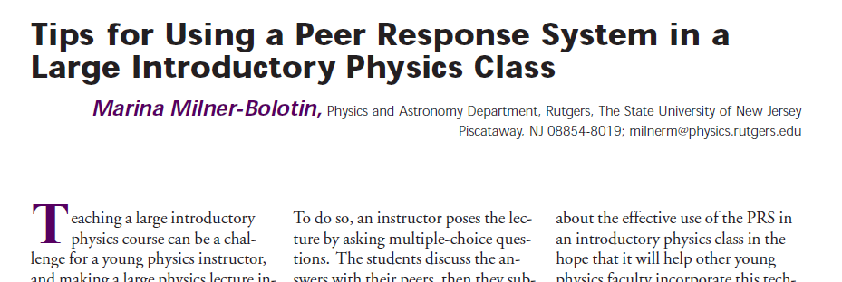
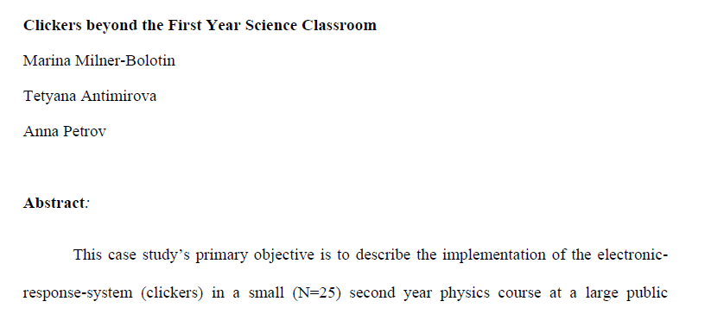
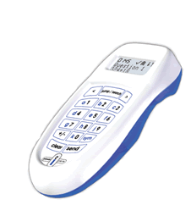
Clickers & Active Learning
2004, The Physics Teacher, 42(8), 47-48.
Journal of College Science Teaching, Fall 2009
2010, Journal of College Science Teaching,
40(2), 18-22.
Notes:
Since today we will focus on clicker-enhanced pedagogy, I would like to say a few words about Eric Mazur, a physics professor at Harvard University, who more than 25 years ago proposed Peer Instruction pedagogy that takes advantage of clickers. In Peer Instruction, a teacher uses clickers to facilitate formative assessment. Peer Instructions relies on class activities that address student conceptual difficulties as they grapple with science concepts. Enacting Peer Instruction pedagogy in a science classroom, as I am sure you agree with me, requires much greater Pedagogical Technological Content Knowledge (TPCK) and flexibility from the teacher, than a traditional teacher-centered instruction. Let me give you an example.

Slide 8
Peer Instruction Pedagogy
(B) Is the correct answer
in both cases
Notes:
As a teacher, you can ask a conceptual question and the students can use clickers to choose an answer. You can see two different examples of conceptual questions. The first questions deals with a famous Monty Hall Problems (a problem in probability) and the second questions focuses on physics – the law of inertia. Examining teacher-candidates responses to these problems, we can see they are being very confused. The immediate pedagogical questions that I see here are:
What do you, as a teacher, do in such a scenario in your classroom?
Are teachers we educate in our Teacher Education Programs well equipped to be flexible and to address student difficulties instead of proceeding with the pre-planned lesson?
Where do you find powerful conceptual questions that will help elicit student difficulties?

Slide 9
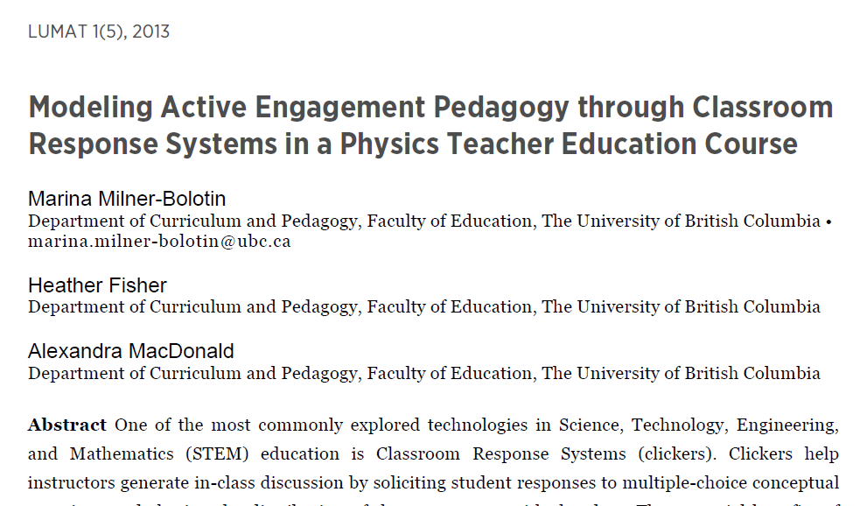
Peer Instruction Pedagogy
[LUMAT: Research and Practice in Math, Science & Technology Education, 2013. 1(5): p. 525-544.]
Notes:
We attempted to answer these questions in our recent paper titled Modeling Active Engagement Pedagogy though Classroom Response System in Physics Teacher Education Course, where Classroom Response Systems is an alternative name for clickers.

Slide 10
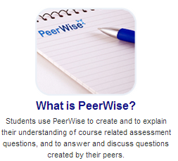
PeerWise Online System
http://peerwise.cs.auckland.ac.nz/
Notes:
The second major technological component in our research is a PeerWise online system. It is developed by our colleagues in New Zealand (Paul Denny, et al.) allows to take PI one step further. It allows teacher-candidate to collaborate online on creating education resources at the same time playing roles of students and teachers.

Slide 11
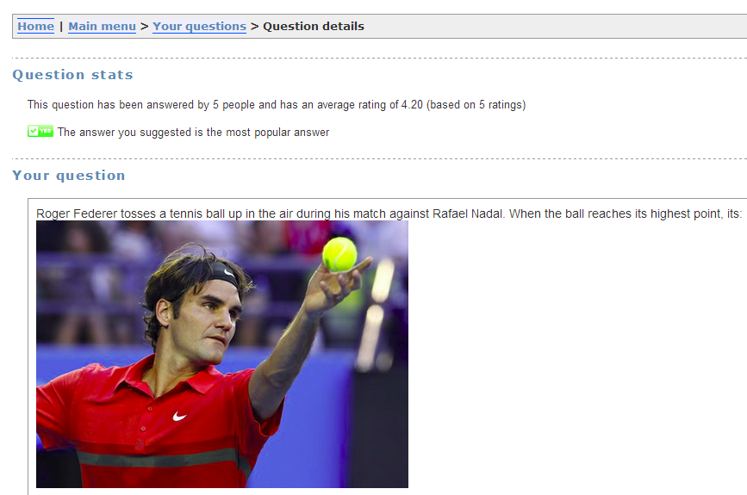
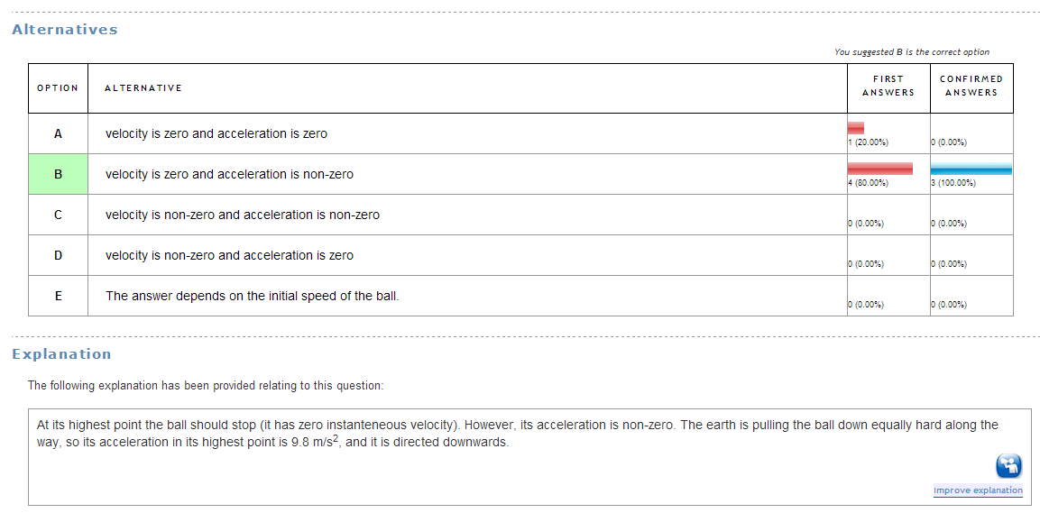
PeerWise Online System
Notes:
Here is an example of a question designed by a student in PeerWise. The question has five possible answers and you can see student statistics. You can comment on the question, rank it, edit it and suggest alternative explanations.

Slide 12
Technology-Enhanced Active Engagement Integration
Peer Instruction modeled in every class
PeerWise used to design, critique, respond to Conceptual Questions as a community of future teachers
Notes:
Why did we decide to integrate modeling Peer Instruction with using PeerWise for out-of-class teacher-candidates’ interactions?
Modeling is a case of practicing what you preach.
The idea behind modeling is help students learn through the observation of experts.
For many teacher candidates, the Teacher Education program is the first opportunity to intentionally reflect on the pedagogies they have experienced as learners over the last 16 years or so.
So we need to model good, research-based pedagogy for them, to ensure they have had a good experience with it
However, if we are going to expect them to take this behaviour into their own classrooms, they need good resources/materials to use
This is the meat of what we wanted to explore in this project.
As instructors we choose to model a variety of pedagogies. We are intentional in our choice of pedagogy. We also want teacher-candidates to understand why we are making certain choices, so they can make their own informed choices in their future classrooms.

Slide 13
Research-Based Objectives
Investigate the effect of Active Engagement (AE) on teacher-candidates’ (TCs’) epistemologies
Explore a possible mechanism for AE pedagogy
Model AE in the context of the
course content
Notes:
Thus, the research-based objectives of our studies are to investigate the effects of Active Engagement technology enhanced pedagogies on teacher-candidates. We wanted to see if engaging them in tech-enhanced learning environment will have the effect on their view of science teaching, if it will affect their views on the nature of science and on the nature of science learning, and if it will affect their epistemologies. We wanted to understand if modeling PI and PeerWise-enhanced pedagogies makes any effect on teacher-candidates. And if there is an effect, then we want to know what it is.
I have to acknowledge that we were very fortunate to receive significant support from the University of British Columbia Teaching and Learning Enhancement Fund (TLEF) and as a result of this effort we were able to have a group of science educators and graduate students working on the project. In addition, it is important to emphasize that in Canada, unlike South Korea and many other countries, most of teacher-candidates in our programs have already earned a Bachelor Degree in the subject they will be teaching. It means that they have been exposed to about 18 years of formal education prior to coming to us: thirteen years of school (K-12) and 4-5 years of university. Most of them, however, have experience passive learning environments and have not been exposed to the pedagogies we would like them to master. Thus modeling this pedagogy in teacher education courses is extremely important.

Slide 14
Teaching & Learning with Technology
TCs experience developing questions
Instructor modeling AE pedagogy
http://scienceres-edcp-educ.sites.olt.ubc.ca/
Notes:
So how did we integrate teaching and learning with technology into the physics methods course?
First of all we used Peer Instruction pedagogy in most of the classes, thus teacher-candidates had a chance to experience this pedagogy as students and as future teachers. We also invited students to use the Mathematics and Science Teaching and Learning through Technology Resource we developed. This resource is a database of conceptual mathematics and science questions based on British Columbia K-12 curriculum:
http://scienceres-edcp-educ.sites.olt.ubc.ca/. Lastly, as part of the course assignments, teacher-candidates were asked to develop 5 conceptual multiple-choice questions every week, answer and comment on 10 conceptual questions designed by their peers and use their feedback to improve their questions.
Thus teacher-candidates were asked to use Active Engagement technology-enhanced pedagogies as students and as teachers.

Slide 15
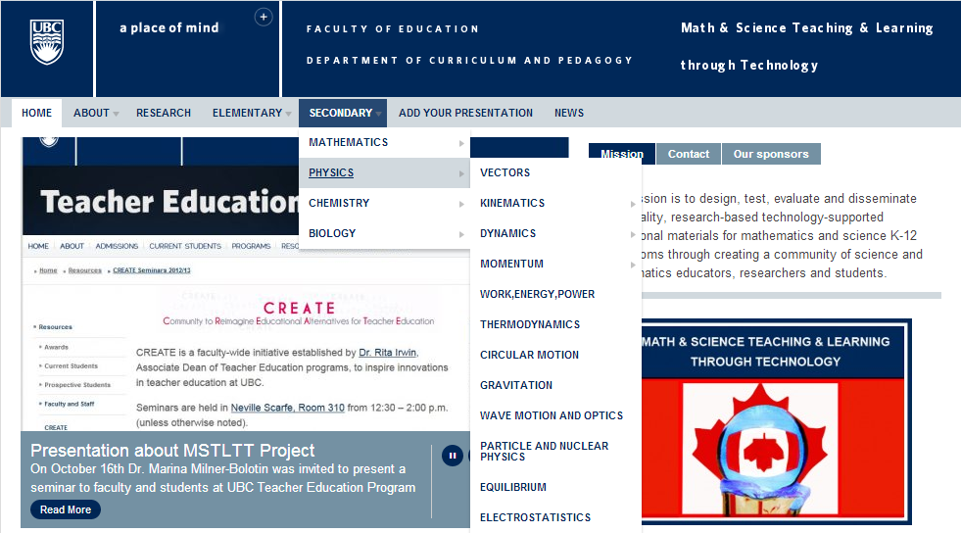
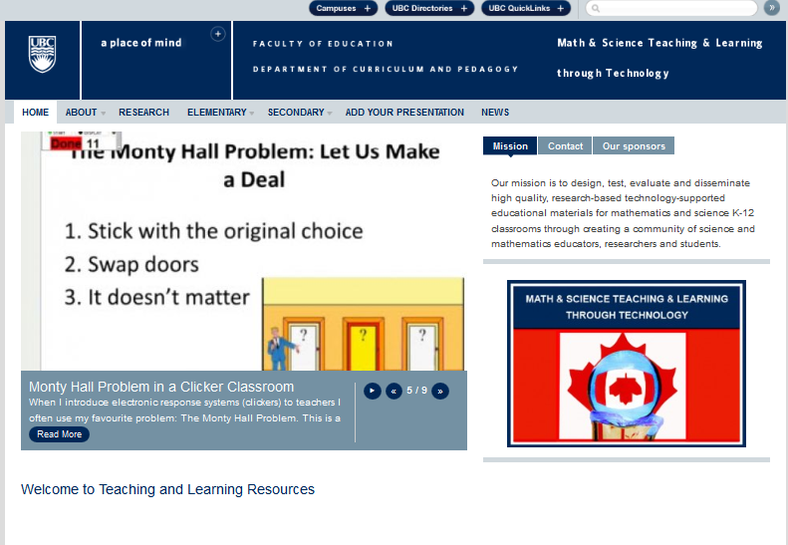
Math & Science Teaching & Learning through Technology
Notes:
This slide shows how our resource looks like. It is divided into primary and secondary, by subject area, and then by specific topics within each subject. These topics are determined largely by the British Columbia Ministry of Education and question sets in the database are developed to meet the Prescribed Learning Outcomes outlined in the Ministry documents.

Slide 16
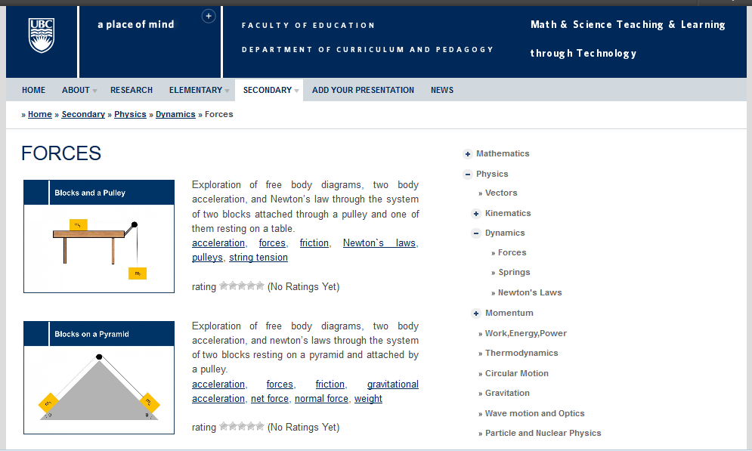
Navigating the Resource
Notes:
As you can see here, under a given category (here, Physics > Dynamics > Forces) there are a variety of questions (all the questions are included into a question set – a sequence of 5-15 questions), each with a brief summary and a list of tags describing the topics covered in that set. The image provides a glimpse into the situation/topic that question set will be covering. On the right, a user of the resource can navigate to the various areas of the resource quickly and conveniently. The resource is free and is open to anybody, teachers, students, teacher-candidates. Moreover, the users can rate the quality of the questions and leave their comments. Every question set is a PowerPoint slide, so teachers can download and edit them as they wish.

Slide 17
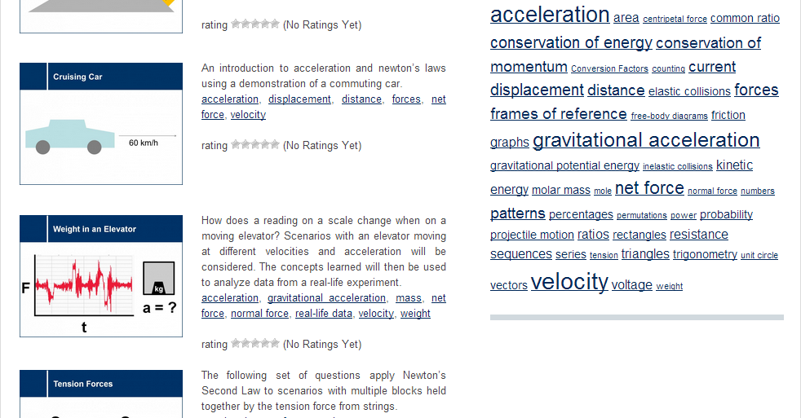
Navigating the Resource
http://scienceres-edcp-educ.sites.olt.ubc.ca/
Notes:
It is also possible to search the resource for a particular topic using the tags, listed on the right hand side of the page. For example, choosing acceleration will bring up a list of all question sets, from all areas, that touch on acceleration. This allows teachers and students to approach topics from different angles.

Slide 18
Question Title
Blocks and a Pulley
Question Title
m₁
m₂
Notes:
This is an overall structure of how we approach the design of the question sets in our resource and how we model it in the classroom.
Each question has a few components in it and we follow the same process to model AE pedagogy in the classroom for TCs to engage in.
Pedagogy
Tags: physics, dynamics, mechanics, weight, gravity, acceleration, constant, velocity, weight, tension, friction
Subject: Physics
Topic: Dynamics – Newton’s second law
Grade Level: Senior High School
Difficulty Level: Medium - Hard
Required Mathematics: Conceptual and algebra
Other comments: Students must understand net forces, how pulleys work

Slide 19
Question Title
Blocks and a Pulley II
Question Title
Two blocks are connected via a pulley. The blocks are initially at rest as block m₁ is attached to a wall. If string A breaks, what will the accelerations of the blocks be? (Assume friction is very small and strings don’t stretch)
A
B
m₁
m₂
Why are the assumptions above important?
Notes:
Question, high level conceptual questions with both visual and written representations.
There are many ways to approach the questions, so we will only discuss one possible iteration of the pedagogy. Please feel free to ask questions after the presentation about possible alternatives.
For example, students may be given time to consider the question on their own, and then will be asked to vote on an answer choice. After that, they will get into small groups and discuss the question together, voting again after this discussion. Finally, students may be asked to consider why each possible answer could be considered by students and what concepts underpin each option.

Slide 20
Comments
Solution
Comments
Answer: E
Justification: None of the above answers is correct. Consider two blocks as one system: one can see that the system has a mass of (m₁+m₂), while the net force pulling the system down is m₁g. Therefore, applying Newton’s second law, one can see that the acceleration of the system must be less than g:
Some people think that the acceleration will be g. They forget that the system consists of two blocks (not just m₁) and the only pulling force is m₁g. Thus the system is NOT in a free fall. Compare this questions to the previous one to see the difference.
Notes:
What makes our resource different from many others is this component of the question set – having a justification for the correct and incorrect answers, to help students or teachers to understand the concept as well as the misconceptions surrounding a given question.

Slide 21
Research-Based Objectives
Investigate the effect of Active Engagement (AE) on teacher-candidates’ (TCs’) epistemologies
Explore a possible mechanism for AE pedagogy
Model AE in the context of the
course content
Notes:
The research-based objectives we discussed earlier helped us choose the theoretical framework for the study. Since we wanted to see how teacher-candidates are affected by Active Engagement technology-enhanced pedagogies we implemented in the physics methods courses, we decided to employ a Technological Pedagogical Content Knowledge Framework described below.

Slide 22
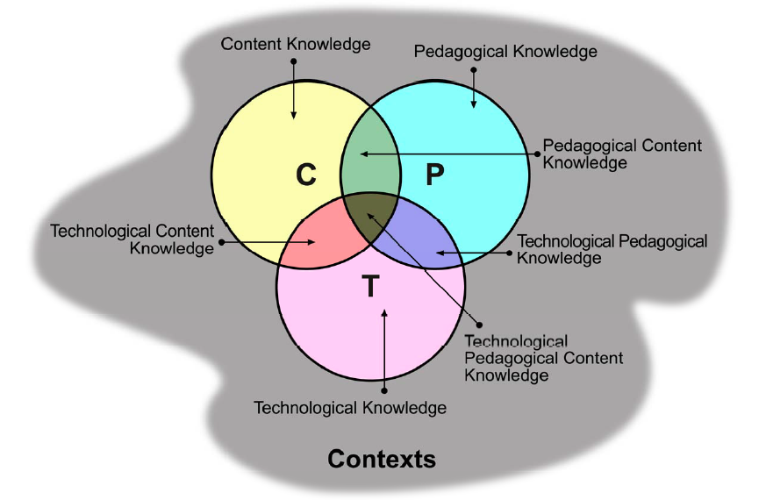
Theoretical Framework
Shulman, L.S., Those who understand: Knowledge growth in teaching. Educational Researcher, 1986. 15(2): p. 4-14.
Koeler & Mishra, 2007
Notes:
Before moving into the research methods employed in our studies, I would like to focus on the theoretical framework that guided our research. In our research we utilize the Pedagogical Content Knowledge framework proposed by Shulman in 1986 and later expanded on by Koehler and Mishra. This framework considers teaching and an overlap and interaction of three different areas – Content Knowledge, Pedagogical Knowledge and Technological Knowledge. In order to succeed teachers have to have expertise in all the areas. For example, knowing physics, doesn’t mean you can teach it, but you also cannot be a successful teacher, if you do not have the grasp of the content. The same can be said about technology, as Technological Pedagogical Content Knowledge is the knowledge of technologies that can help teachers promote specific skills and understanding in their students. The interaction of these three areas what makes a successful teacher in 21st century.
Shulman, L.S., Those who understand: Knowledge growth in teaching. Educational Researcher, 1986. 15(2): p. 4-14.
Koehler, M.J. and P. Mishra, What is technological pedagogical content knowledge? Contemporary Issues in Technology and Teacher Education, 2009. 9(1): p. 60-70.

Slide 23
Research Methods
Secondary Physics Methods Course
(+ 2-week short practicum)
13 students
13 weeks
Pre-Practicum Interviews
(8)
Timeline
Extended Practicum
10 weeks
Enhanced Practicum
3 weeks
Post-Practicum Interviews
(7)
Focus Group (1)
Notes:
In order to answer the research objectives described above we designed the following study.
During the 13 weeks of the physics methods course we implemented technology-enhanced Active Engagement pedagogy. A Research Assistant was present during each one of the course meeting and she observed how teacher-candidates reacted to this pedagogy. In addition, we conducted pre-practicum and post-practicum interviews with teacher-candidates and one big focus group. Thus the entire study took 9 month, since the long practicum took place two months after the physics methods course ended. This allowed us to see the long-term effects of our intervention and evaluate if it affected the pedagogies of teacher-candidates during the long practicum.

Slide 24
Quantitative Data Collection: PeerWise
 | Questions | Answers | Comments
1 | 50 | 110 | 52
2 | 50 | 85 | 40
3 | 51 | 115 | 74
4 | 50 | 90 | 34
5 | 60 | 110 | 79
6 | 50 | 112 | 82
7 | 57 | 109 | 107
8 | 50 | 192 | 14
9 | 50 | 91 | 81
10 | 50 | 100 | 50
Notes:
We will first consider quantitative results: teacher-candidates’ participation in PeerWise community. Since they were asked to come up with 5 questions a week and there were 10 weeks not including the first and last week of classes and pre-practicum week, all of them had to come up with at least 50 conceptual questions and 90 answers to the questions posted by others. Most of the students exceeded this expectation. In addition, most of them were actively commenting on the questions designed by other students.

Slide 25
Results
Koeler & Mishra, 2007
Notes:
We will consider the results in light of the theoretical framework of the study. We will attempt to uncover the connections that teacher-candidates make between the importance of good pedagogical practice and content knowledge pre- and post-practicum.

Slide 26
Results - Qualitative: Direct Impact
“It really opens the door for umm discussions between people. Um regarding a) you know, what is the right answer, and b) how would you explain that to uh either teacher-candidates or to your potential students.”
Pre-Interview 2, Participant 9
Notes:
One theme! Connections that Teacher-Candidates make between the importance of good pedagogical practice and content knowledge pre- and post-practicum.

Slide 27
Direct Impact on our Teacher-Candidates
Content Knowledge
Pedagogical Knowledge
Technological Knowledge
“It really opens the door for umm discussions between people. Um regarding a) you know, what is the right answer, and b) how would you explain that to uh either teacher-candidates or to your potential students.”
Pre-Interview 2, Participant 9
Notes:
One theme! Connections that Teacher-Candidates make between the importance of good pedagogical practice and content knowledge pre- and post-practicum. Please notice that here, we can see the overlap between the content and pedagogical knowledge.

Slide 28
Direct Impact on our Teacher-Candidates
“So, if you set it up in a dynamic where… different types of people have [different needs], so if you need to talk to someone, you still get that, if you need silence, you get to think on it on your own, and then people aren’t so stressed… And they actually get to argue and talk back and forth and they’ll remember it more. So for them, I think they’ll master it more.”
Post-Interview 2, Participant 20
Notes:
One theme! Connections that Teacher-Candidates make between the importance of good pedagogical practice and content knowledge pre- and post-practicum.

Slide 29
Direct Impact on our Teacher-Candidates
“So, if you set it up in a dynamic where… different types of people have [different needs], so if you need to talk to someone, you still get that, if you need silence, you get to think on it on your own, and then people aren’t so stressed… And they actually get to argue and talk back and forth and they’ll remember it more. So for them, I think they’ll master it more.”
Post-Interview 2, Participant 20
Content Knowledge
Pedagogical Knowledge
Technological Knowledge
Notes:
One theme! Connections that Teacher-Candidates make between the importance of good pedagogical practice and content knowledge pre- and post-practicum.

Slide 30
Broad Impact for Teacher Education
Investigate the effect of Active Engagement (AE) on teacher-candidates’ epistemologies
Modeling impacts TCs’ epistemologies, regardless of successes/challenges in practicum
Model AE with the
course content
“I’m there as a teacher, (pause) but I’m also there as a student. Conversely, they’re there as a student, but they’re also there as a teacher. That doesn’t mean they’re teaching necessarily, teaching me. They’re teaching each other... You’re always a student-teacher, regardless of whether or not, what your position says. The-the moment you step out, and you meet someone, you now are both a teacher and a learner.”
Post-Interview 1, Participant 15
Notes:
We also identified broader impact on technology-enhanced Active Engagement pedagogy for teacher education.
Modeling AE is not easy, as most importantly you need a buy-in from teacher candidates. It often is working against a long history of pedagogical exposure. However, it is possible and it has a profound impact. It is especially important in small classes. We found that using Peer Instruction in a small class of teacher-candidates was especially effective. Most importantly, modeling impacts teacher-candidates’ epistemologies, regardless of successes/challenges in the practicum – they start thinking of their own education and teaching differently. They also challenge their own ideas about learning and teaching.

Slide 31
Broad Impact for Teacher Education
Clicker-enhanced pedagogy works as a mechanism for AE pedagogy in a small class
Explore a possible mechanism for AE pedagogy
“Coming into the program, we were all sort of thought that we were expected to be masters, and if the instructor puts up a clicker question, you think ‘Jeez, I don’t actually know the answer’ – immediately you think well, we’re all supposed to be masters, I’m probably the only one who doesn’t know. But uh when the responses come in, you see other people think like you, it’s definitely reassuring.”
Pre-Interview 2, Participant 9
Notes:
Here is another example of what teacher-candidates had to say about the effect of this pedagogy on them.

Slide 32
Broadening the Horizon of Science Education: Synergetic Collaborations across Disciplinary Boundaries
Notes:
Let me finish my presentation with challenging us to think how we use technology in our classrooms and how we prepare future teacher to do it. The Conference organizers challenged us to broad the horizon of science education and be open for collaboration. In our research, we collaborated with the computer science colleagues in New Zealand in order to challenge our science teacher-candidates to rethink how they can use technology in science education to promote active student engagement and meaningful science learning.

Slide 33
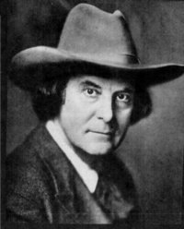
Elbert Hubbard (1854-1915)
One computer can do the work of fifty ordinary teachers. No computer can do the work of one extraordinary Teacher.”
~ Adapted from an American writer, publisher, artist and philosopher, E. Hubbard (1854-1915)
Notes:
Technology is a very powerful thing, yet I want us to recall the century old saying by an American publisher, artist, and philosopher, Elbert Hubbard (1854-1915), who said that one machine can do the work of 50 ordinary men. No machine can do the work of one extraordinary man. I took the liberty to paraphrase it slightly: One computer can do the work of fifty ordinary teachers. No computer can do the work of one extraordinary Teacher”. I challenge you and I challenge myself to collaborate across disciplinary boundaries to help raise extraordinary science teachers in our countries.

Slide 34
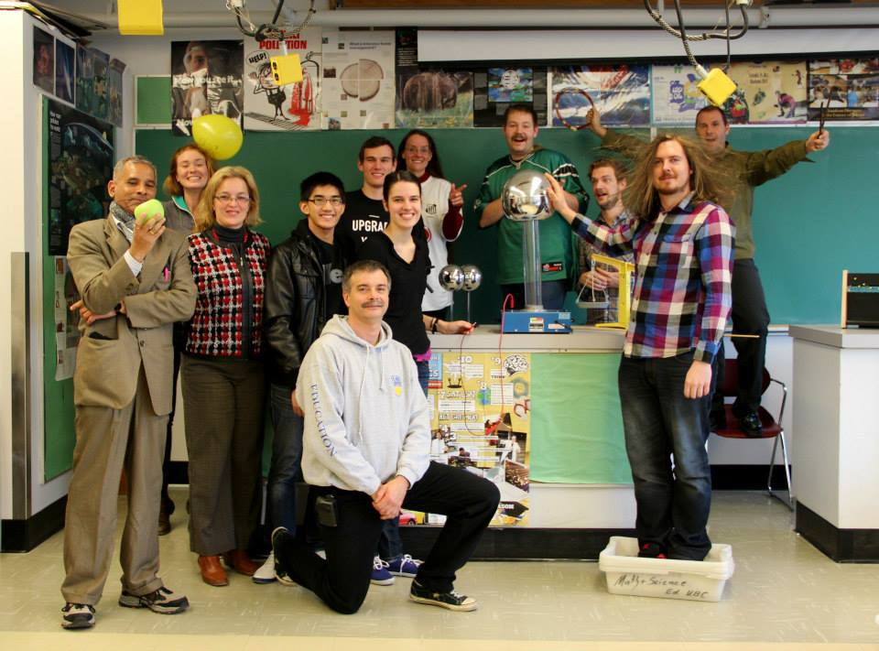

Slide 35
Resources
Beatty, I., Gerace, W., Leonard, W., & Defresne, R. (2006). Designing Effective Questions for Classroom Response System Teaching. American Journal of Physics, 74(1), 31–39.
CWSEI Clicker Resource Guide: An Instructors Guide to the Effective Use of Personal Response Systems (Clickers) in Teaching. (2009, June 1).
Lasry, Nathaniel. (2008). Clickers or Flashcards: Is There Really a Difference? The Physics Teacher, 46(May), 242-244.
Milner-Bolotin, Marina. (2004). Tips for Using a Peer Response System in the Large Introductory Physics Classroom. The Physics Teacher, 42(8), 47-48.
Mishra, P., & Koehler, M. J. (2007). Technological pedagogical content knowledge (TPCK): Confronting the wicked problems of teaching with technology. In Society for Information Technology & Teacher Education International Conference (Vol. 2007, pp. 2214–2226). Retrieved from http://www.editlib.org/p/24919/
Milner-Bolotin, Marina, Fisher, Heather, & MacDonald, Alexandra. (2013). Modeling active engagement pedagogy through classroom response systems in a physics teacher education course. LUMAT: Research and Practice in Math, Science and Technology Education, 1(5), 525-544

