Slide 1


Teaching Conceptual Science with Technology
Dr. Marina Milner-Bolotin
Proudly supported by TLEF
Proudly supported by TLEF
Department of Curriculum and Pedagogy
University of British Columbia
Friday, June 18, 2014
CAP 2014

Slide 2
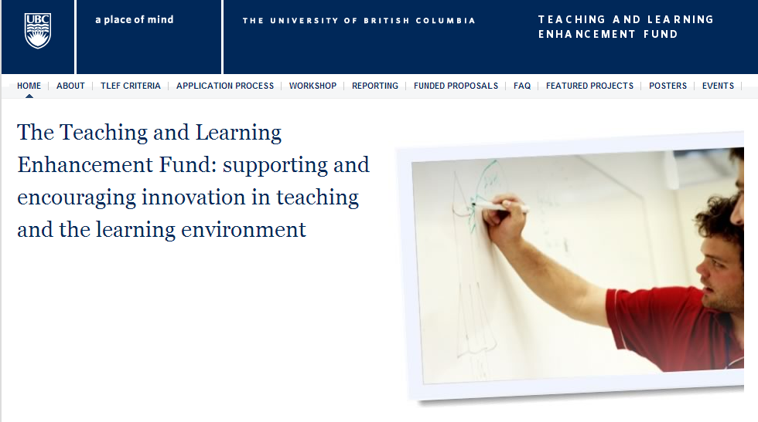

Supported by UBC Teaching & Learning Enhancement Fund
  Generously supported by UBC TLEF 2012-2015: $151, 000

Slide 3

Dr. Marina Milner-Bolotin
Assistant Professor in Science Education, UBC
Department of Curriculum and Pedagogy
e-mail: marina.milner-bolotin@ubc.ca
Web site: http://blogs.ubc.ca/mmilner/
Notes:
Contact information

Slide 4
My Learning & Teaching Trajectory
My mom is a math & physics teacher
M.Sc. In physics, Ph.D. in Science Education
Physics and math teacher since 1991 (gr. 3 – college) in Canada, US, Israel and Ukraine
Used various technologies in STEM teaching
Teaching awards: NSTA, AAPT, UBC, Ryerson, CAP
Teacher educator since 1995
Still learning and I want to learn with you today

Slide 5
Workshop Outline
Introduction: why conceptual science and why technology
Experiencing Peer Instruction: Active engagement with clickers
Discussion: Using technology in Science and Meath teaching
Summary: What is next

Slide 6


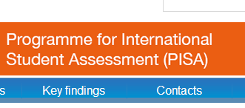
1.
Intro: Why Conceptual Science & Why Technology?
http://www.oecd.org/

Slide 7
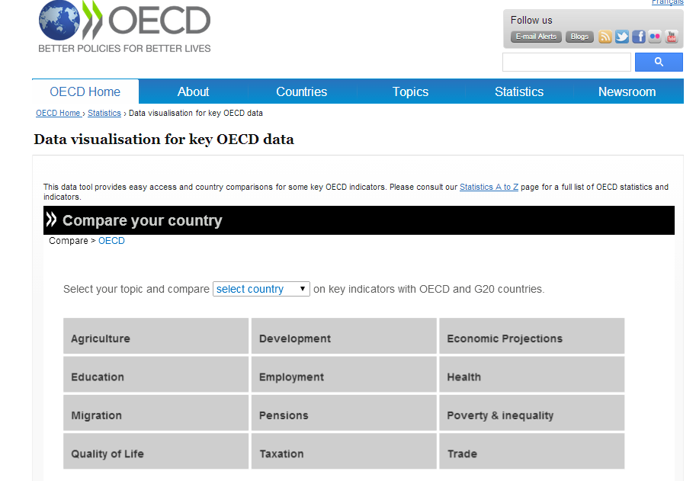
The Value of Conceptual Science Learning

Slide 8
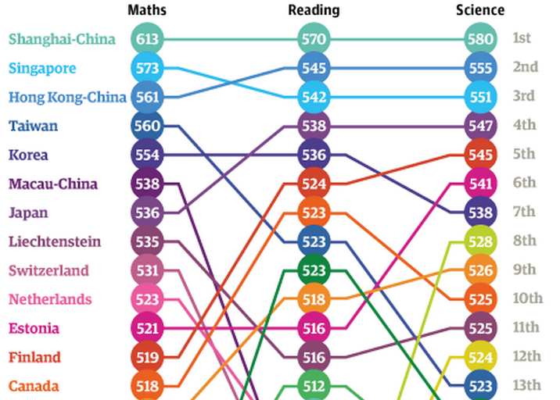
PISA 2012 Results
[OECD, PISA 2012 Results]

Slide 9
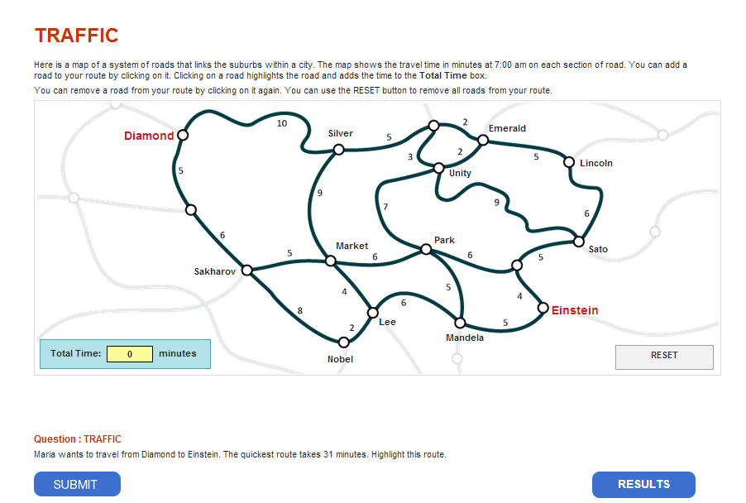
Example of a PISA Question
Notes:
http://www.oecd.org/pisa/test/form/
Here is a map of a system of roads that links the suburbs within a city. The map shows the travel time in minutes at 7:00 am on each section of road. You can add a road to your route by clicking on it. Clicking on a road highlights the road and adds the time to the Total Time box.
You can remove a road from your route by clicking on it again. You can use the RESET button to remove all roads from your route.

Slide 10
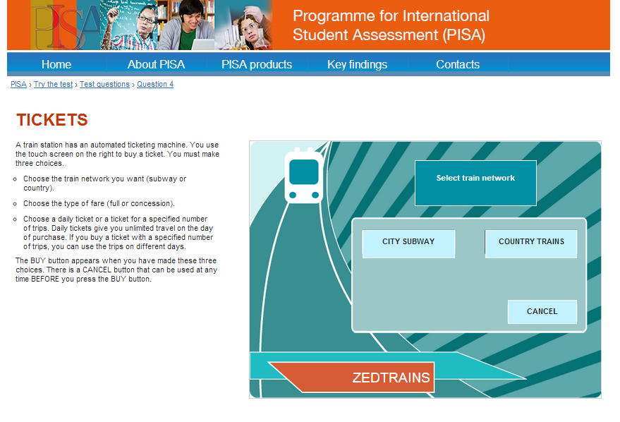
Example of a PISA Question
Notes:
http://www.oecd.org/pisa/test/form/
Here is a map of a system of roads that links the suburbs within a city. The map shows the travel time in minutes at 7:00 am on each section of road. You can add a road to your route by clicking on it. Clicking on a road highlights the road and adds the time to the Total Time box.
You can remove a road from your route by clicking on it again. You can use the RESET button to remove all roads from your route.

Slide 11

Thinking Fast and Slow by Daniel Kahneman, 2011
Central thesis: a dichotomy between two modes of thought:
"System 1" is fast, instinctive and emotional; "System 2" is slower, more deliberative, and more logical.
It delineates cognitive biases associated with each type of thinking by highlighting several decades of academic research to suggest that people place too much confidence in human judgment.
Notes:
It also exists as an audio book. It is a great book for teachers – it discusses how our brains work and how we think sometimes slow but most of the time – fast…

Slide 12
Do Students Learn to Use System 2 in our Science Courses?
15% - 29%
30%-44%
45%-59%
60%-74%
75%-90%
What % of what the students could have learned in our traditional lecture-based courses is actually learned?

Slide 13
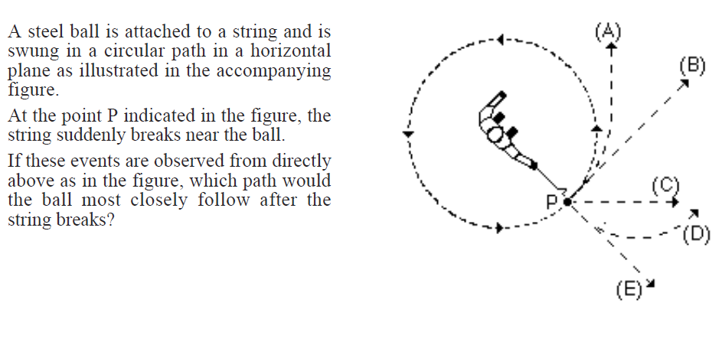
Force Concept Inventory Example
[Hestenes, D., Wells, M., & Swackhamer, G. (1992). Force Concept Inventory. The Physics Teacher, 30(3), 141-157.]

Slide 14
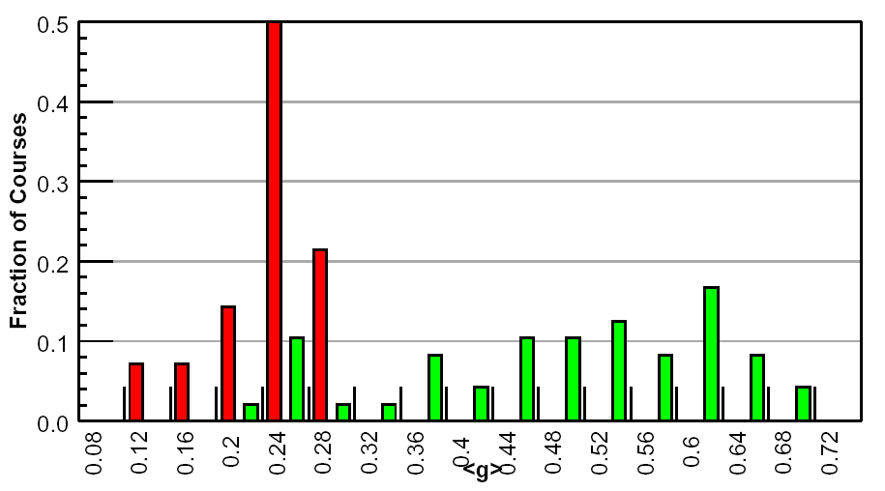
FCI Gain Data
Red: Traditional lecture courses
Green: Interactive engagement
R. Hake, ”…A six-thousand-student survey…” AJP 66, 64-74 (‘98).

Slide 15

Are these Results Surprising?
FREE from the National Academies Press:
http://www.nap.edu/catalog.php?record_id=9853
Notes:
http://www.oecd.org/pisa/test/form/

Slide 16

Why Should We Care?
Let's Talk Science. (2013). Spotlight on science learning: The high cost of dropping science and math.
Notes:
Recent Report from Let’s Talk Science – relevant to Canada

Slide 17
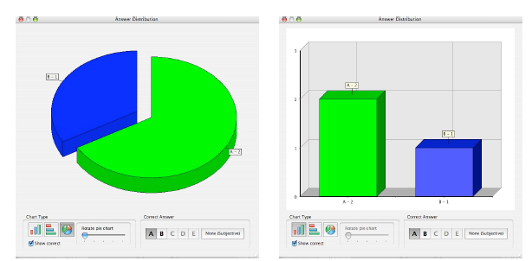


Increasing Student Engagement: Peer Instruction
Not familiar
Somewhat familiar
Watched it in action
Use it in my own classes

Slide 18
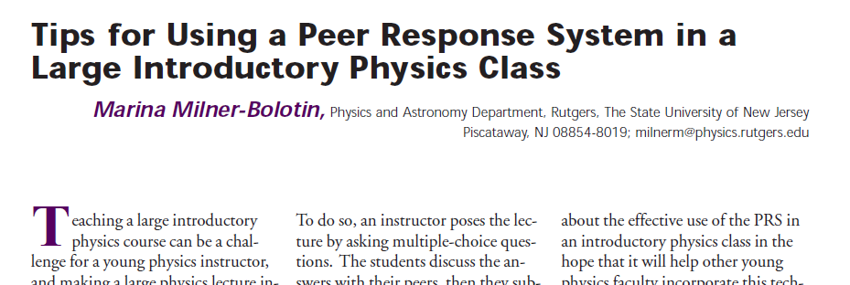
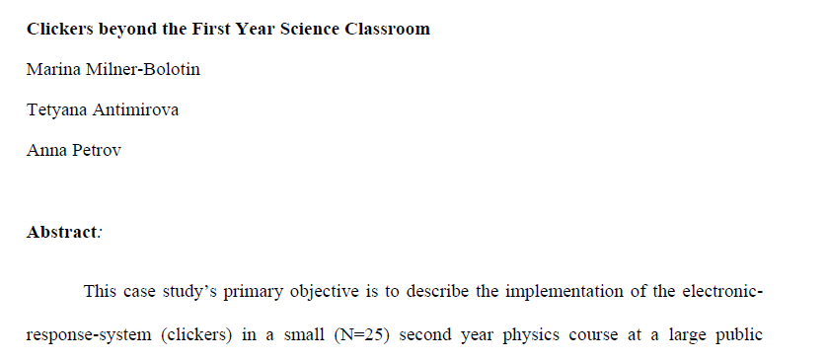
Peer Instruction & Active Learning
2004, The Physics Teacher, 42(8), 47-48.
Journal of College Science Teaching, Fall 2009
2010, Journal of College Science Teaching,
40(2), 18-22.
Notes:
Since today we will focus on clicker-enhanced pedagogy, I would like to say a few words about Eric Mazur, a physics professor at Harvard University, who more than 25 years ago proposed Peer Instruction pedagogy that takes advantage of clickers. In Peer Instruction, a teacher uses clickers to facilitate formative assessment. Peer Instructions relies on class activities that address student conceptual difficulties as they grapple with science concepts. Enacting Peer Instruction pedagogy in a science classroom, as I am sure you agree with me, requires much greater Pedagogical Technological Content Knowledge (TPCK) and flexibility from the teacher, than a traditional teacher-centered instruction. Let me give you an example.

Slide 19
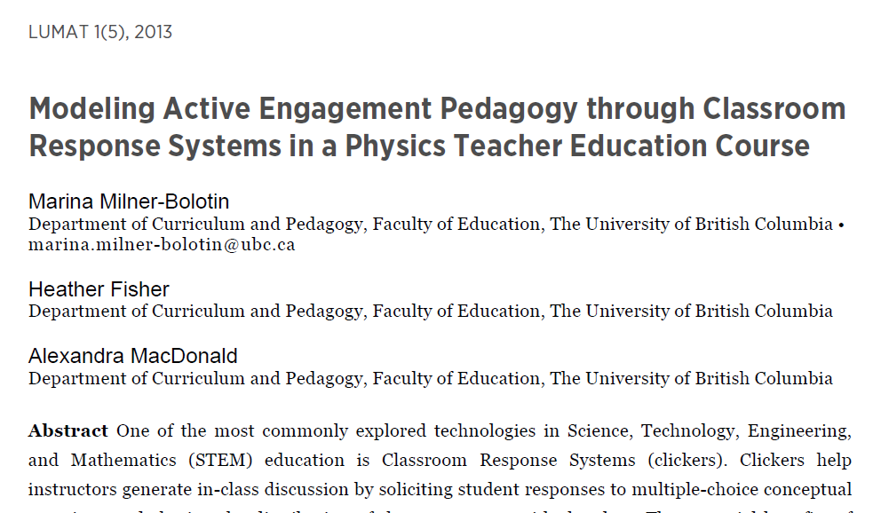
Peer Instruction Pedagogy
[LUMAT: Research and Practice in Math, Science & Technology Education, 2013. 1(5): p. 525-544.]
Notes:
We attempted to answer these questions in our recent paper titled Modeling Active Engagement Pedagogy though Classroom Response System in Physics Teacher Education Course, where Classroom Response Systems is an alternative name for clickers.

Slide 20
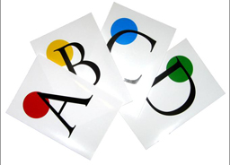
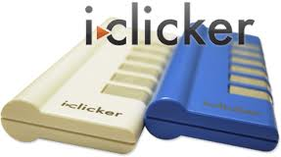
Clickers or Flashcards?
Electronic response systems (clickers) in K-12 classrooms…
[Lasry, N. (2008). Clickers or flashcards: Is there really a difference? The Physics Teacher, 46(5), 242-244. ]
Notes:
Because clickers provide an affordable and reliable way of:
a) Creating active learning environment in a classroom of any size and at any level – from intro to the upper level physics
b)Data collection about student learning to be used for improving teaching & doing educational research!
Since today we will focus on clicker-enhanced pedagogy, I would like to say a few words about Eric Mazur, a physics professor at Harvard University, who more than 25 years ago proposed Peer Instruction pedagogy that takes advantage of clickers. In Peer Instruction, a teacher uses clickers to facilitate formative assessment. Peer Instructions relies on class activities that address student conceptual difficulties as they grapple with science concepts. Enacting Peer Instruction pedagogy in a science classroom, as I am sure you agree with me, requires much greater Pedagogical Technological Content Knowledge (TPCK) and flexibility from the teacher, than a traditional teacher-centered instruction. Let me give you an example.

Slide 21
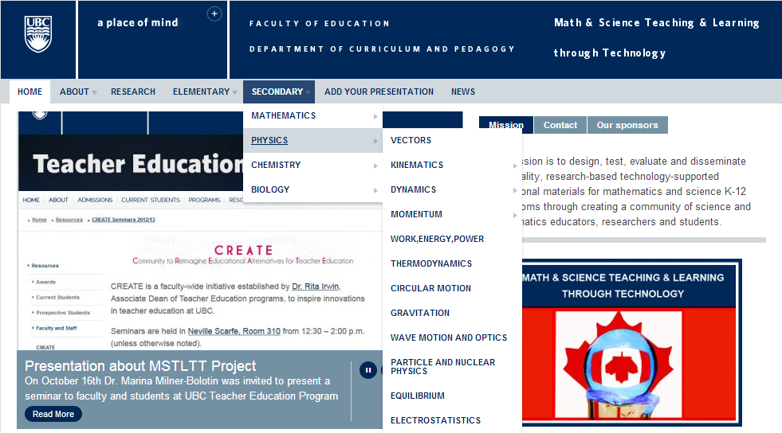

Math & Science Teaching & Learning through Technology
Notes:
This slide shows how our resource looks like. It is divided into primary and secondary, by subject area, and then by specific topics within each subject. These topics are determined largely by the British Columbia Ministry of Education and question sets in the database are developed to meet the Prescribed Learning Outcomes outlined in the Ministry documents.

Slide 22

Question Title
Blocks and a Pulley
Question Title
m₁
m₂
Notes:
Tags: physics, dynamics, mechanics, weight, gravity, acceleration, constant, velocity, weight, tension, friction
Subject: Physics
Topic: Dynamics – Newton’s second law
Grade Level: Senior High School
Difficulty Level: Medium - Hard
Required Mathematics: Conceptual and algebra
Other comments: Students must understand net forces, how pulleys work

Slide 23

Question Title
Blocks and a Pulley II
Question Title
Two blocks are connected via a pulley. The blocks are initially at rest as block m₁ is attached to a wall. If string A breaks, what will the accelerations of the blocks be? (Assume friction is very small and strings don’t stretch)
A
B
m₁
m₂
Why are the assumptions above important?
Notes:
Talking points:
Question development

Slide 24
Comments
Solution
Comments
Answer: E
Justification: None of the above answers is correct. Consider two blocks as one system: one can see that the system has a mass of (m₁+m₂), while the net force pulling the system down is m₁g. Therefore, applying Newton’s second law, one can see that the acceleration of the system must be less than g:
Some people think that the acceleration will be g. They forget that the system consists of two blocks (not just m₁) and the only pulling force is m₁g. Thus the system is NOT in a free fall. Compare this questions to the previous one to see the difference.
Notes:
What makes our resource different from many others is this component of the question set – having a justification for the correct and incorrect answers, to help students or teachers to understand the concept as well as the misconceptions surrounding a given question.

Slide 25
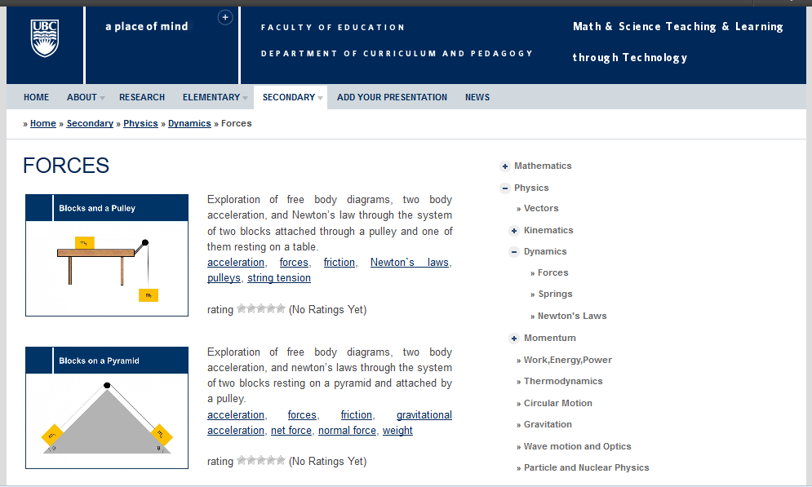
Navigating the Resource
Notes:
As you can see here, under a given category (here, Physics > Dynamics > Forces) there are a variety of questions (all the questions are included into a question set – a sequence of 5-15 questions), each with a brief summary and a list of tags describing the topics covered in that set. The image provides a glimpse into the situation/topic that question set will be covering. On the right, a user of the resource can navigate to the various areas of the resource quickly and conveniently. The resource is free and is open to anybody, teachers, students, teacher-candidates. Moreover, the users can rate the quality of the questions and leave their comments. Every question set is a PowerPoint slide, so teachers can download and edit them as they wish.

Slide 26
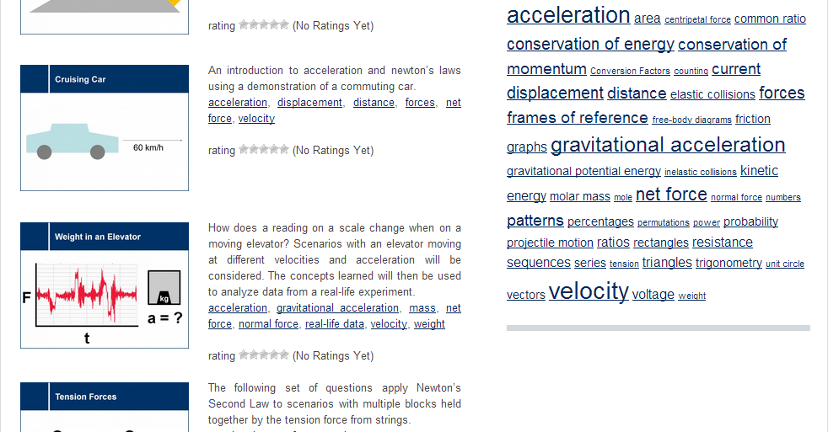
Navigating the Resource
http://scienceres-edcp-educ.sites.olt.ubc.ca/
Notes:
It is also possible to search the resource for a particular topic using the tags, listed on the right hand side of the page. For example, choosing acceleration will bring up a list of all question sets, from all areas, that touch on acceleration. This allows teachers and students to approach topics from different angles.

Slide 27
2.
Experiencing Peer Instruction
Now it is your turn to get engaged!

Slide 28
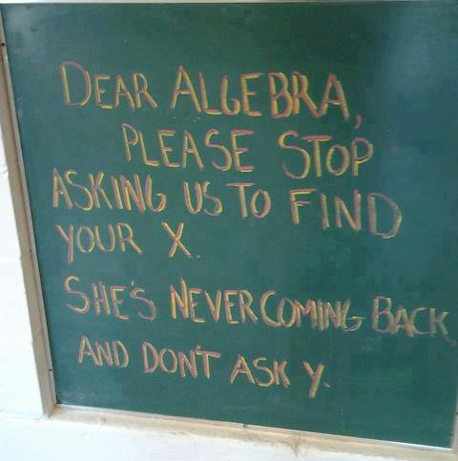
Algebra I
If m and p are positive integers and (m + p) x m is even, which of the following must be true?
If m is odd, then p is odd.
If m is odd, then p is even.
If m is even, then p is even.
If m is even, then p is odd.
m must be even.
Notes:
Answer = A
Re: conditional statements; c and d are not true because THEN means MUST

Slide 29
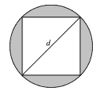
Algebra II
In the figure below, a square is inscribed in a circle with diameter d. What is the sum of the areas of the shaded regions, in terms of d ?
Notes:
Answer is A
More than one way to answer it – what ways are they?

Slide 30
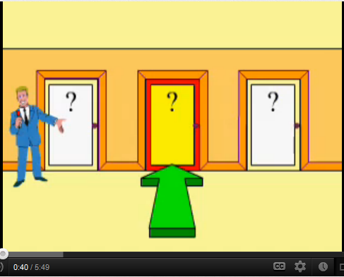
Let Us Make a Deal: Monty Hall Problem
Stick with the original choice
Swap doors
It doesn’t matter
Notes:
http://en.wikipedia.org/wiki/Monty_Hall

Slide 31
Science I: Playing with Buoyancy
A cup is filled to the brim with water and a floating ice. When the ice melts, the water level:
Decreases
Remains the same
Increases (the water spills over)
Notes:
The ice displaces the amount of water equal to its weight, however since the density of the pebble is higher than the density of water, the amount of displaced water to support the pebble is more than its volume. Therefore when the ice melts it all turns to water and occupies exactly the same volume which had been displaced before, which is not true for the pebble. It sinks, therefore it will occupy less volume and the water level will go down!

Slide 32
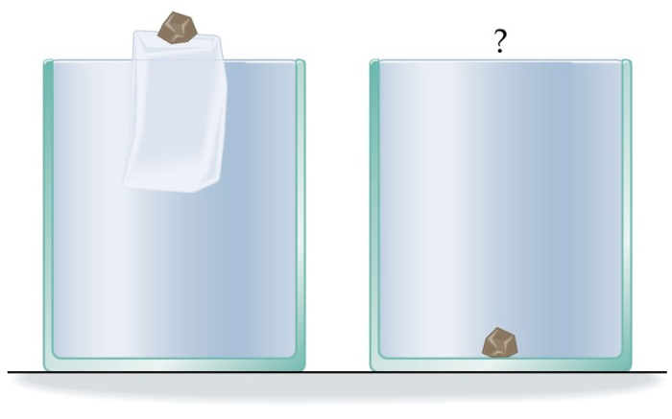
Science II: Playing with Buoyancy
A cup is filled to the brim with water and a floating ice. A small pebble is placed on the ice. When the ice melts, the water level:
Decreases
Remains the same
Increases (the water spills over)
Notes:
The ice displaces the amount of water equal to its weight, however since the density of the pebble is higher than the density of water, the amount of displaced water to support the pebble is more than its volume. Therefore when the ice melts it all turns to water and occupies exactly the same volume which had been displaced before, which is not true for the pebble. It sinks, therefore it will occupy less volume and the water level will go down!

Slide 33
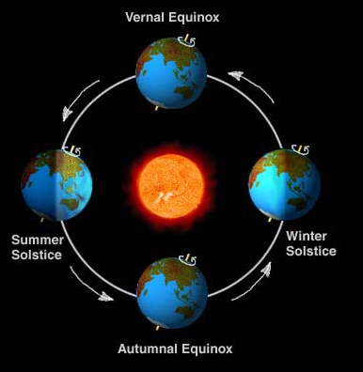
What Causes Seasons?
The tilt of the Earth
The Earth-Sun distance
The weather patterns
The position of Sun spots
All of the above

Slide 34
Why Does Tilt Cause Seasons?
Because one part of the Earth gets closer to the Sun
Because the tilt changes the amount of direct light
Because the tilt and the clouds produce cooler weather
Because the tilt makes another of the Earth to be farther away from the Sun
Because the tilt prevents the Earth from absorbing Sun’s Energy

Slide 35

Discussion
Which questions generated the most productive discussion? Why?
How do you think clickers supported/hindered problem solving? How did clickers affect class dynamics?
Were there multiple ways to solve the problems? How were multiple interpretations dealt with?
What level of understanding did each question address? How did you engage with each type of question?
What did the teacher do to support the students during the activity? What could have been done differently? Was everybody supported?

Slide 36
4.
What is Next?
If you would like to start using Peer Instruction with clickers or flashcards and to use the questions from our online resource and need help to get started, e-mail me: marina.milner-bolotin@ubc.ca
If you are interested in M.A., M.Ed. Or Ph.D. in Science Education at UBC, please let me know. I am looking for knowledgeable and motivated science teachers

Slide 37
Feedback from H.S.
It was really interesting because we had very good discussions as a group. For the question with the cannon ball being fired in the direction of the target but the target was dropped at the same time as being fired, it was a very unexpected result. Afterwards, it made sense after further discussion.
I liked these questions and would like to see more of these in class. Questions like these make you think and personally I can't understand physics without thinking about the principles I learn in class.
The questions challenged me and really made me think, it was more than just plugging in numbers.
The question with the free falling target was a very good question. It really got me thinking about it. It was confusing to begin with, but then when it was explained , it made more sense.
As a teacher I think MSTLTT is a very valuable resource because the questions are engaging, address common misconceptions, they can generate great class discussions promoting critical thinking and they motivate students to carry out further practical work to confirm predictions.

Slide 38
Your Feedback
Excellent, very useful
Good, useful
Neutral, somewhat useful
Bad, not very useful
Horrible, I just wasted my time
If you would like to start using Peer Instruction or clickers and need help to get started, e-mail me: marina.milner-bolotin@ubc.ca

Slide 39
Additional Resources
Beatty, I., Gerace, W., Leonard, W., & Defresne, R. (2006). Designing Effective Questions for Classroom Response System Teaching. American Journal of Physics, 74(1), 31–39.
CWSEI Clicker Resource Guide: An Instructors Guide to the Effective Use of Personal Response Systems (Clickers) in Teaching. (2009, June 1).
Lasry, Nathaniel. (2008). Clickers or Flashcards: Is There Really a Difference? The Physics Teacher, 46(May), 242-244.
Milner-Bolotin, Marina. (2004). Tips for Using a Peer Response System in the Large Introductory Physics Classroom. The Physics Teacher, 42(8), 47-48.
Mishra, P., & Koehler, M. J. (2007). Technological pedagogical content knowledge (TPCK): Confronting the wicked problems of teaching with technology. In Society for Information Technology & Teacher Education International Conference (Vol. 2007, pp. 2214–2226). Retrieved from http://www.editlib.org/p/24919/
Milner-Bolotin, Marina, Fisher, Heather, & MacDonald, Alexandra. (2013). Modeling active engagement pedagogy through classroom response systems in a physics teacher education course. LUMAT: Research and Practice in Math, Science and Technology Education, 1(5), 525-544

