Slide 1
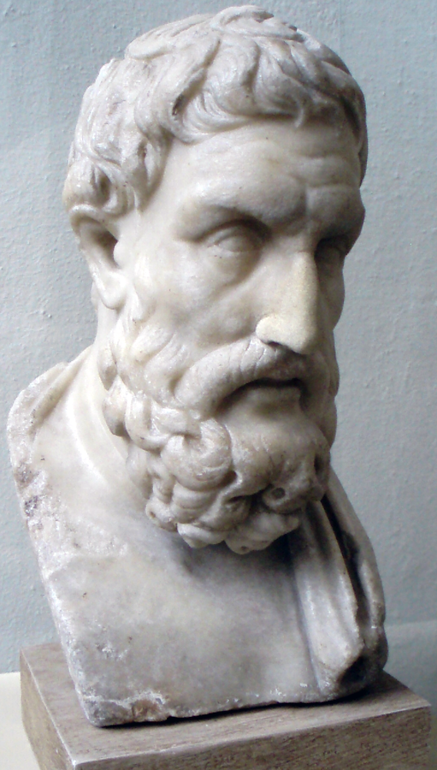
Epicurus & Cicero
PHIL 102, UBC
Christina Hendricks
Spring 2018
Bust of Epicurus from the Pergamon Museum, Berlin, uploaded to Wikimedia Commons by Captmondo, licensed CC BY-SA 3.0
Except images licensed otherwise, this presentation
is licensed CC BY 4.0

Slide 2
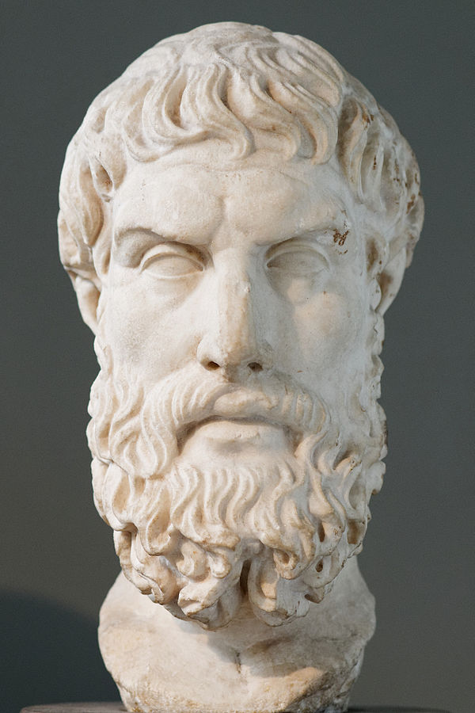
Timeline
Socrates: 469-399 BCE
Plato: 427-348 BCE
Epicurus: 341-271 BCE
Cicero: c. 106-43BCE (Roman)
Roman copy of a bust of Epicurus, after a lost Greek original, Wikimedia Commons, public domain

Slide 3
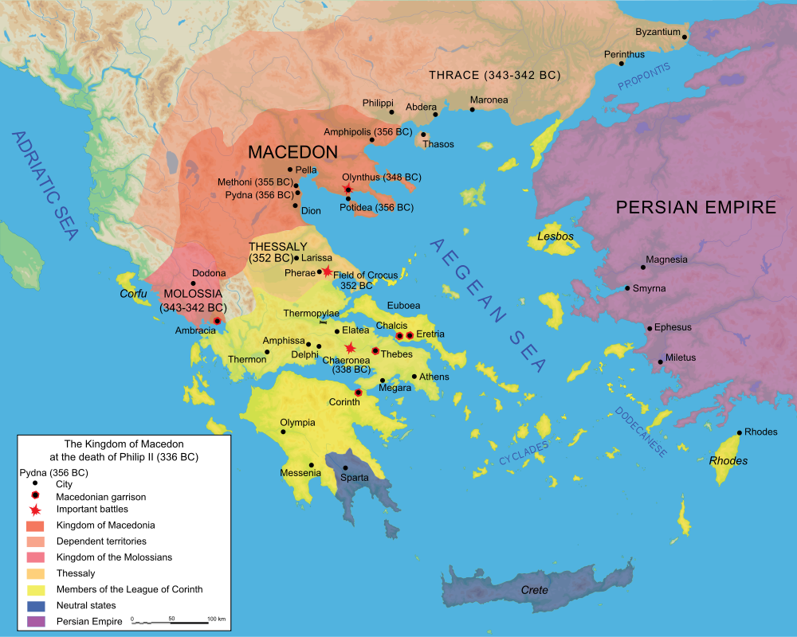
Macedonia & Greece, 336 BCE
Much of Greece conquered by Philip of Macedon (Father of Alexander the Great)
Map of Macedonia, Wikimedia Commons, licensed CC BY SA 2.5

Slide 4
Alexander the Great’s empire, 334-323 BCE
Macedon Empire, Wikimedia Commons, licensed CC BY SA 3.0

Slide 5
Texts we’re reading
Epicurus: “Letter to Menoeceus”: a letter by Epicurus to someone named Menoeceus, telling him how to live a good life
Epicurus: “Principal Doctrines”: a list of short sayings by Epicurus, designed to be easily remembered and put into practice
Cicero: Selections from De Finibus Book 1: a dialogue that includes multiple philosophical views prevalent in Rome at the time

Slide 6
Epicurus: epistemology
Epicurus is an empiricist
the original source of information for knowledge is experience
Either from sensation of things outside of us or experience of our own thoughts & feelings
Icons by stephanie kadam, from Noun Project, licensed CC BY 3.0

Slide 7
Epicurus: Physics
Argument: why, for Epicurus,
the universe is made up only of matter and void (emptiness)
matter is made up of smallest particles called “atoms”
This argument will be on the document camera on screen in class next week

Slide 8
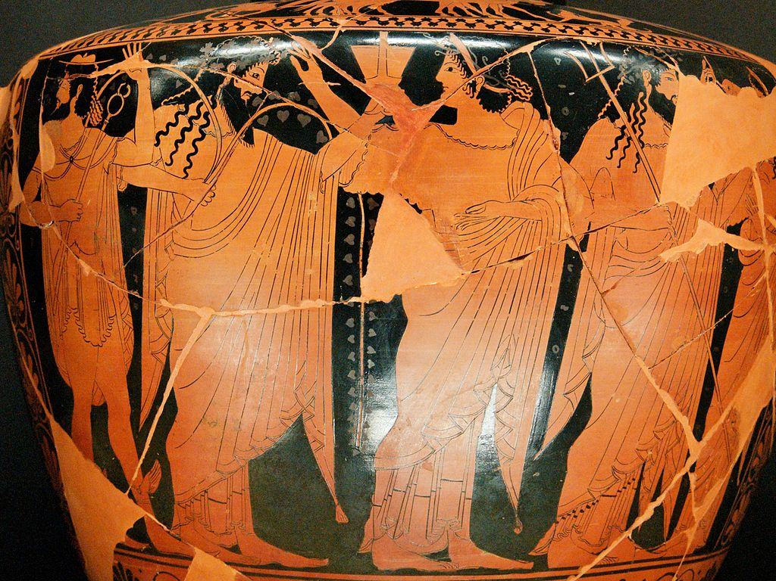
Gods & the soul
The gods do not control the universe; it works on its own through principles of physics
There is no such thing as an immaterial, immortal soul
The soul is made of matter: atoms
Soul & body bound together; soul cannot operate outside body
Hermes, Dionysos, Ariadne & Poseidon, in the Louvre, from Wikimedia Commons,
Public Domain

Slide 9
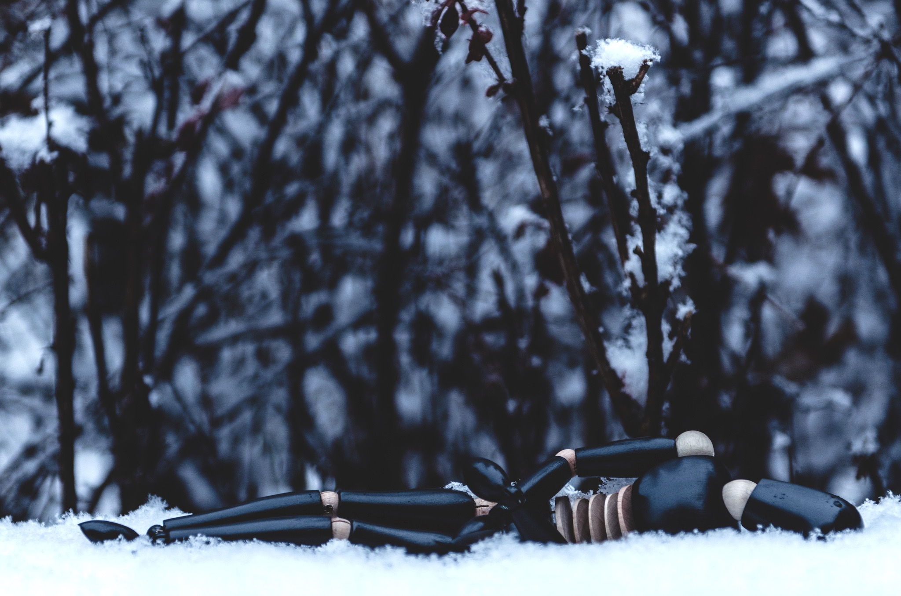
Epicurus on death
Outline Epicurus’ argument in Letter to Menoeceus, first paragraph under “Don’t fear death”
Discuss the strength/weakness of this argument in discussion classes this week.
With winter comes death, Flickr photo by Keith Trice, licensed CC BY 2.0

Slide 10
Evaluating arguments
Questions to ask:
Are the premises true?
If the premises are true, does the conclusion follow with certainty or with high probability?
Deductive arguments: aim to show that if the premises are true, the conclusion must be true
Inductive arguments: aim to show that if the premises are true, the conclusion is highly probable

Slide 11
Why need knowledge of epistemology, physics, gods?
To live the best life possible
Best human life has the “highest good”:
ultimate end/goal of all action
that which is only ever sought as an intrinsic good, not as an instrumental good

Slide 12
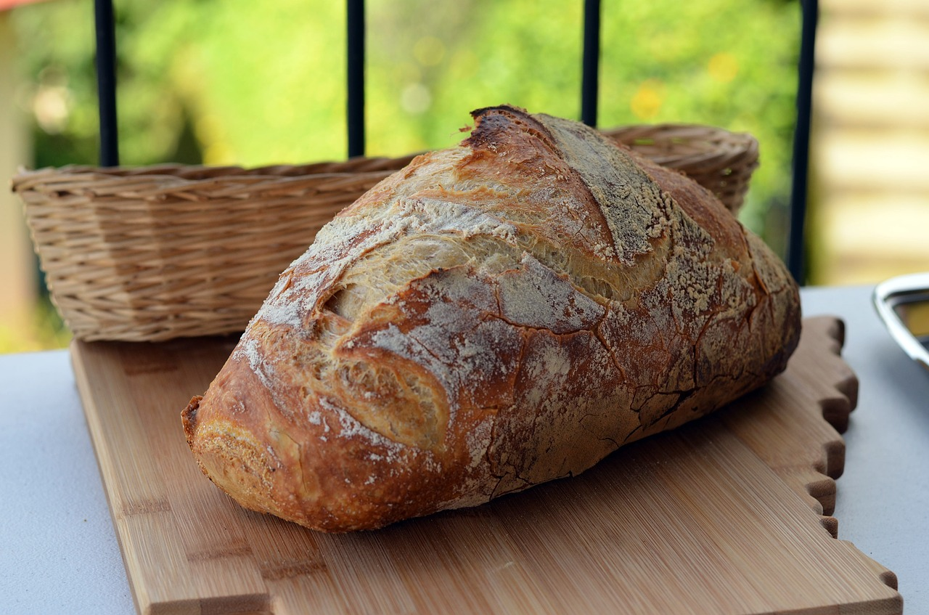
The highest good
For Epicurus, the highest good is pleasure (“Letter to M” p. 2; Cicero p. 1, 3)
Can you think of anything else it might be?

Slide 13
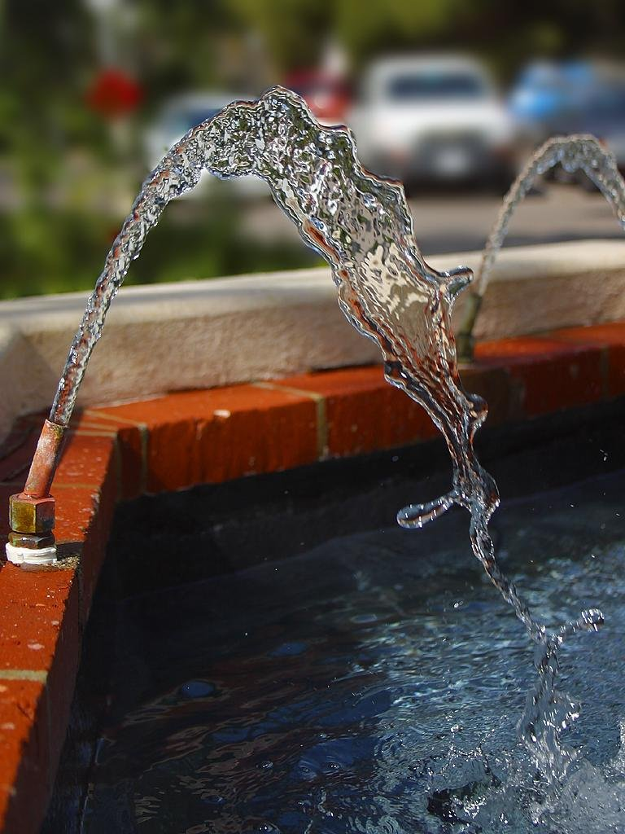
Different kinds of pleasure
Kinetic pleasure
pleasure gotten from fulfilling desires (Cicero p. 2)
Problems with this? (Why wouldn’t it be the best pleasure?)
Static pleasure
Pleasure felt when you don’t have unfulfilled desires, when you have well being, lack of pain (“Ltr to M,” p. 2; Cicero p. 2)

Slide 14
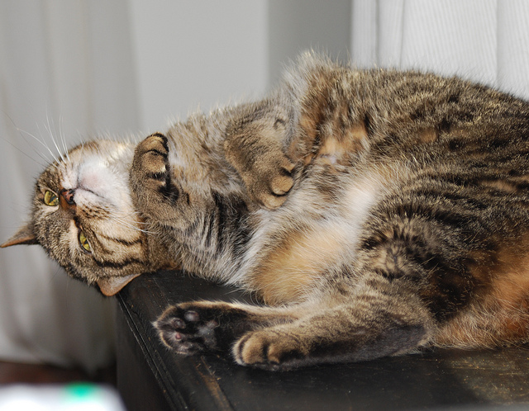
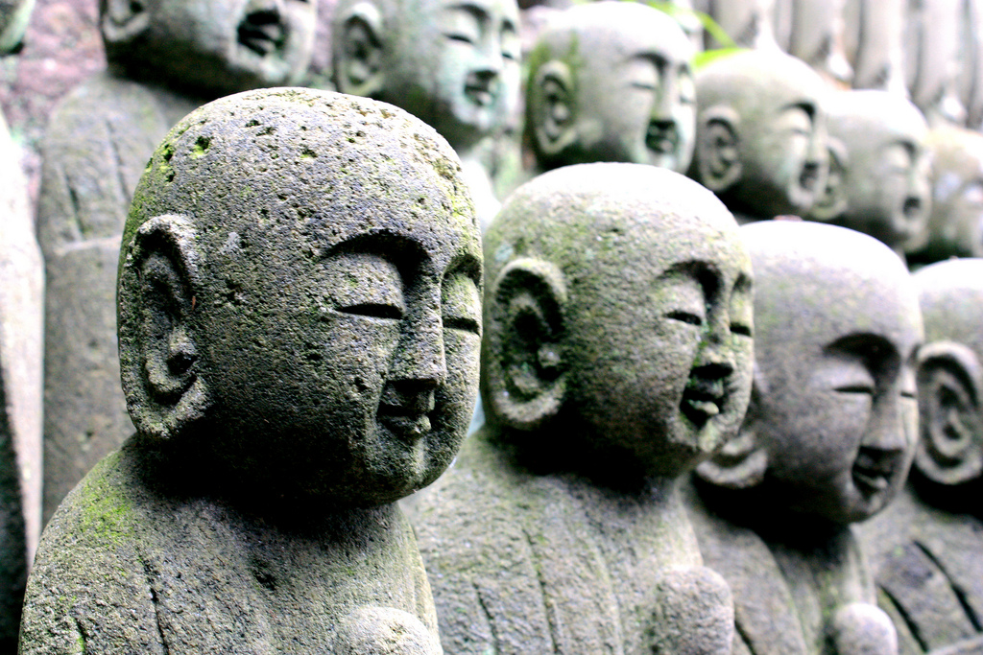
Goal of life: Ataraxia
having a life with a good deal of static pleasure
lack of physical or mental pain, not having unfulfilled desires, sense of peace and tranquility (“Letter to M,” p. 2)
Tabitha the Tabby, Flickr photo shared by Steve Johnson, licensed CC BY 2.0
Buddha statues at Hase-dera, Flickr photo by Andrea Schaffer, licensed CC BY 2.0

Slide 15
How to live the best life
Natural desires
Vain desires
come from “baseless opinion” (Pr Doct #29)
Necessary (Cicero 3-4)
Unnecessary
Always unnecessary; e.g., power, wealth, fame, immortality
Bring pain if not fulfilled; necessary for happiness, health or life itself (Ltr M p. 2); e.g., food, shelter, rest, friendship
Need not bring pain if not fulfilled; can get rid of desire fairly easily (Pr Doct #26, 30); e.g., luxurious food & clothing, (sometimes) sex

Slide 16
Friendship important for best life
Unspoken, Flickr photo by Marina del Castell, licensed CC BY 2.0
Principal Doctrines 27 & 28, Cicero p. 6-7
Why would friends be so important for pleasurable life?
If the highest good is pleasure for oneself, then one seeks friends for one’s own pleasure; can one really have good friendships then?

Slide 17
Virtues important for best life
Principal Doctrines 5, Letter to M p. 3
Cicero’s text: moral virtues include wisdom, temperance, courage, justice
Epicurus’ view of justice, Pr. Doctrines 31-38: mutual agreements not to cause or allow harm
Justice is what leads to the most pleasure in various times/places; may be same for all people, or not (there may not be universal rules of justice)

Slide 18
Virtues only good b/c ataraxia
Practicing the virtues is only instrumentally good: good because leads to something else that’s good (pleasure, ataraxia)
Being virtuous is not intrinsically good
How/why?
Good b/c leads to
Happy face icon by Milky-Digital innovation, from The Noun Project

