Slide 1
Mozi (“Master Mo”)
Philosophy 102, Jan. 2018
University of British Columbia, Vancouver
Christina Hendricks
Except images noted otherwise, this presentation is licensed CC-BY 4.0

Slide 2
Cyclical pattern of ruling dynasties
New dynasty
Ups & downs
Tyrant ruler
Rebellion
From Van Norden, Introduction to Classical Chinese Philosophy (2011), p. 5

Slide 3
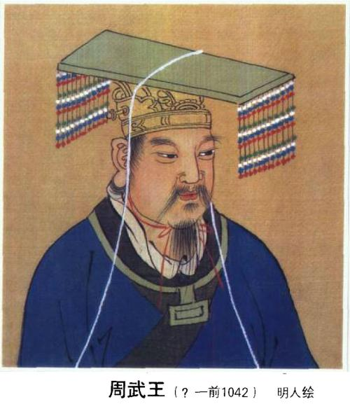
Sage Kings (p. 72)
King Yu: founded Xia dynasty
Evil Tyrant Jie overthrown by Tang
King Tang: founded Shang dynasty
Tyrant Zhou overthrown
King Wen recognized as better ruler than Zhou but didn’t rebel; his son Wu did (~1040 BCE)
Kings Wen & Wu: founded Zhou dynasty
Continues until about 221 BCE
King Wu of Zhou dynasty, public domain on Wikimedia Commons
From Van Norden, Introduction to Classical Chinese Philosophy (2011), pp. 4-10

Slide 4
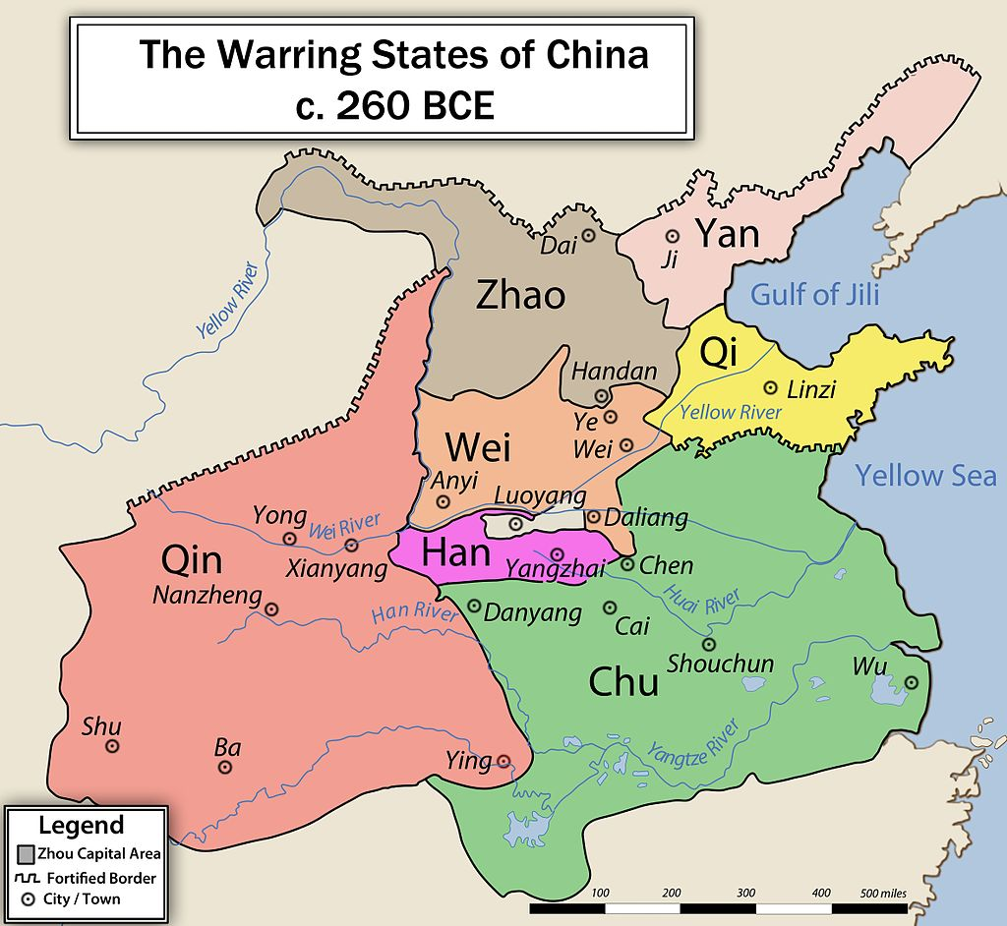
Warring States Period
China blank map by Alan Mak,
Licensed CC BY-SA 3.0
Warring states map by Philg88, licensed CC BY-SA 3.0

Slide 5
Mozi’s timeline
427-348
Plato
Epicurus
Kongzi
Socrates
551-479
469-399
341-271
Mozi: between 479 & 390?

Slide 6
This text, & connection to course
Authorship?
Dry, logical style
Will connect Mozi to Mill and Singer
Mind map from syllabus page of course website

Slide 7
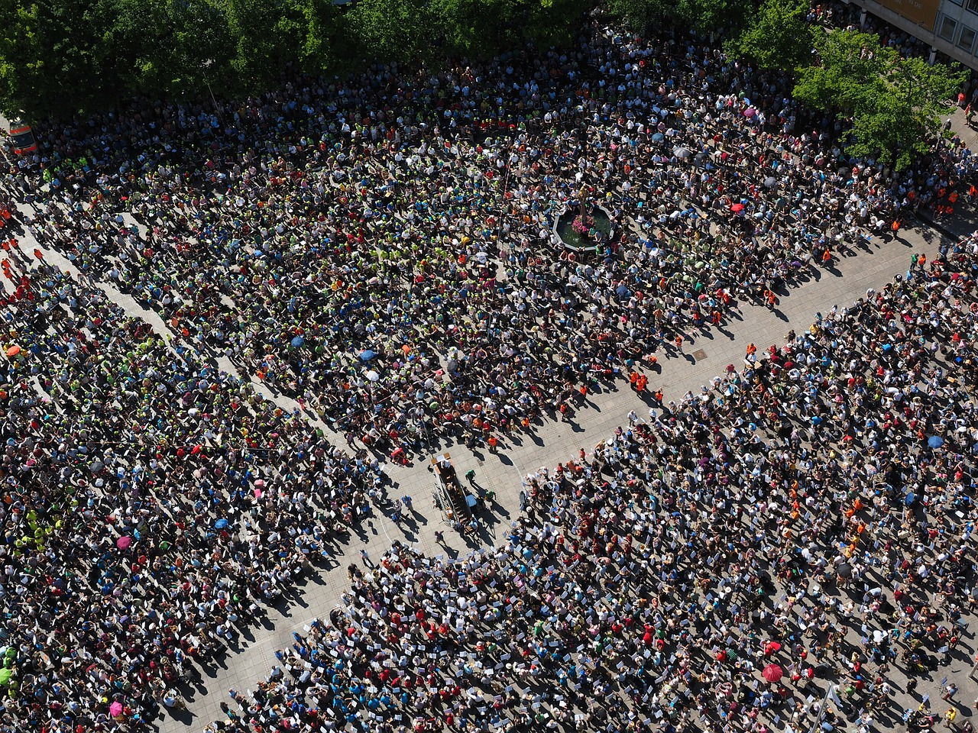
What’s needed for human welfare in a state
But what about chpt. 20?
Some degree of material wealth
Large population or family
Social order
Houses image and crowd image licensed CC0 on pixabay.com; bird icon purchased from thenounproject.com

Slide 8
Impartial caring
What do you get from the text about what it means to “replace partiality with impartiality” and engage in impartial caring (68)?
What examples does the text (or could you) give to explain what this looks like?

Slide 9
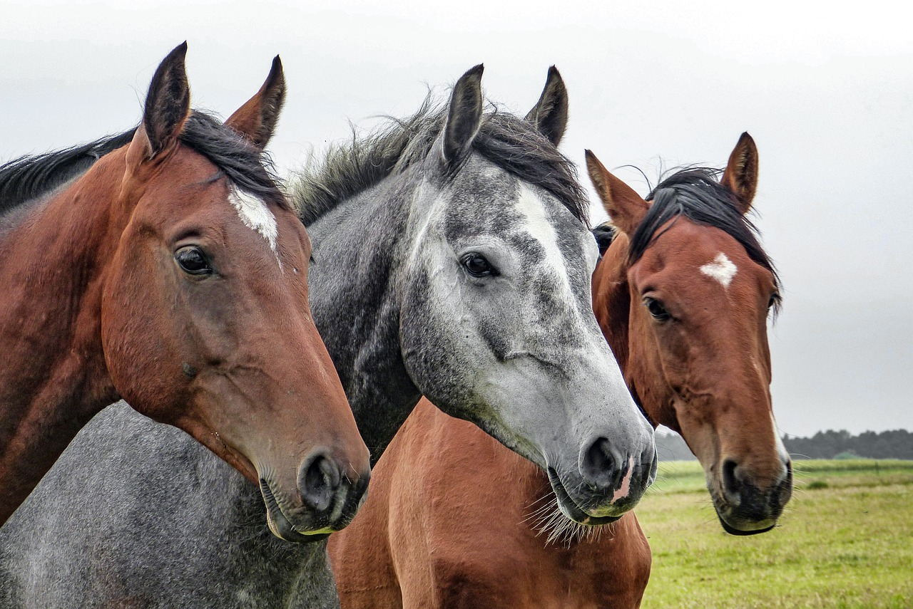
Meaning of words: jian ai
jian: impartiality, treating people similarly
ai: taking care of someone
you can “ai” pets or livestock as well as people
Not about how you feel but what you do
Horses image licensed CC0
on pixabay.com

Slide 10
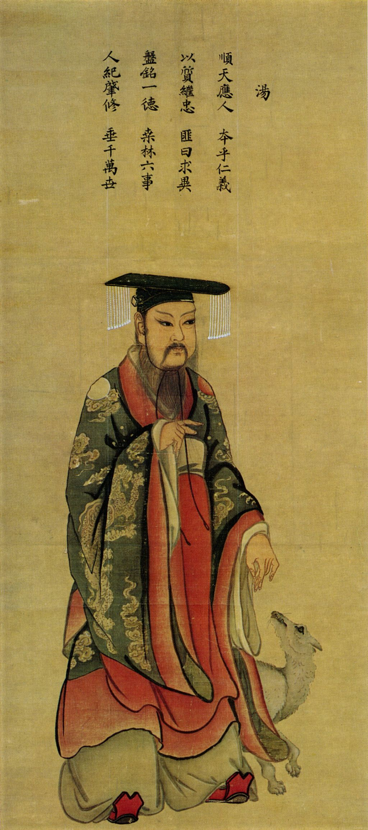
Examples & Your View
Rulers and subjects
Charity, helping others in need (including elderly, children)
Don’t engage in aggressive war
Your view of these points? (LC)
King Tang of Shang, public domain on Wikimedia Commons

Slide 11
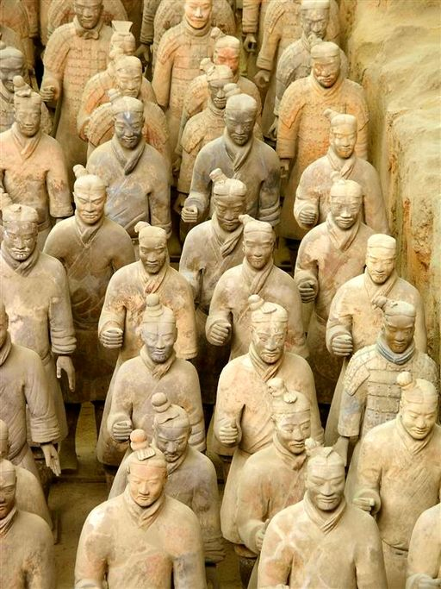
Why should we act this way?
Good consequences (68-69): wealth/material goods, population, social order
Thought experiments (70-71) show we already desire it
It is the will of Heaven
Terracotta Army by Tor Svensson,
licensed CC BY-SA 3.0 on Wikimedia Commons

Slide 12
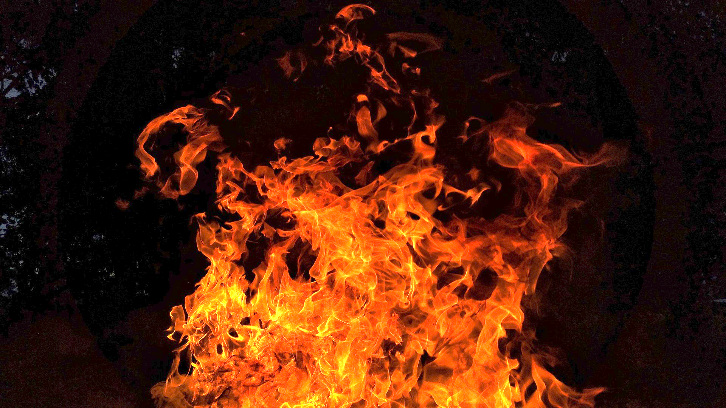
Is impartial caring even possible?
Examples of sage-kings shows it’s possible
If some think it’s too hard…people have been brought to do much harder things
Fire image licensed CC0
on pixabay.com
Walking into fire, p. 75-76

Slide 13
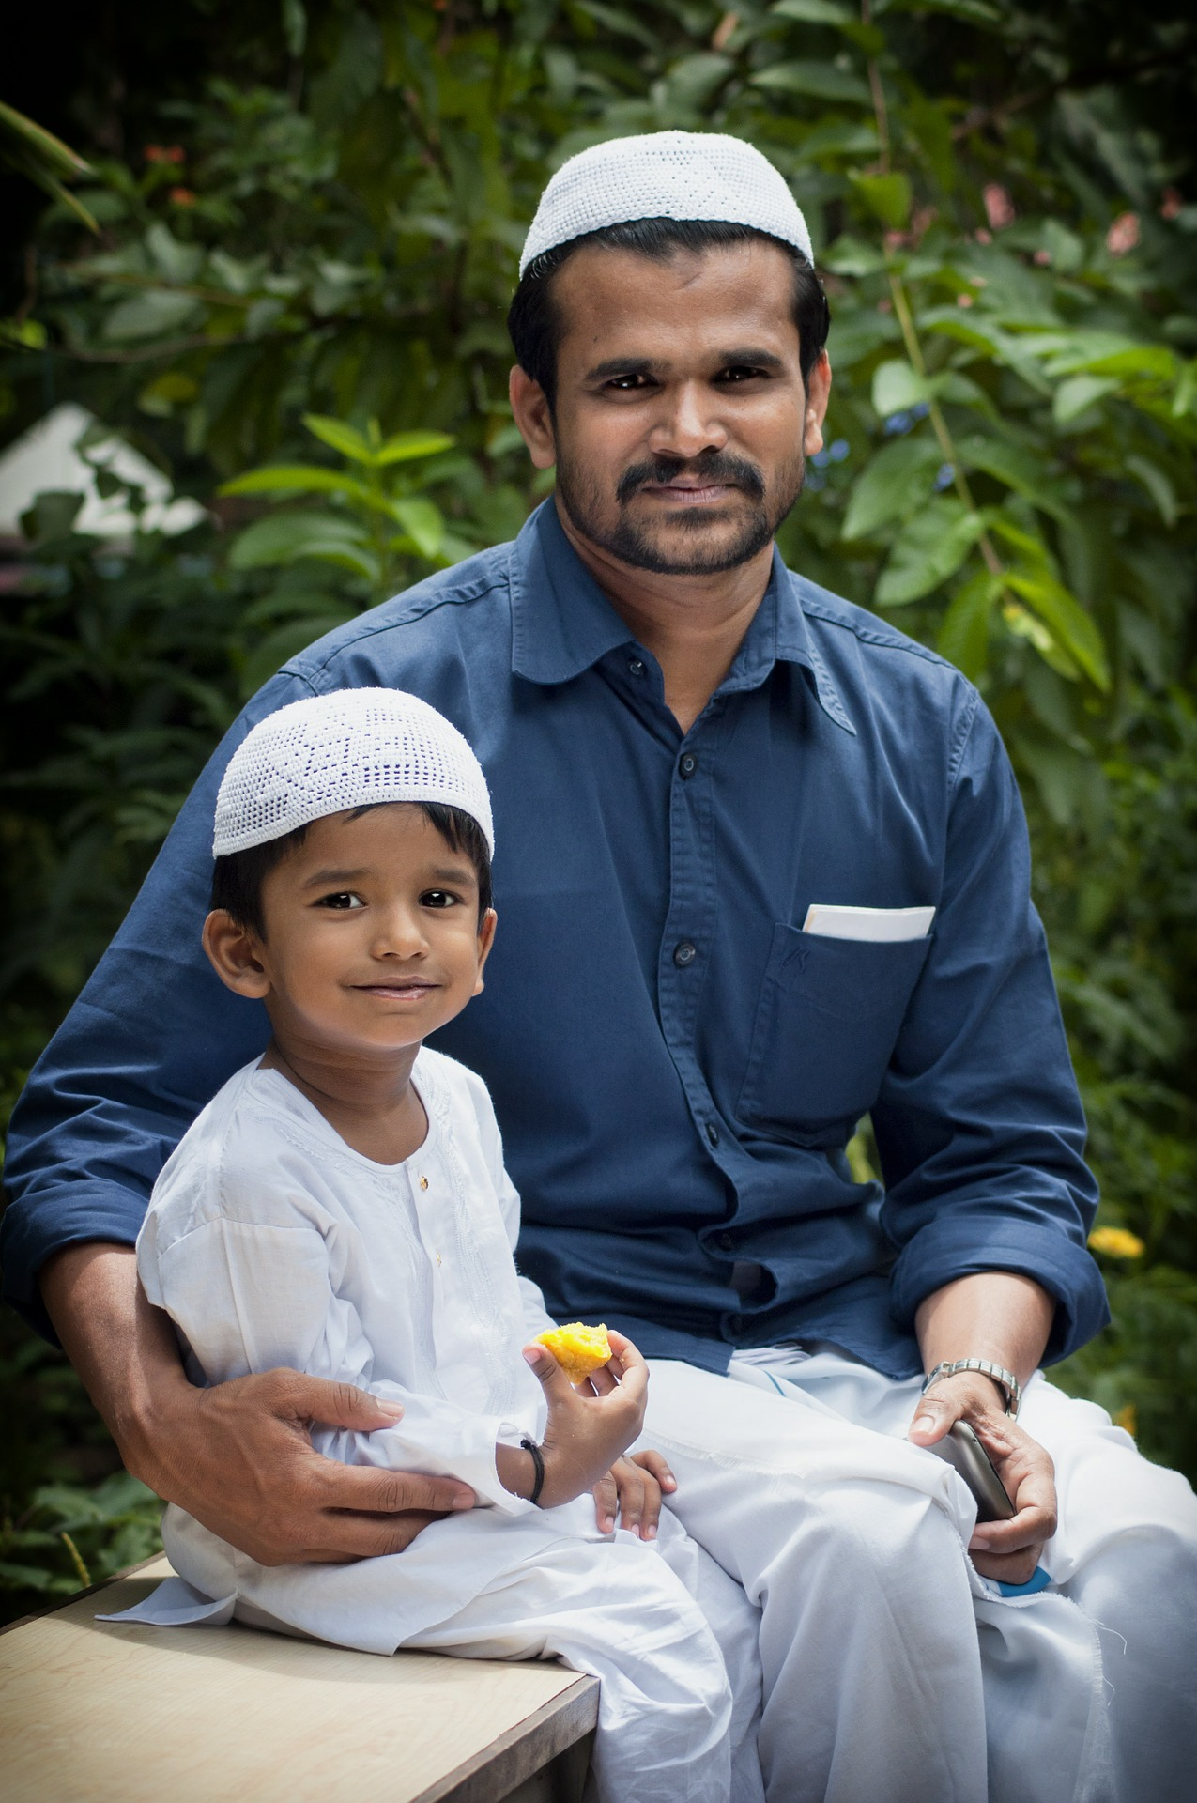
What about filial piety?
Doesn’t impartial caring mean we don’t care as much for our own parents & grandparents?
Social order requires we fulfill our familial roles.
Father & child, licensed CC0 on pixabay.com

Slide 14
Summary
We should engage in impartial caring in order to achieve the three main things needed for human welfare in a society.
This means:
No aggressive war
Being frugal in order to not waste resources & ensure enough for all

