Slide 1
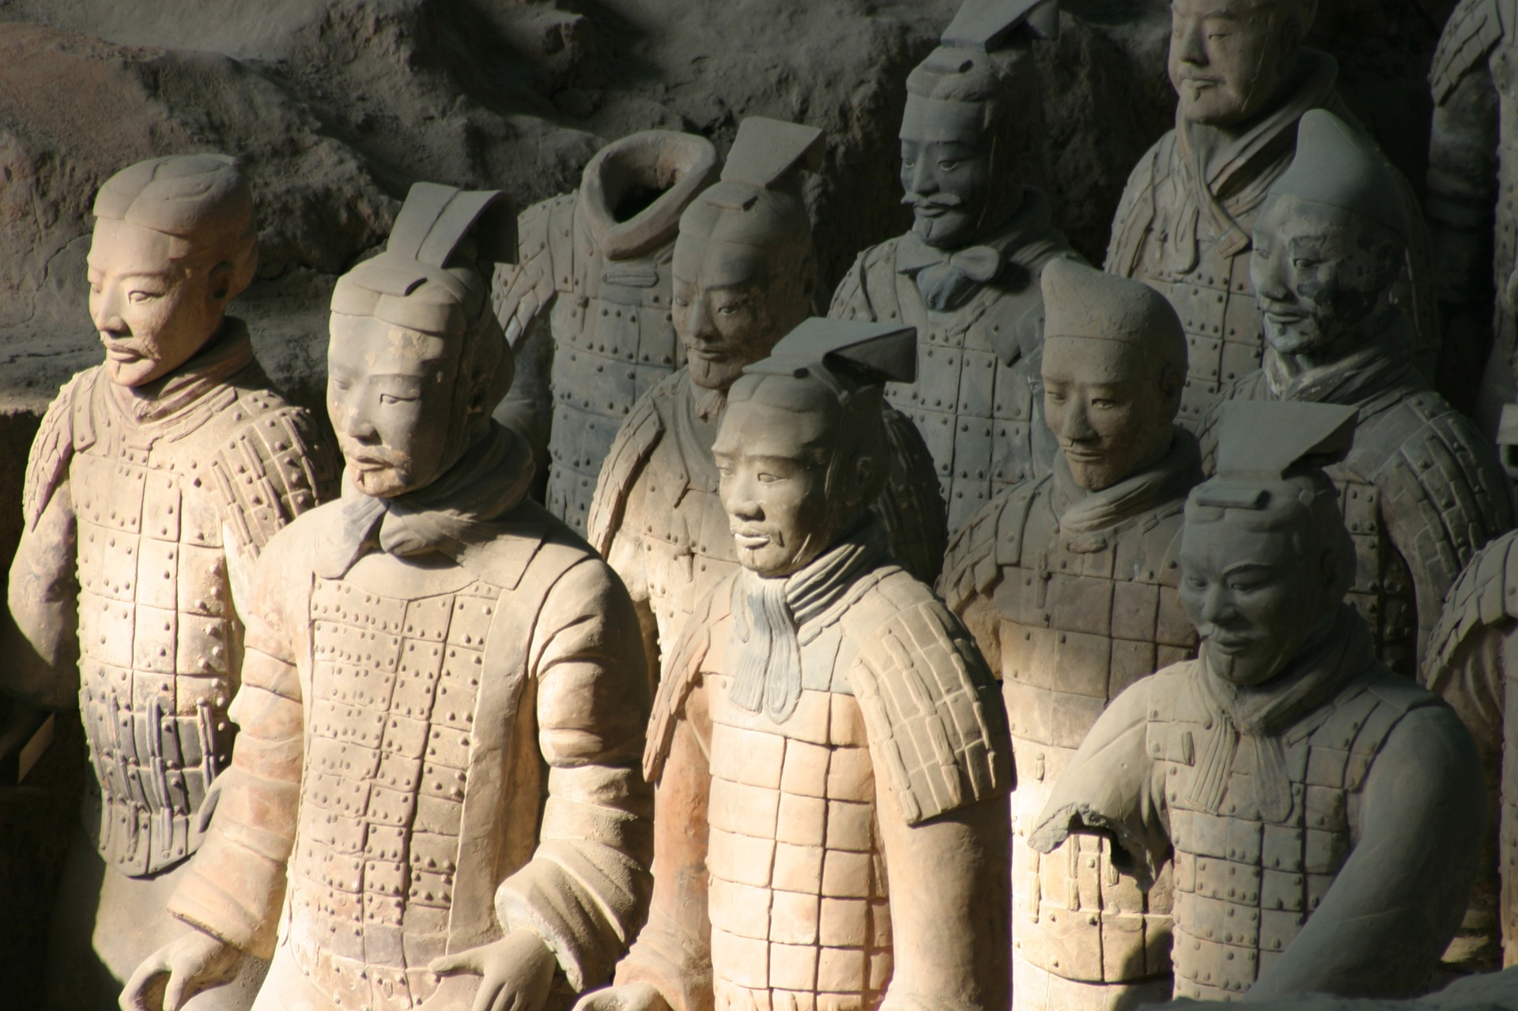
Thomas Nagel, “Death” (1979)
PHIL 102, January 2018, UBC
Christina Hendricks
Except images noted otherwise, this presentation is licensed CC-BY 4.0

Slide 2
If there is nothing after death, is death still a bad thing for the person who dies?
Isn’t it obvious that it is? Why even ask the question?
Blank picture frames image licensed CC0 on pixabay.com

Slide 3
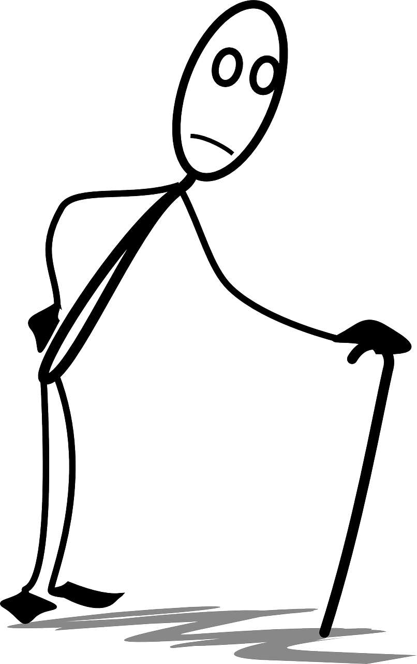
Epicurus’ view
Death can only be bad for a person if they can experience it as bad.
Nagel disagrees
BAD for that person
Stick figure licensed CC0 on pixabay.com

Slide 4
Reading philosophy articles
Skim or read whole article (or part of a text) and find overall point (conclusion / thesis statement)
Look for premises: reasons supporting thesis
Outline the argument
Paper icon purchased from
thenounproject.com

Slide 5
Structure of Nagel’s article
Intro to the overall question (p. 1)
Specific ways he’ll address it (pp. 2-3)
Hypothesis (top of p. 4): death is bad b/c it’s a loss of something good (life)
Objections to the hypothesis (4), & responses to those (pp. 4-8)
Last question: is it death always bad for a person (e.g., even when live to natural end of human life)?

Slide 6
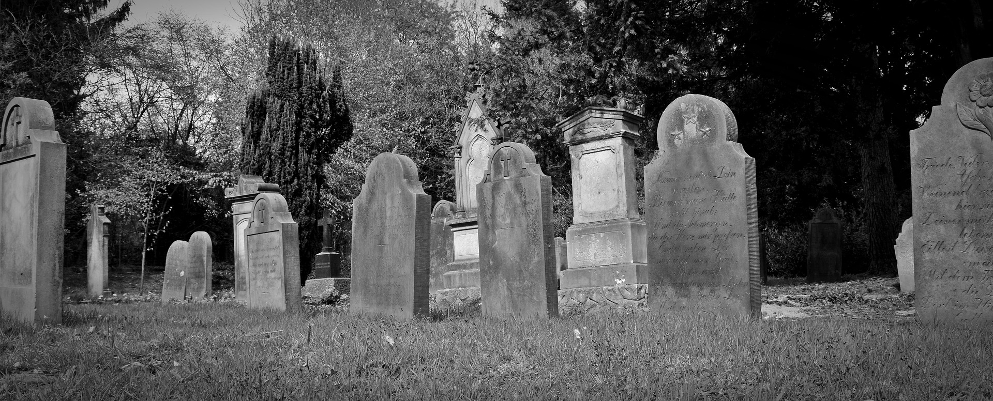
Nagel’s argument
Conclusion: Death is bad for the person who dies, because it’s a loss of something good (life)
Outline of this argument on document camera
Gravestones image licensed CC0 from pixabay.com

Slide 7
One of the objections he replies to
Obj: How can we assign a ”loss” of life to a person who is dead? Who is it that “loses”? (4)
Reply: “what happens to [a person] can include much that does not take place within the boundaries of his life” (6)
After death:
Broken deathbed promise
Stick figure licensed CC0 on pixabay.com

Slide 8
Another reply to that objection
We can think of persons as extended in time: a combination of their history, their present state, and their future possibilities
Including the possibilities they could have had if hadn’t died when they did
Icon by Harold Weaver, from the Noun Project

Slide 9
Another objection
Obj: If death is bad for the person who dies, then why isn’t the time before birth also bad for him/her? (7)
Person A
Born at
Time 1
Reply: If born earlier, wouldn’t be the same person, so couldn’t be bad for him/her. (8)
Born at Time 2
Can’t be Person A
Icon by Creative Stall, from The Noun Project

Slide 10
Last question in the article
Must we take the loss of life as always a bad thing, because a loss of future possibilities, since we are naturally mortal?
Reply: From perspective within our lives, it would be good to have more, even if we recognize (from outside) that we can’t; so loss is still bad to us.
…
Icon by Harold Weaver, from the Noun Project

Slide 11
Summary & link to Epicurus
Death is bad for the person who dies b/c it’s a loss to that person of future possibilities of a good thing (life).
Is bad for that person
Stick figure licensed CC0 on pixabay.com

Slide 12
Comments & questions on Nagel
https://is.gd/phil102nagel

