Slide 1
J.J. Thomson, “The Trolley Problem” (1985)
PHIL 102, UBC
Christina Hendricks
Spring 2018
Except images licensed otherwise, this presentation is licensed CC BY 4.0

Slide 2
Review a little from the first video
http://is.gd/TrolleyProblemVideos

Slide 3
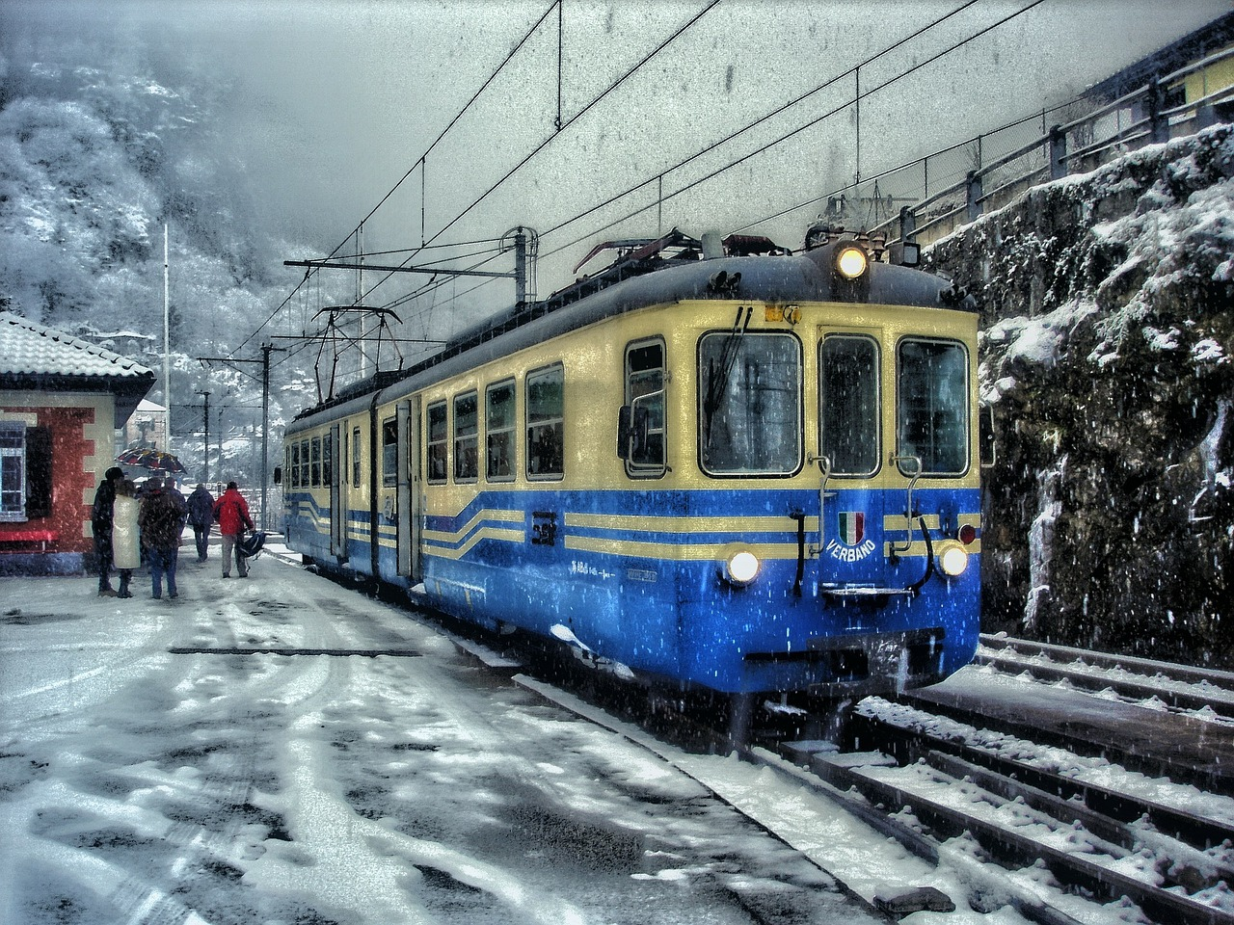
Trolley Driver
5
1

Slide 4
Transplant
Transplant

Slide 5
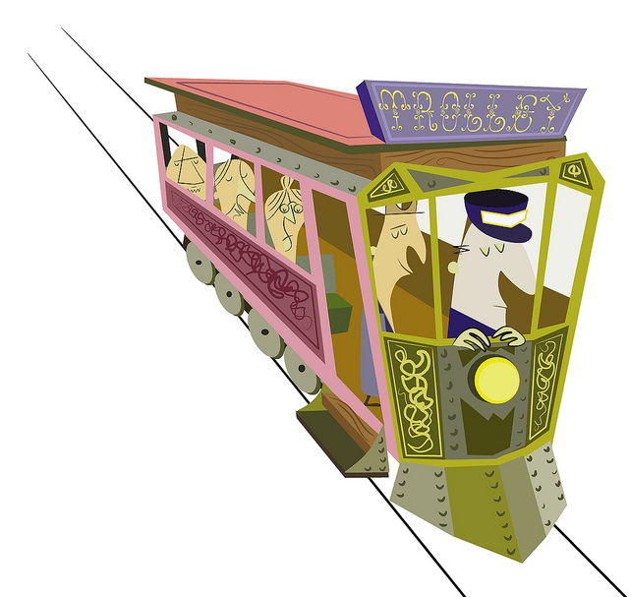
Philippa Foot’s view
Trolley Driver
Transplant
May turn trolley
Dr. must not transplant
WHY?
Trolley, Flickr photo shared by John Holbo, licensed CC BY-NC 2.0

Slide 6
Learning Catalytics on Foot’s view

Slide 7
Thomson’s response to Foot
Foot’s solution won’t work for a different case from “trolley driver”: “bystander at the switch”
This raises a question about Foot’s solution generally…

Slide 8
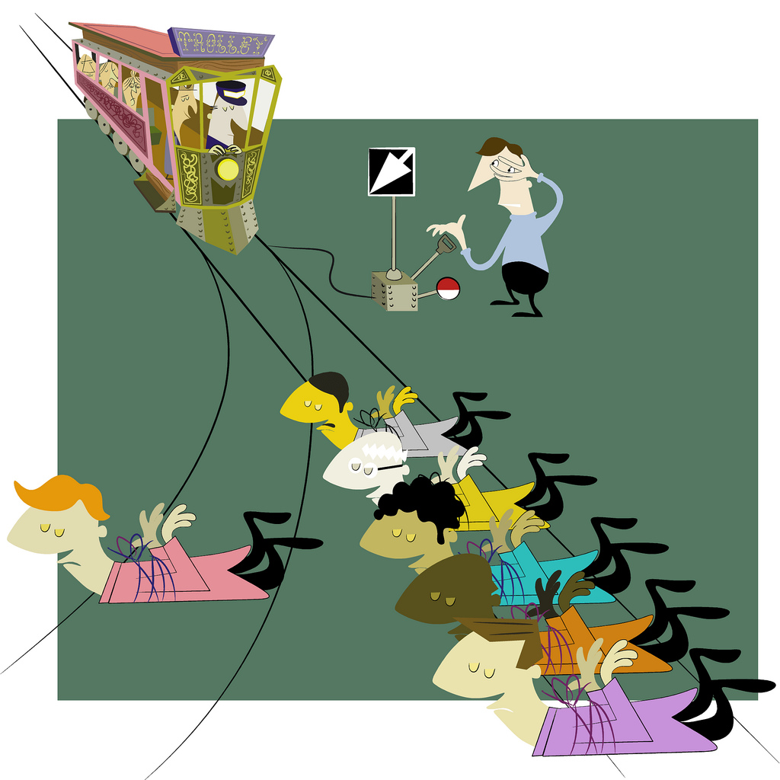
Bystander at the Switch
Permissible to flip the switch?
Basic Trolley Scenario, Flickr photo shared by John Holbo, licensed CC BY-NC 2.0

Slide 9
Thomson’s main question
Bystander at switch
Transplant
WHY?
Basic Trolley Scenario, Flickr photo shared by John Holbo, licensed CC BY-NC 2.0

Slide 10
Using people as means to ends?
Is the difference between transplant and bystander that the latter doesn’t use someone merely as a means to save others?
No: “loop” case

Slide 11
Can we appeal to rights?
“rights trump utilities” (1404)
Can we say, then, that (1404):
Surgeon cannot transplant b/c violates the right to life of patient, but
Bystander can flip switch b/c doing so doesn’t violate right to life of the one who is killed?
Then why can’t surgeon transplant?
Can still flip switch even if this violates right to life (1405-1406)

Slide 12
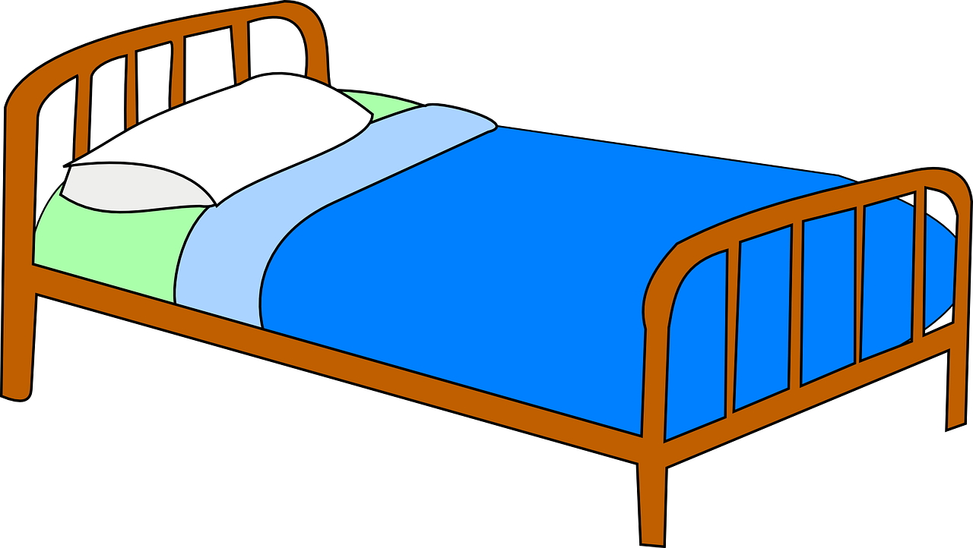
Thomson: how to distinguish bystander from transplant (not in videos)
Bystander: saves 5 by making something that threatens them, threaten 1 instead (1407)
Not true of transplant
Lethal gas in hospital case (1407-1408)

Slide 13
“Distributive Exemption”
“permits arranging that something that will do harm anyway shall be better distributed than it otherwise will be—shall … do harm to fewer rather than more” (1408).
Bystander may turn the trolley even though this might violate right to life of the one killed
We may deflect gas fumes in the hospital
The surgeon must not transplant

Slide 14
But…
Distributive exemption is only morally permissible if we can deflect a harm from many onto fewer “by means which do not themselves constitute infringements on the rights of the one” (1409)

Slide 15
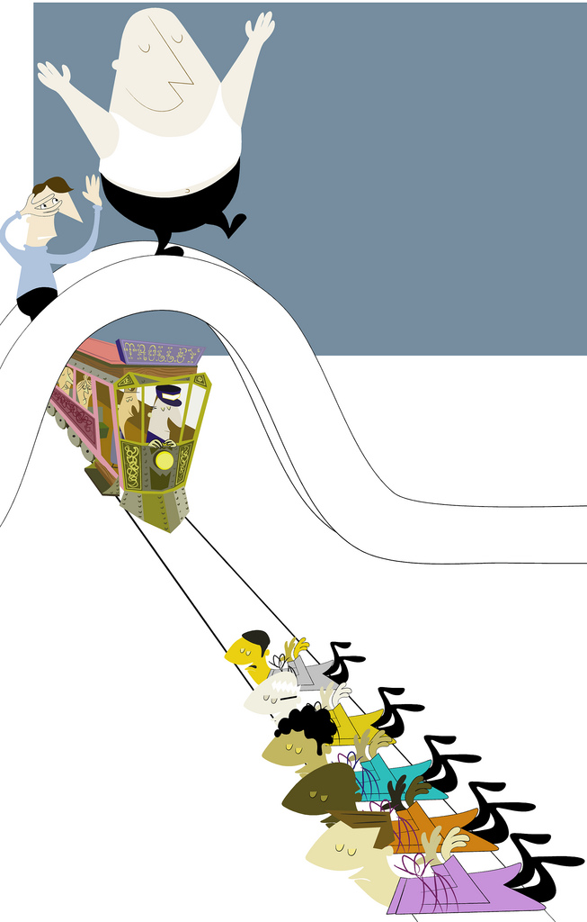
“Fat Man”
Bridge Situation, Flickr photo shared by John Holbo, licensed CC BY-NC 2.0
Basic Trolley Scenario, Flickr photo shared by John Holbo, licensed CC BY-NC 2.0

Slide 16
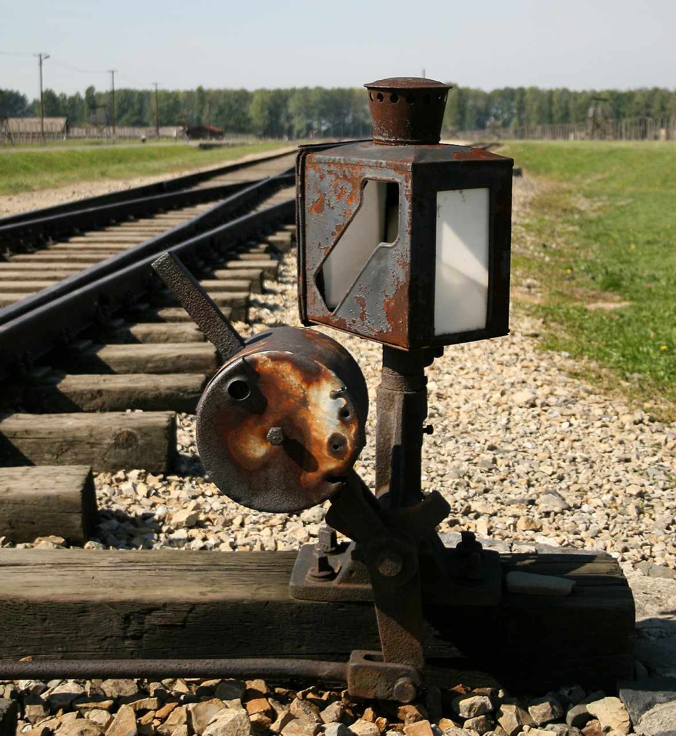
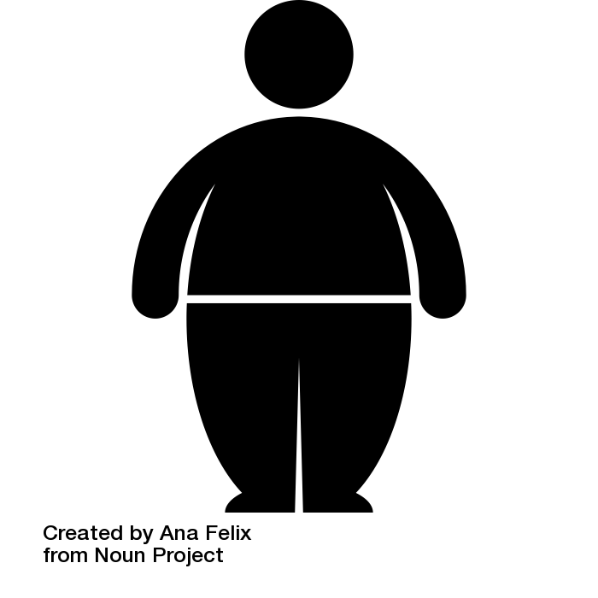
Summary & review
Why?

Slide 17
Connection to utilitarianism
Would a utilitarian say all of the following are permissible?
trolley driver
bystander at the switch
transplant
large person on bridge
If one thinks some/all of these are not permissible, then why (esp. if one is utilitarian)?

Slide 18
Why these weird scenarios?
What could be the point of unrealistic thought experiments like this?
In what ways might we apply some of the concerns in the trolley problem to real world moral issues?

Slide 19
Credits
Images not credited are licensed CC0 from pixabay.com, except:
Some trolley diagrams licensed CC0 from Wikimedia Commons

