Slide 1
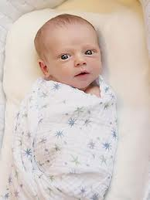
I’m literate in Babysitting Any Young Age Child

Slide 2
What is literacy ?
-Competence or knowledge in a specific area

Slide 3
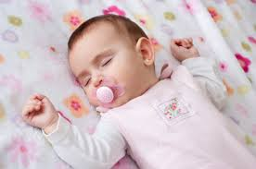
What Does It Mean To Be Literate In Babysitting?
-1% or powdered
If they drink milk or eat solid foods
Babies need to burp after finished they’re bottle
Baby has diaper rash you know while changing
Put baby to sleep around 7 or 8 o-clock
You need to know……..
- Type of milk they drink,
-Babies aged before 1 year can sleep when ever
-When the diapers need changing
-If they’re crying then they probably want more milk
-A toddler needs afternoon nap

Slide 4
Why I’m literate In Babysitting?
-I’ve been around kids all my life
-I have babysat every age before 1 year old
-I do it everyday after school until evening
-everyday I’m given a child and I take care of them
-I make more than 10 milks or the kids a day

Slide 5
How Can I Improve In Babysitting?
-Asking for extra work
-Working full time

Slide 6
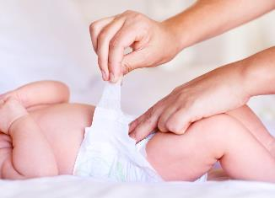
Who Taught Me?
My mom taught me
Use to watch what she did
She taught me how to change a diaper
How to make milk(powered)

Slide 7
What Motivated Me?
I motivated myself because, I didn’t have to do but it just felt good to help kids, and it made me feel more mature responsible and.

Slide 8
What else do you need to know about babysitting?
-what kind of powder milk
-how to change a diaper
-how to make milk
-if they have allergies
-what size diaper they are
-what they like
-you need to know the emergency phone numbers
-where the care cards are are
-what the care card numbers are
-just in case know where the insurance papers/card are unless they don’t have one
-Allergies medications
-medicine for when the child isn’t feeling well

Slide 9
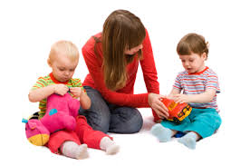
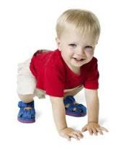
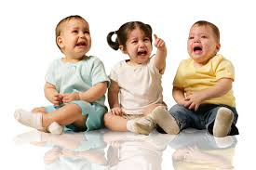
What Do They Call What I’m Literate At?
Babysitting !!!!!

Slide 10
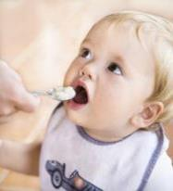
How To Teach Someone To Babysit?
-Feed baby breakfast
-Feed them milk
-Change diaper because they just ate a lot
-Carry baby if they’re crying
-Play with them
-If toddler let them walk around
-If crying put to sleep with milk
-if toddler at noon put them to sleep
-if awake feed them lunch
- Put to sleep at night

