Slide 1
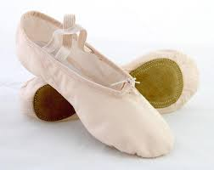
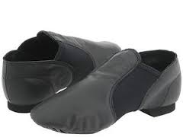
Dance

Slide 2
What is literacy?
Literacy is to be good or strong at something you care about and are interested/passionate in.

Slide 3
What is dance?
Dancing is a form of movement where you put a sequence of different steps together and move to the beat of the music. Certain types of dance are also ways to express your thoughts and feelings. (Lyrical, ballet, contemporary)

Slide 4
Why am I literate in dance?
What got me into dancing?
I have been taking dance since I was six years old
I know how to dance in many different types of dance, even if I’m not the best at it
I am motivated to learn more and become a better dancer learning from my mistakes
I know many different dance moves and techniques
I can catch on to quick choreography faster than most people
When I was younger, my mom took drop-in classes at my studio and I loved coming to watch. One day she brought me in to try a class and I caught on quickly and loved it. I continue to take dance because I am so used to going to the studio and I am passionate for it. I still take classes and still love dancing.

Slide 5
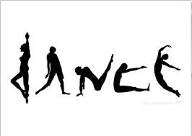
Learning to become a dancer☺
Learn the basics (How to keep rhythm and the beat to the music)
Dance steps are formed in counts of eight (1,2,3,4,5,6,7,8 (For anyone who doesn’t know how to count☺))
Finding the proper counts in the music to keep track of what you are doing
When you learn different moves, you have to practice to make it perfecto
HAVE FUN!
Dancing takes practice, patience, skill and motivation

Slide 6
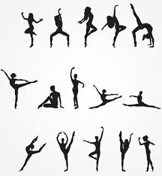
Different moves
Jazz: Jete, fouette, chasse, fan kick, hitch kick, straddle jump
Ballet: First, second, third, fourth, fifth position for feet and arms
Other: Splits, kicks, turns (pirouette, pique )
(FYI these are not mandatory for beginners… just for me)

Slide 7
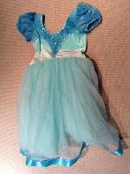
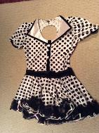
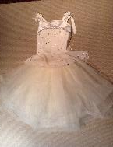
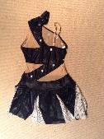
Photos yay

Slide 8
Thank you for watching!

