Slide 1
Golf

Slide 2
Literacy Definition
Literacy is… To not only have the ability to read and write, but rather in an individual’s capacity to put those skills to work in shaping the course of his or her own life.

Slide 3
What is golf
A game in which clubs with wooden or metal heads are used to hit a small, white ball into a number of holes in the ground

Slide 4
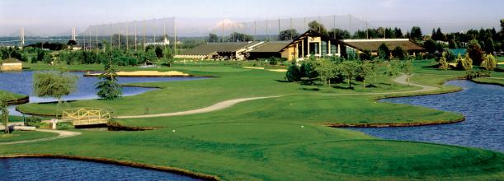
What got me into golf
Terms of golf
My Dad got my sisters to play when they were younger, now I’m into the sport. My dad took me to lessons at Mayfair Lakes when I was around the age of 4. My teacher was Mrs. K and two other teachers. I continued golf because I love the sport and being with my dad at the golf course.
There are certain terms for golf like…
Chipping
Putting
Birdy etc.

Slide 5
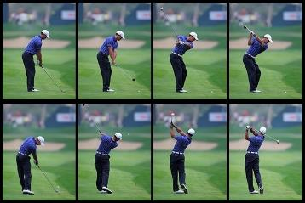
This is how I would teach golf
Hitting
The right stance
How to grip the club probably
How to swing the club probably
How to-do the finishing pose

Slide 6
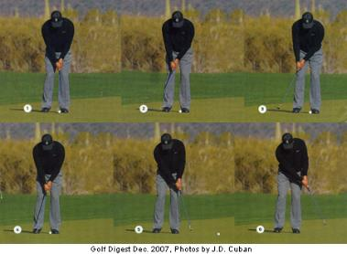
This is how I would teach golf
Putting
Steps one and two are the same as hitting. (stance and grip)
How to swing the putter

Slide 7
Thank you for watching!

