Slide 1
hockey

Slide 2
How I’m literate in hockey
I’m literate in hockey because I know the rules, I am good at playing the sport, I like to watch NHL all the time, I know most of the teams in the sport, and it is my favourite sport.

Slide 3
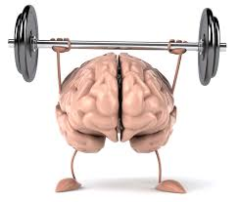
What is literacy
Literacy is to be good or knowledgeable about something.

Slide 4
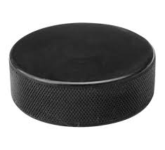
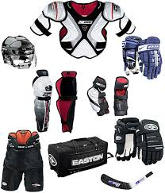
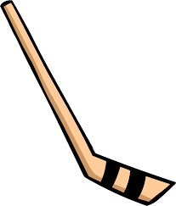
What I need to know for hockey
to know the rules : penalty rules, tripping, hooking, unsportsmanlike conduct
the equipment they need: helmet, gloves, stick, chest protector, elbow pads, pants, shin pads, skates
how they play their positions: center, left wing, right wing, left defense, right defense, goalie
have good teamwork
Have good skills: skating, shooting, passing, stopping,

Slide 5
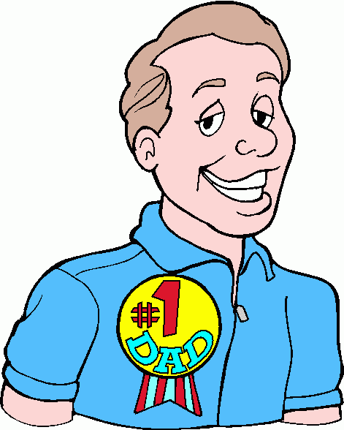
What inspired me
My dad taught me how to play when I was five years old. It was fun and interesting. We watched games together which inspired me. Vancouver Canucks used to be my favourite team but now it’s Detroit Redwings. I feel inspired when I watch the professional hockey teams because I can see how they play.

Slide 6
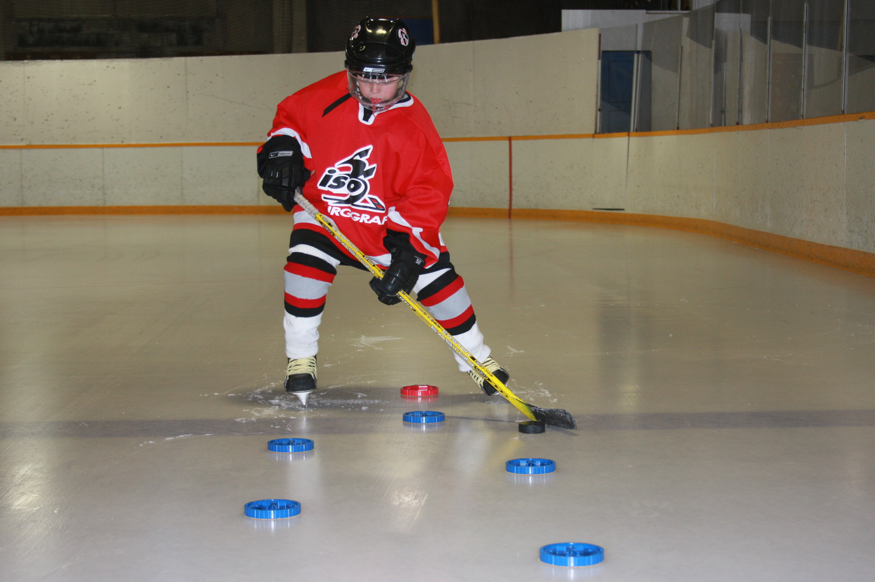
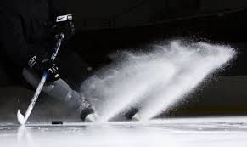
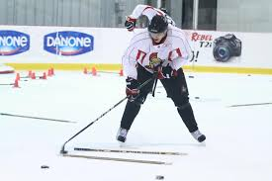
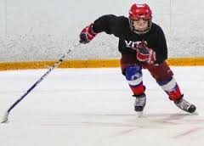
What do I still need to improve on?
Stopping
Stick handling
Skating faster and having more stamina

Slide 7
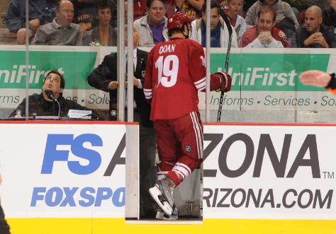
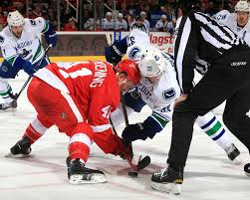
Hockey terms
Penalty – if a rule is broken, you could have two minutes in the penalty box, five minutes in the penalty box or a suspension from the game.
Icing – when the player with the puck is behind the red line, and shoots it down the ice and it gets to the end of the other team’s zone it goes back to the team that shot the puck’s zone.
Offside – when a player on the same team as the player with the puck crosses the blue line before the player with the puck the ref blow’s the whistle and it’s an faceoff

Slide 8
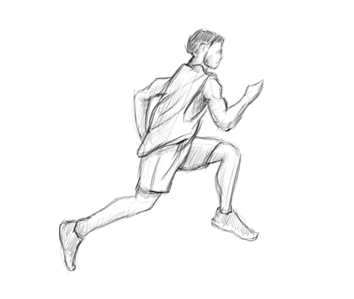
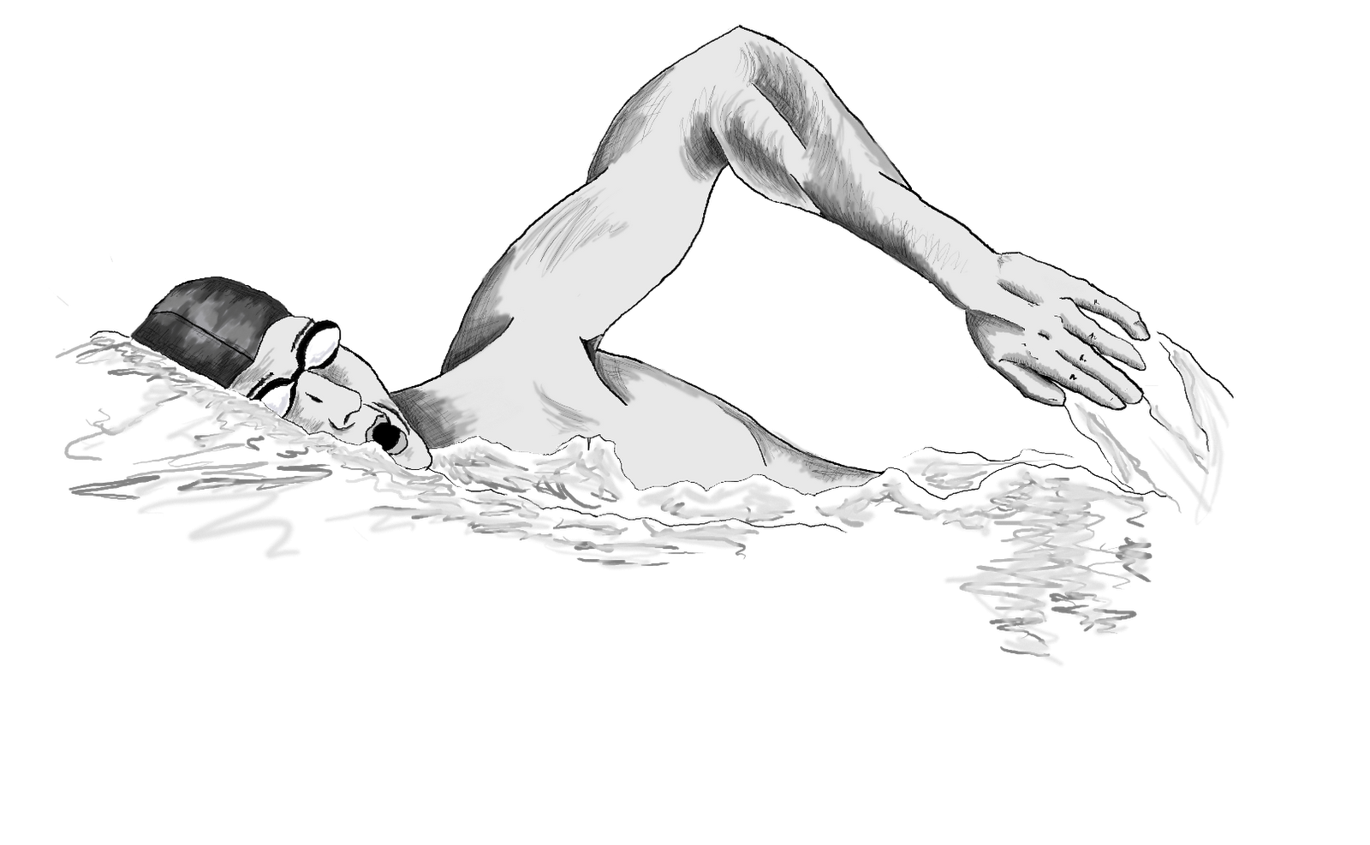
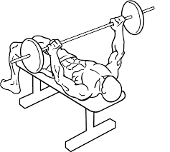
In the future
I want to keep playing hockey when I get older.
To keep practicing and improving my stopping, stick handling, and skating faster
Do some cross-training to build up my stamina and strength.

Slide 9
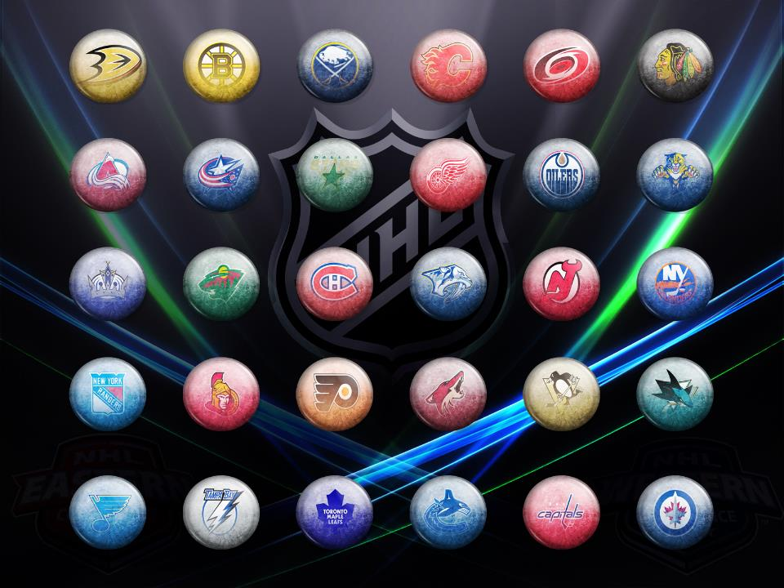
The end

