Slide 1
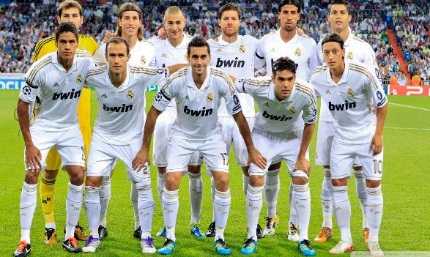
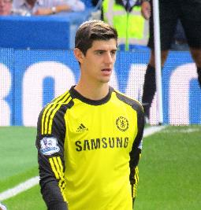
Soccer

Slide 2
What literacy means to me
To be good or strong at something
But is that all?
No, you actually don’t have to be good at something, you could also know a lot about something to be literate in it.

Slide 3
What am I literate in?
Soccer
How can someone be literate in soccer?
You can:
Have a good kick
Be good at defending
Be good at passing
Be a good goalkeeper
You can also:
Know the rules
Follow the leagues
You MUST Know that:
there are 11 people on the field
there is 2 teams
there is one ball
If you can do/know any of these things, you can be literate at soccer

Slide 4
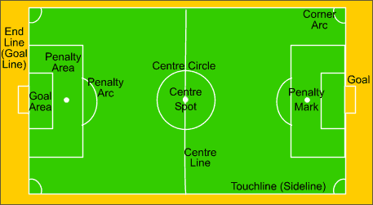
What makes me literate in soccer
I am literate in soccer because I know all of the rules, I practice a lot, and I am a big fan of all of the big leagues in the sport.
What Inspired me
When I was 4, I watched a soccer game on TV. The way the players played and how I really enjoyed the game made me get into soccer. I was inspired by all of the players and how it looked like they put a lot of work into getting good at the sport, so I joined a soccer team. My first season did not go as well though, I only scored 10 goals in like 30 games. My goal is to play for Egypt one day. (I was so much of a try hard I counted.)

Slide 5
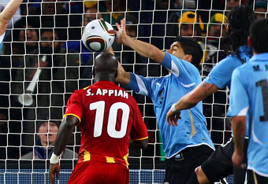
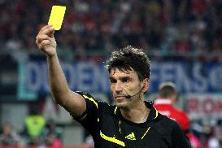
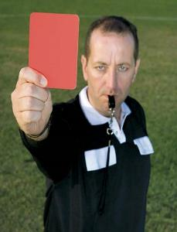
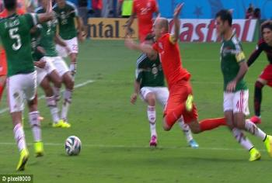
The Rules
In my opinion, if you want to be literate in soccer the most important thing that you have to do is to learn the rules.
Yellow cards
Handballs
Red cards
And fouls

Slide 6
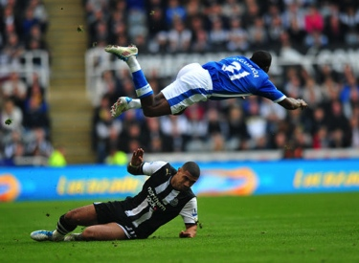
Handballs/fouls
An handball is when a player uses his hand to touch the ball, sometimes when it is unintentional the handball doesn’t get called.
A foul is when a player mistimes his tackle or just intentionally hurts another player, this usually ends with an player getting booked.
Luis Suarez’s historical handball against Ghana in the 2010 world cup.

Slide 7
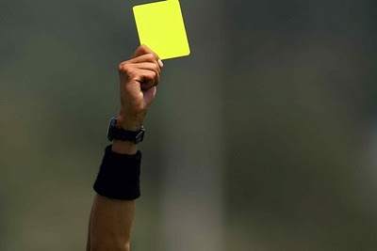
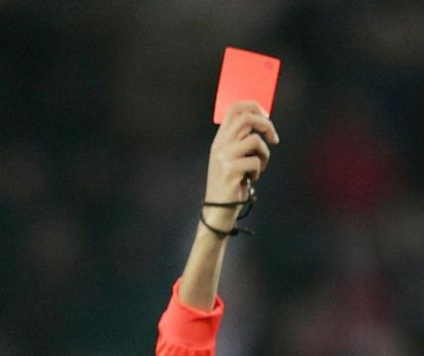
Bookings
An booking is one of the most popular rules in soccer. A booking is when the referee holds up an certain coloured card in front of the player who broke the rule (usually a handball or a foul.)
Yellow card: a warning to the player, if you get two yellow cards, your out of the game.
Red card: if you get this booking, your officially out of the game.

Slide 8
The End

