Slide 1
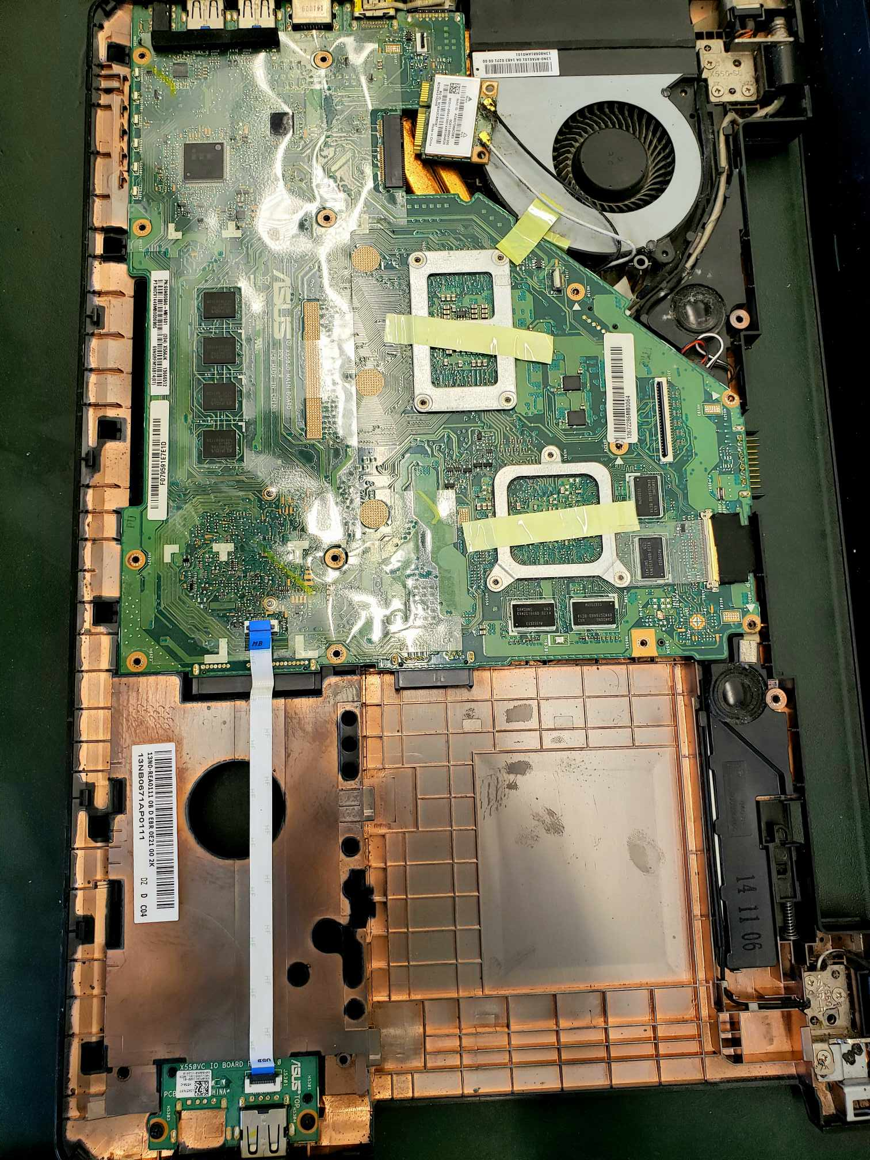
Slide Deck Template
Electronic Repair
Circuits and the Circular Economy!
Week 2
October 5 2024

Slide 2
Land Acknowledgement
<Add land acknowledgement>

Slide 3
Table of Contents
01
02
Staying Safe
Approaching a Repair
03
04
Disassembly
Understanding a Circuit
05
06
Finding the Problem
Fixing the Problem
07
Repair and Repairability

Slide 4
Safety first!
Staying safe working with electronics
Lets review the safety tips from last session.

Slide 5
Staying Safe working with Electronics
Preparing your workstation
Self
Tie back long hair
Take off dangling jewelry and rings
Remove loose clothing (eg. scarves, or baggy sleeves)
Space
Check for tripping hazards
Work on a stable, dry surface
No food & drink
Device
Look for warning stickers
Inspect the device for sharp edges.

Slide 6
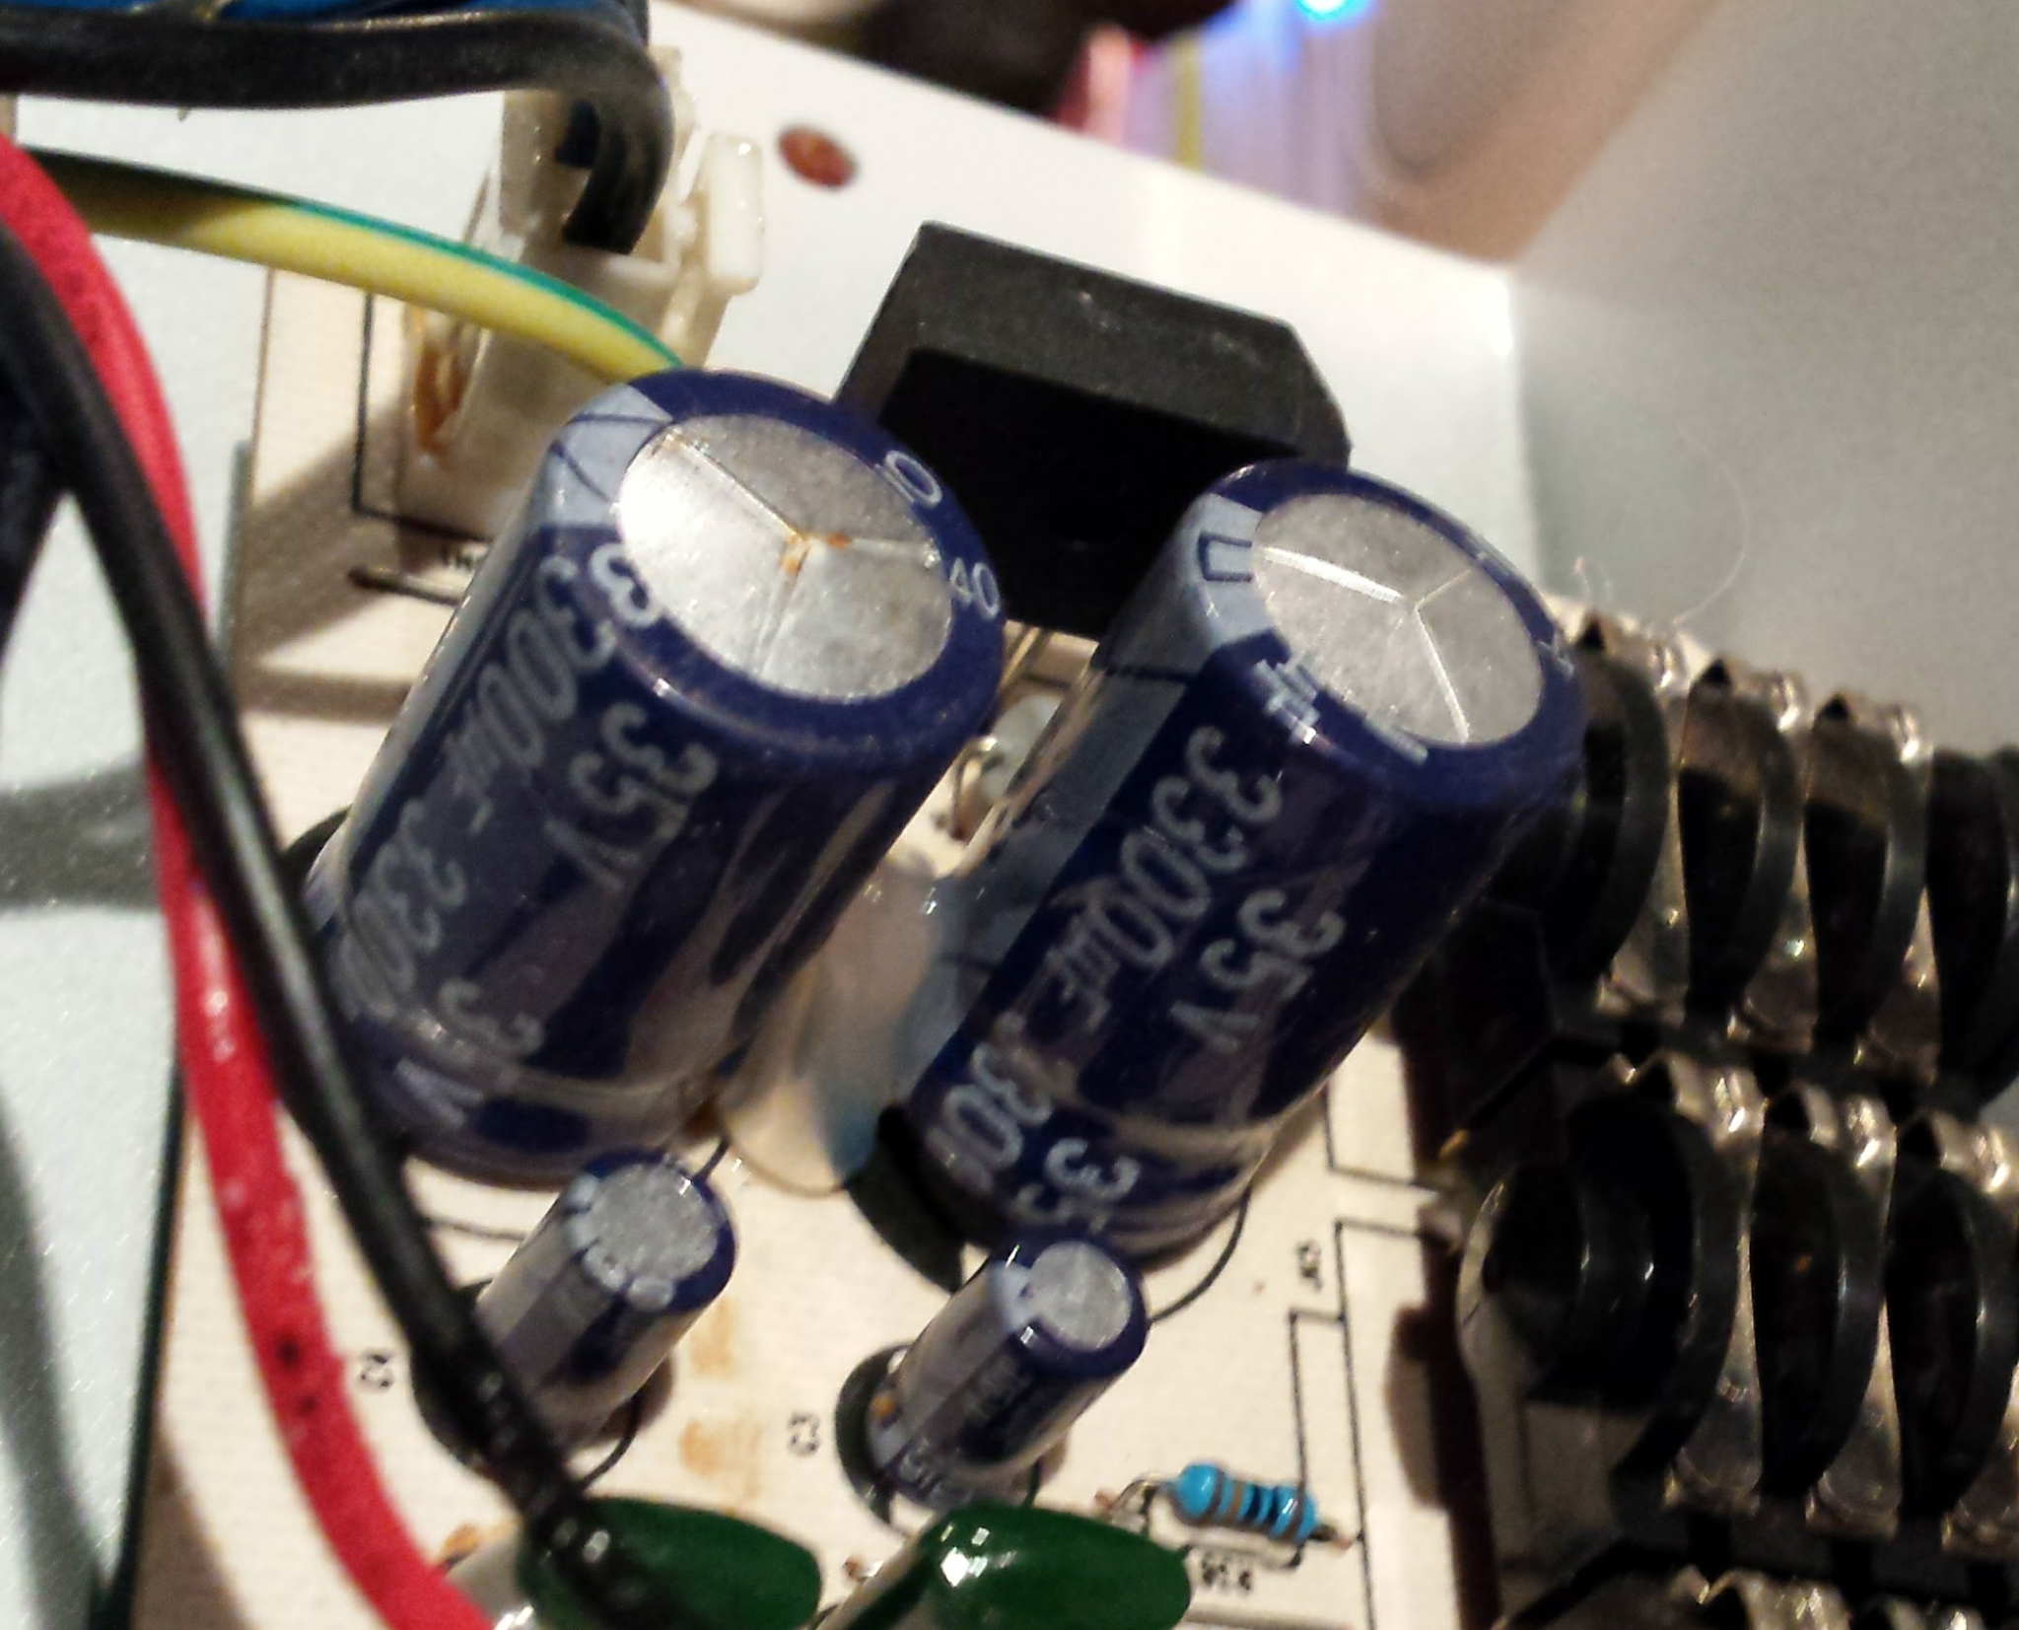
Staying Safe working with Electronics
How to not get shocked!
1. Unplug the device
The AC power coming from wall sockets is especially high power!
2. Remove batteries
Most batteries are lower power, but we still need to remove them before starting our work.
3. Watch out for large capacitors
Big capacitors can store charge for a long time. Watch out for these, and ask for help if you notice one.

Slide 7
Staying Safe working with Electronics
More safety hazards
1. Batteries
Battery chemicals can be dangerous if they are broken or punctured. Keep an eye out for this, and don’t touch damaged batteries.
2. Chemicals
Circuits, especially older ones might contain chemicals like mercury or lead. Wash your hands after touching a circuit.
3. Dangerous devices
Some devices are especially dangerous. Avoid high power appliances (like washing machines), microwaves, old fashioned cathode tube TVs, PC power supplies

Slide 8
Activity: Spot the Safety Hazard.
There are some serious safety problems in the picture below? Who can find all 12?
Todo: Make new Graphic

Slide 9
Approaching a Repair
Before we jump into taking things apart, lets ask ourselves a few questions.

Slide 10
Approaching a Repair
To fix a broken device, we first need to understand why its not working.
How is it working now?
If some features work and others don’t, that is a useful clue.
What could have happened to it?
Did you drop it? Did it get wet? Is it very old?

Slide 11
Activity: Choose one device
Hopefully you have some broken electronics in front of you.
Choose one that seems like an interesting problem to work on!

Slide 12
Activity: How is it working now?
First of all, figure out how the device is broken.
Ask yourselves some questions:
What happens when you turn it on?
In what way is it working? In what ways is it not working?
What is the history of the device and of the problem? (eg. did you drop it?)
Do you have any ideas about what part of the device might have broken?

Slide 13
Disassembling a Device
You should have a real device ready at your station, and a set of screwdrivers. Like last session, we’ll start by taking off the cover so we can see the circuitry.

Slide 14
Activity: Disassemble your device!
Start by finding all the screws - check all sides
Unscrew them one by one - but take note of where you put them so that you can put things back together!
Careful with prying things apart - ask for help if in doubt.

Slide 15
How did the disassembly go?
Could the product be designed in a way that makes this easier?

Slide 16
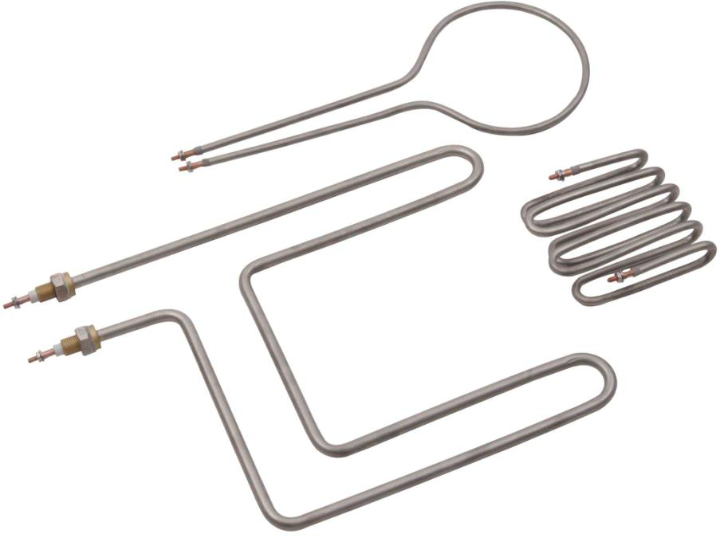
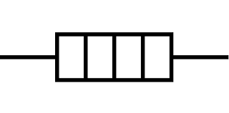
If we have time…
Heating Elements
A heating coil works essentially as a big chunky resistor with a non-conductive coating. When a lot of electricity passes through it it heats up.
Is there a heating element in your circuit?

Slide 17
Understanding a Circuit
Like last week, lets try and understand the circuit in front of us. We’ll rei

Slide 18
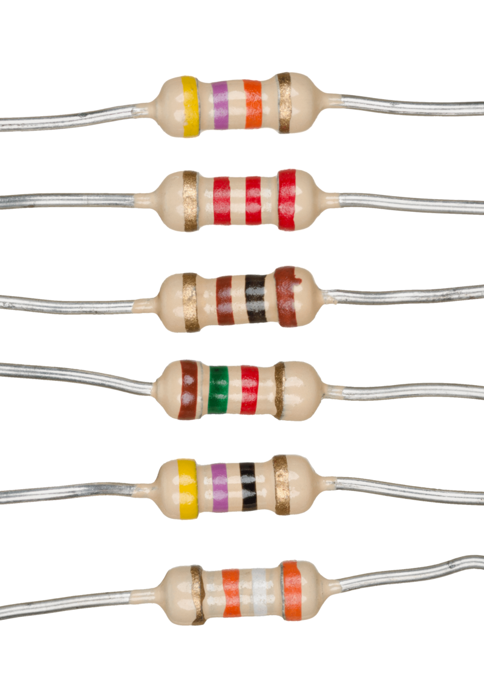
Resistors
Resistors are usually small components (about the size of a big ant), with colorful stripes.
These stripes indicate their resistance (more on that later)
How many resistors are in your circuit?

Slide 19
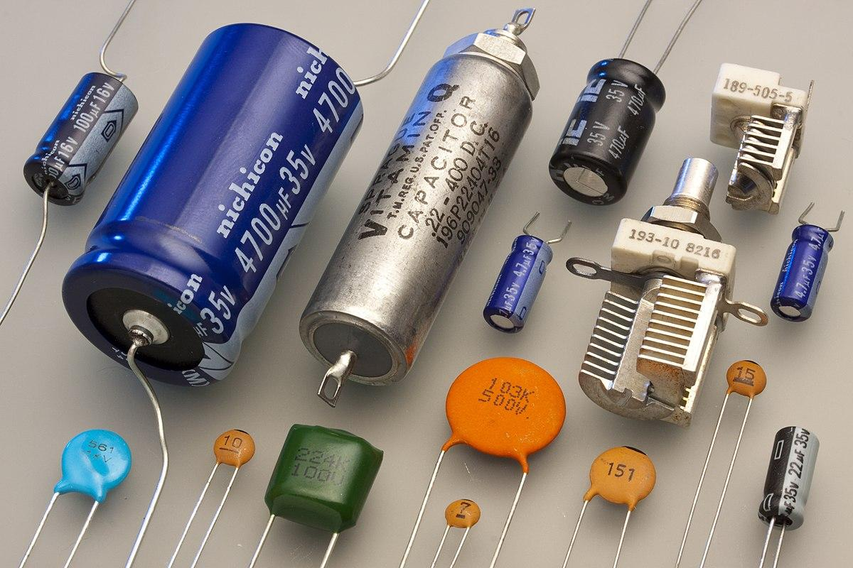
Capacitors
Capacitors often look either like tiny tin cans, or little (often orange) skittles.
How many capacitors are in your circuit?

Slide 20
Switches
Switches are another important part of a circuit that lets the user interact with it - changing settings or turning it on and off.
How many switches are in your circuit?

Slide 21
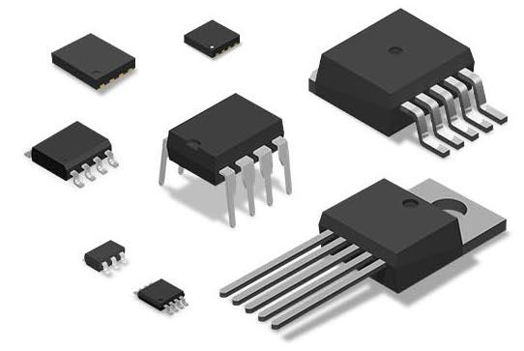
Integrated Circuits
More complicated circuitry might be stored in compact integrated circuits.
Often these have a part number on them that you can google to find out what it does!
How many resistors are in your circuit?

Slide 22
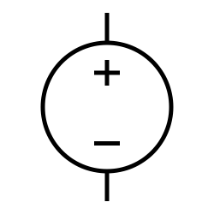
Power Sources
A circuit needs a power source! The power source could be a battery, or the power might come from a wall outlet.
Where is the power source in your circuit?

Slide 23
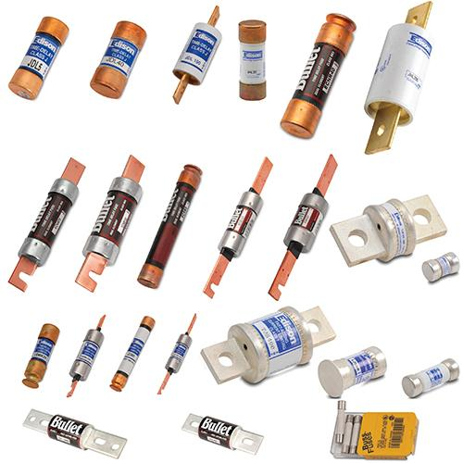
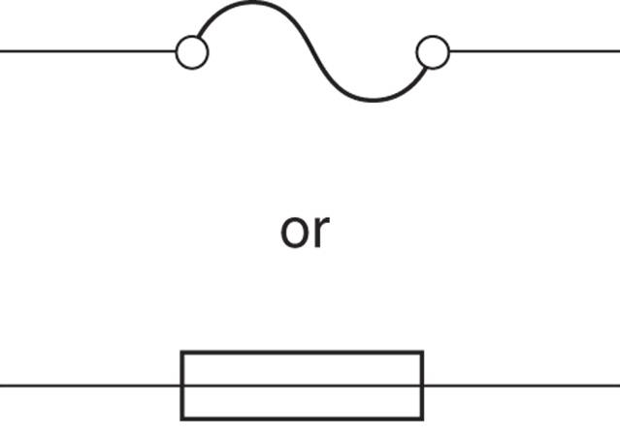
If we have time…
Fuses
Fuses are important for safety. They stop electricity passing through the circuit if the circuit overheats, or if there is too much electricity passing through it.
Fuses come in many shapes and sizes.
Is there a fuse in your circuit?

Slide 24
If we have time…
Activity: Putting it all together
Draw a diagram of your circuit, including all the resistors, capacitors, switches, power sources and heating elements that you’ve found, and how they’re connected.
If you aren’t sure about something thats ok for now! Put it into the diagram as a ‘black box’ of unknowns.

Slide 25
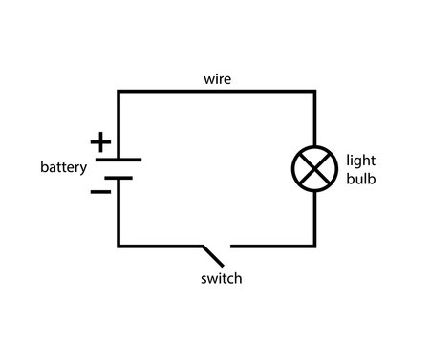
If we have time…
Activity: Putting it all together
For example, in this circuit a battery, switch and light bulb are all connected.

Slide 26
Finding the Problem
If it isn’t already clear, the next step is to start searching for the problem. Why isn’t the circuit working the way it should?

Slide 27
Disconnected Wires or Loose Connections?
Sometimes when something is dropped, or not connected very well to begin with, wires can become loose. Even loose connections can cause problems. You can check that the wires are connected the way you expect with a multimeter.
Do you see any wires or components that look loose or disconnected?

Slide 28
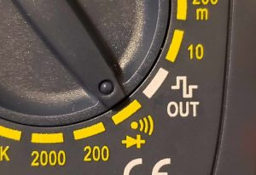
Review: Testing continuity
Switch the multimeter dial to continuity mode.
Touch the multimeter dials to two points of the circuit that you think should be connected
(Like two ends of the same wire)
Connected? The multimeter should display ‘0’ and beep

Slide 29
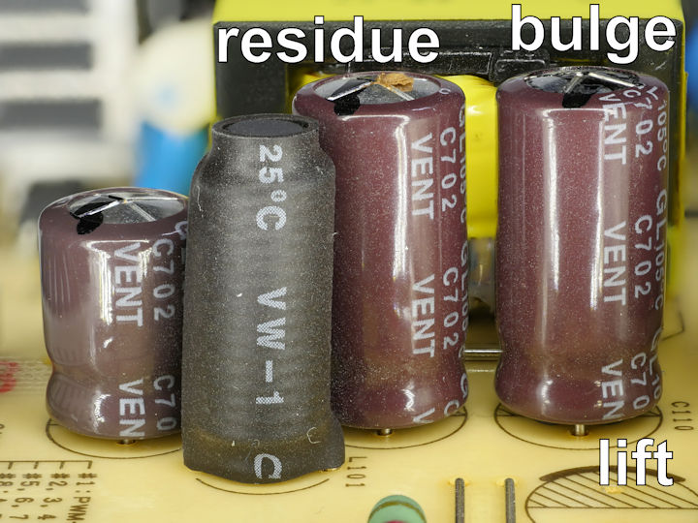
Burnt out capacitors?
Sometimes it is possible to spot when a capacitor is broken. You can also check capacitance with a multimeter.
On the capacitors, or other components, do you see any marks or residues, or things that look burnt?

Slide 30
Blown fuses
Thermal fuses might blow if the device overheats, and might need to be replaced. You can use a multimeter to check continuity across a fuse: a good fuse will be like a wire and the multimeter will beep. For a blown fuse, it will be an ‘open circuit’ and the multimeter won’t beep.
Do you see any thermal or electrical fuses in your circuit?

Slide 31
Activity
Take a closer look at the circuit to try to find the problem, checking for
Loose connections
Broken capacitors
Blown fuses
And anything else that looks suspicious.
Use your multimeter to investigate more closely.

Slide 32
Activity
Has anyone identified the problem with their circuit?

Slide 33
Fixing the Problem
Maybe we found the problem, maybe we need more time. If we found the issue, what steps can we take to fix it?

Slide 34
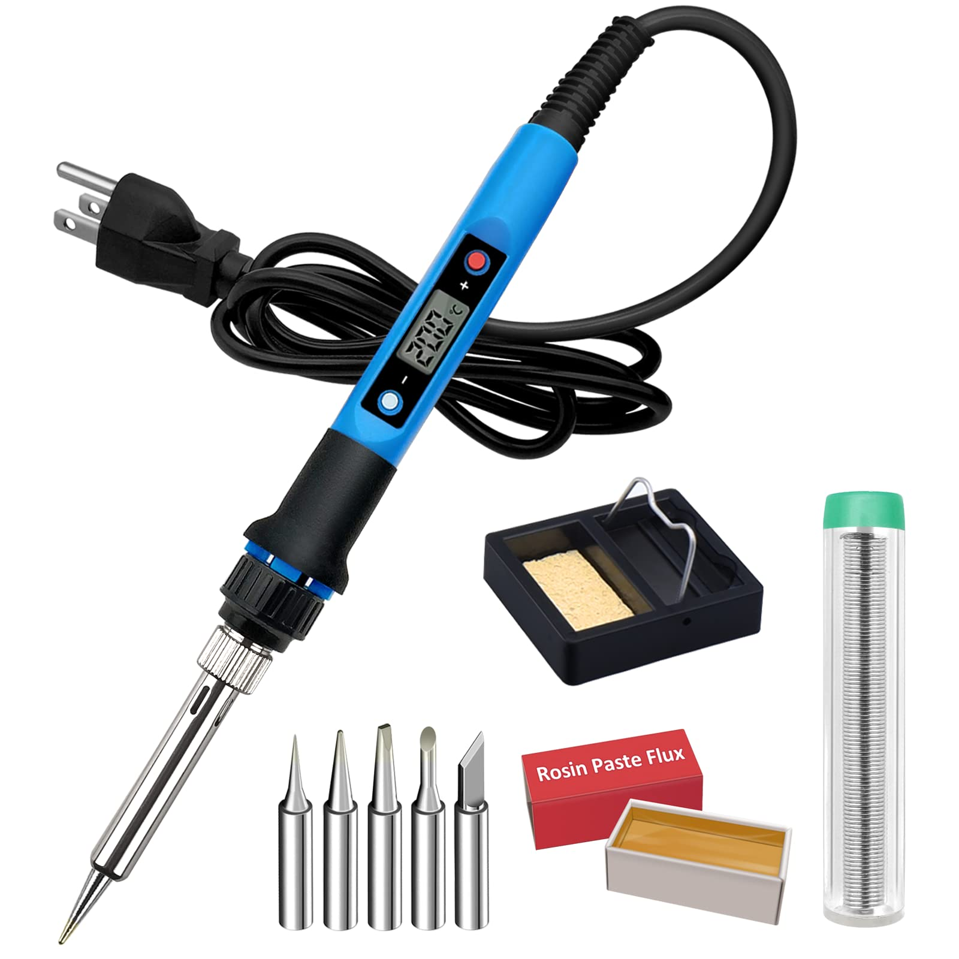
Fixing loose connections
Loose connections can be fixed using a soldering iron. Using a soldering iron, you can melt liquid solder to connect two wires or components together.
This can take some practice!

Slide 35
Replacing broken parts
If you found a blown fuse or broken capacitor, you may be able to replace it to fix the device. You’ll need a replacement part with the same specifications.

Slide 36
Activity: Lets fix something!
Lets watch an example of fixing a loose connection using a soldering iron. Gather around the soldering iron stations to watch a demonstration.

Slide 37
Repairability
Was this repair easy? If not what can be done to make it easier.

Slide 38
Right to Repair
Last week we talked about Right to Repair legislation, and how it can make manufacturers…
Provide repair manuals
Offer parts for sale
Share diagnostic tools
Adjust warranty policies
Would these things have helped you with your repair?

Slide 39
Design for Repairability
When designing a new product, engineers make important decisions that can impact repairability of a product.
What aspects of the current design of your device made repair difficult? easy?

Slide 40
Activity: Design for Repairability
In groups, talk about what could be changed about your device to make it more repairable.
Can you propose a new and improved, more repairable device?

Slide 41
What have we learned?
V
÷
÷
I R
x
Practical Skills
How do we stay safe during a repair?
How do we approach a repair?
Social Context
Why is Right to Repair important?
Theory
What does it mean to design for repairability?

Slide 42
Questions?

