Slide 1

Ten Cases - Ten Clauses - Ten Contexts
Part B “Connecting” | Talk 5
Video Game Law 2013
UBC Law @ Allard Hall
Jon Festinger Q.C.
Centre for Digital Media
Festinger Law & Strategy LLP
@gamebizlaw
jon_festinger@thecdm.ca

Slide 2
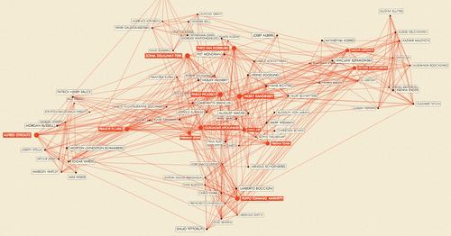
Follow Ups Talk 4: Creating as Connecting
For the exhibition “Inventing Abstraction 1910-1925” MoMA mapped how different abstract artists influenced each other http://exp.lore.com/post/41877532653/for-the-exhibition-inventing-abstraction

Slide 3
One more proof: Learning is a Remix
“The Usefulness of Useless Knowledge” By Abraham Flexner, American educator (1939, Harpers)
http://library.ias.edu/files/UsefulnessHarpers.pdf
“…Marconi was inevitable. The real credit for everything that has been done in the field of wireless belongs, as far as such fundamental credit can be definitely assigned to anyone, to Professor Clerk Maxwell who in 1865 carried out certain abstruse and remote calculations in the field of magnetism and electricity…. Other discoveries supplemented Maxwell’s theoretical work during the next fifteen years. Finally in 1887 and 1888 the scientific problem still remaining — the detection and demonstration of the electromagnetic waves which are the carriers of wireless signals — was solved by Heinrich Hertz... The inventor in the legal sense was of course Marconi, but what did Marconi invent? Merely the last technical detail, mainly the now obsolete receiving device called coherer, almost universally discarded.”
Thus it becomes obvious that one must be wary in attributing scientific discovery wholly to anyone person. Almost every discovery has a long and precarious history. Someone finds a bit here, another a bit there. A third step succeeds later and thus onward till a genius pieces the bits together and makes the decisive contribution.”

Slide 4

Nordic freedoms: two more things
World Press Freedom Index: “The Nordic countries have again demonstrated their ability to maintain an optimal environment for news providers. Finland (1st, 0), Netherlands (2nd, +1) and Norway (3rd, -2) have held on to the first three places. Canada (20th, -10) only just avoided dropping out of the top 20.”http://en.rsf.org/press-freedom-index-2013,1054.html
Swedish tech start-ups outdoing European rivals (c/o Roch Ripley)http://www.theglobeandmail.com/report-on-business/international-business/european-business/swedish-tech-start-ups-outdoing-european-rivals/article8183599/

Slide 5
Today…
Connecting as/by Contracting
Ten Cases
Ten Clauses
Ten Contexts
& some lessons learned…
(next week Connecting as/by Technology – legal implications)

Slide 6
Things to Look For
Collisions of CONTRACT &:
Copyright freedoms
Expressive freedoms
Creative freedoms
Connective freedoms
Preference to gamer in game or developer outside of game
Implications of contracts as individual bargains &/or mass agreement
Contractual complexity as a consequence of infinite slice-able &dice-able nature of IP.

Slide 7
Repeat After Me…….
“I am agreeing. I am not reading what I am agreeing to. I am doing this thousands of times. Each document I am agreeing to & not reading is different, often quite different, from every other document I am agreeing to and not reading.”

Slide 8

WE HAVE ARRIVED AT….

Slide 9
WARNING & NOTICE
The materials that follow are filled with often dense, repetitive and difficult to follow legal language. You will find yourself scrambling to understand what the quoted text says and why those particular words and concepts are being conveyed……..It will be difficult to understand…..
AND THAT IS THE POINT

Slide 10
Case 1: Blizzard v. Internet Gateway (Battle.net clone)
Davidson & Associates, Inc. v. Internet Gateway, 2004 U.S. Dist. LEXIS 20369 (E.D. Mo. 2004), aff’d 2005 U.S. App. LEXIS 18973 (8th Cir. 2005)
EULA: “… subject to the grant of license hereinabove, you may not, in whole or in part, copy, photocopy, reproduce, translate, reverse engineer, derive source code, modify, disassemble, decompile, create derivative works based on the Program, or remove any proprietary notices or labels on the program without the prior consent, in writing, of Blizzard.”
TOU: “You are entitled to use Battle.net for your own personal use, but you shall not be entitled to … (ii) copy, photocopy, reproduce, translate, reverse engineer, modify, disassemble, or de-compile, in whole or in part, any Battle.net software; (iii) create derivative works based on Battle.net; (iv) host or provide matchmaking services for any Blizzard software programs or emulate or redirect the communication protocols used by Blizzard as part of Battle.net, through protocol emulation, tunneling, modifying, or adding components to the Program, use of a utility program, or any other technique now known or hereafter developed for any purpose, including, but not limited to, network play over the Internet, network play utilizing commercial or non-commercial gaming networks, or as part of content aggregation networks without the prior written consent of Blizzard or exploit Battle.net or any of its parts for any commercial purpose …”

Slide 11
Davidson (con’d)
“BnetD” versus Blizzard’s own “Battle.net”
Amici Curiae Brief supporting defendants by teachers of IP Law in U.S. law schoolshttps://www.eff.org/sites/default/files/filenode/Blizzard_v_bnetd/20040221_law_professor_brief.pdf
Argued unsuccessfully that insofar as they prohibit permissible “reverse engineering” Blizzard’s EULA’s should be preempted by copyright law. Alternatively argued that enforcement of the EULA’s should be denied under the Doctrine of Copyright Misuse (related to concept of “Copyright Monopoly”).
Attempted unsuccessfully to preserve Sega Enterprises v. Accolade, Inc. statement of the application of Fair Use to to reverse Engineering

Slide 12
Case 2: Blizzard v. In Game (gold-farming)
Blizzard Entertainment, Inc. v. In Game Dollar, LLC,
United States District Court for C.D. Cal., Case No. SACV07-0589-JVS
(2007)
TOU: “You agree that you shall not, under any circumstances, ... Exploit the Game or any of its parts, including without limitation the Game Client, for any commercial purpose, including without limitation use at a cyber cafe, computer gaming center or any other location-based site without the express written consent of Blizzard;”
EULA: “You may not share the Account or the Login Information with anyone other than as expressly set forth herein.”
“When engaging in Chat in the Program, or otherwise utilizing the Program, you may not:…Disrupt the normal flow of dialogue in Chat or otherwise act in a manner that negatively affects other users including without limitation posting commercial solicitations and/or advertisements for goods and services available outside of the World of Warcraft universe;…Sending [sic] repeated unsolicited or unwelcome messages to a single user or repeatedly posting similar messages in a Chat area, including but not limited to continuous advertisements to sell goods or services;”

Slide 13
Blizzard v. In Game (con’d)
In 2007 Blizzard sued In Game Dollar. IGD through a subsidiary offered power-leveling and virtual gold-selling services. IGD sent spam messages to players though WoW’s chat system to advertise its services.
Blizzard claimed all this effected a diminishment of gamer enjoyment and experience resulting in lost subscribers and lost revenue. Causes of action included: violation of Blizzard’s EULA and ToU; intentional interference with contract; unfair competition & unjust enrichment.
IGD shut down its business & the case settled in Jan. 2008 by consent order.

Slide 14
Case 3: MDY v. Blizzard (WoW Glider/bot)
MDY Industries, LLC v. Blizzard Entertainment, Inc., 2008 U.S. Dist. LEXIS 53988
EULA: “Grant of Limited Use License. If you agree to this License Agreement, computer software (hereafter referred to as the “Game Client”) will be installed on your hardware. If your hardware meets the minimum requirements, the installation of the Game Client will enable you to play the Game by accessing your account with the Service (your “Account”). Subject to your agreement to and continuing compliance with this License Agreement, Blizzard hereby grants, and you hereby accept, a limited, nonexclusive license to (a) install the Game Client on one or more computers owned by you or under your legitimate control, and (b) use the Game Client in conjunction with the Service for your non-commercial entertainment purposes only. All use of the Game Client is subject to this License Agreement and to the [TOU], both of which you must accept before you can use your Account to play the Game.”
TOU: “You agree that you will not (i) modify or cause to be modified any files that are a part of the Program or the Service; (ii) create or use cheats, bots, "mods", and/or hacks, or any other third-party software designed to modify the World of Warcraft experience; or (iii) use any third-party software that intercepts, "mines", or otherwise collects information from or through the Program or the Service. Notwithstanding the foregoing, you may update the Program with authorized patches and updates distributed by Blizzard, and Blizzard may, at its sole and absolute discretion, allow the use of certain third party user interfaces.”

Slide 15
MDY (con’d)
EFF take:https://www.eff.org/deeplinks/2010/12/mixed-ninth-circuit-ruling-mdy-v-blizzard-wow
“The Ninth Circuit today issued its decision in the second of a trio of cases that raise the critical legal question of whether "magic words" in a end-user license agreement… slapped onto a consumer product can turn buyers…into mere licensees, rather than owners…
Ownership matters, because otherwise Blizzard and other software vendors can wipe away important consumer rights with legalese contained in license agreements.
In September, the Ninth Circuit held that buyers of software…are not owners as long as the vendor saddles the transfer with enough restrictions to transform what the buyer may think is sale into a mere license. Today, in yet another blow to user rights, the Ninth Circuit ruled that Blizzard’s license restrictions for WoW accomplish the same purpose.
However, the court also held that using Glider in WoW play in violation of Blizzard’s terms did not amount to copyright infringement…The license term that forbade WoW players from using Glider was a covenant a promise not to do something rather than a condition limiting the scope of the copyright license. And while violating "antibot" covenants might breach a contract, it does not violate any copyright. (By contrast, creating a derivative work might.)
This point may seem a bit arcane, but it's crucial because it helps avoid a situation in which violating contracts and EULAs could result in a copyright infringement lawsuit (with the heavy club of statutory damages, attorney's fees and low standards for injunctions) rather than just a simple breach of contract claim…”

Slide 16
Case 4: Blizzard v. Marshall (Battle.net clone)
Blizzard Entertainment, Inc. v. Marshall, District Court for the Central District of California, Case No. 10-cv-00450-DOC-RNB (2010)
Beta Test Agreement: “Subject to the license granted hereunder, you may not, in whole or in part, copy, photocopy, reproduce, translate, reverse engineer, derive source code from, modify, disassemble, decompile, or create derivative works based on the Game... Failure to comply with the restrictions and limitations contained in this Section 7 shall result in the immediate, automatic termination of the license granted hereunder and may subject you to potential civil and/or criminal liability.
Without limiting Blizzard's rights hereunder, you agree that you shall not, under any circumstances:...
(iii) host, provide or develop matchmaking services for the Game or intercept, emulate or redirect the communication protocols used by Blizzard in any way, including without limitation through protocol emulation, tunneling, packet sniffing, modifying or adding components to the Game, use of a utility program or any other techniques now known or hereafter developed, for any purpose, including without limitation unauthorized network play over the Internet, network play utilizing commercial or non-commercial gaming netWorks, or as part of content aggregation networks;
(iv) Facilitate, create or maintain any unauthorized connection to the Game, including without limitation any connection to any unauthorized server that emulates, or attempts to emulate, the Game. All connections by or to the Game may only be made through methods and means approved by Blizzard. Under no circumstances may you connect, or create tools that allow you or others to connect, to the Game other than those expressly provided by Blizzard for use by Beta Testers;...

Slide 17
Blizzard v. Marshall (con’d)
Consent to Monitor. WHEN RUNNING, THE GAME MAY MONITOR YOUR COMPUTER'S RANDOM ACCESS MEMORY (RAM) FOR UNAUTHORIZED THIRD PARTY PROGRAMS RUNNING CONCURRENTLY WITH THE GAME. AN "UNAUTHORIZED THIRD PARTY PROGRAM" AS USED HEREIN SHALL BE DEFINED AS ANY THIRD PARTY SOFTWARE, INCLUDING WITHOUT LIMITATION ANY "ADDON," "MOD," "HACK," "TRAINER," OR "CHEAT," THAT IN BLIZZARD'S SOLE DETERMINATION: (i) ENABLES OR FACILITATES CHEATING OF ANY TYPE; (ii) ALLOWS USERS TO MODIFY OR HACK THE GAME INTERFACE, ENVIRONMENT, AND/OR EXPERIENCE IN ANY WAY NOT EXPRESSLY AUTHORIZED BY BLIZZARD; OR (iii) INTERCEPTS, "MINES," OR OTHER WISE COLLECTS INFORMATION FROM OR THROUGH THE GAME. IN THE EVENT THAT THE GAME DETECTS AN UNAUTHORIZED THIRD PARTY PROGRAM, THE GAME MAY (a) COMMUNICATE INFORMATION BACK TO BLIZZARD, INCLUDING WITHOUT LIMITATION YOUR ACCOUNT NAME, DETAILS ABOUT THE UNAUTHORIZED THIRD PARTY PROGRAM DETECTED, AND THE TIME AND DATE THE UNAUTHORIZED THIRD PARTY PROGRAM WAS DETECTED;…”

Slide 18
Blizzard v. Marshall (con’d 2)
TOU: Users may not "use ... unauthorized third-party software designed to modify the service, any Game or any Game experience," "host, provide, or develop matchmaking services for any Game or the service, or intercept, emulate or redirect the communication protocols used by Blizzard in any way, for any purpose, including without limitation unauthorized play over the internet ... ”
------------------------------------------------------------------------------------------------
Blizzard alleged Justin Marshall led “StarCrack” a hacker group developing servers emulating Blizzard’s Battle.net (where have you heard this before?), allowing gamers with pirate copies of the StarCraft 2 (which was still in a closed beta) to play multiplayer online.
In April 2010, Blizzard sued Justin Marshall and unnamed defendants for breach of contract, copyright infringement, circumvention of copyright protection systems in violation of the DMCA and tortious interference with contract.
“The suit was dropped a week later, with Blizzard stating that the “matter had been resolved in a way that has allowed us to dismiss the lawsuit.””
http://mygaming.co.za/news/news/5840-blizzard-not-afraid-to-go-after-hackers.html

Slide 19
Case 5: Vernor v. Autodesk (re-sale)
Vernor v. Autodesk, Inc., 2010 U.S. App. LEXIS 18957
EULA: “YOU MAY NOT: (1) modify, translate, reverse-engineer, decompile, or disassemble the Software . . . (3) remove any proprietary notices, labels, or marks from the Software or Documentation; (4) use . . . the Software outside of the Western Hemisphere; (5) utilize any computer software or hardware designed to defeat any hardware copy-protection device, should the software you have licensed be equipped with such protection; or (6) use the Software for commercial or other revenue-generating purposes if the Software has been licensed or labeled for educational use only.
[Y]ou must destroy the software previously licensed to you, including any copies resident on your hard disk drive . . . within sixty (60) days of the purchase of the license to use the upgrade or update . . . . Autodesk reserves the right to require you to show satisfactory proof that previous copies of the software have been destroyed.”

Slide 20
Vernor (con’d)
Decision: “Timothy Vernor purchased several used copies of Autodesk, Inc.'s AutoCAD Release 14 software ("Release 14") from one of Autodesk's direct customers, and he resold the Release 14 copies on eBay. Vernor brought this declaratory judgment action against Autodesk to establish that these resales did not infringe Autodesk's copyright…
We hold today that a software user is a licensee rather than an owner of a copy where the copyright owner (1) specifies that the user is granted a license; (2) significantly restricts the user's ability to transfer the software; and (3) imposes notable use restrictions. Applying our holding to Autodesk's SLA, we conclude that CTA was a licensee rather than an owner of copies of Release 14 and thus was not entitled to invoke the first sale doctrine or the essential step defense…
These are serious contentions on both sides, but they do not alter our conclusion that our precedent from Wise through the MAI trio requires the result we reach. Congress is free, of course, to modify the first sale doctrine and the essential step defense if it deems these or other policy considerations to require a different approach.
…We remand for further proceedings consistent with this opinion, including consideration of Vernor's copyright misuse defense.”

Slide 21

Case 6: iRacing (Mods)
iRacing Motorsports Simulations, LLC v. Tim Robinson, District Court for the District of Massachusetts, Civil Action No. 05cv11639-NG (May, 2009)
EULA: “You may not, in whole or in part, copy, photocopy, reproduce, translate, reverse engineer, derive source code, modify, disassemble, decompile, create derivative works based on [NASCAR 2003], or remove any proprietary notices or labels on [NASCAR 2003] without the prior consent, in writing, of [iRacing].”
Mod community encouraged in past but line drawn?…

Slide 22
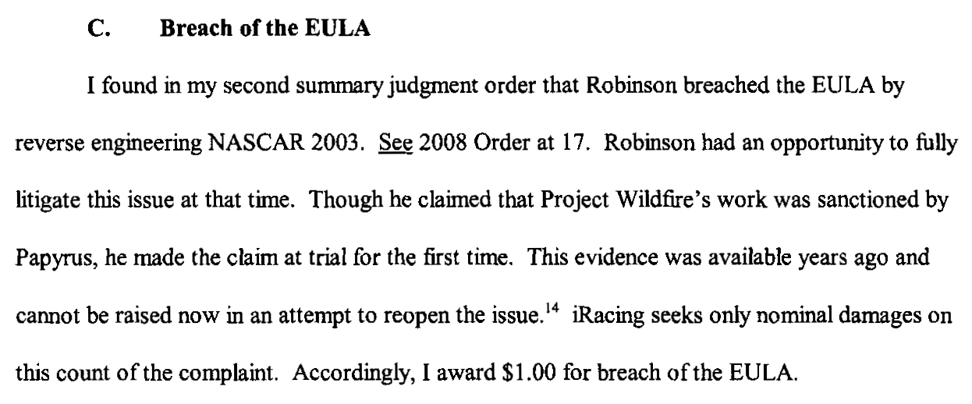
iRacing (con’d)

Slide 23
Case 7: Smallwood v. NCSOFT (addiction)
Smallwood v. NCSOFT, 730 F. Supp. 2d 1213 (Dist. Court. D. Hi. 2010)
EULA: “THE MAXIMUM AMOUNT OF NC INTERACTIVE'S (OR ANY OF ITS SHAREHOLDERS, PARTNERS, AFFILIATES, DIRECTORS, OFFICERS, SUBSIDIARIES, EMPLOYEES, AGENTS, SUPPLIERS, LICENSEES OR DISTRIBUTORS) LIABILITY TO YOU UNDER THIS AGREEMENT SHALL NOT EXCEED AN AMOUNT EQUAL TO THE LOWER OF THE (i) ACCOUNT FEES OR (ii) PURCHASE PRICE OF THE ADDITIONAL FEATURES EACH OF THE FOREGOING (i) OR (ii) AS PAID BY YOU TO NC INTERACTIVE IN THE PRECEDING SIX (6) MONTHS.
IN NO EVENT SHALL NC INTERACTIVE, NOR ANY OF ITS CONTENT PROVIDERS, SHAREHOLDERS, PARTNERS, AFFILIATES, DIRECTORS, OFFICERS, EMPLOYEES, AGENTS OR SUPPLIERS, BE LIABLE TO YOU OR TO ANY THIRD PARTY FOR ANY SPECIAL, INCIDENTAL, CONSEQUENTIAL, PUNITIVE OR EXEMPLARY DAMAGES, (INCLUDING, WITHOUT LIMITATION, LOSS OF BUSINESS PROFITS, BUSINESS INTERRUPTION, LOSS OF BUSINESS INFORMATION OR ANY OTHER PECUNIARY LOSS), REGARDLESS OF THE THEORY OF LIABILITY (INCLUDING CONTRACT, NEGLIGENCE, OR STRICT LIABILITY) ARISING OUT OF OR IN CONNECTION WITH THE SERVICE, THE SOFTWARE, YOUR ACCOUNT OR THIS AGREEMENT WHICH MAY BE INCURRED BY YOU, WHETHER OR NOT NC INTERACTIVE (OR ANY SUCH OTHER RELEASED PARTY) MAY HAVE BEEN ADVISED THAT ANY SUCH DAMAGES MIGHT OR COULD OCCUR.”

Slide 24
Smallwood (con’d)
Decision:
http://scholar.google.ca/scholar_case?case=17471300131704032790&q=smallwood+v.+ncsoft+corp&hl=en&as_sdt=2,5&as_vis=1
“Plaintiff became psychologically dependent and addicted to playing Lineage II. During the years that Plaintiff played Lineage II, the phenomena of psychological dependence and addiction to playing computer games was recognized by and known to Defendants. Defendants never gave Plaintiff any notice or warning of the danger of psychological dependence or addiction from continued play…
The Court finds the agreement here valid. Plaintiff had notice of the User Agreement, was required to affirmatively agree to it by clicking "I agree," and had an opportunity to cease playing Lineage II if he disagreed with it…
Thus,…it appears that one cannot preemptively waive a gross negligence claim…Accordingly, the Court finds that the waiver and limitation of liability in the User Agreement is not valid as to the gross negligence claim…
Under Texas law, a party also may not waive its right to bring a fraud claim…
However, because Plaintiff's claim for defamation is based upon negligence, Plaintiff's damages for such a claim are limited under the User Agreement...
If, however, Plaintiff can establish gross negligence…then Plaintiff's damages will not be limited…”

Slide 25
Case 8: Hernandez (gold-farming)
Hernandez v. Internet Gaming Entertainment, Ltd., United States District Court Southern District of Florida, Case No. 07-21430-Civ-COHN/SNOW (Filed May 31, 2007, Settled August 26, 2008)
TOU: “[Y]ou may not sell items for "real" money or otherwise exchange items for value outside of the [virtual world].”
Complaint by gamer states "IGE’s calculated decision to reap substantial profits by knowingly interfering with and substantially impairing the intended use and enjoyment" of WoW through gold-farming, camping spawns and spamming chat violated WoW’s EULA & ToU leading to lost time, competitive disadvantage, and diminished experience for honest game subscribers. The complaint further alleges that the plaintiff gamers were intended third party beneficiaries of the ToU and EULA between IGE U.S. and Blizzard and suffered harm as a result of IGE U.S.’s breach of these agreements (contrast to Micro Star v. FormGen – Duke Nukem 3D mod disc where Micro Star was held not to be a 3rd party beneficiary of an implicit license agreement between FormGen & the gamer authorizing the creation of new levels).

Slide 26
Case 9: Zynga v. Labrasca (virtual currency)
Zynga Game Network, Inc. v. Labrasca, District Court for N.D. Cal., Case No. 5:09-cv-02958-PVT (2009)
“The Terms of Service that govern users' play of the Game provide that the "chips" used in the Game "are not redeemable for any sum of' real world' money or monetary value." The Terms of Service also prohibit sale of "chips" "for 'real world' money" and prohibit the use of the Game for unacceptable purposes, including activity in "conflict with the spirit or intent of' the Game.”
----------------------------------------------------------------------------------------
Zynga commenced action against Labrasca for infringing the trademark ZYNGA and violating its Texas Hold ‘Em Poker ToS. Zynga alleges that Labrasca runs a number of websites using the ZYNGA trademark which sell virtual poker chips usable online in the game. By consent judgment in 2009 Zynga received $45,000 as well as fees and costs.

Slide 27
Case 10: Evony v. Holland (on-line clone)
Evony, LLC et. al. v. Holland, United States District Court W.D.
Penn., Case No. 2:11-cv-00064 (2011)
Complaint:
“33. The very first term of the Terms of Use prohibits accessing the Evony Game servers with any modified Evony Game Client or with any other software.
34. The Terms of Use expressly prohibits the “use of cheats, automation software (bots), hacks, mods or any other unauthorized third-party software, databases or scripts designed to modify the Evony experience;…exploit[ation of] the game or any of its parts, including without limitation the Service, for any commercial purpose...; use [of] any unauthorized third-party software that intercepts, ‘mines’, or otherwise collects information from or through the game or the Service, including without limitation any software that reads areas used by the Game to store information about a character or the game environment;…facilitate, create or maintain any unauthorized connection to the Game or the Service.”
35. The Terms of Use expressly states that users shall not “reverse engineer, decompile, or disassemble Evony, except and only to the extent that such activity is expressly permitted by applicable law notwithstanding this limitation.”
36. The Terms of Use further prohibits actions that “[d]isrupt the normal flow of dialogue in Chat or otherwise act in a manner that negatively affects other users including without limitation posting commercial solicitations and/or advertisements for goods and services available outside of the Evony game.”

Slide 28
Evony v. Holland (con’d)
Evony operated a MMO strategy game. The business model of the game was based on players purchasing virtual items, not subscriptions. The action claims the defendant operated a server, copied and published a version of the game called "Evony Second Opinion." Evony’s action against Holland claimed breach of contract, trademark infringement, copyright infringement etc. Default judgment for $300,000 was awarded in Jan. 2011.
Judgment @: http://scholar.google.ca/scholar_case?case=7727257468813299449&hl=en&as_sdt=2&as_vis=1&oi=scholarr&sa=X&ei=9J8RUbjpJ-GmigL--YHICA&ved=0CDAQgAMoADAA
Pleading @: http://www.scribd.com/doc/47426727/Evony-v-Holland-11-Cv-00064-TFM-W-D-Pa-Jan-18-2011

Slide 29
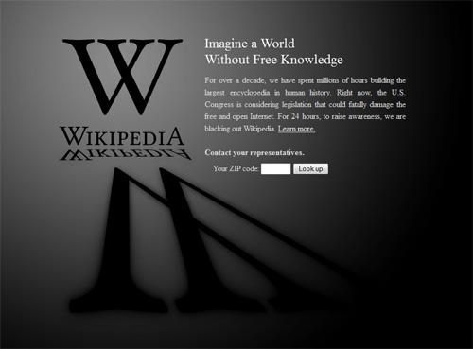
The Post IP World: Redux
Two vastly different versions:
Post IP World A = Superseding Contracts rendering IP all but irrelevant {where we are?}
Post IP World B = User Rights + standard formatted, treaty based and/or consumer protected minimalist contracts {where we are not}

Slide 30
OBSERVATIONS 1
Copyright – legislative public interest framework: serious consequences with serious defenses (fair use/dealing)
Contract – seemingly of a lesser order of seriousness with weak defenses HOWEVER CONSIDER:
+ advantage of the pen
+ intimidation of consumer
+ click-wrap – “fiction” of reading/agreeing
+ lack of standardized/approved/reasonable terms
+ morality of “Contracting out” of:
a.) free speech/expression rights
b.) prevailing statutory copyright laws/rights
c.) {& we have not even mentioned privacy yet}

Slide 31
OBSERVATIONS 2
Can interpret/understand/rationalize almost all the cases as pro User Rights/Gamer Rights; not actually pro-developer
1. MDY v. Blizzard – players using Glider/bots not copyright infingement.
2. Smallwood v. NCSoft – Court preserved some causes of action to addicted gamer despite contract.
Contracts we have seen are all different from each other:
Has there ever been a time where one type of contract is “agreed to” by billions of people?
2. Where is standardization (industry associations; international treaties; consumer protection legislation)?
3. Irony is lawyers complicity for fear of plagiarizing (& copyright).

Slide 32
Takeaways??
Imagine a world without license agreements:
What would happen?
* All cases cited have multiple causes of action
* EA’s original position – no EULA on PC games
WiLd ThOuGhT: CONSUMER CONTRACTS/LICENCE AGREEMENTS – Are they redundant &/or unnecessary?
Are they “…a tale told by an idiot, full of sound and fury, signifying nothing.” (Macbeth Act V, SceneV)
What about STANDARDS or STANDARDIZATION?
(EFF or Creative Commons “approved” standard form EULA’s, ToS’, (non) Privacy Agreements?)
Otherwise….Role of legislation/consumer protection/regulation/government? (TBD Part C of course - “Controlling”)
Notes:
Takeaways

Slide 33
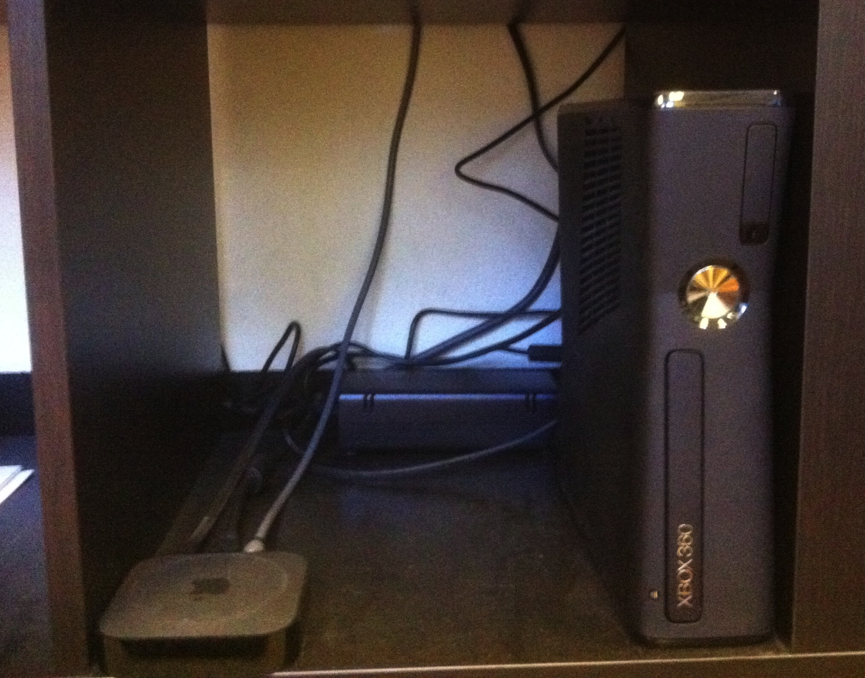
NEXT WEEK….
THE WHEELBARROWS: A REPORT FROM THE FRONTLINES OF OUR “CONNECTING” LIVING ROOMS - ON THE LEGAL IMPLICATIONS OF CONVERGEANCE…

Slide 34
Our Academic Partners

