Slide 1

The Terminator & the Orc
Part D “Conciliation” | Talk 11
Video Game Law 2013
UBC Law @ Allard Hall
Jon Festinger Q.C.
Centre for Digital Media
Festinger Law & Strategy LLP
@gamebizlaw
http://blogs.ubc.ca/videogamelaw/
jon_festinger@thecdm.ca

Slide 2

Now at Part D: Conciliation (final leg of journey)
Part A = Creating
Part B = Connecting
Part C = Controlling

Slide 3
Any Questions on 1st Three memes
Part A = Creating
Part B = Connecting
Part C = Controlling
??????????????????????

Slide 4
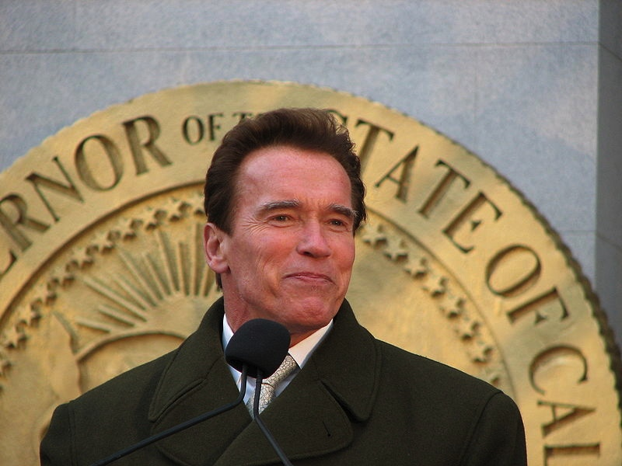

(How) do these (cases) resemble each other?
The Terminator & the Orc
Brown v. Entertainment Merchants Association, 131 S. Ct. 2729 (2011)
(originally VSDA v. Schwarzenegger)
http://www.wneclaw.com/firstamendment/brown.pdf
Davidson & Associates, Inc. v. Internet Gateway, 2005 U.S. App. LEXIS 18973 (8th Cir. 2005) http://cyber.law.harvard.edu/people/tfisher/2005%20Blizzard%20Abridged.pdf

Slide 5

BnetD case “seems to be about”…
* “BnetD” versus Blizzard’s own “Battle.net”
*Amici Curiae Brief supporting defendants by teachers of IP Law in
U.S. law schools
https://www.eff.org/sites/default/files/filenode/Blizzard_v_bnetd20040221_law_professor_brief.pdf
* Argued unsuccessfully that insofar as they prohibit permissible
“reverse engineering” Blizzard’s EULA’s should be preempted by
copyright law. Alternatively argued that enforcement of the EULA’s
should be denied under the Doctrine of Copyright Misuse (related to
concept of “Copyright Monopoly”).
*Attempted unsuccessfully to preserve Sega Enterprises v. Accolade, Inc. statement of the application of Fair Use to to reverse Engineering
* HARSHEST MOD CASE

Slide 6
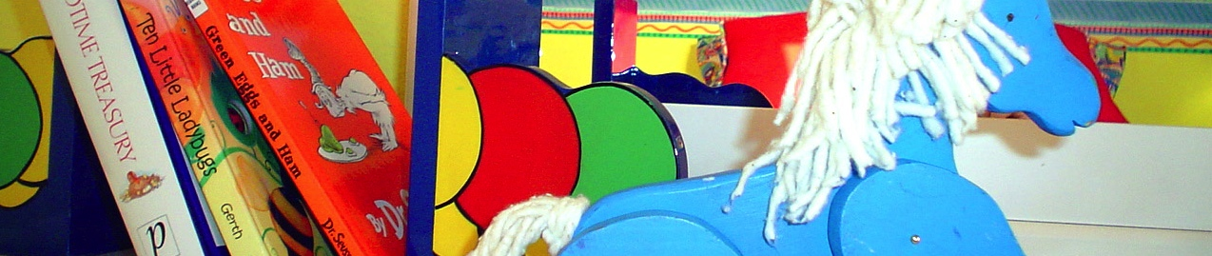
Schwarzenegger case “seems to be about”…
California Statute defined “violent video game” as :
“(d)(1) “Violent video game” means a video game in which the range of options available to a player includes killing, maiming, dismembering, or sexually assaulting an image of a human being, if those acts are depicted in the game in a manner that ...: A) Comes within all of the following descriptions:
(i) A reasonable person, considering the game as a whole, would find appeals to a deviant or morbid interest of minors.
(ii) It is patently offensive to prevailing standards in the community as to what is suitable for minors.
(iii) It causes the game, as a whole, to lack serious literary, artistic, political, or scientific value for minors.”
“Your children are not your children.
They are the sons and daughters of Life’s longing for itself.
They come through you but not from you,
And though they are with you yet they belong not to you.”
Kahlil Gibran

Slide 7
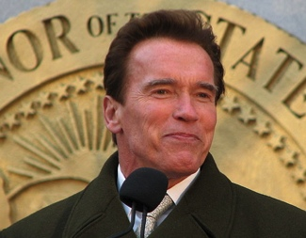

on ‘Correlation not Causation’…
“In sum, the evidence presented by the State does not support the Legislature’s purported interest in preventing psychological or neurological harm. Nearly all of the research is based on correlation, not evidence of causation, and most of the studies suffer from significant, admitted flaws in methodology as they relate to the State’s claimed interest. None of the research establishes or suggests a causal link between minors playing violent video games and actual psychological or neurological harm, and inferences to that effect would not be reasonable. In fact, some of the studies caution against inferring causation. Although we do not require the State to demonstrate a “scientific certainty,” the State must come forward with more than it has. As a result, the State has not met its burden to demonstrate a compelling interest.”

Slide 8
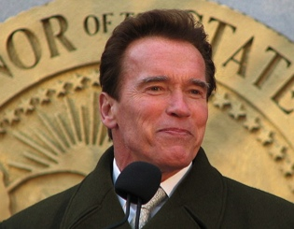
on Comparative Literature
“California's argument would fare better if there were a longstanding
tradition in this country of specially restricting children's access to
depictions of violence, but there is none. Certainly the books we give
children to read -- or read to them when they are younger -- contain no
shortage of gore. Grimm's Fairy Tales, for example, are grim indeed. As
her just deserts for trying to poison Snow White, the wicked queen is
made to dance in red hot slippers "till she fell dead on the floor, a sad example
of envy and jealousy." Cinderella's evil stepsisters have their eyes pecked out
by doves. And Hansel and Gretel kill their captor by baking her in an oven.
High-school reading lists are full of similar fare. Homer's Odysseus blinds
Polyphemus by grinding out his eye with a heated stake. In the Inferno, Dante
and Virgil watch corrupt politicians struggle to stay submerged beneath a lake of
boiling pitch. And Lord of the Flies recounts how a schoolboy is savagely
murdered by other children while marooned on an island.
This is not to say that minors' consumption of violent entertainment has never
encountered resistance. In the 1800's, dime novels depicting crime and "penny
dreadfuls" were blamed in some quarters for juvenile delinquency. When motion
pictures came along, they became the villains instead. Radio dramas were next,
and then came comic books. And, of course, after comic books came television
and music lyrics.”

Slide 9
on the impact of ‘Interactivity’…
“California claims that video games present special problems because they are “interactive,” in that the player participates in the violent action on screen and determines its outcome. The latter feature is nothing new: Since at least the publication of The Adventures of You: Sugarcane Island in 1969, young readers of choose-your-own-adventure stories have been able to make decisions that determine the plot by following instructions about which page to turn to. As for the argument that video games enable participation in the violent action, that seems to us more a matter of degree than of kind.” (Justice Scalia delivering the opinion of the Court)
Versus
“When all of the characteristics of video games are taken into account, there is certainly a reasonable basis for thinking that the experience of playing a video game may be quite different from the experience of reading a book, listening to a radio broadcast, or viewing a movie. And if this is so, then for at least some minors, the effects of playing violent video games may also be quite different. The Court acts prematurely in dismissing this possibility out of hand.” (Justice Alito, concurring in the result)

Slide 10

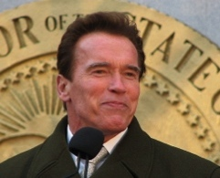
Truth in ‘tone’…
Audio of the June 20, 2005 oral argument in 8th Circuit Court of Appeal in Blizzard v. BnetD (Davidson) @ 32:40 – 33:05: “This case does not involve new creation. There may be a case that does. This isn’t it…”
http://archive.org/details/EighthCircuitCourtofAppeals
Audio of the November 2, 2010 oral argument in the U.S. Supreme Court in Brown v. Entertainment Merchants Association @ 1:13 - 7:20 + 11:25 - 14:04: “What’s a deviant violent video game?...Some of the Grimm’s Fairy Tales are quite grim…” + “I’m not concerned with the jury judging, I’m concerned with the producer of the game…”
http://www.oyez.org/cases/2010-2019/2010/2010_08_1448

Slide 11
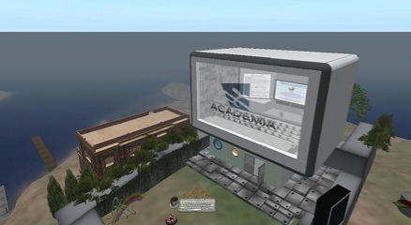

Common Denominator 1
The word: CREATIVITY
Problem is not in asserting creativity (of Blizzard/game makers); it is in both cases the denial of the creativity of others (modders, children, the child in all of us)
Recall uniquely personal “Hollywood Model” of creation (‘It’s all about ME & MY UNIQUE TALENT’)
In Swartzenegger the Court was protecting the implications of creativity no matter how extreme (in terms of violence, not sex) so the creator can create (& the user can ‘benefit’)
In Davidson argument was that BnetD was anything but creative (because it all changes if user creativity is implicated???)
Never mentioned: USERS ARE CREATORS

Slide 12


The (Shocking) Truth About Game IP?
All games are inherently creative & interactive
2. Games must have a larger evolutionary purpose (Talk 1)
3. Video games are in fact “evolved” games
4. In this context “the “art” though wonderful is incidental to the game…
5. The experience, the evolving narrative
& playing (creation) is the key…
6…& the player is the co-creator of the game…
The “Red Herring”?:
IP in a game is more incidental then core ???

Slide 13

Common Denominator 2
A new version of the “Mrs. Smith” conundrum..
Traditional censorship of information &
“copyright as censorship”
See ourselves as “creative” but perhaps not really anyone else in the “real world” (quite so much) – jealousy as a base instinct; &/or we didn’t see that much vale in “creativity”
WE DON’T ACTUALLY ACCEPT EACH OTHERS CREATIVITY & ABILITIES (or at least not easily; at least not that tolerantly)
“The fault, dear Brutus, is not in our stars,
But in ourselves…” (Julius Caesar l, ii,140-141)

Slide 14
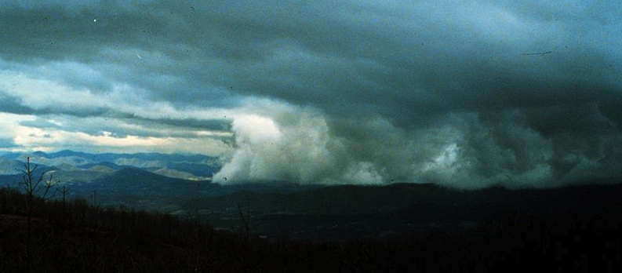
Common Denominator 3: “Chill”
Censorship = Libel Chill
(& other creative “chills” like “Contempt”)
Copyright Infringement fears
= uncertainties = “Creative Chill”

Slide 15
The Academic Battleground
1. “The Illegal Process: Basic Problems in the Making and Application of Censorship” by James Grimmelmann: http://lawreview.uchicago.edu/sites/lawreview.uchicago.edu/files/uploads/Dialogue/Grimmelmann%20Online.pdf
In response to:
1A. “Orwell’s Armchair” by Derek Bambauer: http://lawreview.uchicago.edu/sites/lawreview.uchicago.edu/files/uploads/79_3/01%20Bambauer%20ART.pdf
(Re indirect v. direct internet censorship – Bambauer argues direct preferable)
2. “Collateral Censorship and Freedom of the Press” by Christina Mulligan http://papers.ssrn.com/sol3/papers.cfm?abstract_id=2224058
(Net intermediaries need near-complete immunity to avoid chill of gov’t effectively censoring creators)
3. “The Regulatory Turn in IP” by Mark Lemley
http://papers.ssrn.com/sol3/papers.cfm?abstract_id=2172440
4. “A Case for the Public Domain” by Clark Asay
https://papers.ssrn.com/sol3/papers.cfm?abstract_id=2201066
5. “Error Costs & IP Law” by Joseph Miller
http://papers.ssrn.com/sol3/papers.cfm?abstract_id=2212256
(Problems with over-broad IP laws)

Slide 16
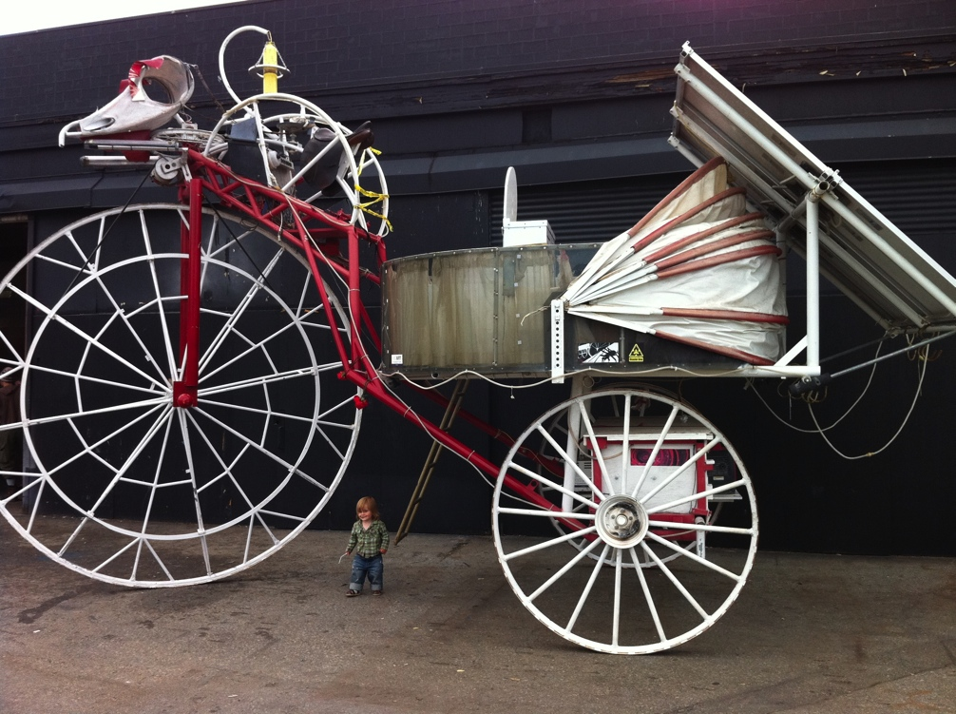

Application of all this…
TO MODS

Slide 17
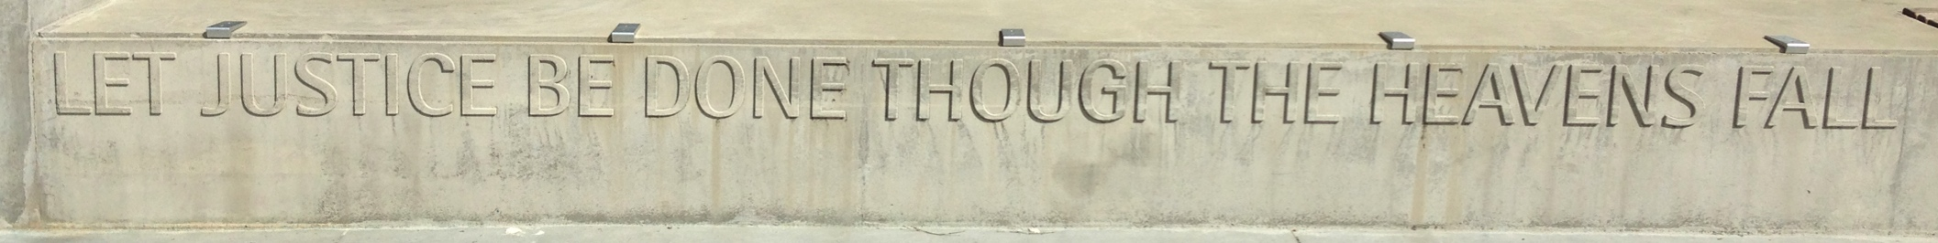
"The world as we have created it is a process of our thinking. It cannot be changed without changing our thinking”
Albert Einstein

Slide 18

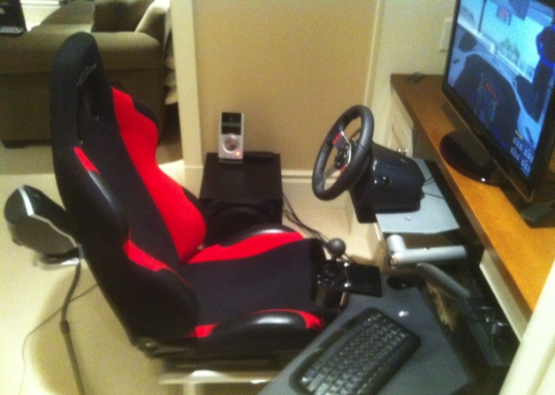

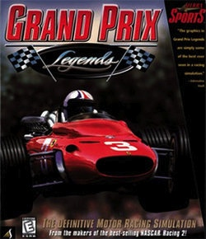
Grand Prix Legends & mods:
A personal history…

Slide 19

Conflicting memes of “CREATIVE”
1. “Everything is a ReMix”
“If you wish to make an apple pie from scratch, you must first
invent the universe.” – Carl Sagan
“There is no doubt that creativity is the most important human resource of all.
Without creativity, there would be no progress, and we would be forever
repeating the same patterns.” - Edward de Bono
“The great driver of scientific and technological innovation [in the last 600 years
has been] the increase in our ability to reach out and exchange ideas with other
people, and to borrow other people’s hunches and combine them with our
hunches and turn them into something new.” – Steven Johnson “Where Good
Ideas Come From: The Natural History of Innovation”(book)..also see:
http://www.youtube.com/watch?feature=player_embedded&v=0af00UcTO-c#!
“All Creative Work is Derivative” – Nina Paley
http://blog.ninapaley.com/2010/02/09/all-creative-work-is-derivative/
“Creativity is just connecting things.” - Steve Jobs in a Wired Magazine
interview (Feb. 1996) http://www.wired.com/wired/archive/4.02/jobs_pr.html

Slide 20

2. The “Hollywood Model”
* “The creative is the place where no one else has ever been. You have to leave the city of your comfort and go into the wilderness of your intuition. What you’ll discover will be wonderful. What you’ll discover is yourself.”
* View that creativity is uniquely personal (or not) impacts and informs belief, perspective and approach to copyright & IP (film & music) – consequences of “specialness” (and entitlement?)
* Personal creation mythology deeply rooted in our psyches’: “And G-d said: ‘Let us make man in our image, after our likeness;”(Genesis, Chap. 1 Verse 26)
* Role and consequences of copyright law aligning along according to personal belief: Copyright literalists’ adopt “self” generated model of creativity? “Connection-ists” adopt more open source model?

Slide 21
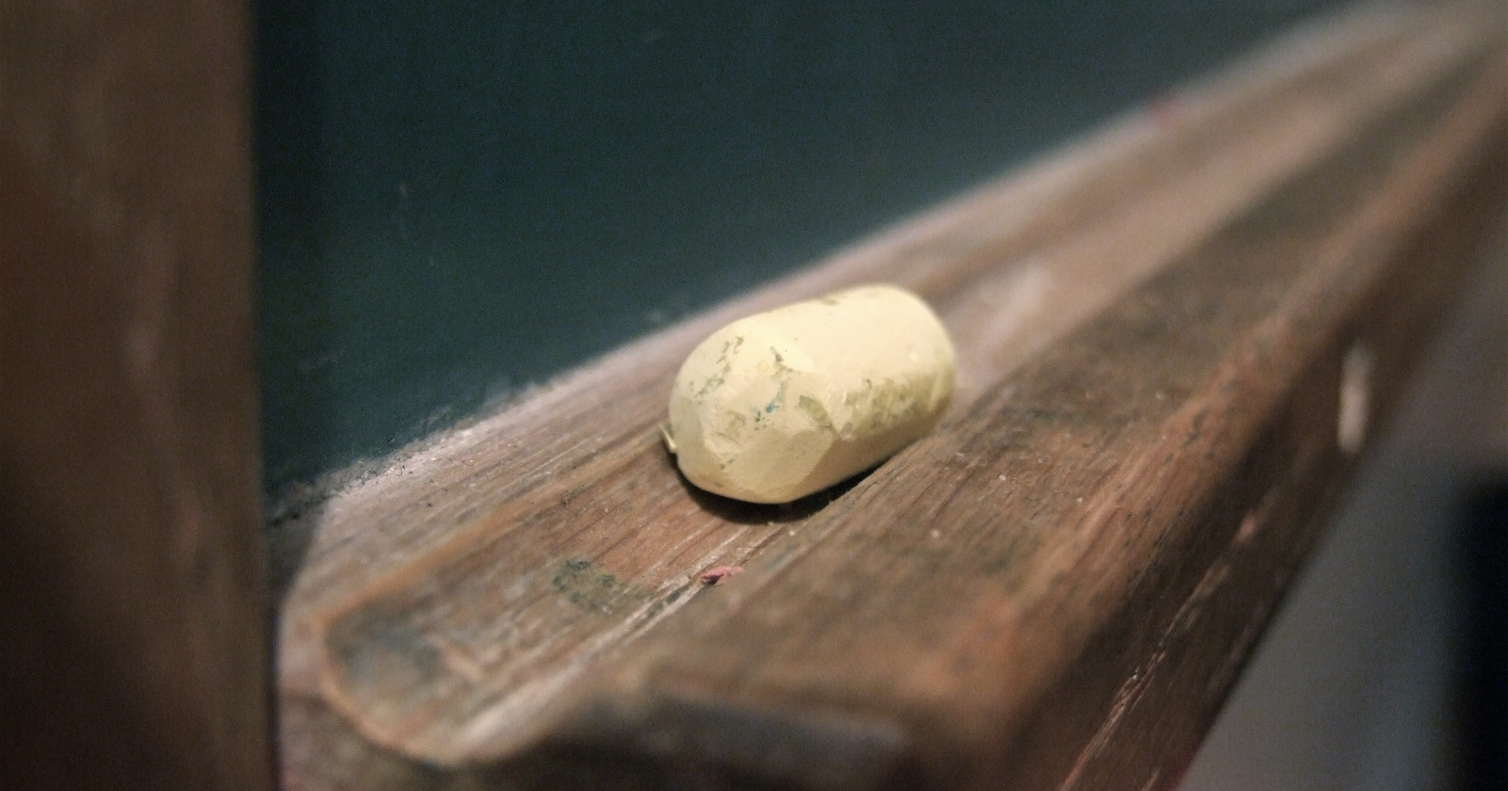
Education as modding

Slide 22

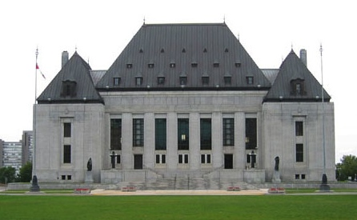
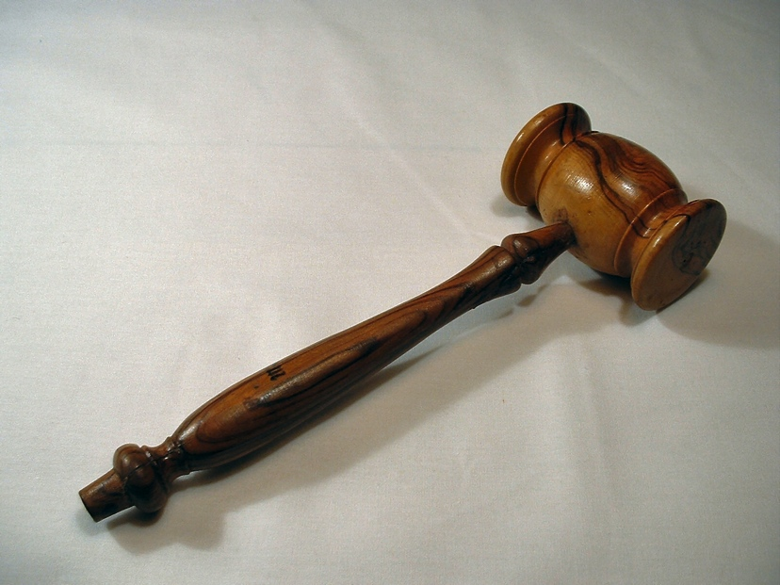
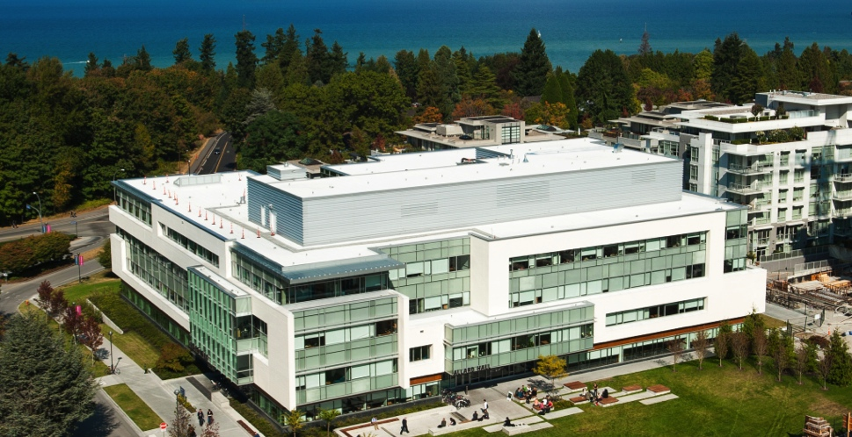
The Common Law as Modding

Slide 23
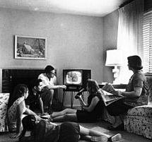
Problem 1: CREATIVE CHILL
Remember “Mrs. Smith”?: Now Revisited
THE “MRS. SMITH” PRINCIPLE
Human Instinct to Censor?
“What matters is not what Canadians think is right for themselves to see. What matters is what Canadians would not abide other Canadians seeing because it would be beyond the contemporary Canadian Standard of tolerance to allow them to see it.” (1985 SCC Dickson CJ Towne Cinema v. The Queen )
THE “MRS. SMITH” PRINCIPLE REVISITED
WE DON’T ACTUALLY ACCEPT EACH OTHERS CREATIVITY & ABILITIES (or at least not easily; at least not that tolerantly)

Slide 24

Problem 2: Remember the Idea/Expression
Dichotomy ?
Once upon a time…a long time ago……
Private Public
Idea Expression

Slide 25
(TODAY) IN THE DIGITAL WORLD
idea
private
EXPRESSION
PUBLIC

Slide 26
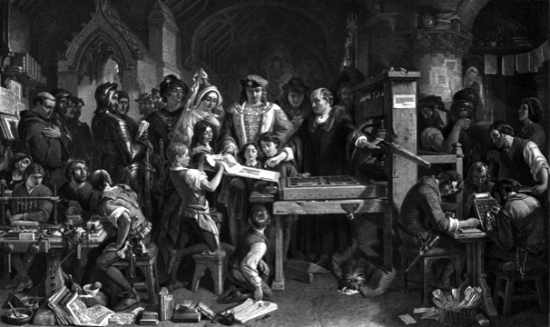
Understanding Copyright as part of the democratization of thought? As part of a trajectory of creative freedoms?
From King…to Parliament…to Government
Regulator…to Industry Self Regulation…to Author…
to User..Or (effectively) STOP @ 1710 Staute of Anne?
Strange then that Copyright constrains Speech???
Right to Mod/CREATE perhaps the legitimate child of both Free
Speech & Copyright Laws
Meaning perhaps our understanding of copyright should prioritize
the creative freedoms associated with content creation & use in
preference to the “private ownership” aspects:
WHAT IS MOST FUNDAMENTAL?
= Right to Mod/CREATE?

Slide 27
Cases Neither Allow Nor Prohibit (Creative) Modding
Micro Star v. FormGen 1998 USCA
2. Davidson & Associates, Inc. v. Internet Gateway 2005 USCA (D&A = Blizzard):
Audio of the June 20, 2005 oral argument in 8th Circuit Court of Appeal in Blizzard v. BnetD (Davidson) @ 32:40 – 33:05: “This case does not involve new creation. There may be a case that does. This isn’t it…”
3. iRacing v. Robinson (2007 Mass. Dist. Ct.)
4. MDY Industries, LLC v. Blizzard Entertainment, Inc. (2010 USCA):

Slide 28
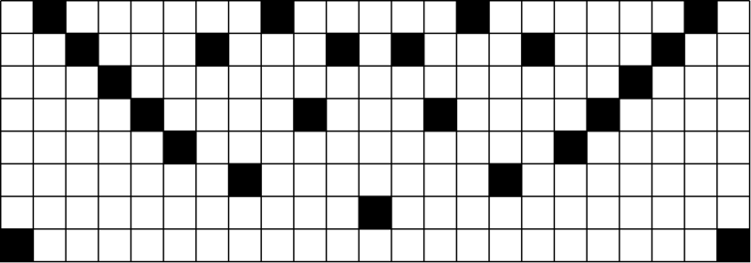
Common Denominators of the Cases
Creativity is never in issue in the cases
Copyright Law is only directly relevant in Microstar (& Galoob “Game Genie”) - no contractual nexus, so sole “copyright only” case.
“Fair Use” mods question evaded/avoided/confused by:
Contract Law (Davidson, iRacing & MDY all involved EULA, ToS or ToU terms & obligations, or DMCA).
Nothing creative in what Micro Star did – they did not create a mod – they usurped mod creators without permission
Conclusion: No precedent that game mods are not “Fair Use”.
Can interpret/understand/rationalize almost all the cases as pro User Rights/Gamer Rights; not actually pro-developer

Slide 29

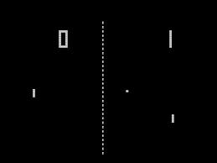
Right to Mod Argument - Method A:
Revert to No Protection for Games
“Games and Other Uncopyrightable Systems” Bruce Boyden 2011
http://www.georgemasonlawreview.org/doc/Boyden_18-2_2011.pdf
“Games therefore pose a number of challenges for copyright and patent law. Yet to date, intellectual property doctrine and scholarship has not really grappled with the slippery nature of games. Indeed, copyright has developed a very simple black-letter rule to handle them: games are not copyrightable. That rule begins to fall apart on close examination, however. It turns out that while games per se are not copyrightable, most of their constituent elements are: the board, pieces, cards, and even the particular expression of the rules. What could be the purpose of such a rule?”

Slide 30
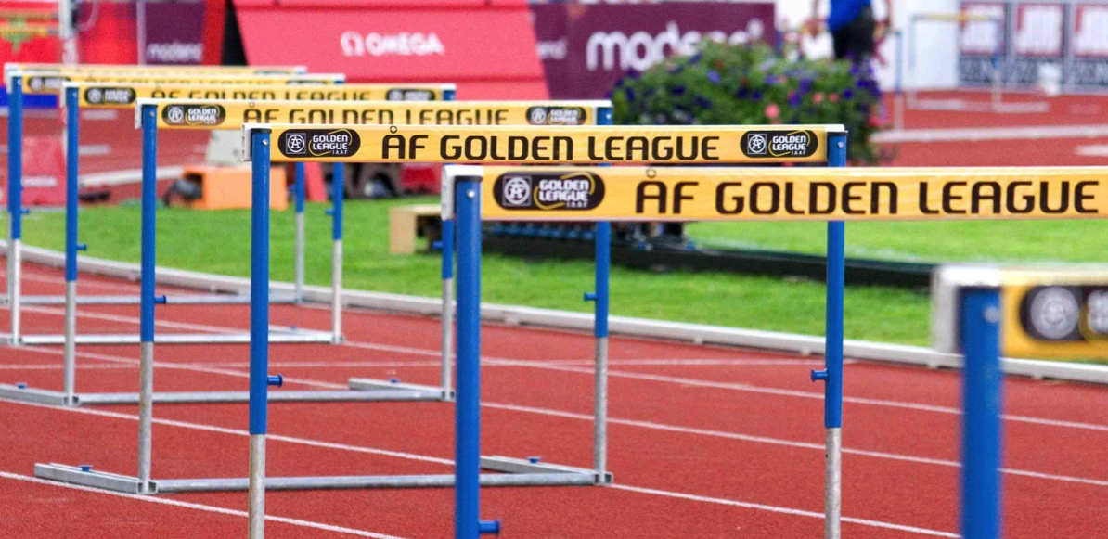
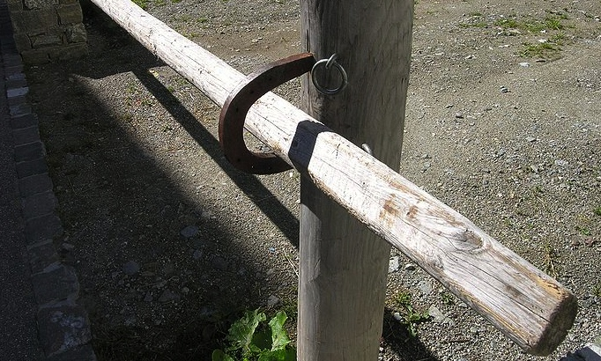
Right to Mod Argument – Method B:
Raise Thresholds for IP Protection
* “Personal Genius” theory of creativity undermined by low level of originality in copyright and ease of differentiation in patent. See “The Innovation Dilemma: Intellectual Property and the Historical Legacy of Cumulative Creativity” - Graham M. Dutﬁeld and Uma Suthersanen (U.K.): “The downside of having a wide capacity to protect, however, is that copyright law does manage to ensnare essential information and elements that form a part of the knowledge base, which in turn impedes the progress of follow-on innovators who must build upon such vital building blocks.” http://www.academia.edu/860340/

Slide 31

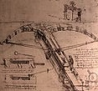
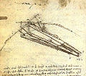
Right to Mod Argument – Method C:
Fair Use/Dealing – “User Rights”
Recent SCC “User” paradigm shifts
USERS ARE CREATORS TOO
“The August “Copyright Pentalogy” & previous cases
Moving from fair dealing as an exception to copyright infringement towards proactive “User Rights”
Right to Link (Crookes v. Newton)
Right to longer iTunes previews
Tech Neutrality
Fair dealing is to be assessed from the point of view of the purchaser/user
“Research” need not be associated with traditional intellectual pursuits

Slide 32
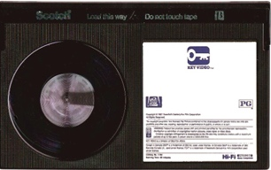
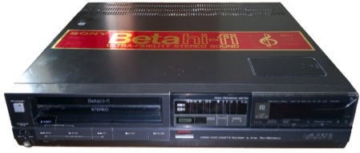
Right to Mod Argument – Method D:
“Context Shifting”
Imagine a world without Sony v. Universal SCOTUS
464 U.S. 417 (1984) (Betamax) time-shifting” fair use?
Why isn’t everything in digital world not a form
of tool enabled “time-shifting”
= “context shifting”
Key Factors in Sony:
a. enlarged audience; b. did not impair copyright value
Jumping off point for Fair Use discussion - Isn’t digital “todays “tool”
>>> “Context shifting”

Slide 33
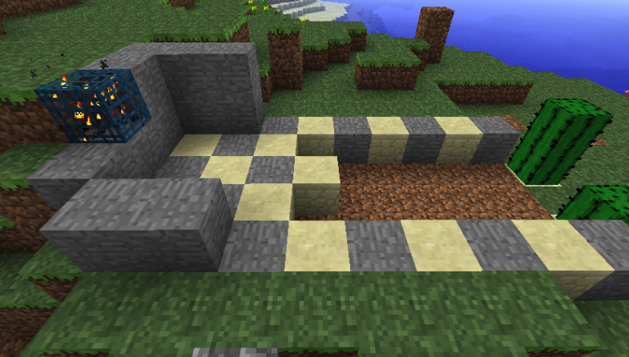

Right to Mod Argument – Method E:
Right to Mod/CREATE
SHOULD NOT User Rights/Right to CREATE-Mod really be a creative/expressive right rather than an IP right/protection?
Part of Freedoms of Thought/Conscience?
Part of Free Expression (criticism & review/news reporting)
An expanded “public interest” based Fair Dealing/Fair Use?
As an independent “right”

Slide 34
Can we (please)……
…….evolve a single standard:
For CREATORS as USERS, &
For USERS as CREATORS
…….to match reality…..
Facilitating “true” INTERACTIVITY set Mods apart from other (one-way) art
It make a difference that mods/games are a tool of other/further creativity.
Who owns SHARED CREATIVITY?
Is modding a “Right to CREATe” (expression/speech) or a “Creator’s Right” (part of/defense to: copyright)?
Users Rights a ought to be a “Right to CREATe” not “Rights of Creation”

Slide 35
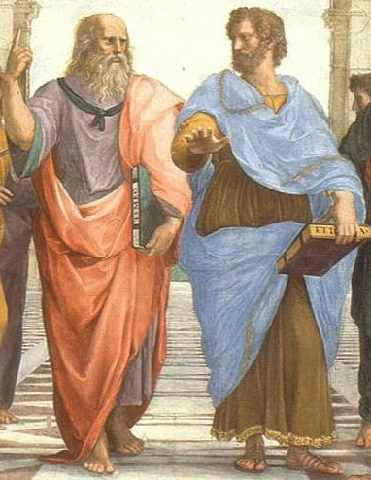
NEXT TIME….
ETHICS & GAMES

Slide 36
Our Academic Partners

