Slide 1

Mass Effect-s
Part C “Controlling” | Talk 9
Video Game Law 2013
UBC Law @ Allard Hall
Jon Festinger Q.C.
Centre for Digital Media
Festinger Law & Strategy LLP
@gamebizlaw
jon_festinger@thecdm.ca

Slide 2

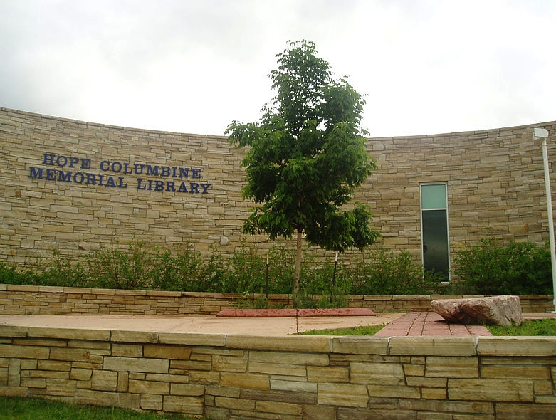
The Assault on Videogames
The Assault by Videogames
REMIXING VIOLENCE & CIVIL SOCIETY

Slide 3
LAST WEEK A: Layers of Control
12. Theft, assault (criminal law)
11. Currency/taxation (statutory/regulatory).
10. Gambling (regulatory body – criminal law back-drop)
9. Unfair competition (Competition/anti-trust)
8. Misleading promises/advertising, physical or psychological harm
(consumer protection)
7. Medium specific regulation (constitutional)
Out of the Game Norms
------------------------------------------------------------------------------------------------
In the Game (Magic Circle) Ethics (of Originality, Creativity & Expression)
6. Industry self regulation
5. Personality rights (tort, IP)
4. EULA/ToS (contractual, private)
3. IP (copyright, patent, trademark – statutory)
2. Technology (quasi extra-legal)
1. Community (extra-legal)

Slide 4


LAST WEEK B: The new video game (hypothetical)
Real-world “play” (“Ingress” – Capture the Flag mechanic)
+ Immersive control mechanism (Google Glass)
+ Anywhere/any device capability (the “cloud”)
+ “Open World” design (literally & Google Earth)
+ Tools/weapons (AR Drone Quadra Copter; Google Car)
IS THIS REALLY A GAME?
+

Slide 5
Intro: “Secrets” of contractual immunity
Overall video game population is about one third kids
ESA Game Player Data: “Sixty-eight percent of gamers are 18 years of age or older” http://www.theesa.com/facts/gameplayer.asp
See also “2012 Sales, Demographic and Usage Data”http://www.theesa.com/facts/pdfs/ESA_EF_2012.pdf
“91 percent of kids are gamers, research says” (also kids responsible for 44% of physical software sales)http://news.cnet.com/8301-13506_3-20118481-17/91-percent-of-kids-are-gamers-research-says/
EULA’s & ToS do not mention underage use & even more rarely mention penalties (e.g. Check CoD EULA & ToU)
EULA’s & ToS not really obvious in violence debates
WHY? Because EULA’s & ToS are irrelevant…
“Gordion Knot” - contracts don’t bind kids
Example of how ineffectual EULA & ToS can be…

Slide 6


Industry Complicity? 1.
“And here's another dirty little truth that the media try their best to conceal: There exists in this country a callous, corrupt and corrupting shadow industry that sells, and sows, violence against its own people…Through vicious, violent video games with names like Bulletstorm, Grand Theft Auto, Mortal Kombat and Splatterhouse. And here’s one: it’s called Kindergarten Killers. It’s been online for 10 years…” --- Wayne LaPierre NRA --- http://home.nra.org/pdf/Transcript_PDF.pdf
(Bulletstorm=sci-fi; Grand Theft Auto=crime; Mortal Kombat=fantasy; Splatterhouse=horror; Kindergarten Killers=“flash”)
WHAT’S MISSING?... CALL of DUTY; BATTLEFIELD; America’s Army…
* “Shooters: How Video Games Fund Arms Manufacturers” - Simon Parkin http://www.eurogamer.net/articles/2013-02-01-shooters-how-video-games-fund-arms-manufacturers
* “EA removes links to gun sellers on ‘Medal of Honor’ page”
http://www.theverge.com/2012/12/27/3807900/ea-removes-links-to-gun-sellers-on-medal-of-honor-page
Double Standards Test?
--------------------------------
See also: “Invading Your Hearts and Minds”:
Call of Duty and the (Re)Writing of Militarism in
U.S. Digital Games And Popular Culture” (2010)
http://ejas.revues.org/8831

Slide 7

Industry Complicity? 2.
Industry maturity issue?
Actual maturity issue (young geeky males trying to be cool)?
Counter-culture roots become trendy poseur rebellion?
The “Grand Theft Auto San Andreas/Hot Coffee” saga
“Debate intensifies over Hot Coffee sex in GTA” (Gamespot June 11, 2005) http://www.gamespot.com/news/debate-intensifies-over-hot-coffee-sex-in-gta-6128837
“Hot Coffee controversy grows as Hilary Clinton weighs in” (Gamesindustry International July 14, 2005)http://www.gamesindustry.biz/articles/hot-coffee-controversy-grows-as-hilary-clinton-weighs-in
“ESRB concludes investigation into Grand Theft Auto: San Andreas; Revokes M (Mature) Rating” http://www.esrb.org/about/news/7202005.jsp
“BREAKING: RB Recalls San Andreas” (Kotaku July 20, 2005) http://kotaku.com/113506/breaking-esrb-recalls-san-andreas

Slide 8
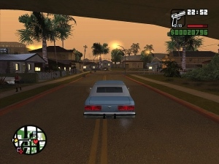
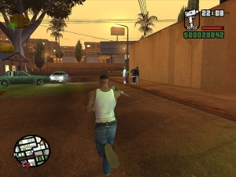
Industry Complicity? (2 – GTA saga continued)
“Who spilled Hot Coffee? The man who uncovered gaming's greatest sex scandal”: http://www.eurogamer.net/articles/2012-11-30-who-spilled-hot-coffee
“Federal Trade Commission Complaint against Take-Two & Rockstar Games” (July 17, 2006): http://www.ftc.gov/os/caselist/0523158/0523158c4162TakeTwoInteractiveandRockstarComplaint.pdf
Settled June 8, 2006: http://www.ftc.gov/opa/2006/06/grandtheftauto.shtm
To “corporatize” - solution or greater problem?

Slide 9

Industry Complicity? 3.
EULA’s & ToS generally do not even mention
underage use
Avoiding the issue?
Not wanting to scare anyone off?
Confirming ineffectualness?
Looking the other way?
Confirming double standard?
"We consider it a good principle to explain the phenomena by the simplest hypothesis possible.” Ptolemy (c. AD 90 – c. AD 168)

Slide 10
Violent Games, Liability & Regulation: Cases
Watters v. TSR (D&D) 1990 USCA
James v. Meow (Heath High, Kentucky) 2002 USCA
Sanders v. Acclaim (Columbine) 2002 US Dist.
Wilson v. Midway (Mortal Kombat) 2002 US Dist.
------------------------------------------------------------------------------------------------
American Amusement v. Kendrick 2001 USCA (protecting minors)
IDSA v. St. Louis 2003 USCA (protecting minors)
VSDA v. Maleng 2004 US Dist. (regulate games depicting violence against law enforcement)
ESA v. Blagojevich 2006 USCA (protecting minors)
EMA v. Henry 2007 US Dist. (protecting minors)
ESA v. Swanson 2008 USCA (purchase contrary to “rating”)
ESA v. Chicago Transit 2010 US Dist. (restricted “M” game ads on CTA vehicles)
ESA v. Schwarzenegger 2011 SCOTUS (prohibited violent video games) - Talk 10 upcoming

Slide 11
Violent Games, Liability & Regulation: Rationales
Proximate cause (civil) not demonstrated - not foreseeable - studies ambiguous re “actual harm”
Products liability claims inapplicable
Duty to exercise ordinary care
------------------------------------------------------------------------------------
Link of violent games to violence unproven – causality not demonstrated; correlation not cause
Thought control = totalitarianism = family responsibility
Drafting not narrowly tailored to objective
Vague & ambiguous definitions/provisions
Classic literature/film, Bible, fairy-tale comparisons

Slide 12


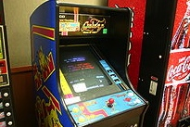
Canada - potentially quite different (if tested)
Montreal v. Arcade Amusements 1985 SCC – City By-Law 5156 (1977) cannot discriminate based on age (under 18) prohibiting entry to video arcade (narrowly construed decision)
Irwin Toy v. Quebec 1989 SCC - constitutionality of ban on commercial advertising directed at children under 13 upheld (no evidence or discussion of direct harm)
R. v. Sharpe 2001 SCC - reasoned apprehension of harm to children is sufficient (child pornography)

Slide 13
The Political Issue
Majority of Americans Believe Games Contribute to Violence: http://www.escapistmagazine.com/news/view/122351-Majority-of-Americans-Believe-Games-Contribute-to-Violence
Sen. Lamar Alexander: Games are a Bigger Problem Than Guns:
http://www.gamepolitics.com/2013/01/30/sen-lamar-alexander-games-are-bigger-problem-guns
VERSUS
Former FBI Profiler: Video Games Do Not Cause Violence:http://gamepolitics.com/2013/02/25/former-fbi-profiler-video-games-do-not-cause-violence#.USwJD6XR0m0
Little Evidence Sandy Hook Shooter Was a Gamer: http://www.ign.com/blogs/andreweisen/2013/01/25/little-evidence-sandy-hook-shooter-was-a-gamer
25 Video Game Violence Studies, Summarized: http://kotaku.com/5976781/25-video-game-violence-studies-summarized
I’m Mentally Ill, I Love Violent Video Games, And They’ve Never Made Me Feel Like Killing Anyone:
http://kotaku.com/5976286/im-mentally-ill-i-love-violent-video-games-and-theyve-never-made-me-feel-like-killing-
Anyone
Video Games Hold No Answers: http://www.huffingtonpost.com/paul-mones/video-games-violence_b_2480823.html
I was Adam Lanza: http://www.thedailybeast.com/articles/2012/12/22/i-was-adam-lanza.html
---------------------------------------------------------------------------------------------------------------------------------------------------
Invitation to a Dialogue: Media Violence
http://www.nytimes.com/2013/01/23/opinion/invitation-to-a-dialogue-media-violence.html?_r=0

Slide 14

Evolving Memes & Cultural/Legal Choices
Areopagitica - John Milton 1644
Lady Chatterley’s Lover – D.H.
Lawrence 1928
Elvis on Ed Sullivan 1956
Lenny Bruce convicted for obscenity
1964 (posthumously pardoned)
The Pentagon Papers 1971
All in the Family 1971
Sony Betamax 1977 (Sony v. Universal
SCOTUS1984)
The Satanic Verses Salmon Rushdie 1988
Madonna “Like a Prayer” 1989
Anonymous 2003
GTA/Hot Coffee 2004
Aaron Swartz (1986 -2013)
WE LOOK BACK and LAUGH (& CRY)
Re Alberta Legislation (Alberta Press Act unconstitutional) SCC
1938
Roncarelli v. Duplessis (revoking liquor license of Jehovah’s
witness unconstitutional) SCC 1959
Irwin Toy (advertising directed at children constitutional) SCC
1989
R. v. Butler (sex with violence obscene) SCC 1992
Dagenais v. CBC (publication bans limited) SCC1994
Little Sisters (Customs Act power to exclude obscenity upheld
but implementation was discriminatory) SCC 2000
Crookes v. Newton (hyperlinking allowed) SCC 2011
ESA v. SOCAN (tech neutrality/fair dealing expansions &
Pentalogy) SCC 2012
A.B v.Bragg (anonymity for bullied complainant) SCC 2012
Privacy?
Remixing?
Interoperability?
Net Neutrality?
* part of cover
“The Selfish Gene”
Richard Dawkins
TRAJECTORY OF OPENNESS?

Slide 15
Footnote: Recent SCC “User” paradigm shifts
The August “Copyright Pentalogy” & previous cases
Moving from fair dealing as an exception to copyright infringement towards proactive “User Rights”
Right to Link (Crookes v. Newton)
Right to longer iTunes previews
Tech Neutrality
Fair dealing is to be assessed from the point of view of the purchaser/user
“Research” need not be associated with traditional intellectual pursuits
See: “Reflections on the Supreme Court of Canada 2012 Copyright Decisions” (IP Osgoode) Nov. 29,2012http://www.iposgoode.ca/2012/11/ip-osgoode-speaker-series-the-honourable-mr-justice-marshall-rothstein-%E2%80%93-reflections-on-the-supreme-court-of-canada-2012-copyright-decisions/

Slide 16

Perspective: A Law to know - but not a Legal Principle
2nd LAW OF THEROMODYNAMICS – ENTROPY
The total entropy of any isolated
thermodynamic system tends to
increase over time…
higher the entropy,
higher the chaos (disorder)
Yes, we are now in the puddle…
trying to make sense of the cube…
*Entropy = the only quantity in the physical sciences that implies the arrow of time >>>>>

Slide 17
Examining ENTROPY starting with…The Painful Truth
Watters v. TSR, Inc., 904 F. 2d 378 - Court of Appeals, 6th Circuit 1990 (Dungeons & Dragons):
“But if Johnny's suicide was not foreseeable to his own mother, there is no reason to suppose that it was foreseeable to defendant TSR…
…The fact is, unfortunately, that youth is not always proof against the strange waves of despair and hopelessness that sometimes sweep seemingly normal people to suicide, and we have no way of knowing that Johnny would not have committed suicide if he had not played Dungeons & Dragons…
…As far as the record discloses, no one had any reason to know that Johnny Burnett was going to take his own life. We cannot tell why he did so or what his mental state was at the time. His death surely was not the fault of his mother, or his school, or his friends, or the manufacturer of the game he and his friends so loved to play. Tragedies such as this simply defy rational explanation, and courts should not pretend otherwise.”

Slide 18

A Case For Absolutes (1) (but not the one you expect)
One good that appears absolute is……….(drumroll please)...
…dialectics on issues of
…violence, censorship & fear
(as well as protecting ourselves from ourselves)
Proof: INCREASE in debate over censorship/freedom issues appears to parallel DECREASE in violence & crime
Parallels: Steven Pinker “The Better Angels of Our Nature: Why Violence Has Declined”
*to paraphrase - our ability to reason has allowed us to curtail the
appeals of violence

Slide 19
A Case For Absolutes (2)
Another good that appears absolute is that addressing problems at
their extremes often makes for an odd & inappropriate middle
Dealing with violent video games with a goal of preventing further
New Town’s & Columbine’s mixes up causality & correlation
Seems likely that games don’t create killers but that killers seek out
killing games as an outlet (explains study results where violent games
and sexual outlets appear to decrease “deviance”)
“Gun Control Debate: Violent Video Games Actually
Decrease Violence, Study Finds”: http://www.policymic.com/articles/28280/violent-video-games-actually-decrease-violence-study-finds
“Research: As Violent Video Game Sales Climb,
Violent Crime Among Youths Decreases”: http://www.gamepolitics.com/2013/02/13/research-violent-video-game-sales-climb-crime-among-
youths-decreases#.UR9AI6XR0m0

Slide 20
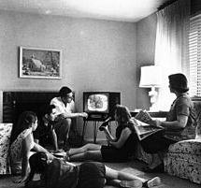
A Case For Absolutes (3)
3rd ABSOLUTE (as mentioned):
historical truth (?) that
we look back & laugh (and cry) at previous censorship
“What matters is not what Canadians think is right for themselves to see. What matters is what Canadians would not abide other Canadians seeing because it would be beyond the contemporary Canadian Standard of tolerance to allow them to see it.” (1985 SCC Dickson CJ Towne Cinema v. The Queen )
THE “MRS. SMITH” PRINCIPLE
Human Instinct to Censor?
(non-dialectical- impedes progress)

Slide 21



A Case For Absolutes (4)
A BOLD QUESTION
Is all speech & creativity is “political”?
(in the digital age)

Slide 22


Virtual v. Real GUNS: the obvious distinction
Guns are not the cause of violence
They are actually a part of the violence.
It is for that reason they are different from media
influences, video-games and the rest.
Related: difference between ACTIONS (e.g. rampage killing)
& INFLUENCES (video-games, movies).
Between them lies INTERPRETATION
(which is about education)

Slide 23

Game Wars: Episode 4
A New Hope
Broader gaming audience; education; tasteless violence (E.g. Hitman 3 controversy?); mobile etc.
Leads to alienation of hardcore?
Leads to developer reaction against gratuitous sex & violence in games?
Leads to noticing these bad games aren't that good - - - As opposed to censorship.
“Nine Signs That Video Games Grew Up a Bit in 2012”http://kotaku.com/5966587/nine-signs-that-video-games-grew-up-a-bit-in-2012

Slide 24
Additional Sources…
* “The Agony and the Exidy: A History of Video Game Violence and the Legacy of Death Race” http://gamestudies.org/1201/articles/carly_kocurek
* “The Darknet and the Future of Content Distribution” crypto.stanford.edu/DRM2002/darknet5.doc
* “Violence and videogames: we look at the studies cited in the aftermath of Sandy Hook”http://www.pcgamer.com/2012/12/20/violence-and-videogames-we-look-at-the-studies-cited-in-the-aftermath-of-sandy-hook/
* “Don't Trust the Research Saying Video Games Cause Real-World Aggression”http://www.slate.com/blogs/crime/2012/12/21/wayne_lapierre_don_t_listen_to_the_nra_the_research_saying_video_games_cause.html
* “All Games Are (In A Sense) Violent” http://techcrunch.com/2012/12/22/all-games-are-in-a-sense-violent/
* “Video games don't create violence in society, they reflect it http://www.polygon.com/2013/1/14/3875420/video-game-violence
* “Expert: Violent Video Games Should Be For Adults Only” http://hereandnow.wbur.org/2013/02/21/video-games-guns

Slide 25

Women Gamers – Women in Games
(sources)
“Video Games and Aestheticising Sexual Violence”http://gamingbolt.com/video-games-and-aestheticising-sexual-violence
“A Feminist Reviews Tomb Raider's Lara Croft” http://www.forbes.com/sites/carolpinchefsky/2013/03/12/a-feminist-reviews-tomb-raiders-lara-croft/
“Hitman Absolution: Trailer causes outrage”http://www.pocket-lint.com/news/45874/hitman-absolution-trailer-causes-outrage-io-games-producer-talks-violence-and-content
“In Virtual Play, Sex Harassment Is All Too Real”http://www.nytimes.com/2012/08/02/us/sexual-harassment-in-online-gaming-stirs-anger.html
“Image Based Harassment and Visual Misogyny”http://www.feministfrequency.com/2012/07/image-based-harassment-and-visual-misogyny/
“Fear of a Woman Warrior”http://www.gamespot.com/features/fear-of-a-woman-warrior-6404142/
“On being a girl in computer science - a confession” by Dr. Kimberly Vollhttp://zanytomato.tumblr.com/post/44978912674/on-being-a-girl-in-computer-science-a-confession

Slide 26

Kids & Video Games
Surprisingly (to some) positive?

Slide 27


Game Addiction
“Top 10 Cases of Extreme Game Addiction”http://listverse.com/2010/11/07/top-10-cases-of-extreme-game-addiction/
“Problems with the Concept of Video Game “Addiction”: Some Case Study Examples” - Richard T. A. Woodhttp://laurier.communicationstudies.ca/files/wood_problems_game_addiction.pdf
“A case study of Internet Game Addiction - Eun Jin Lee"http://wpblog.uncfsu.edu/fsu_news/files/2012/01/Journal-of-Addictions-Nursing-Article-on-A-Case-Study-of-Internet-Game-Addiction.pdf
“Computer and Video Game Addiction—A Comparison between Game Users and Non-Game Users”https://www.sfu.ca/cmns/courses/2011/325/class/13zachary/3_final_project/Misc_files/Computer%20and%20Video%20Game%20Addiction%20%20Weinstein.pdf
Video Game Addiction.Orghttp://www.video-game-addiction.org/video-game-addiction-articles/study-documents-prevalence-of-pathological-behavior-among-young-video-gamers.htm

Slide 28

Next Class: Controlling the Controllers
The many meanings of Privacy in Video Games
Contours of Video Game Regulation?

Slide 29
Our Academic Partners

