Slide 1
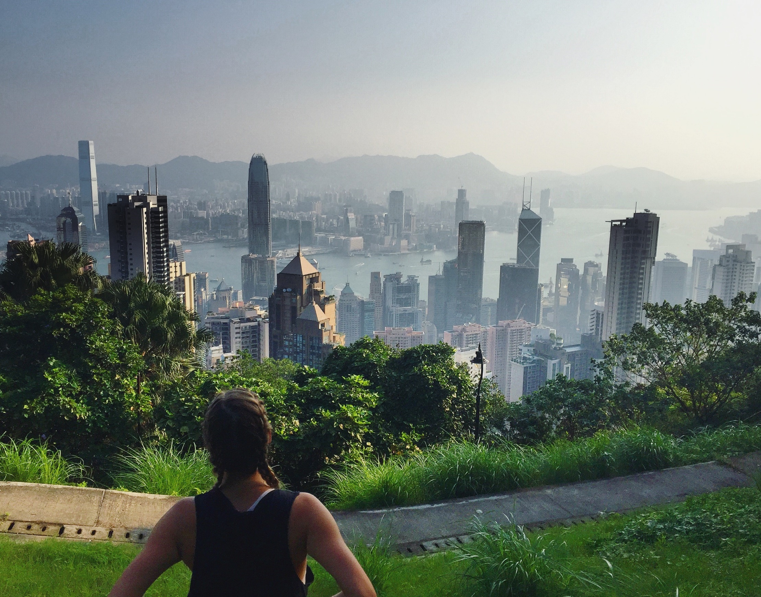
SAFE TRAVEL ESSENTIALS

Slide 2
Maintain the Student Safety Abroad Registry
Stay informed of travel conditions
Offer students resources advice and help while travelling

Slide 3
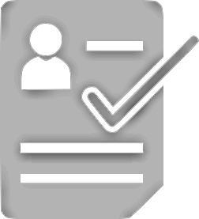
Use safe travel resources
Register your trip with UBC and your home country
Research and prepare for travel risks

Slide 4
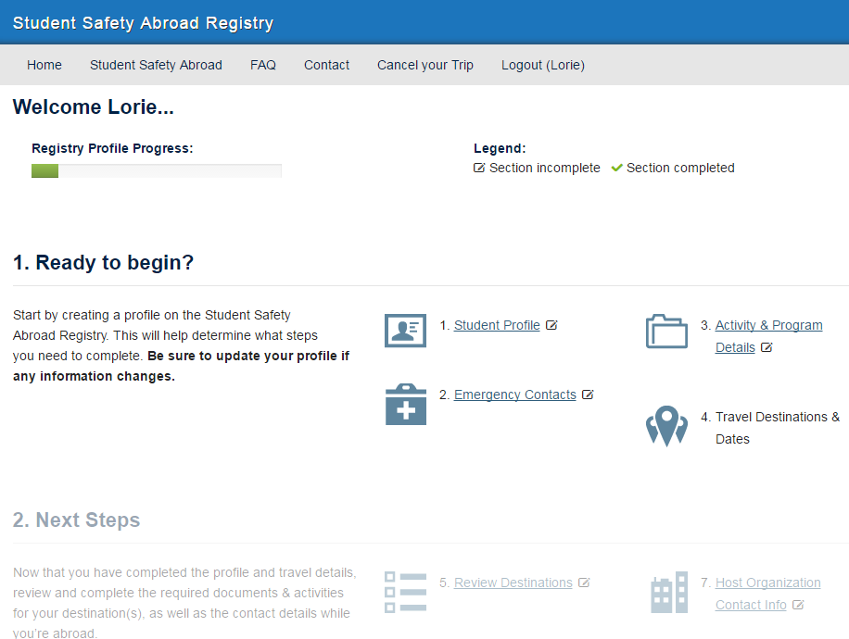

Slide 5
Who’s travelled away from home on their own?

Slide 6
Who’s been to their destination before?

Slide 7
Find a partner and share a story of a previous travel mishap. Focus on:
What happened?
How did you respond?
What did you learn?
Be prepared to share back to the group

Slide 8
CASE STUDY

Slide 9
You have a couple of weeks left at your destination and decide it’s time to check out the hike that everyone has been telling you about. It’s the one with amazing views that isn’t difficult; tourists do it all the time. You head out with a friend and around the midpoint you lose your footing and slip. Ouch! You feel severe pain in your lower leg, notice swelling and cannot bear any weight on your leg. You already know there is cell-service since you just posted a picture of one of the lookouts on Instagram.
How would you respond?
Are there extra challenges since you’re somewhere new?
Could you have done anything in advance to avoid the incident?

Slide 10
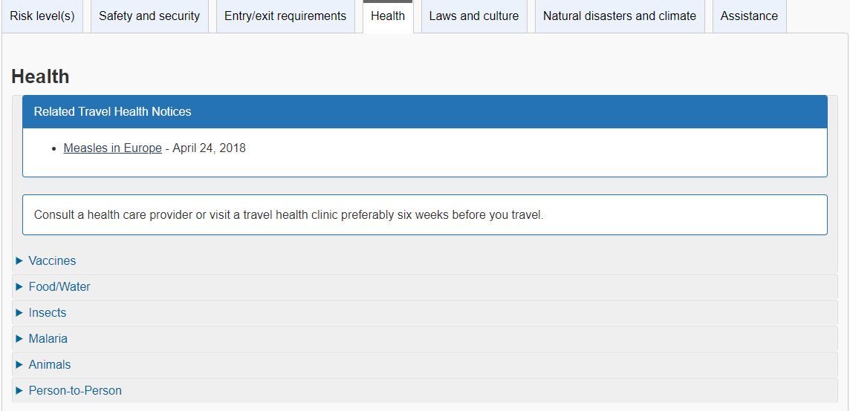

Slide 11
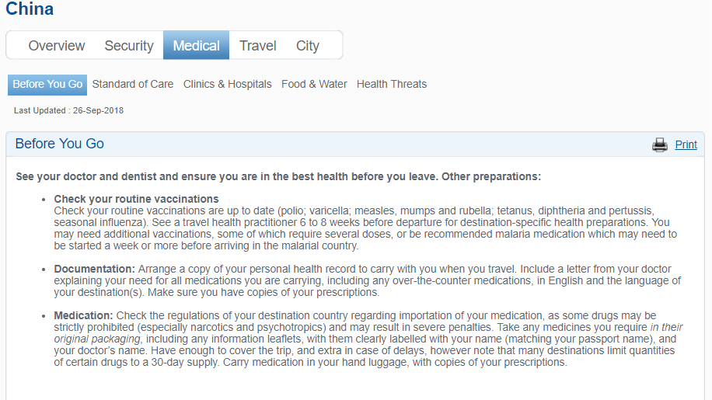

Slide 12
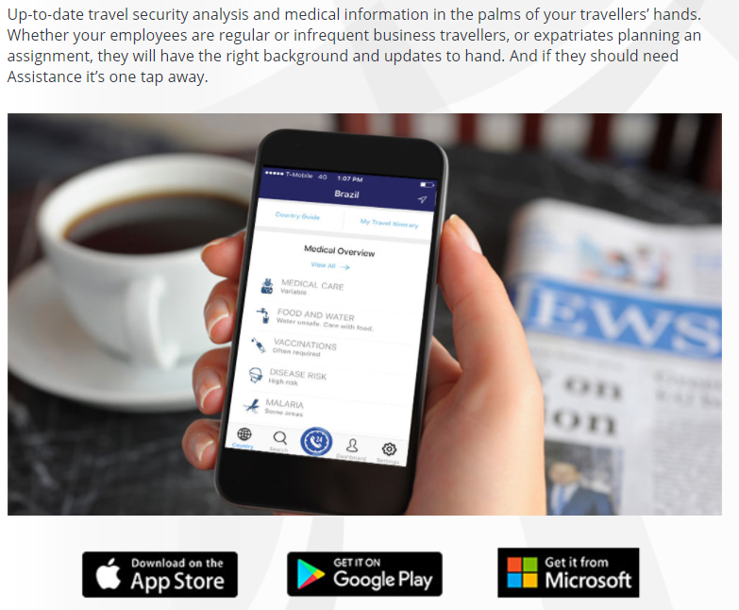

Slide 13
If I have MSP, or another provincial insurance plan, I don’t need travel insurance
FALSE

Slide 14
FALSE
If my host university requires I purchase local insurance I don’t need travel insurance

Slide 15
The AMS/GSS Plan does include travel insurance

Slide 16
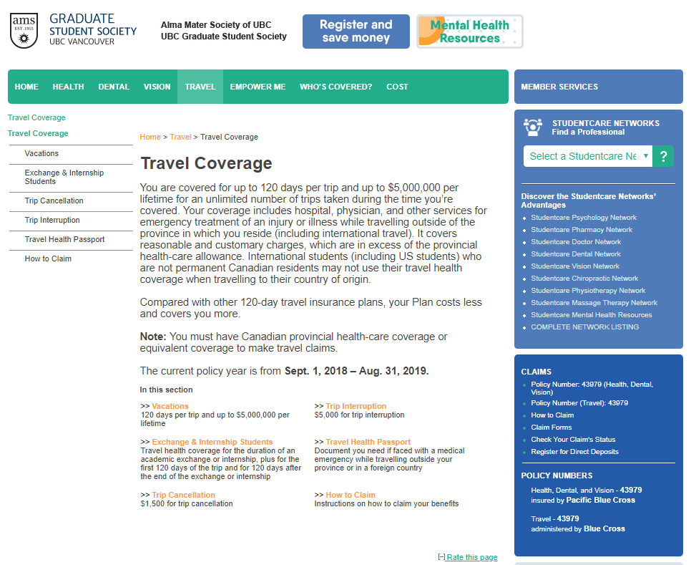

Slide 17
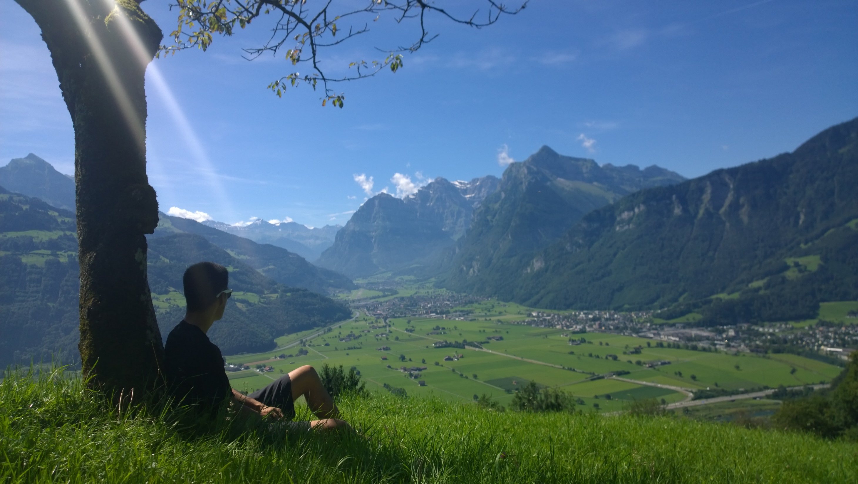
A risk is the possibility of losing something of value
Risks can be specific to
Your destination
The types of activities you engage in
Yourself

Slide 18
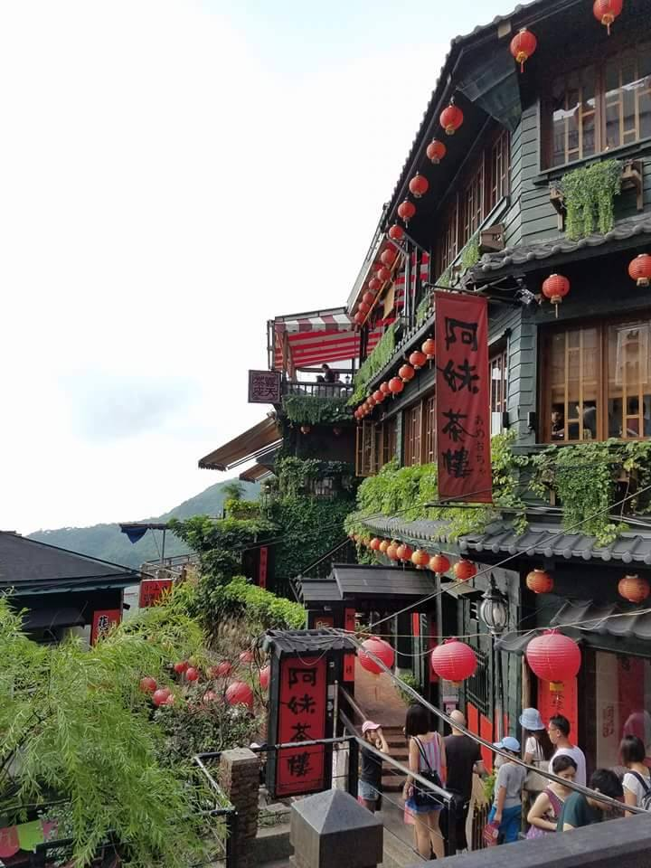
What’s one thing you’re going to do to prepare for a safe trip?

Slide 19
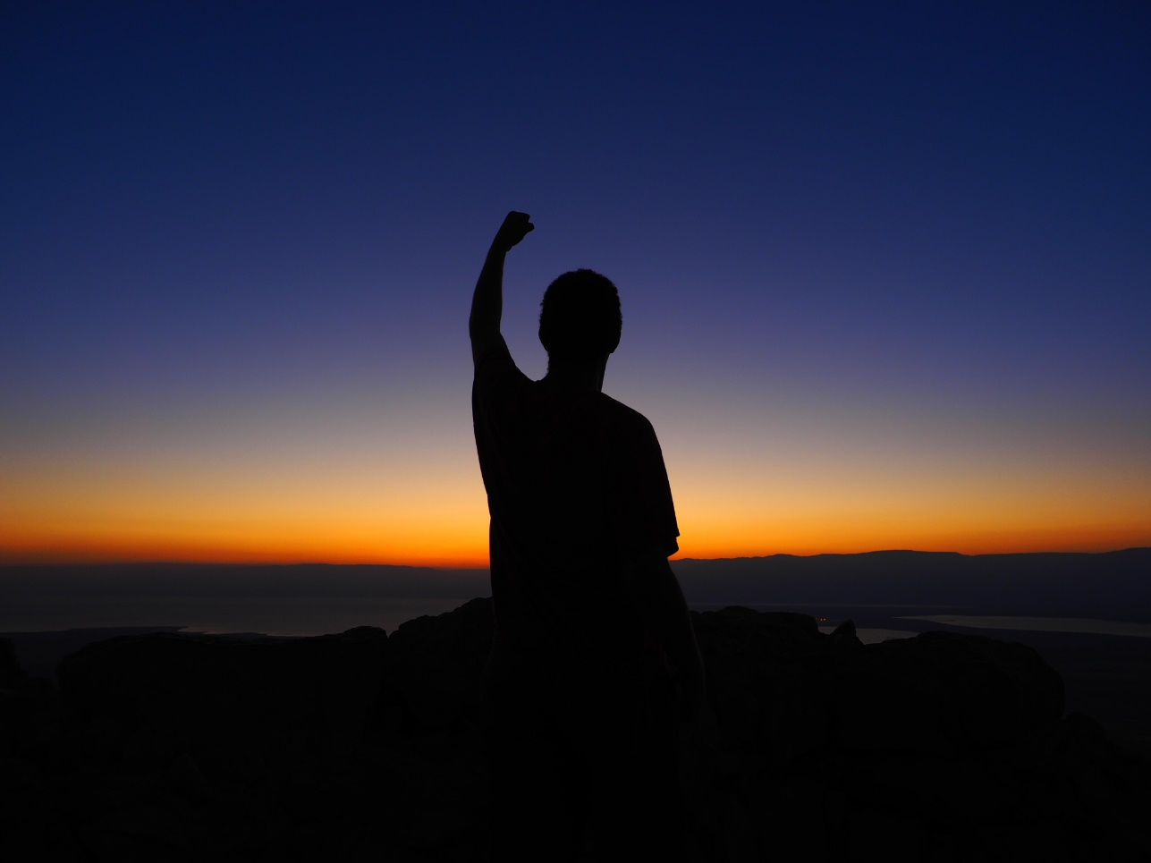
safety.abroad@ubc.ca

