Slide 1
UBC MBA Global Learning – Info Session
Alina Yukhymets, Manager Global Learning

Slide 2
UBC MBA Global Learning
Today’s Topics
MBA Exchange
GNAM
IMBA
UBC MBA-Yale MAM
Notes:
Why Consider Exchange
Application & Selection Process
Registration, Grading
When and How much

Slide 3
UBC MBA Exchange Program
“Simply put, the benefits of exchange are beyond your imagination.”

Slide 4
UBC MBA Exchange Program
Why MBA Exchange?
Network with future international business leaders
Align yourself with another top business school
Further global perspective
Notes:
GUIDELINES:
Remember to try and follow the “7 by 7 Rule” (max. 7 words per line, and max. 7 lines of text) as outline in the Usage Guidelines reference
The audience will be less distracted from reading and listen to the presenter if there is minimal text

Slide 5
UBC MBA Exchange Program
Why MBA Exchange?
Study topics not available at UBC MBA
Get a head start on your international job search
Have a great experience that will change your life!
33 Business Schools in 22 countries
Notes:
GUIDELINES:
Remember to try and follow the “7 by 7 Rule” (max. 7 words per line, and max. 7 lines of text) as outline in the Usage Guidelines reference
The audience will be less distracted from reading and listen to the presenter if there is minimal text

Slide 6
UBC MBA Exchange Program
Who Participates in Exchange?
10% to 15% of MBA class
Students are selected by Sauder
Minimum 70% average
Partner Schools accept 1 to 2 students
Notes:
GUIDELINES:
Remember to try and follow the “7 by 7 Rule” (max. 7 words per line, and max. 7 lines of text) as outline in the Usage Guidelines reference
The audience will be less distracted from reading and listen to the presenter if there is minimal text

Slide 7
UBC MBA Exchange Program
How are Partner Schools Selected?
Academic Reputation
Relevant Courses
Academic Timeline (Fall Term)
Student Services
Geographic Location
Ability to achieve a balance of students
Notes:
GUIDELINES:
Remember to try and follow the “7 by 7 Rule” (max. 7 words per line, and max. 7 lines of text) as outline in the Usage Guidelines reference
The audience will be less distracted from reading and listen to the presenter if there is minimal text

Slide 8
UBC MBA Exchange Program
Current Partners - The Americas
Fundacão Getúlio Vargas, Sao Paulo
EGADE, Monterrey
Notes:
GUIDELINES:
Remember to try and follow the “7 by 7 Rule” (max. 7 words per line, and max. 7 lines of text) as outline in the Usage Guidelines reference
The audience will be less distracted from reading and listen to the presenter if there is minimal text

Slide 9
UBC MBA Exchange Program
Current Partners - Asia & The Pacific
Chinese University of Hong Kong, Hong Kong
Hong Kong University of Science & Technology, Hong Kong
Peking University, Guanghua School of Management, Beijing
Tsinghua University, Beijing
China Europe International Business School, Shanghai
Fudan University School of Management, Shanghai
Shanghai Jiaotong University, Shanghai
Notes:
GUIDELINES:
Remember to try and follow the “7 by 7 Rule” (max. 7 words per line, and max. 7 lines of text) as outline in the Usage Guidelines reference
The audience will be less distracted from reading and listen to the presenter if there is minimal text

Slide 10
UBC MBA Exchange Program
Current Partners - Asia & The Pacific
Melbourne Business School, Australia
Keio University, Tokyo
Yonsei University, Seoul
Singapore Management University, Singapore
Nanyang Technological University, Singapore
National University of Singapore, Singapore
Indian Institute of Management, Ahmedabad
Indian Institute of Management, Bangalore
Notes:
GUIDELINES:
Remember to try and follow the “7 by 7 Rule” (max. 7 words per line, and max. 7 lines of text) as outline in the Usage Guidelines reference
The audience will be less distracted from reading and listen to the presenter if there is minimal text

Slide 11
UBC MBA Exchange Program
Current Partners - Europe & the Middle East
Copenhagen Business School, Copenhagen
ESADE, Barcelona
IE, Madrid
ESSEC, Paris
EDHEC Business School, Lille & Nice
Notes:
GUIDELINES:
Remember to try and follow the “7 by 7 Rule” (max. 7 words per line, and max. 7 lines of text) as outline in the Usage Guidelines reference
The audience will be less distracted from reading and listen to the presenter if there is minimal text

Slide 12
UBC MBA Exchange Program
Current Partners - Europe & the Middle East
Manchester Business School, Manchester
Rotterdam School of Management, Rotterdam
SDA Bocconi, Milan
WHU, Otto Beisheim Graduate School of Management, Koblenz
Notes:
GUIDELINES:
Remember to try and follow the “7 by 7 Rule” (max. 7 words per line, and max. 7 lines of text) as outline in the Usage Guidelines reference
The audience will be less distracted from reading and listen to the presenter if there is minimal text

Slide 13
UBC MBA Exchange Program
Current Partners - Europe & the Middle East
University of Cologne, Cologne
Vienna University of Economics and Business Administration, Vienna
Aalto School of Economics, Helsinki
Tel Aviv University, Tel Aviv
Notes:
GUIDELINES:
Remember to try and follow the “7 by 7 Rule” (max. 7 words per line, and max. 7 lines of text) as outline in the Usage Guidelines reference
The audience will be less distracted from reading and listen to the presenter if there is minimal text

Slide 14
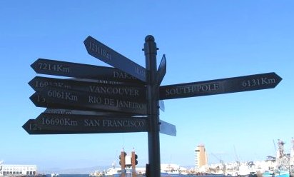
UBC MBA Exchange Program
Application Requirements
Application Form
Resume
Essay
Possibly Interview
Application Fee $415 (refundable if no spot)
Application via on-line portal
Application: Due January 20, 2020
Notes:
GUIDELINES:
Remember to try and follow the “7 by 7 Rule” (max. 7 words per line, and max. 7 lines of text) as outline in the Usage Guidelines reference
The audience will be less distracted from reading and listen to the presenter if there is minimal text

Slide 15
UBC MBA Exchange Program
Selection Criteria
Reasons
Fit for Academic and/or Career goals
Academic Performance
Maturity & Professionalism
Strong ambassador for UBC Sauder
Notes:
GUIDELINES:
Remember to try and follow the “7 by 7 Rule” (max. 7 words per line, and max. 7 lines of text) as outline in the Usage Guidelines reference
The audience will be less distracted from reading and listen to the presenter if there is minimal text

Slide 16
UBC MBA Exchange Program
Academic Requirements While On Exchange
Must take a ‘full-time course load’ comparable to 8 modules
Fill as many Track requirements as possible prior to exchange
Notes:
GUIDELINES:
Remember to try and follow the “7 by 7 Rule” (max. 7 words per line, and max. 7 lines of text) as outline in the Usage Guidelines reference
The audience will be less distracted from reading and listen to the presenter if there is minimal text

Slide 17
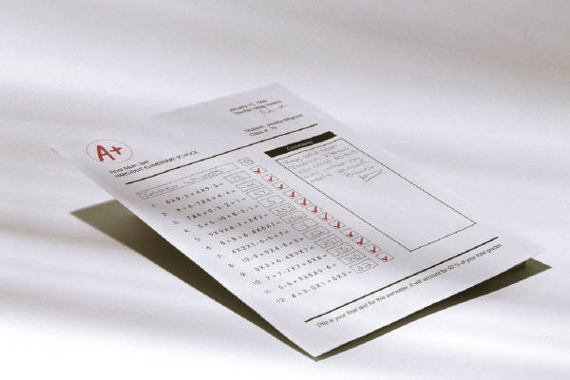
UBC MBA Exchange Program
REGISTRATION & GRADING
Registered by RHL Office in exchange course
‘BA 530’ (~12 Credits)
Completed coursework evaluated by Sauder after receiving host school transcripts
Assessed on a Pass/Fail basis
Notes:
GUIDELINES:
Remember to try and follow the “7 by 7 Rule” (max. 7 words per line, and max. 7 lines of text) as outline in the Usage Guidelines reference
The audience will be less distracted from reading and listen to the presenter if there is minimal text

Slide 18
UBC MBA Exchange Program
WHEN DO I GO ON EXCHANGE?
Fall 2020 - Periods 6 & 7
Timing differs by Exchange Partner
Earlier Start: Ex. National University of Singapore (August)
Later Start: Ex. Manchester Business School, ESADE (October)
Go for full term or just one Period!
Spring 2021 (after program completion) is possible
Notes:
GUIDELINES:
Remember to try and follow the “7 by 7 Rule” (max. 7 words per line, and max. 7 lines of text) as outline in the Usage Guidelines reference
The audience will be less distracted from reading and listen to the presenter if there is minimal text

Slide 19
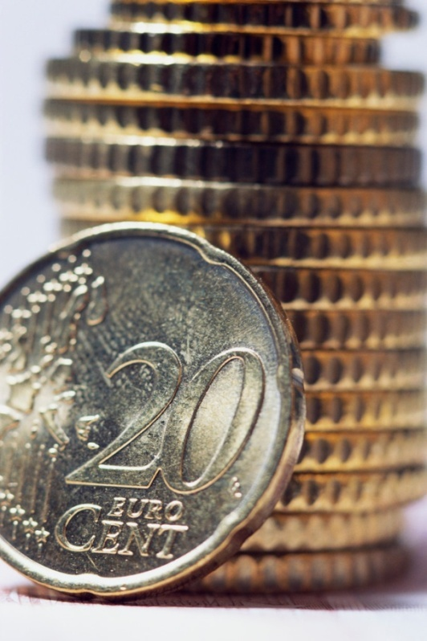
UBC MBA Exchange Program
Exchange Costs:
UBC Tuition
Transportation
Accommodation
Books & Study Packages
Language Class Fees
Personal Expenses
Application fee
EXCHANGE STUDENT SCHOLARSHIPS AVAILABLE!
Notes:
GUIDELINES:
Remember to try and follow the “7 by 7 Rule” (max. 7 words per line, and max. 7 lines of text) as outline in the Usage Guidelines reference
The audience will be less distracted from reading and listen to the presenter if there is minimal text

Slide 20
UBC MBA Exchange Program
EXCHANGE & The MBA JOB SEARCH
Opportunity for International Job Search
Access to host school recruiting
Access to BCC Postings – COOL
MBA Internships
Talk to your Career Coach
Notes:
GUIDELINES:
Remember to try and follow the “7 by 7 Rule” (max. 7 words per line, and max. 7 lines of text) as outline in the Usage Guidelines reference
The audience will be less distracted from reading and listen to the presenter if there is minimal text

Slide 21
UBC MBA Exchange Program
DECISION-MAKING TOOLS
MBA Exchange Fair – Nov 18
“Global Learning” Folder in Canvas
Exchange Partner Websites
Exchange Reports online
BCC Career Coach
Exchange Advising
Notes:
GUIDELINES:
Remember to try and follow the “7 by 7 Rule” (max. 7 words per line, and max. 7 lines of text) as outline in the Usage Guidelines reference
The audience will be less distracted from reading and listen to the presenter if there is minimal text

Slide 22
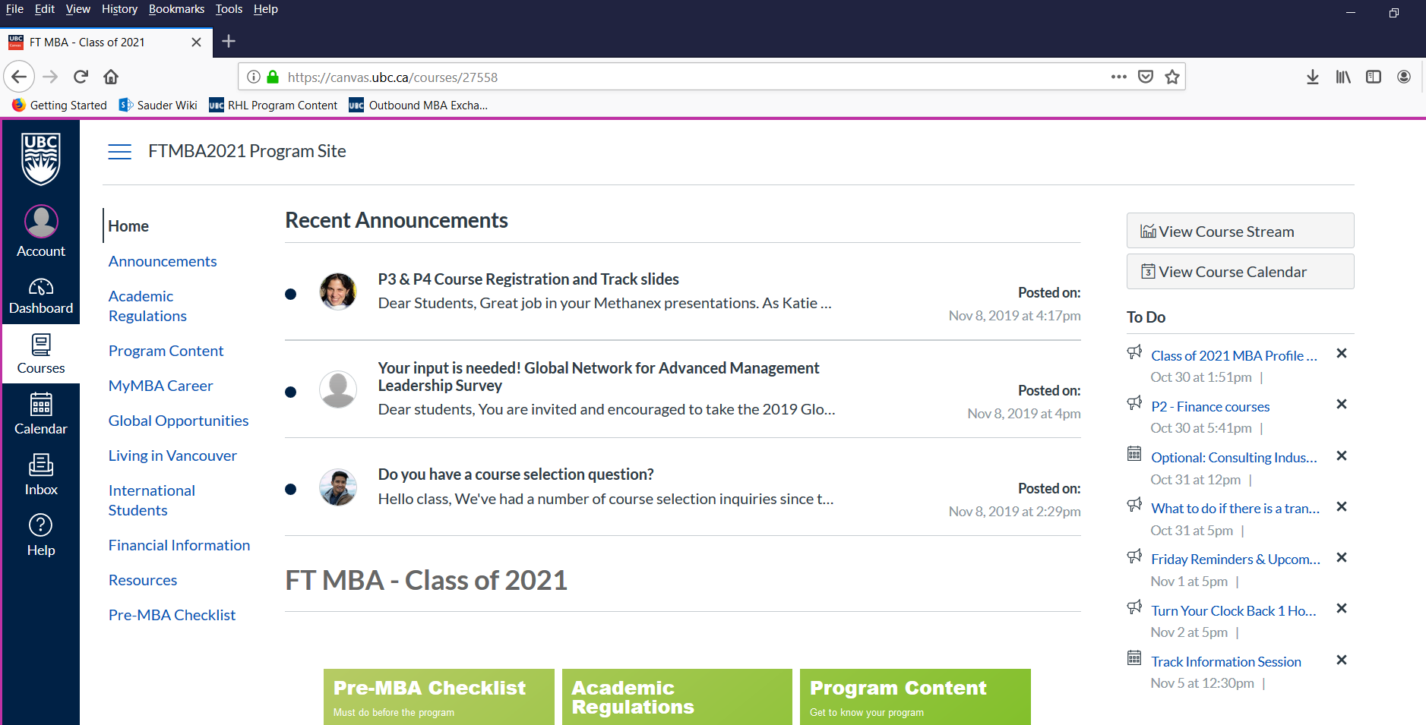
UBC MBA Exchange Program
Exchange Information in Canvas
Notes:
GUIDELINES:
Remember to try and follow the “7 by 7 Rule” (max. 7 words per line, and max. 7 lines of text) as outline in the Usage Guidelines reference
The audience will be less distracted from reading and listen to the presenter if there is minimal text

Slide 23
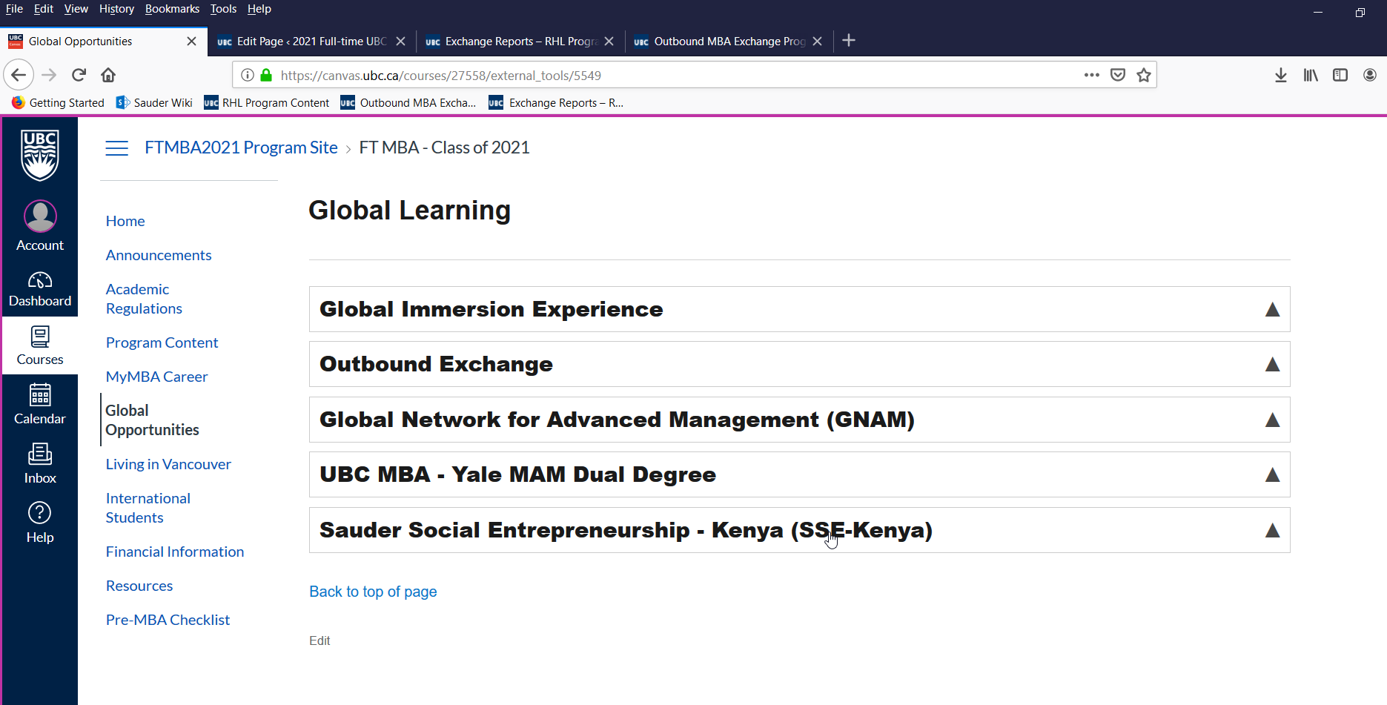
UBC MBA Exchange Program
Exchange Information in Canvas
Notes:
GUIDELINES:
Remember to try and follow the “7 by 7 Rule” (max. 7 words per line, and max. 7 lines of text) as outline in the Usage Guidelines reference
The audience will be less distracted from reading and listen to the presenter if there is minimal text

Slide 24
UBC MBA Exchange Program
Important Dates: Exchange Timeline
Date | Activity
Nov. 18, 2019 | Exchange Fair
January 20, 2020 | Exchange Applications Due
Late January 2020 | Interviews
February 2020 | Nominations Announced
April to May 2020 | Formal Acceptance from Host School
Notes:
GUIDELINES:
Remember to try and follow the “7 by 7 Rule” (max. 7 words per line, and max. 7 lines of text) as outline in the Usage Guidelines reference
The audience will be less distracted from reading and listen to the presenter if there is minimal text

Slide 25
UBC MBA Exchange Program
MBA students currently on Exchange in:
ESADE (Barcelona)
IE Madrid
SDA Bocconi (Milan)
Manchester Business School
Shanghai Jiaotong
CEIBS (Shanghai)
Fudan (Shanghai)
Rotterdam School of Management

Slide 26
UBC MBA Global Learning Options
Global Immersion (2020)
Exchange (Fall 2020)
Global Network Week (Oct. 2020)
Global Network SNOCS ( Fall 2020)
IMBA in Shanghai
UBC MBA – Yale MAM Dual Degree

Slide 27
UBC MBA Global Learning - GNAM
Global Network for Advanced Management (GNAM)
Sauder is the only Canadian member of Global Network
Unprecedented access to learning opportunities around the world
30 business schools
in 28 countries
across 5 continents
Notes:
First, the GNAM. The full name is Global Network for Advanced Management. GNAM is launched in 2012 so it just marked its 5th anniversary. It is an international partnership spearheaded by the Yale School of Management and connecting leading global business schools, dedicated to integrating international experience into graduate business education. UBC Sauder School of Business is now the only Canadian member of the Global Network for Advanced Management (GNAM),
GNAM provides unprecedented access to learning opportunities globally (30 partners around the world).

Slide 28
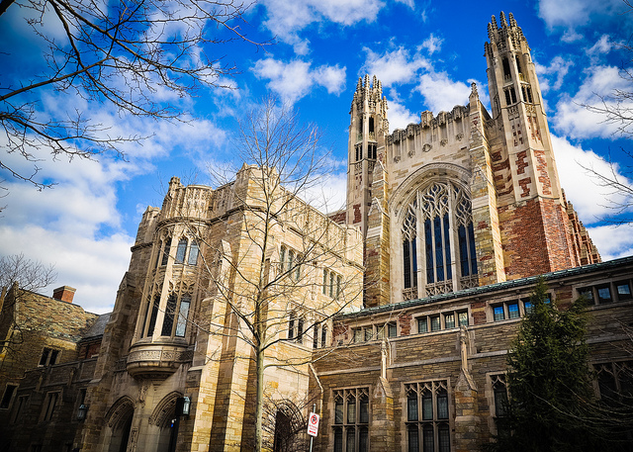
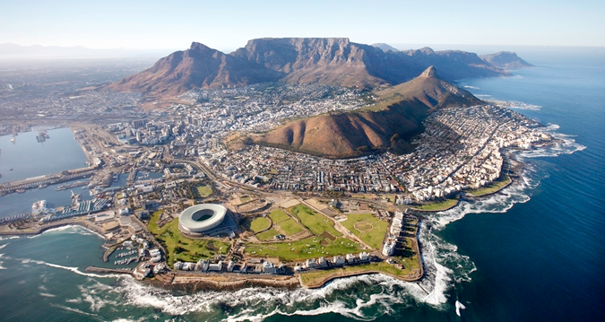
UBC MBA Global Learning - GNAM
Global Network Week
October 2020
Global Network Courses/SNOCs
Sept – Dec 2020
Notes:
There are two type GNAM course IMBAs can apply as an option:
Global Network Weeks – intensive study at partner institutions in short courses count for credit towards your IMBA degree. One week in Mar 2019
Global Network Courses – real-time virtual classes count for credit towards your IMBA degree
*Students from IMBA Class of 2018 went to Korea, Costa Rica, Israel & Renmin University
IMBAs have the opportunity to take GNAm course in two formats: in person 1 week intensive courses or online learning over a few months. Our Global Learning team will lead and manage the communication and application for all these learning activities. More details will come out after your Vancouver Residency. Please keep in mind that some of the schools are very popular so we cannot guarantee your top choice. All application is upon approval.

Slide 29
UBC MBA Global Learning - IMBA
IMBA
4-day UBC IMBA courses in Shanghai
Notes:
Do not book any work travel during exam week!
Exams can take place on Friday nights or Saturdays!!!!!

Slide 30
UBC MBA Global Learning – Yale MAM

Slide 31
UBC MBA Global Learning – Yale MAM
UBC MBA – Yale MAM Dual Degree
UBC MBA: Sept 2019 – July 2020
Apply for Yale MAM: Dec 2019
Start Yale MAM: Aug 2020
Complete UBC MBA at Yale: Aug-Dec 2020
UBC MBA graduation: May 2021
Yale MAM graduation: May 2021
Notes:
Finally, those who are interested, will have an opportunity to learn more and apply for the Yale MAM dual degree program. Students can apply while in the final year of their MBA degree, finish the MBA in July and start Yale MAM in August.

Slide 32
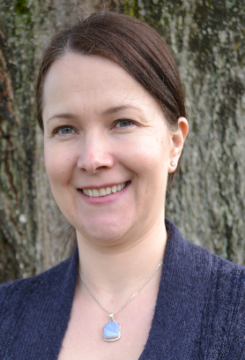
RHL Contacts – Global Learning
Alina Yukhymets
Manager, Global Learning
T: 604.827.5283
E: alina.yukhymets@sauder.ubc.ca
E: RHLglobal@sauder.ubc.ca

