Slide 1
MM Program
Introduction to Secondary Business Research
Irena Trebic, David Lam Management Research Library

Slide 2

Agenda
Overview of David Lam Library services and resources
Introduction to secondary research in business
Community Business Projects form + research activity
Please feel free to follow along on your laptop.
Notes:
For our agenda,
We’ll start with an overview of the library’s services and resources,
And then I’ll provide an introduction to the business research landscape, as it’s a little different than some of the fields you’ve trained in.
I’ve also talked to your instructor for BAMA 550 and will be focusing some time on resources for the brand review assignment – while the brand assignment will be our example, these resources will be useful for you in other classes as well.

Slide 3
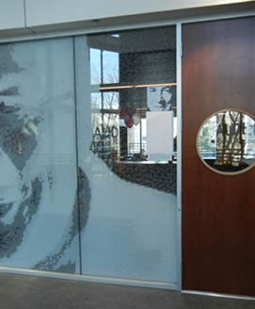
David Lam Management Research Library
CLC:Online on Canvas
lam.library.ubc.ca
Materials on commerce and business administration
Librarians who specialize in business research
Located with the Canaccord Learning Commons
Notes:
Materials including
Business Databases
Books & ebooks
Journals, magazines and newspapers
Career resources
The Canaccord Learning Commons also offers programs and workshops on various topics including writing improvement and finance databases.

Slide 4
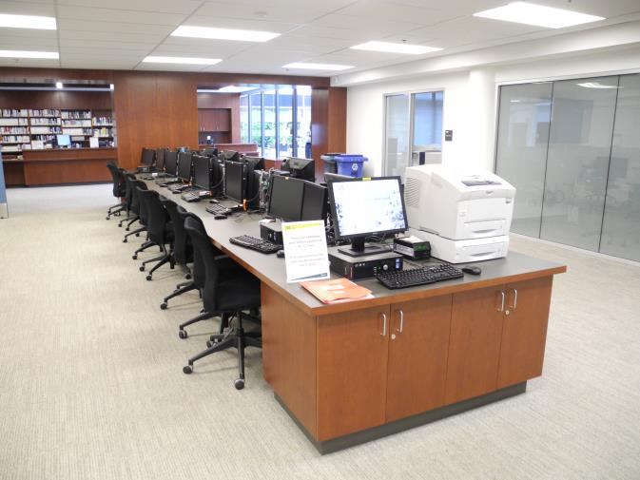
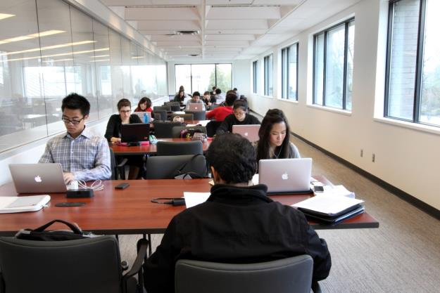
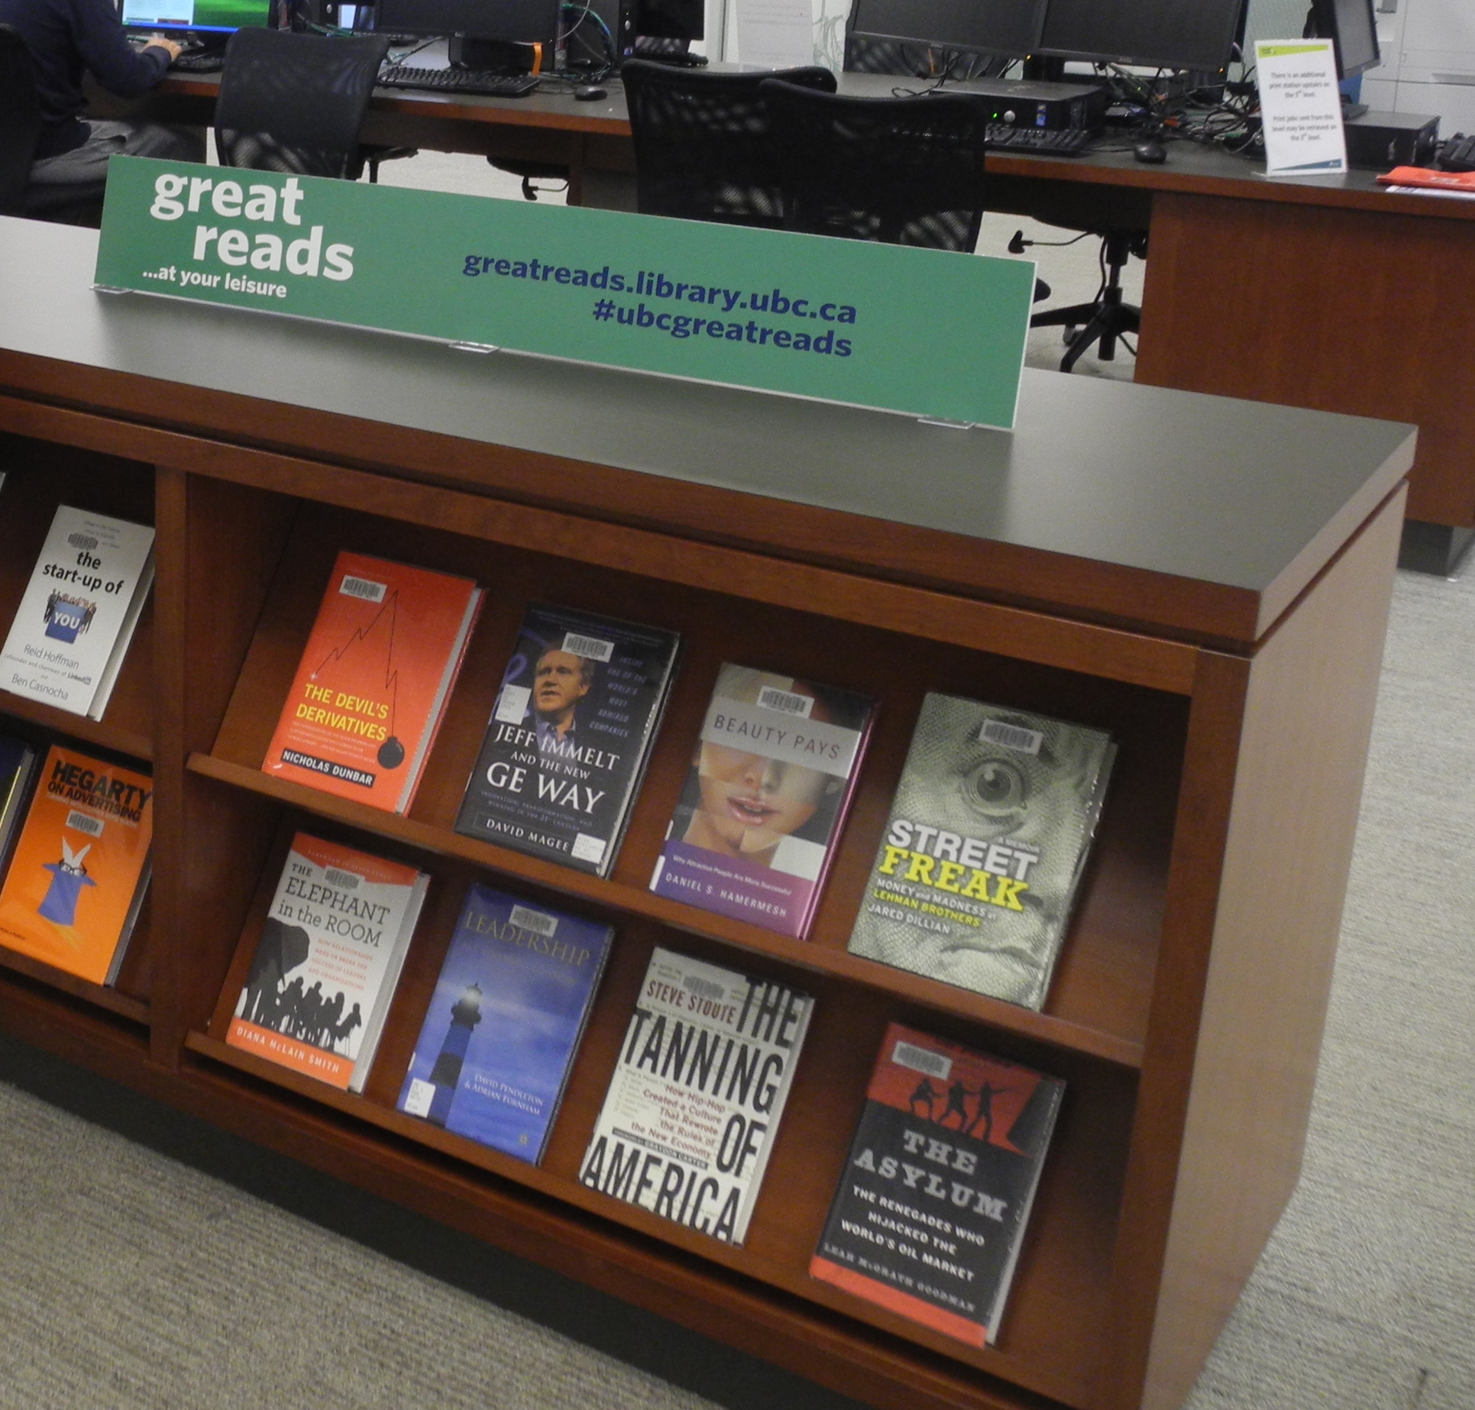
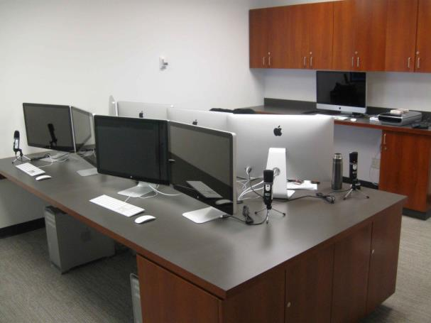
David Lam Library & Canaccord Learning Commons
More than just a Library
Notes:
When you arrive in our space, you’ll find much more than just books. The business collection is at Lam Library. We are one of several branches at UBC. Other branches eg Koerner has economics books.
We have bookable study spaces, we offer co-curricular programs such as writing coaching, we have a media lab and of course tons of business and career books, the latest newspapers and many journals for you to browse.

Slide 5
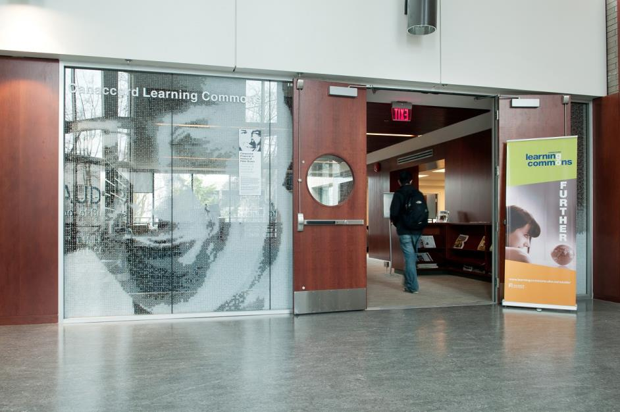
David Lam Library & Canaccord Learning Commons
Privileged access to…
Business e-books
Journals
Articles
Statistics
Market research reports
Accessible through specialized research databases
Notes:
In addition to print books and great reads, we have…..
Your tuition pays for these resources so be sure to take advantage of them.

Slide 6

David Lam Library – Business Librarians
Our skills:
Expert search skills
Specialist knowledge of business databases
“You have given us a clear direction when we were lost in the databases.”
– Master of Management team
http://www.keepcalm-o-matic.co.uk/
Notes:
We license databases that are commonly used in the business world and we are familiar with their content and the most efficient ways to search them.
We provide research help at our drop-in desk or by appointment (more later)
And we manage a website and curate business research guides and create tutorials for how to use databases.

Slide 7
Accessing Library Resources
Use computers at any UBC Library and sign on with your UBC card or your CWL.
You will need to sign on with your CWL to search databases remotely.
Your CWL will entitle you to search most databases remotely.
Notes:
Some specialized financial databases are only available on certain computers in the library or in the Wayne Deans Investment Analysis Centre.

Slide 8
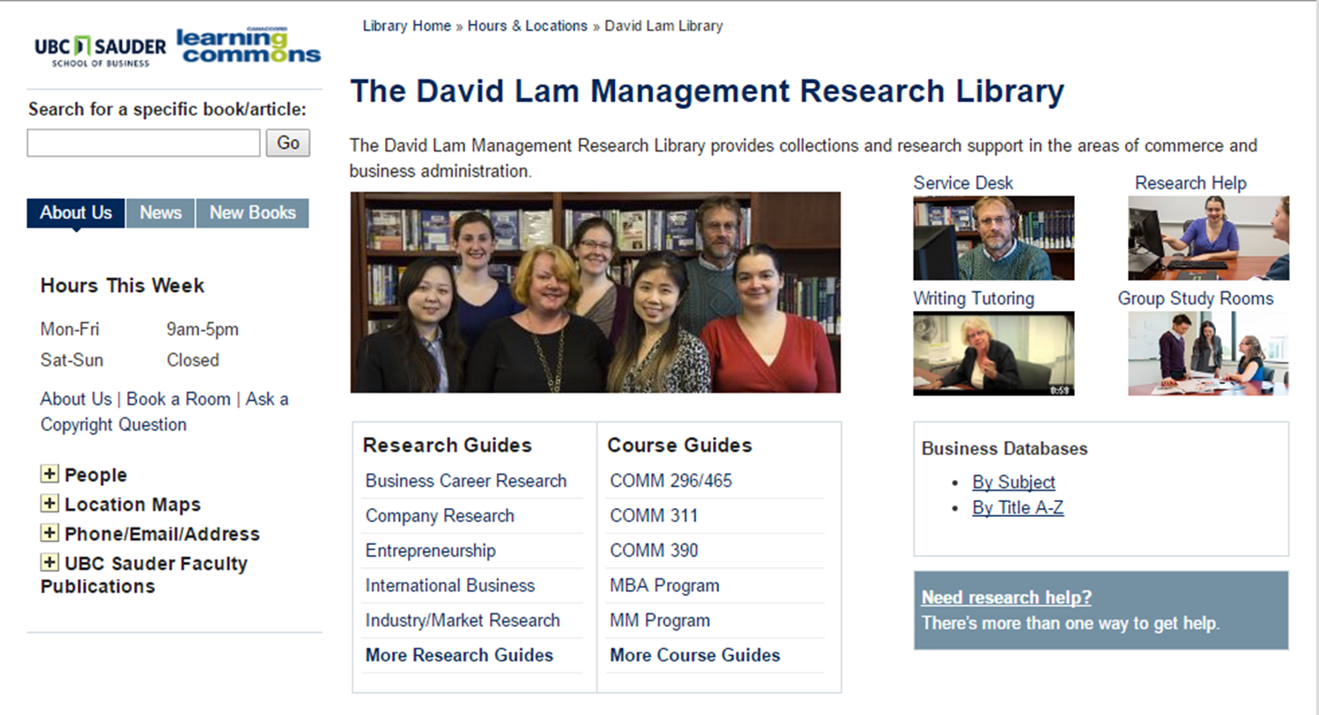
David Lam Library website: lam.library.ubc.ca
Our research guides provide links to library databases and free resources
Notes:
Let’s return to our home page, and look at one of our research guides.
They’re arranged by topic, and the most popular are on the home page.
Click on more, to find others that might work for you, depending on your course or research topic.
e.g. Marketing, company research.

Slide 9
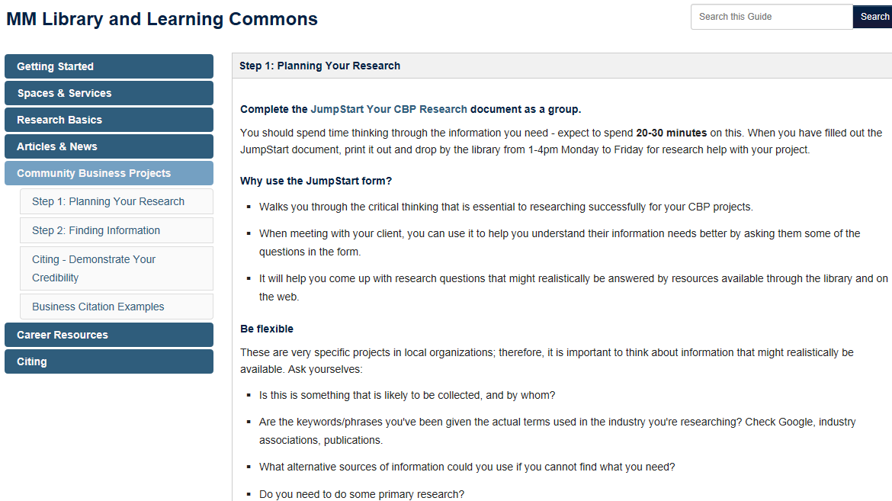
Your Guide to the Library & CLC
http://guides.library.ubc.ca/mm
Navigate the guide by clicking on the tabs
Notes:
Starting point for you on information on services and resources available to you through the David Lam Library and the Canaccord Learning Commons during your entire program.
Bookmark this page and refer to it every time you have research to do – for an assignment, CBP, career research (it’s also linked from Connect under MyLibrary)
For more on library services and facilities, browse the Spaces & Services section of the guide. Two things to let you know:
Your UBC Card is your library card. If you’re printing in the library it’s also your print card, but I believe you can also print in the grad lounges and they use a different system.
Any questions about the space/services? Ask at the entrance desk to the CLC
[Go through all the tabs (coming back to research basics later) and use them as a guide to introducing Dlam and CLC.

Slide 10
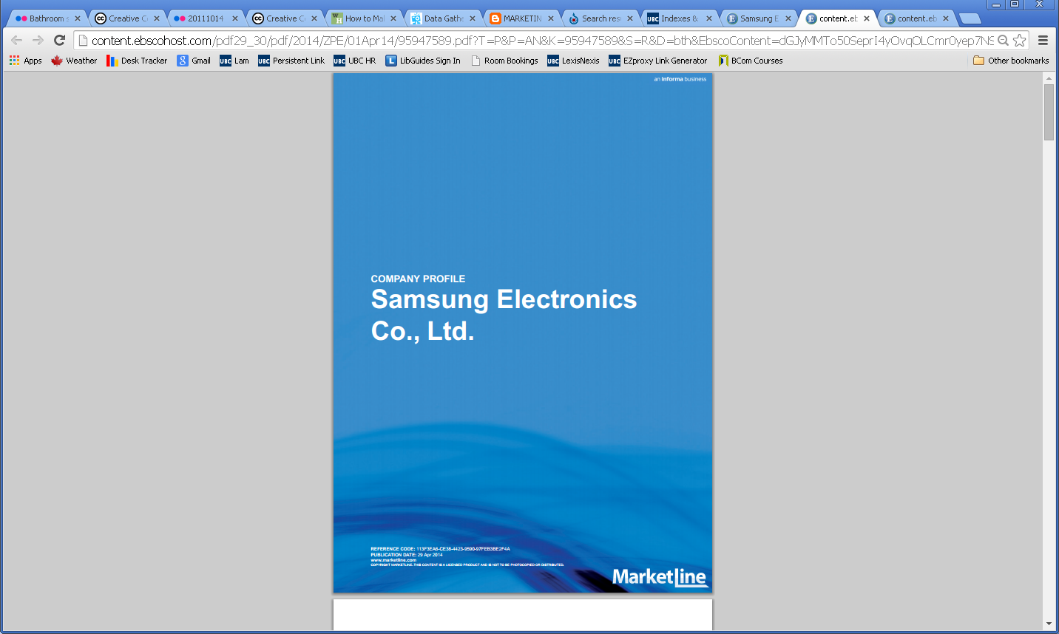
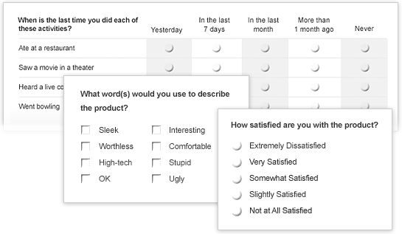
Research Basics:
Primary vs. Secondary Research
Primary Research
Image: MarketLine. (2014). Samsung Electronics Co., Ltd. Retrieved from Business Source Complete database.
Image: http://marketingresearch1358fst.blogspot.ca/2011/06/marketing-research.html
Secondary Research
Notes:
First off, what do I mean by secondary research? [PRIZE: Kimberly gives]
– Research that has been published before. Could be stats, reports, datasets, articles.
-This is the type of research that libraries specialize in collecting and providing access to.
Taking it a step further, what does the fact that secondary research has already been published mean for your research?
-it’s not published for your specific purpose
-so you may need to extrapolate, use several sources
-you need to acknowledge others’ work; we’ll talk about this.

Slide 11
Research Basics:
Examples of secondary research in business
Business topic - e.g. leadership, social marketing
Company research - competitors, best practices
Consumer research – trends, opinions
Industry/Market research (including brands)
Location research (city, province, country, regulations)

Slide 12
Researching a Market
Market research includes researching the:
Industry – overview, trends, regulations
Consumers – behaviour, demographics
Competitors
Location – business, economic, political climate, local legislation/regulations
Notes:
The research you are doing for your brand may include researching a specific industry or market, which you may have to do for other classes, for your career research and an important skill for the future workplace.
I’ll keep reminding you that this session is not just about this assignment – knowing how to do this research is going to help you throughout your program.

Slide 13
Market Research Reports
The library subscribes to some market research databases.
We cannot give access to reports on the Internet.
But we can help you search our databases for alternatives.
Notes:
Library subscribes to databases of reports – cost 1000s of dollars to general public. Company/organization has researched the market & created a report. Find under Top Sources for Marketing and Market Research or Industry research. (Passport GMID is one of these)
If you can find a report that covers your industry or market in the location you want, it is great. They are at the broad industry level or country level or broader – you will not find a report in these databases for a province or city. In some cases may not find Canada. Consider how you might use the report in conjunction with other sources
Challenges:
1000s more reports available at cost online – see Google search results. Unless it’s in one of the databases we subscribe to, you can’t access these.
Only for broad markets in countries/regions

Slide 14
Article Databases
What’s included?
news events
ideas and concepts
strategies
current information
economic conditions
companies, products, industries
consumer behaviour
risks
various perspectives
e-business
Articles are a good place to start searching on any topic, because of the diversity of content included.
Article databases allow you to search many magazines, newspapers and scholarly journals at the same time.
They also allow you to limit your search (make it more specific) by date, subject, country, company, product, etc.
Notes:
This page will be shown on all of our research guides, because articles are universally useful for business research.
You may be familiar with searching for scholarly articles using certain journals and databases.
In business it’s not uncommon that we use articles from trade publications, news sources or popular business magazines.
Business article databases will contain all of those types of sources and allow you to search and then add limits.
The databases may be similar to scholarly source databases you might come across, because database companies tend to cover many different subjects.

Slide 15
Searching Article Databases: Boolean Operators
Combine search words using AND, OR to enable more precise searching in databases.
AND narrows
your search
Use between different concepts in your search
chocolate and China
OR expands
your search
Use between words with similar meanings
“business planning” or “business strategy” or “strategic planning”
Notes:
When you use AND, the database looks for articles that only feature both of the concepts. It narrows your search.
OR looks for articles that have either of the concepts, so it will give you MORE results.
Databases contain high quality information that you cannot find through Google. But they require you to be very precise in how you search.
Unlike Google, databases search exactly what you type in – so typing in a sentence is a bad idea. Instead we use boolean terms to combine short words and phrases together.

Slide 16
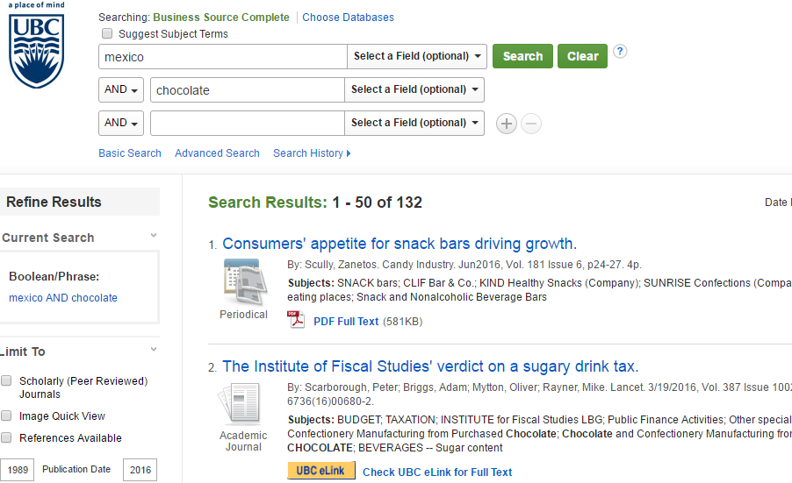
Article Database: Business Source Ultimate
What’s in it?
Articles
Magazines
Journals (HBR)
Country profiles
Industry profiles
Market research reports
Company profiles (eg. Marketline)
Company SWOT analyses
Enter your search words and click
If the full article is available, you can open it.
If not, you will see
Click on it to find the full article in another database.
Notes:
Let’s look in one of the top article databases, Business Source Complete. This is one of the first databases you want to check because of the variety of content.
This database is great because it not only has articles, it also includes country profiles, industry profiles, SWOT analyses of companies and market research reports.
DEMO search: “international trade” AND (“business planning” OR “business strategy” OR “strategic planning”) AND Asia
Within each row, we have put words with a similar meaning and combined them with OR
Each search row represents a different concept, with AND in between

Slide 17
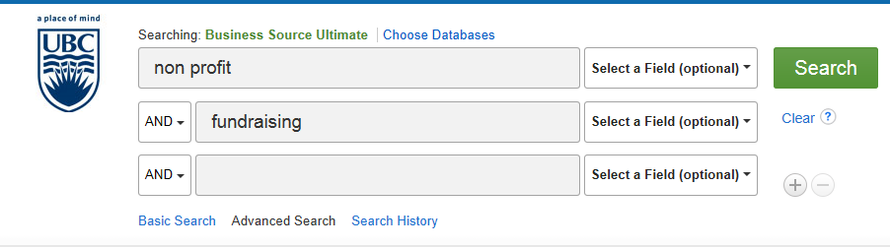
Activity
Spend 10 minutes researching your topic in Business Source Ultimate
Notes:
Limit source type
marketing strategy as SUBJECT, AND social media

Slide 18
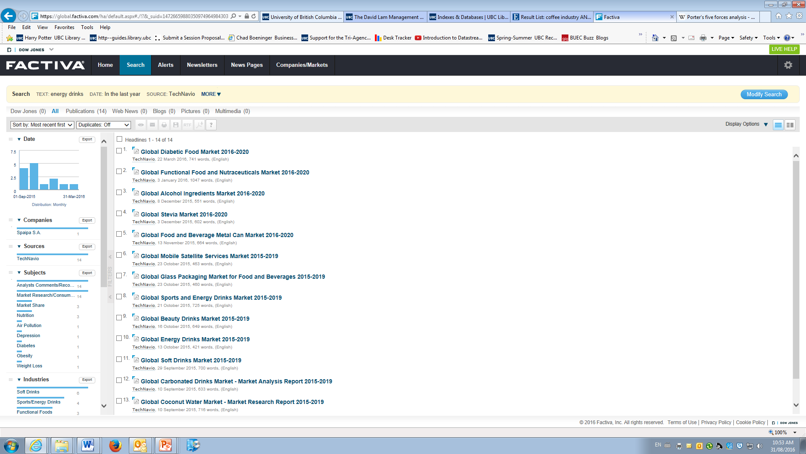
Article Database: Factiva
What’s in it?
Newspapers
Journals
Magazines
Country profiles
Industry profiles
Company news and information
Patent information
Multilingual global resources
Tips:
For tech reports, search TechNavio as the source
Notes:
Let’s try another top database for international business publications: Factiva.
We could put our search in like we did before, but we need to add brackets to break up our search and put the and & or in ourselves.
Limit to last year, and change to newest first.
DEMO: “international trade” AND Asia
If we search for a company, we can use the company search section to find articles.
A lot of the articles come up in Korean.
You can look at the headlines to see announcements of contracts which Daewoo has won around the world.
For well known publicly traded firms, we can use the Companies/Markets tab to get a profile.
Factiva has news and business sources from around the world in many languages. It is updated throughout the day.

Slide 19
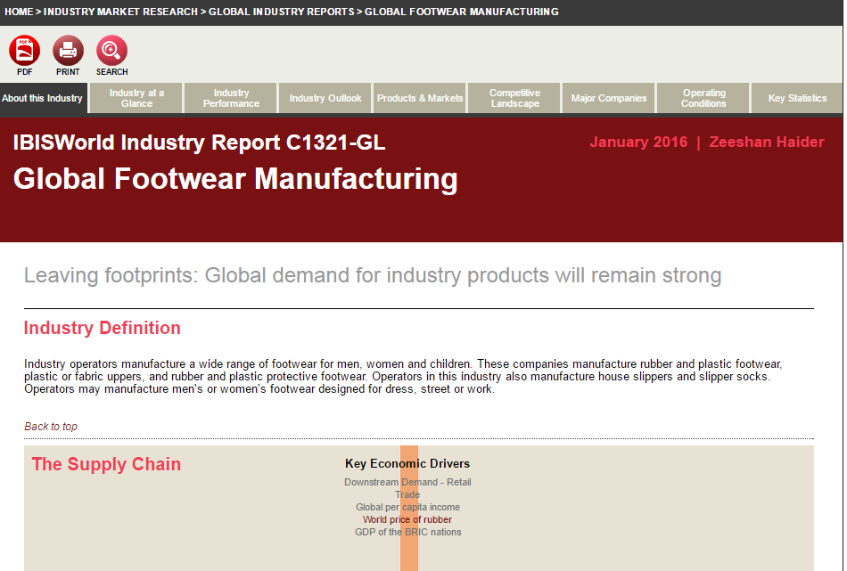
Industry Profile database: IBISWorld
What’s in it?
Market reports for
700 + US industries
400 + Canadian industries
70 global industries
Includes:
industry drivers
supply chain
major markets
industry outlook
benchmarks
barriers to entry
Notes:
IBIS World is an excellent source with industry overviews for US, Canadian and global markets.
Browse the titles or put in your keywords.
Global Business Activities – Global Biotech
Each tab has different information.
You can search online or download the PDF. In what section did you find the answer?
What is the biggest threat to our company in the international market? Eg Answer:
Barrier: “the level of initial capital investment”
Threat: “the extremely well-entrenched position of the industry's major players.”
Competition in this industry is high for example.

Slide 20
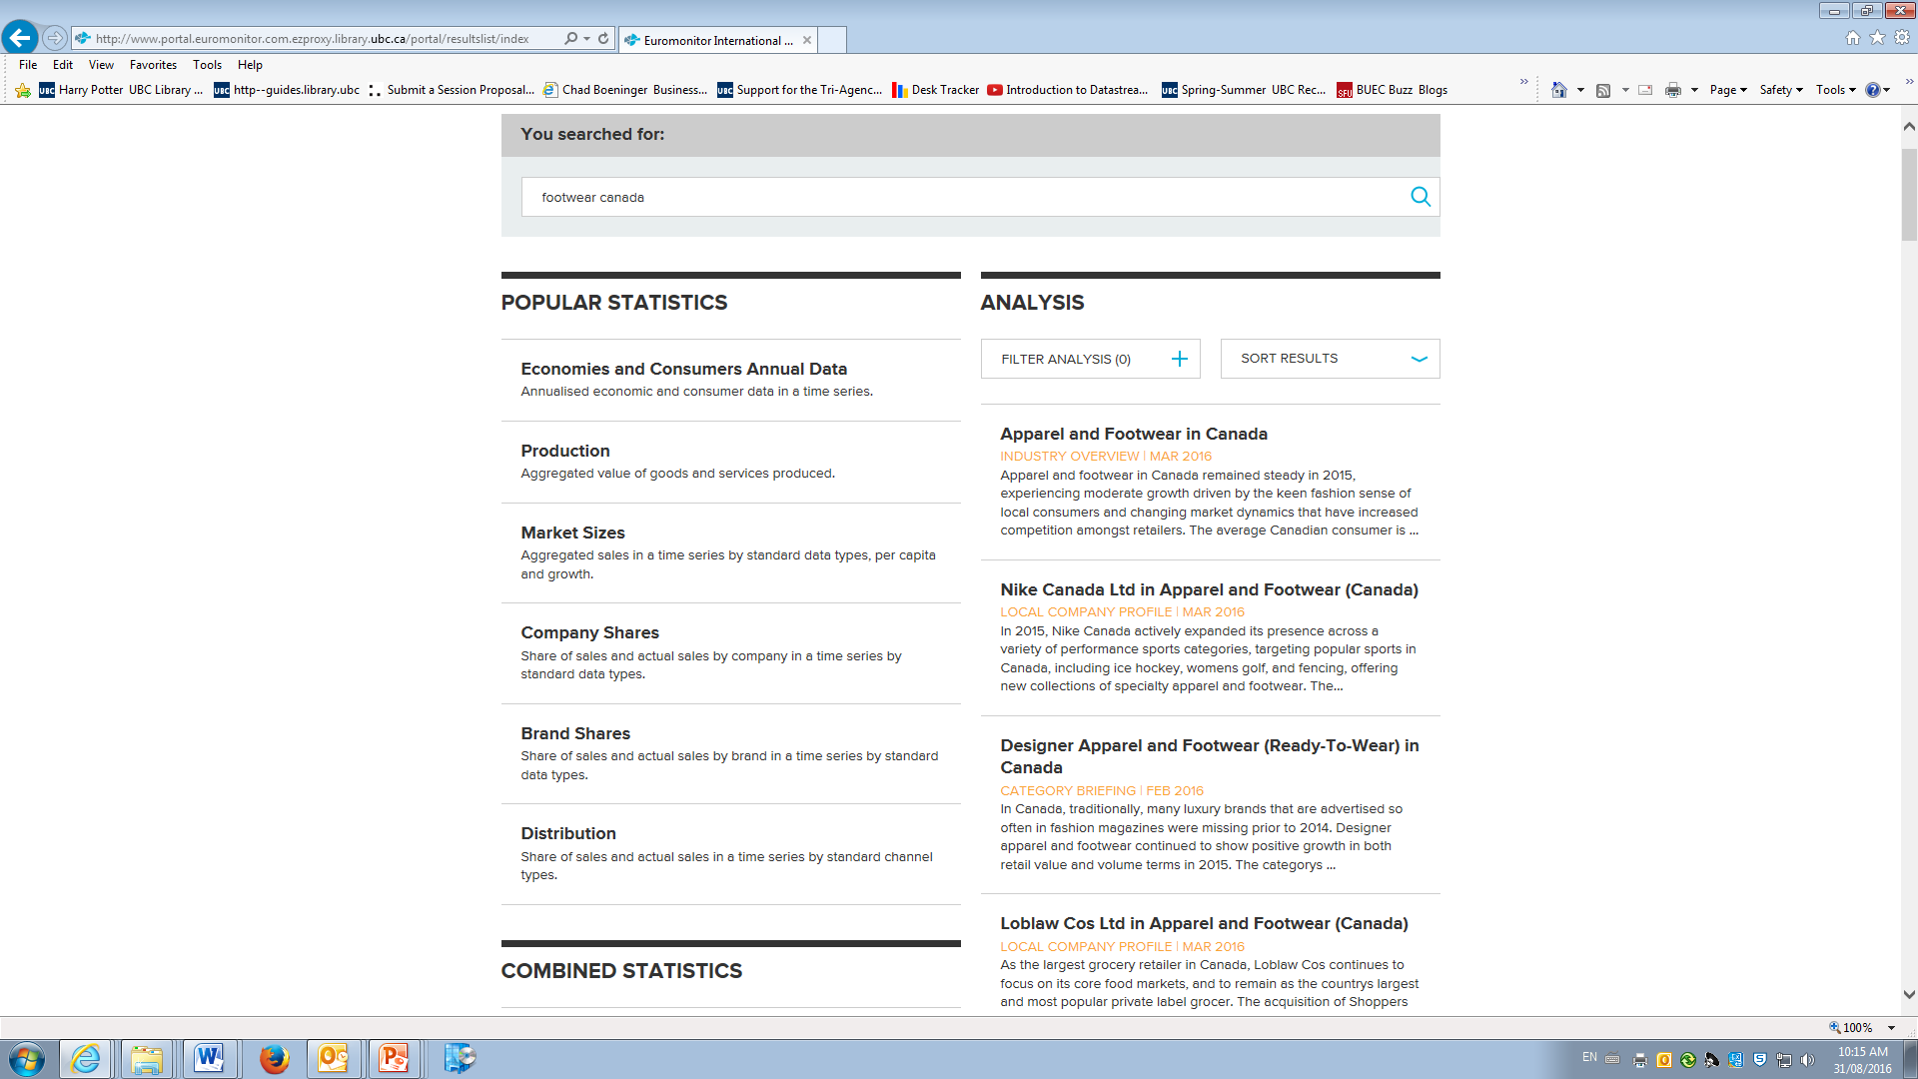
Industry Profile database: Passport GMID
What’s in it?
Market reports for
specific industries in
specific countries
Includes:
industry drivers
supply chain
major markets
industry outlook
barriers to entry
many statistics
forecasting
Notes:
Another excellent market research database with global coverage is Passport.
This one will ask you to login again, and to verify you’re a current student.
It is used by top companies that do marketing research.
It covers economies, consumers and fast moving consumer products.
Use the search box, or explore their dashboards to compare countries or economies.
Industry, Infrastructure and Environment Dashboard
Change category > Consumption of Diesle/Gasoil
You can export the dashboard to PDF or PowerPoint
Market size, company shares, brand shares.

Slide 21
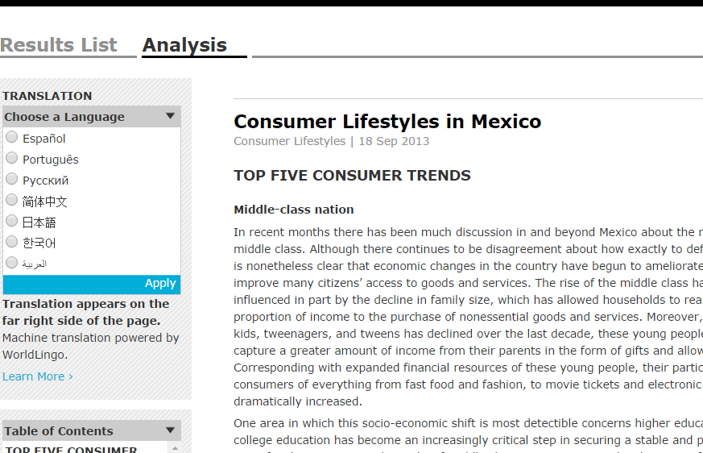
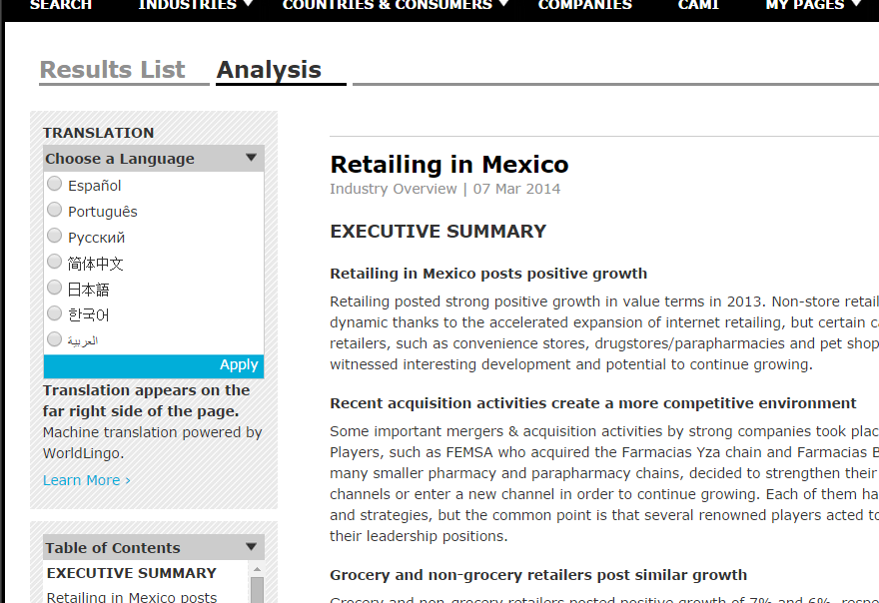
Industry Overviews, Consumer Trends, Company Profiles, by Country: Passport GMID
Reports & Data, e.g.:
Consumer Lifestyles in Mexico, Mexico Country Pulse
Retailing in Mexico
Cocoa Ingredients
Global Packaged Food
Global Confectionery Overview: Key Categories, Countries and Trends to 2019
Nestlé SA in Packaged Food: Confectionery , Ice Cream , Sauces , Dressings and Condiments (World)
Business Environment: Mexico
Mexico Country Profile
Notes:
Ask: What are the 3 main ingredients in cocoa?
So many reports and statistics! And check back often
This database is only available while you’re a student
Extra login process
Focus is on Fast Moving Consumer Products
[Show Industries, Retailing, Mexico…also More Related Items]
Also try search bar: confectionery, candy, chocolate, cocoa, companies, country

Slide 22
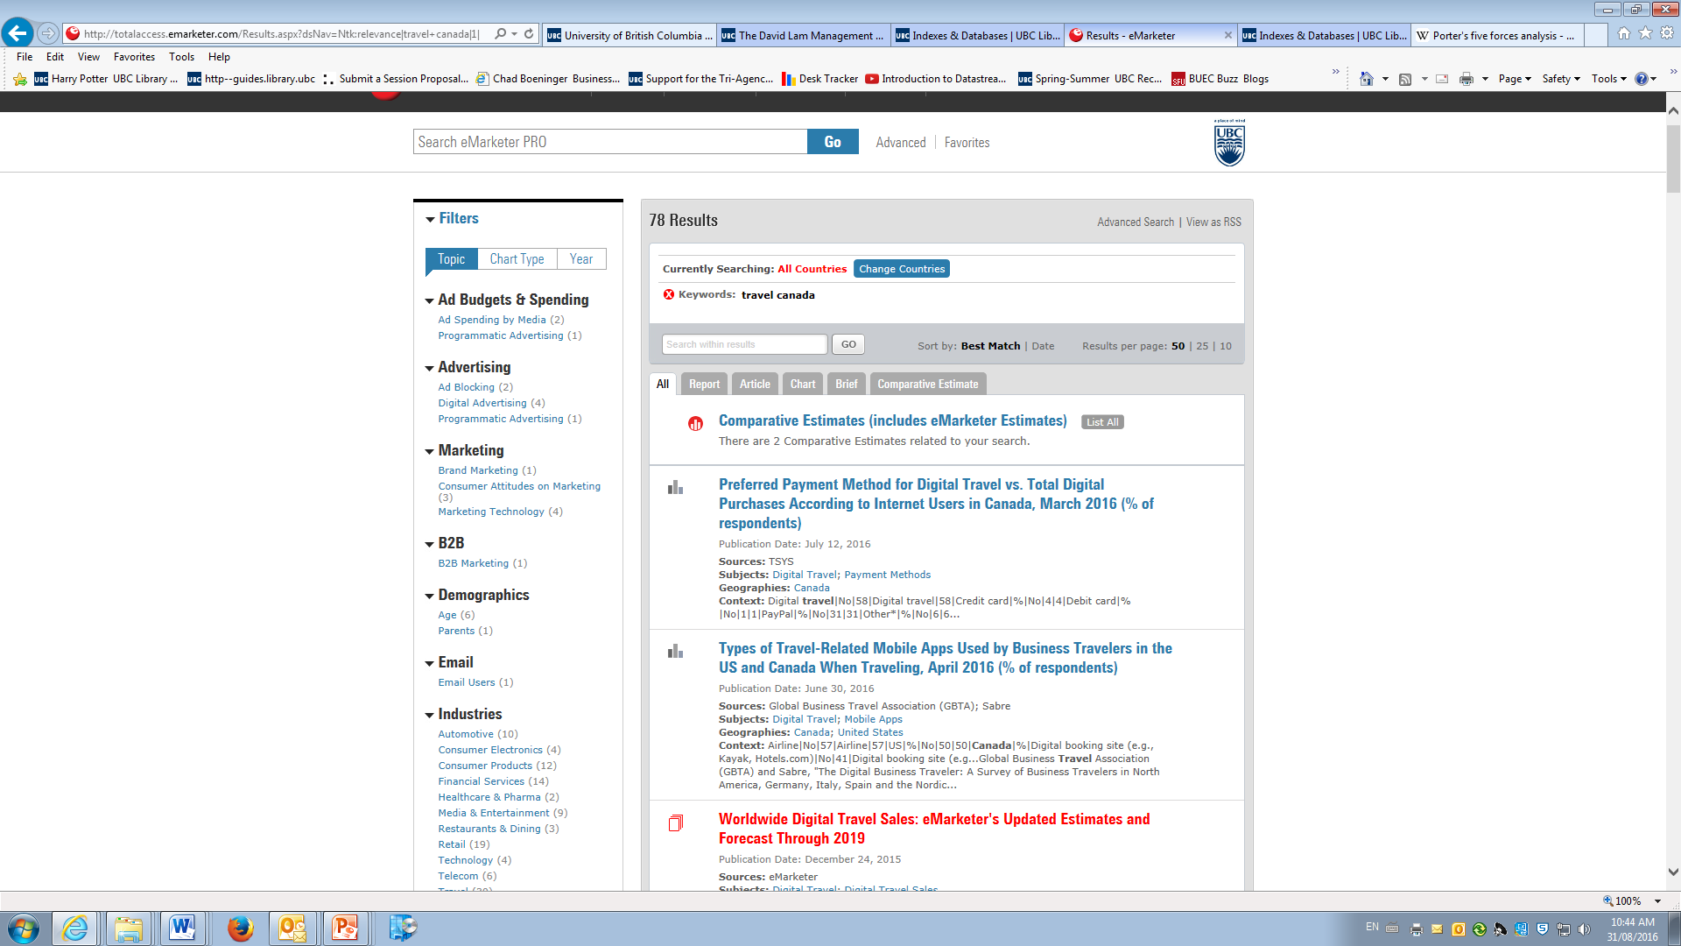
Market research and trend analysis: eMarketer
Notes:
Market research reports and data on insights and trends related to digital marketing/advertising, mobile, retail & ecommerce, social media, and more.
Forecasts, market penetration, market share and rankings, etc.
Demographics and consumer insights (global coverage)
Captures metrics, charts and graphs from thousands of publications

Slide 23
WARC: World Advertising Research Center
Use WARC to research:
case studies
market research and methods
communications effectiveness
consumer insight and behaviour
Notes:
Topics, Marketing Strategy
Case studies
Search “sustainability”

Slide 24
Government agencies & Inter-Governmental Organizations
Government agencies are reputable and valuable sources of:
Economic statistics
Industry statistics and analysis
Financial incentives
Regulations & legislation
Taxation
Company/Association directories
Many government levels and agencies – federal, state, provincial, municipal – may bring you data.
Think about what level of government might be likely to collect your data.
Notes:
Government agencies or inter-governmental organizationsare useful for finding country specific information for industries and trade.
Some information will be

Slide 25
Researching an Industry or Market: Websites
Two good sources of free information are:
Industry association websites
e.g. Canadian Cosmetic Toiletry & Fragrance Association
Government websites
e.g. Health Canada, Industry Canada, Stats Canada
Notes:
So far, I’ve talked about library databases. What about free websites – how can searching with Google help you?
If you do want to start with Google – be selective. Two good places to look – government and industry association websites
Industry associations – for industry news, facts, stats, profiles and to identify competitors (through membership lists) – e.g. Unilever Canada is a member of the CCTFA
To find them, just Google industry keywords and association and a country name if relevant
Government sources – some include industry profiles, statistics, legislation and regulations – Health Canada has legislation and regulations for cosmetics/beauty products
Your success with this will vary according to the industry you are researching – resources are not equal!

Slide 26
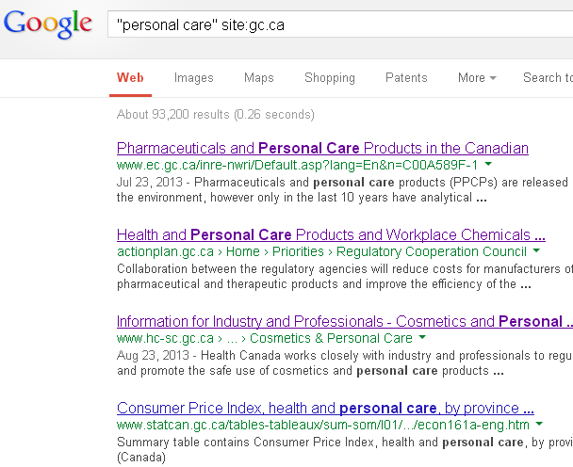
Researching an Industry or Market:
Google search tips
Limit by site domain to narrow your search to government websites:
e.g.
“beauty products” site:gov.bc.ca
(BC gov)
“personal care” site:gc.ca
(federal gov)
cosmetics and industry site:.org
(NGOs, associations, nonprofits)
Notes:
Anyone used the advanced search in Google before to restrict by domain name?
Best way to limit to government sites – can do this for any research you think the government might have some resources on
Remember to try different words or phrases to get different results, e.g. in this case, could be “personal care”, “cosmetics” “beauty products”, etc This applies in article databases too – identify synonyms

Slide 27
Tips for Research Success
  Critical thinking: Identify questions in advance that you want to answer with your research
  Search strategy: Try different search words to vary your results and use the database search tips guide
  Whether the information is published: Be flexible: identify alternatives if you cannot find the information you need
  Have you asked for help?: Ask the librarians if you cannot find information
Notes:
Some tips to pass on to you, from our experience helping students. You will be most successful if you:
Translate your research need into questions that a database or book might answer (this will save you time if you do it upfront)
Think of search words with a similar meaning and use the database tips guide – typing a sentence into a library database won’t work
If the information isn’t collected or published free online or in a database available through the library, you will not be able to find it – move on
Come and ask us for help on search strategy and which databases to use. Before that you need to do part 1: critical thinking. We cannot do that for you!
It’s easy to leave out researching in library databases because Google is easier – I understand. But you are missing out on high quality resources by not using our databases and your instructors want you to use them.
In the business world, if you were asked to do research, you won’t have access to all of the databases here, but you might have some. If you find resources that are quick to access but not credible, what will that do for your reputation?

Slide 28
Research Strategy:
Who would collect/publish the information?
I need to find out how many new vehicles were registered in BC in 2016. Where can I find this out?
  Primary research
  Statistics Canada
  Market research databases
Statistics Canada collects not only census data, but also economic and industry statistics.
Statistics are often available at the federal and provincial level and sometimes for municipalities.
B. Statistics Canada
Notes:
Can someone who selected Statistics Canada tell us why?
Statistics Canada is not only the source of census data. It also a great resource for Canadian economic and industry statistics, at the federal, provincial level. Some data is also available at the city level.
Of course, you won’t usually have 3 clear choices like this and you won’t know exactly where to look – but it’s still valuable to think who might collect the data, to narrow it down.

Slide 29
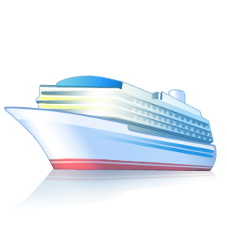
Research Strategy:
Who would collect/publish the information?
“I need to find the number of cruise ship passengers who shop for clothing in Yaletown.” Where can I find this out?
  Market research databases
  Article databases
  Free websites
  Primary research
What you can find through secondary research:
Monthly cruise ship passenger statistics (Port of Vancouver)
Articles on cruise ship passengers and shopping in Vancouver
Profile of the BC Cruise Industry (Cruise BC Association)
This is a very specific group of consumers and a very specific location.
D. Primary research
Notes:
Can someone who selected primary research tell us why?
Who would collect this data? And why? Maybe a local market research company? If it is this specific it’s unlikely to exist and be published.
You will have to do primary research to find this out – interviews, surveys?
But what can we find out through secondary research that might be helpful? - Critical thinking means thinking of alternatives!
We are not experts in your topic. I had to do some research to find this out. Knowing where to look and how to search is where we can help you.

Slide 30
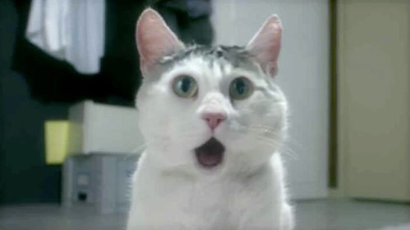
Research Basics – Citing
Question: “What do I need to cite?”
You must cite ALL sources!
Including: articles, books, videos, presentations, lectures, blog posts, websites, images, interviews with individuals (even your own)
In the body of your report (in-text citations)
In a reference list following your report
Acknowledgements in presentations
Image: http://www.boomsbeat.com/articles/1367/20140317/cute-surprised-faces-fluffy-cats-photos.htm/
Citation Style:
Most often APA in business
Check with your instructor
Notes:
Your CBP Report: Demonstrating credibility through citations
Sometimes in the workplace citing is overlooked.
This is an important step as it adds credibility to you as a researcher and writer.
Shows you’ve backed up your conclusions with research.
Don’t forget to include citations in the text of your report, wherever you use the secondary data, the reader should be able to find it in the reference list at the end and then get to the data source itself.
Saying “our analysis shows…” is not enough! Where did you get the analysis? Even on slide presentations it looks more credible if you have included the source of your data. Your clients in your live case assignments will know that you can’t have done all the research yourself.

Slide 31
JumpStart Your Research form
Tool for planning your research process
Steps to developing a research strategy
Share with your group members and your client
Begin your search by consulting the resources listed on the MM Research Guide

Slide 32

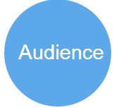
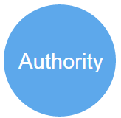

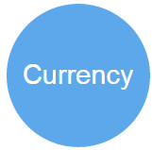
Evaluate your Sources
Why was it created?
Generalized or
Specialized?
Credible source?
Comprehensive or
Just a point of view?
When was it published?
Notes:
Whether you find information online through freely available sources, or at a library, you should still evaluate it.
Question: what should you consider?
Reminder in business information may not always need to be academic or peer reviewed.
Purpose: Why was this created? Selling or promoting a product?
Coverage: Is it comprehensive? Or just one point of view?
Audience: General or specialized?
Currency: When was it published?
Authority: Can you identify who wrote it? Are they credible?

Slide 33
Research Help
Reference desk:
Drop-in research help Mon-Fri, 1-4pm
on Zoom
https://lam.library.ubc.ca/research-help-2/
Research help by email:
http://lam.library.ubc.ca/ask-us/
The Keep Calm-O-Matic
Notes:
Visit a librarian in the CLC
No appointment necessary

Slide 34

Wrap Up Summary
David Lam Library is the business library on-campus, but you may want to visit other branches while you’re here.
Business research uses many types of sources, including subscription or free resources
Access business databases from lam.library.ubc.ca using your CWL
Research guides are available for many subjects:
  International business
  Marketing
  Industry & Market Research
  Company Research
  Economics

Slide 35

Questions
Image: http://www.winkle.eu/best-practice/5-questions-ask-market-research-agency-hire/

