Slide 1
THE CASE
METHODOLOGY
Orientation

Slide 3
The Major Purposes of Cases
Cases area a story that provide a context in which:
Professors can introduce tools and concepts
Students can practice applying tools and concepts, and engage in critical thinking
Students can become more comfortable with ambiguity

Slide 4
Traditional Cases & Live Cases/Decision Briefs
Traditional cases
Restricted to info supplied; fixed point in time
Live Cases/Decision briefs
Limited information; live; need to explore and find more information
For both approaches
Identify and prioritize issues
Analyze data
Make recommendations
Practice at management decision making
Systematic
Logical
Evidence based

Slide 5
How and Why we Choose Cases
Choose a variety of:
Industries
Geographical settings
Times
Integration themes
What sort of things could you learn in case analysis that might be transferable across industries, geographies, and time periods?

Slide 6
Macro Elements of the Case Method
Issues: identify, organize, prioritize
Analysis: underlying causes; insights; alternative actions considered
Recommendations: supported by your analysis; action plan; caveats

Slide 7
The Case Preparation Stages
A) Identify Issues
B) Analysis
C) Alternative Generation
D) Decision Criteria
E) Alternative Assessment
F) Recommendation
G) Action and Implementation
H) Missing information and assumptions
Use in preparing a memo, or for class discussion, or for a competition

Slide 8
Stages of Learning in Cases
Individual Preparation
Small group discussion
Large group (class) discussion
After case personal reflection
L
LG
SG
Individual
T

Slide 9
Approaching a Case
Skim the case quickly to “get a feel”
Look to see if a specific decision point is identified (typically in the first or last paragraph)
Then, read the case carefully
Can you identify the issues?
How are they linked?
For cases expect to tackle interaction of disciplines, i.e.
How does marketing impact the supply chain?
How does culture impact accounting practices?
Other interactions you might find?

Slide 10
“What, Why, & How”
• “What” course of action should be taken
• “Why” reflects your evidence, directly from the case and distilled from your analysis
• “How” is the implementation plan

Slide 11
Dimensions & Difficulty Levels
Analytical: what is the task?
Simpler case has task or issue identified
More challenging cases leave identification open for student to identify
Conceptual: what concepts should be used?
Simpler cases may have a single, specified concept
More challenging cases may require multiple (possibly unspecified) concepts to be tackled
Presentation: the structure of the information
Clear and complete or ambiguous and incomplete

Slide 12
Tools for Analysis - Qualitative

Slide 13
Questions to Ask - Quantitative
How would you analyze the numbers in this case? What numerical framework can you build to inform your thinking?
What answers (and possible further questions) arise from your analysis?
Assumptions and identification
Sensitivity analysis

Slide 14
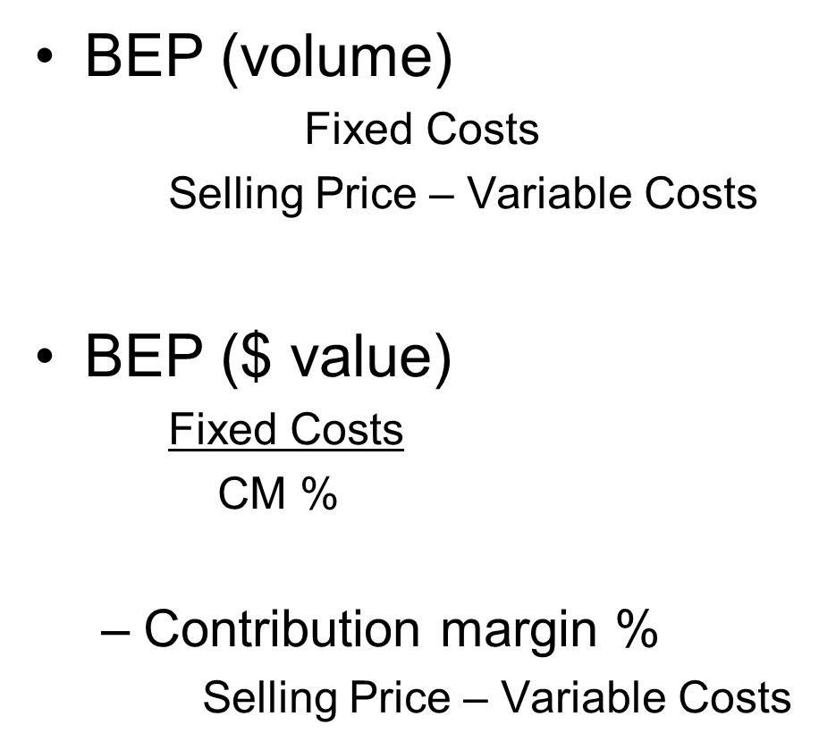
E.g., Break Even Point Calculations

Slide 15
Decision Criteria
What decision criteria could you use to screen alternative options?
Hint: List under qualitative and quantitative

Slide 16
Alternative Assessment
 | Cost | Time | Risk | Ease | Add other criteria
Alt 1
Alt 2
Alt 3
Several options available
Focus here on “Alternative Analysis Matrix”
Can do as unweighted or better still, weighted
Engage team in discussing assumptions behind weightings and ratings

Slide 17
Missing Information & Assumptions
This is important to document for your own notes and sometimes there will be space to include as a caveat(s)
However, do NOT avoid making a recommended decision saying that there is “not enough information”
The case default is: you are THE decision-maker, at the time of the case with only the information in the case….what would you do and why?

Slide 18
Student Myths
MYTH: There is one right answer
We are more interested in your demonstrated analysis than the specific recommendation that you come up with
MYTH: I should repeat case info in my paper to show that I have read it
This is a waste of space – don’t do it
MYTH: The firm actually chose the right option
In fact, firms often do not make a “good” decision, given the information in the case

Slide 19
Feedback on Cases
Grades and written feedback
Exemplars from cohort
Overall feedback to the class (from professor)
Feedback through in-class case discussion
Feedback from peers throughout the process

Slide 20
Professionalism & Integrity
Professionalism in case-work? What does that mean?
The value of case learning
The internet and other temptations

Slide 21
How are Live Cases/Decision Briefs Different from/Similar to Traditional Cases?
Current time
Seeking more information is encouraged
Otherwise – very similar
A management decision
Messy information that is never complete
Similar problem
Organization and analysis steps will aid you
Be systematic

Slide 22
Southwest Airlines: Some Questions to Consider
What are the success factors that have driven Southwest Airlines in its recent performance (at the time of the case)?
Given the current chain of events – what would you recommend to Southwest Airlines with respect to their pricing strategy moving forward? Why?

Slide 23
Conclusion
This has been an INTRODUCTION to CASE METHODOLOGY
Cases provide frameworks for learning about management issues, analysis and decision making
There is no single right answer to a case
With practice you can become good at tackling
New industries
Complex data
Ambiguity
Building your “toolkit” and making good tool selections
And respond effectively to problems and opportunities

