Slide 1
SAFE TRAVEL ESSENTIALS
safety.abroad@ubc.ca

Slide 2
How are you feeling about travelling?
Nervous, I’m not sure what to expect
Excited and ready to go!

Slide 3
UBC’s responsibilities:
Maintain the Student Safety Abroad Registry
Stay informed of travel conditions and follow policy guidelines
Offer students resources advice and help while travelling

Slide 4
Students’ responsibilities:
Research and prepare for travel risks
Register your trip with UBC and your home country
Use safe travel resources

Slide 5
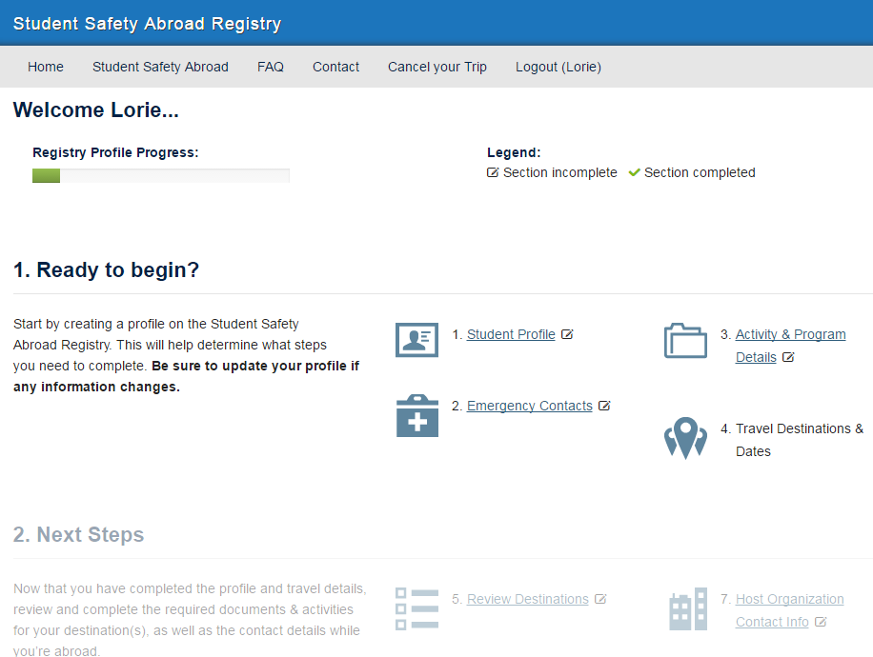

Slide 6
A note on student travel cancellations
Guided by the Student Safety Abroad Policy
Relies heavily on advice from Global Affairs Canada
Are made using the best available information at the time
We are still living with travel risks; conditions may change rapidly

Slide 7
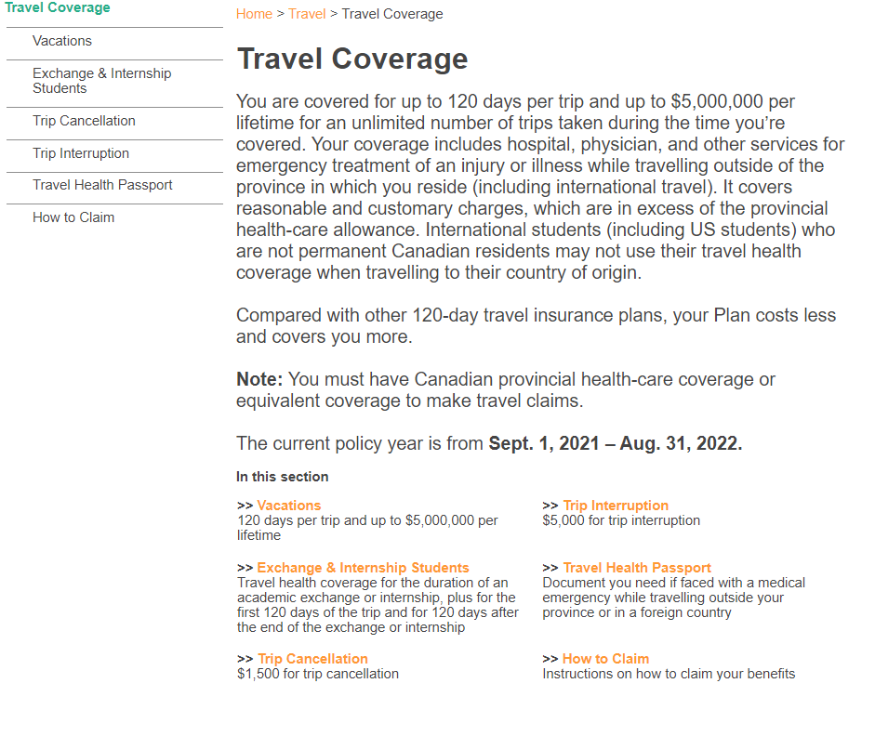
source: https://www.studentcare.ca/rte/en/UniversityofBritishColumbiaAMSGSS_Home

Slide 9
Travel risks are the possibility of encountering a situation that could cause harm
Travel risks can be specific to:
Your destination
The types of activities you engage in
Yourself
Think about what types of risks you may encounter with your upcoming trip.

Slide 10
Travel-risk planning:
Carefully consider the risks you might encounter while travelling and answer the following for each scenario:
How would this situation impact my well-being and ability to carry on with my plans?
Is there anything you can do in advance to either avoid it or reduce the impact if you encounter the situation?
If you encounter the situation, what steps you would take and what resources you would use to help?

Slide 11
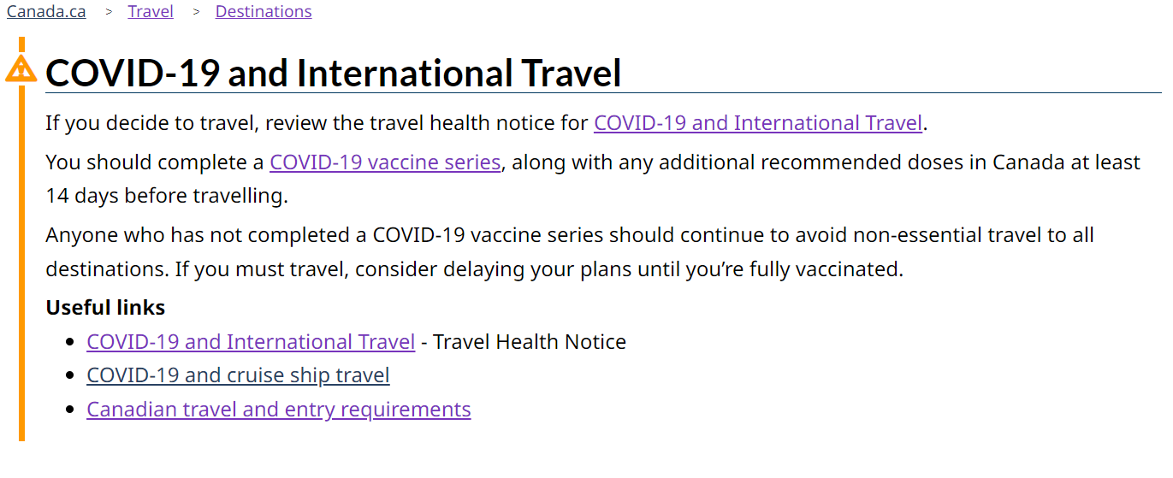
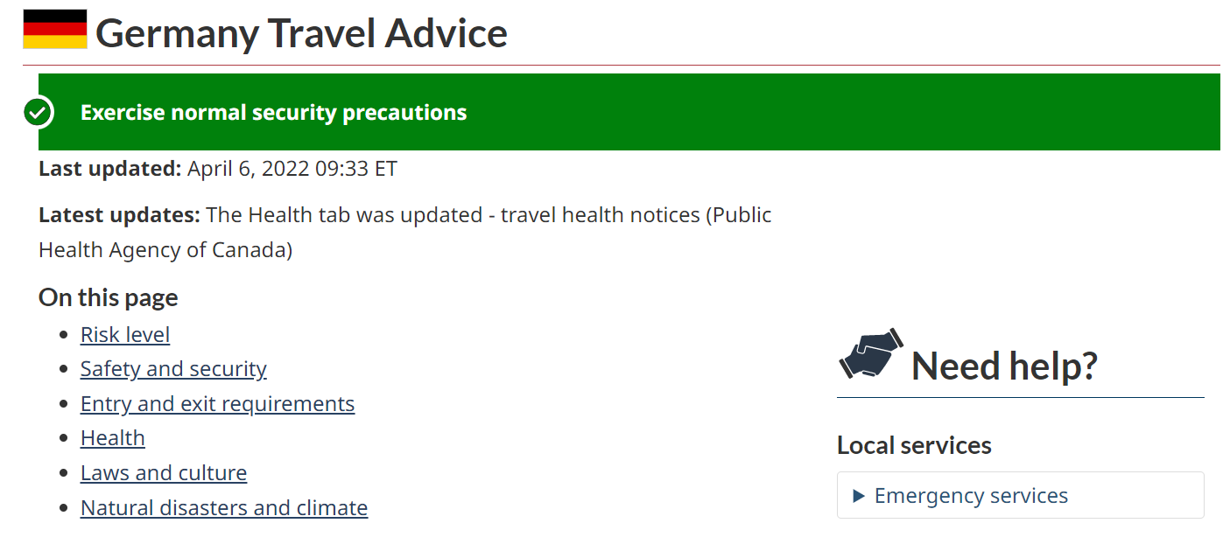
source: https://travel.gc.ca/destinations/germany

Slide 12
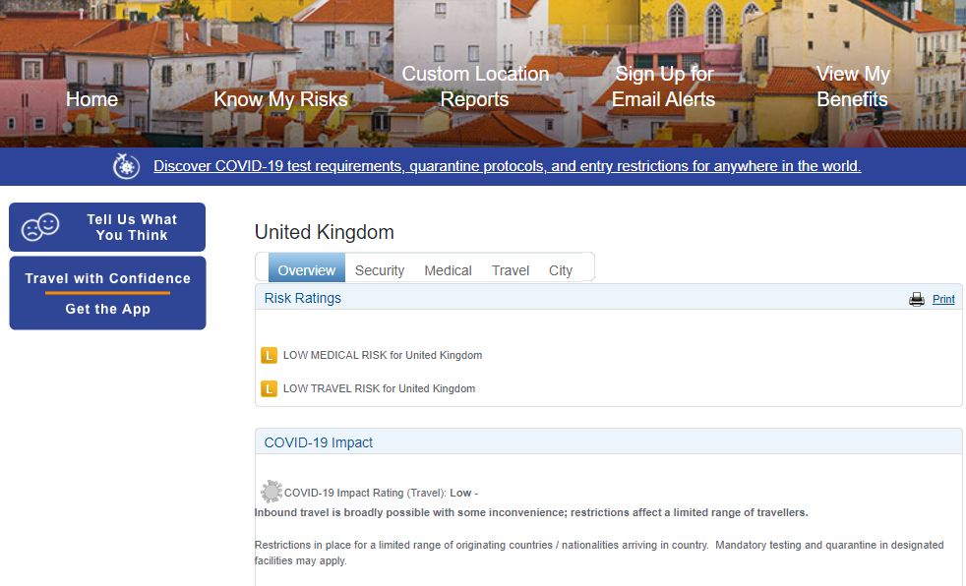
source: https://www.internationalsos.com/

Slide 13
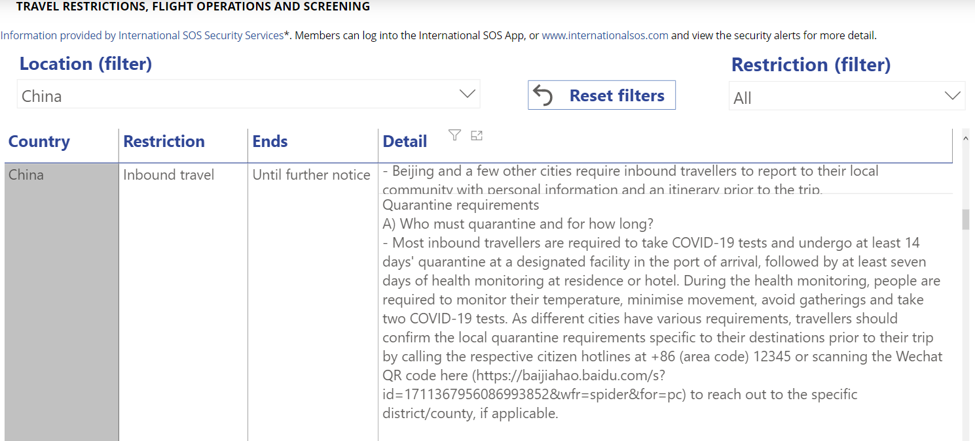
source: https://www.internationalsos.com/

Slide 14
