Slide 1
Thursday School Visits EDUC 315/321

Slide 2
Active Engagement
build relationships
monitor student progress
monitor student behaviour
identify and work with individual students
work with small groups

Slide 3
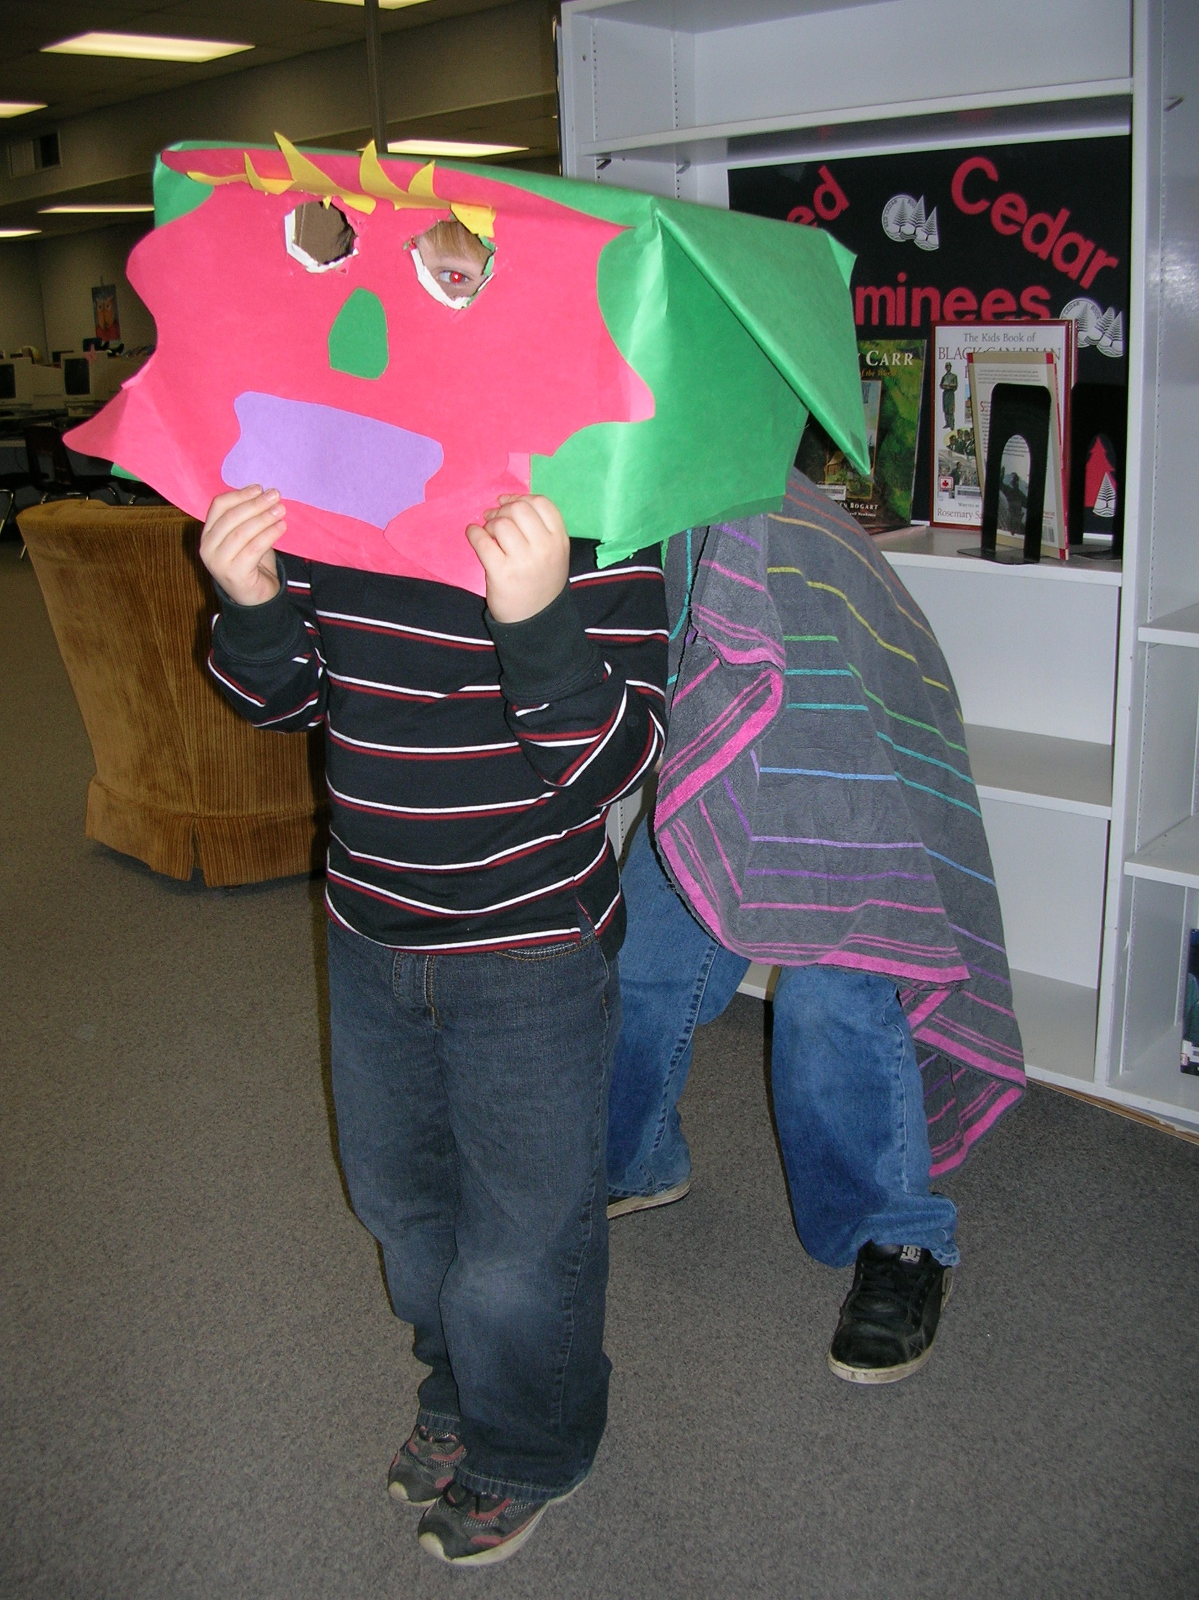
Focused Observations
classroom procedures
classroom rules
classroom set-up
techniques for re-directing
students
techniques for encouraging students
logical consequences for behaviour

Slide 4
Preparation
Before and after school:
look at resources
look at field trip opportunities
offer to prepare lesson materials, photocopy, create displays of student work

