Slide 1

Top Five Considerations for Managing to Teach

Slide 2
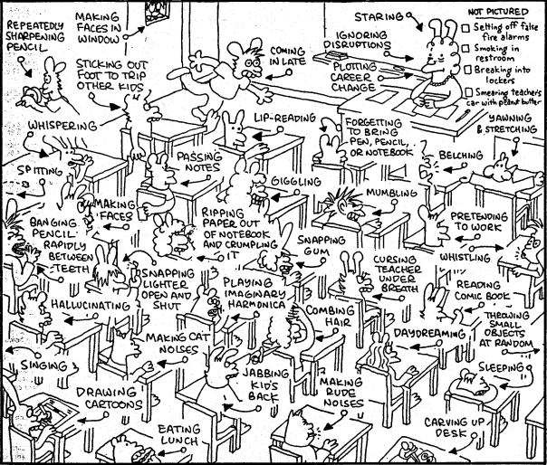
Kids Rule, Teachers Drool!

Slide 3

Relationship

Slide 4
Engagement
Know your students – what are their interests?
Hook – build interest
Active Learning – what will they do?
Hands on
Interactive
Technology
Plan, Plan, Plan

Slide 5
Fillers
Limit down time
Early finish activities – extension of lesson, finish up
Sponge Activities – 20 questions, eye spy, etc
Brain Breaks – Sevens, Go Noodle, Breathing Exercises such as Four Square Breathing

Slide 6
Signals and Cues
Call and Response
Lights
Music
Countdown
Hand signals

Slide 7
Disruption
Law of Least Intervention
Consistency
Wait Time – Always quiet before speaking!!!!
Eye contact
Proximity
Private
“Do you have a question?”
Praise and Positive Reinforcement

Slide 8
Resources
Books: Managing to Teach – Carole Cummings, Classroom Management: A Thinking and Caring Approach- Barrie Bennet
Websites: Edutopia, Laura Candler, Whole Brain Learning
http://www.askdrsears.com/topics/parenting/discipline-behavior/25-ways-talk-so-children-will-listen
http://www.edutopia.org/blog/classroom-management-tips-novice-teachers-rebecca-alber

