Slide 1
Brita Case
March 2006

Slide 2
Brita – Overview
Past
Pioneer in water filter technology
Over 10 years of successful sales and market domination
Present
“Leaky bucket” and decreasing market share
Future
Brita Blue Filters
Notes:
Environment – Top line performance was

Slide 3
Brita’s success – the “blue-water” decade
1988
1993
- First in the market with
value proposition of
great tasting water
- Educational ad campaign on
how to use Brita
“Tap water transformed”
1999
- National distribution (40,000 stores)
- Brand awareness 70%
- 18% of 103mil households use Brita
- 80% of customers still using it one year on
- Industry worth $350MM (owned 71%)
- 70 competitors failed
- Consumer choice limited to tap water or PT
Brita created the market for filtered water, aided by shifting consumer values towards safety, health, and great taste

Slide 4
Brita’s problems 1999 - 2006
Brita’s share of the filtered water market was threatened by PUR (exacerbated when they were purchased by P&G) and the emergence of bottled water (1997)
Strategy 1 | Strategy 2 | Strategy 3 | Strategy 4 | Strategy 5
Where does water belong? | Bottled Water as the bad guy | Leaky Bucket | Tap water Turn-offs | Bottled Water as the bad guy Re-visited
Quit the water business Beverage vs. filter | Difficult to change people’s behaviour Bottled water taste without the bottle | 46% of PT lapsed in a year Gauge & Windows innovation did not succeed | Revisit filtration when BW is so prevalent Transform the taste of tap | More convenient Cheaper
Brita did not identify their target market and failed to come up with an effective value proposition

Slide 5
Target market selection criteria
Criteria | Tap Traditionalists | Weary Tap Satisfied | Principled Filtered Fans | Affluent Fridge Followers | Assertive Self improvers | Bottled Water Indulgers
Segment is well defined/identifiable | All of the segment are well defined.
Accessible | 1 | 2 | 6 | 4 | 5 | 3
Competitor Intensity | Highest tap satisfaction index (220) limited room for market entrant | High competitive intensity(lots of substitutes) focus convenience & budget | FM, other pitchers, refrigerator filter system | No room for non-refrigerator mark entrant | Competition from other filtered water options: Refrigerator, FM, PT, and bottled water | High-20% of producers control 80% of sales
Stability of preferences | Want: Tap Water Likely to switch: No Susceptible to innovation: No TSI: 220 | Want: Cheap & Convenient Likely to switch: No Susceptible to innovation: No TSI: 171 | Want: Filtered Water Likely to switch: No Susceptible to innovation: Yes TSI: 43 | Want: Convenient filtered water Likely to switch: No Susceptible to innovation: Yes TSI: 81 | Want: Volume, healthy, value-seekers Likely to switch: Yes Susceptible to innovation: Yes TSI: 121 | Want: Simplicity and accessibility Likely to switch: No Susceptible to innovation: Maybe TSI: 34
Profit potential | Low | Low | High | Medium | High | Low

Slide 6
Target market selection rationale
Water Consumption
Primary Source of Water
Notes:
.

Slide 7
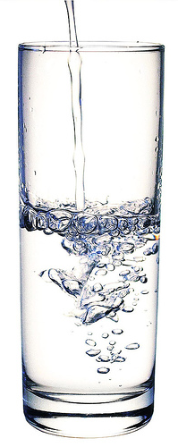
Target Markets
Principled Filter Fans
Current core consumer base
High accessibility and profitability
Primary source of water : Filtered water
Sound bite: Filtered water is healthier than tap
Assertive Self-Improvers
Potential new segment
Good accessibility
High growth potential: Lack of penetration & high water consumption
Primary source of water : Filtered water & Tap water
Sound bite: I drink a lot of water – it keeps me healthy

Slide 8
Consumer perspective on competitive products
Consumer Perception (PT vs. FM)
Consumer Perception (BW vs. PT)

Slide 9

Brita Blue – Smart Filter
The Filter
How it Benefits Brita
Helps solve leaky bucket
How it Benefits the Customer
Convenience – Know when to change filter
Safer – Change filter to avoid contaminants
Increases filter purchases
Differentiates us from competition
The Website
How it Benefits Brita
Increases customer interaction
How it Benefits the Customer
Customer data – demographics
Additional revenue stream
Drinks water for health – meet daily quota of consumption
Ease of purchase

Slide 10
Brita’s Value Proposition
Points of Parity
Points of Differentiation
Remove Contaminants
Tastes Better Than Tap
Convenience – Color Indicator
Water Clarity
Website
Brita Blue is the most technologically advanced and cutting-edge filter on the market because its colour-change indicator lets you know when a new filter is needed so that you can avoid contaminants and continue enjoying clear, great-tasting water.
Notes:
.

Slide 11
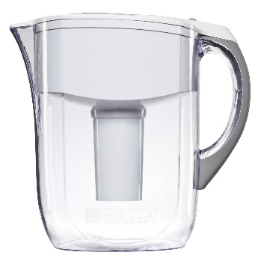
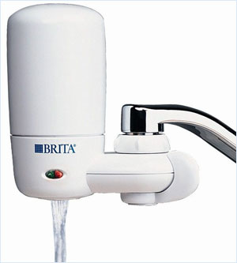
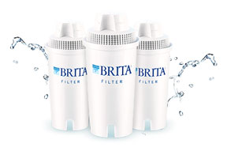
Pricing Considerations
New Filter
Product | Pitcher | Faucet Mounted | “Traditional” Filter | Brita Blue (New Filter)
New Price | Unchanged | Unchanged | Unchanged | High price high margin
Rationale
Traditional Filter
Traditional Filter
Assumptions:
Optimal filter changes occur 6x per year (1/2months)
Customer leakage on traditional filter wrt PT= 20%

Slide 12


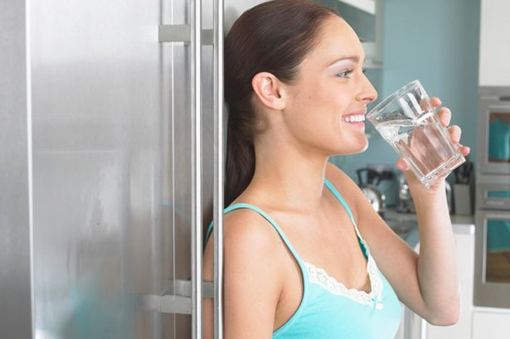



Methods of Distribution

Slide 13
Communication Strategy- Focusing on the 6 M’s
Mission
Message
Media
Money
Measurement
Market
- Increase awareness, consideration and purchase of our Brita Blue Smart filter
- Our existing customers
- The Assertive Self-Improvers
- Brita Blue alerts you to change your filter
- Website allows you to track your water consumption
- TV & print ads
- Website
- To be determined
- Sales of Brita Blue
- # subscribed users on the website

Slide 14
Decision Making Process
Awareness
Consideration
Attitude
Trial
Repeat/
Loyalty
Product Promoting Ads
Affective Ads
Provide to Yoga Studios/Gyms
Brand-Building Ads
Apply push & pull tactics to influence the customer decision making process
Notes:
Awareness: Build around informational ads
Attitude: Build around emotive ads focusing on health and being cutting edge
Trial: Our segment is very likely to purchase after trying it so we will provide yoga studios, gyms and other places they frequent with it so they can try it
Repeat/Loyalty: Brand-Building Ads

Slide 15

Product-Promoting Ad
Notes:
Awareness: Build around informational ads
Attitude: Build around emotive ads focusing on health and being cutting edge
Trial: Our segment is very likely to purchase after trying it so we will provide yoga studios, gyms and other places they frequent with it so they can try it
Repeat/Loyalty: Brand-Building Ads

Slide 16
Decision Making Process
Awareness
Consideration
Attitude
Trial
Repeat/
Loyalty
Product Promoting Ads
Affective Ads
Provide to Yoga Studios/Gyms
Brand-Building Ads
Apply push & pull tactics to influence the customer decision making process
Notes:
Awareness: Build around informational ads
Attitude: Build around emotive ads focusing on health and being cutting edge
Trial: Our segment is very likely to purchase after trying it so we will provide yoga studios, gyms and other places they frequent with it so they can try it
Repeat/Loyalty: Brand-Building Ads

Slide 17
Attitudinal & Behavioral Objectives
Attitudinal Objectives
Behavioral Objectives
Think
The Brita Blue filter is trustworthy and convenient
Do Change Filters
Increase filter change frequency and confidence
Feel
Brita cares about overall well-being and caters to my lifestyle
Do Use Website
Create Brita Blue account & improve consumption awareness
Believe
Brita is improving my overall quality of life
Don’t Switch Brands
Decrease likelihood of brand-switching

Slide 18
Risk & Concerns with Marketing Strategy
The current marketing plan is focused on sending a single message to consumers regardless of their product choice
Single Message to Consumers
Consumer Price Sensitivity
Demand elasticity with respect to price is unknown for our target segments (ie. will the more expensive filter fail on the basis of price)
Website Adoption
The Assertive self-improvers, despite being diligent, do not indicate a heavy use of the internet. If the segment does not use the website there is room for competitors to displace us
Competitor Innovation
An omnipresent threat in the competitive and fragmented filtered water market, will P&G come up with a more innovative product?

Slide 19
Questions?

Slide 20

Appendix A: The Website
Filter Capacity
Days used
Cups per Litre
Cups per Day
Example
100 L
50 Days
4.23
8.46

Slide 21
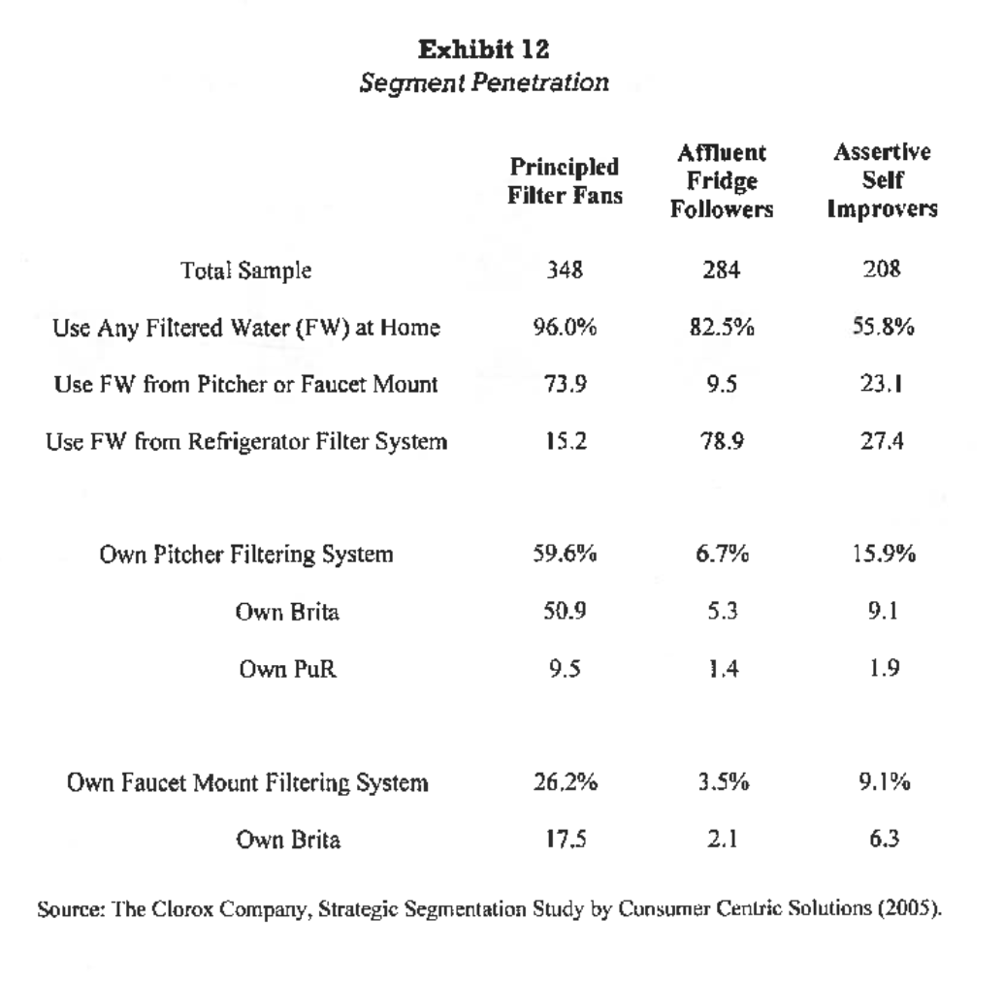
Appendix B

