Slide 1
Examples of Data Vis Coding
Go to Tutorials on course web site
R and leaflet tutorial follows Ben Fry’s Data Vis Pipeline with 311 call data from City of Vancouver
Processing is fun: learn how to code shapes
CARTO: Assignment 3 will introduce you to a TINY bit of CSS and PostGreSQL
Google MyMaps – not really coding, user interface
JavaScript D3.js

Slide 2
R leaflet example: Interactive map of 311 complaint data from City of Vancouver https://allthisblog.wordpress.com/2016/10/10/r-with-leaflet-vancouver-311-tutorial/
Acquire: download data from City web site
Parse: ‘fix’ geo-tagged data and geocoded for lag/long coordinates
data is geo-tagged with block face (30xx) and street name: fix
Needed to make decision re: offset points – how?
Filter: Select points outside of geographic area for City – edit or delete
Mine: data has 100+ categories for complaints, we had to create less categories for mapping!
Represent: plot base map and points (leaflet, Stamen layers)
Refine: colours, symbols
Interact: select layers, popups

Slide 3
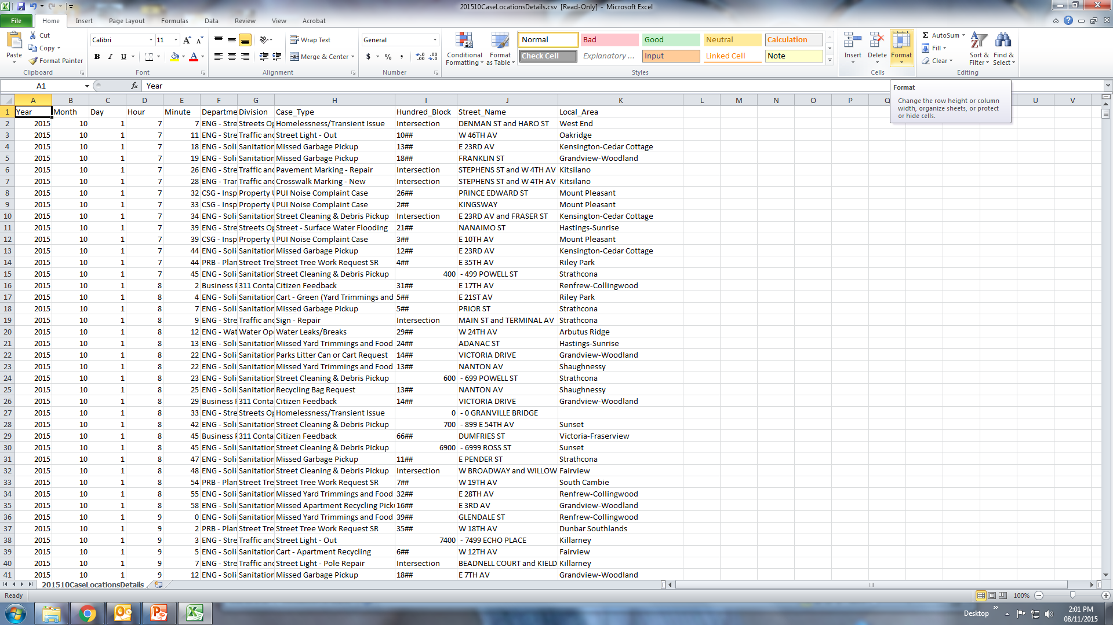

Slide 4
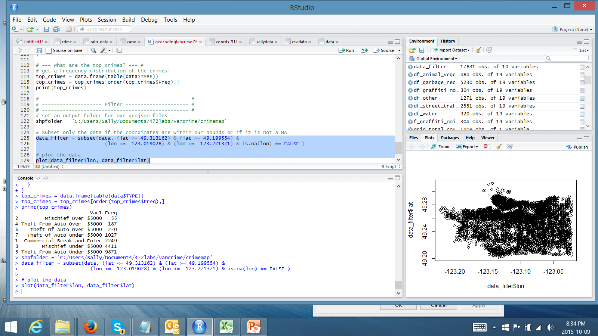
Students work: following tutorial
Acquire, Parse, Filter and Mine

Slide 5
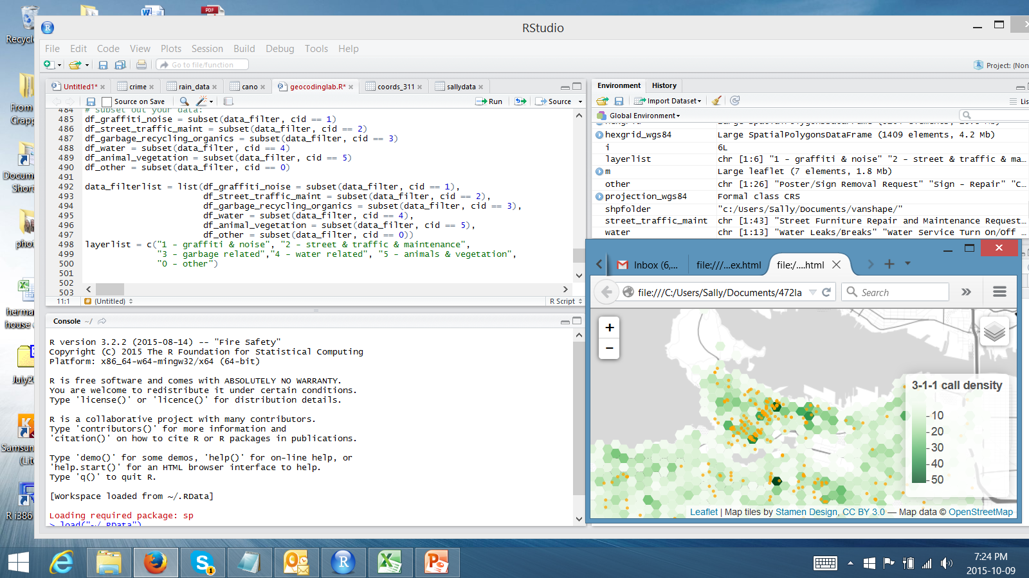
Refine, Interact

Slide 6
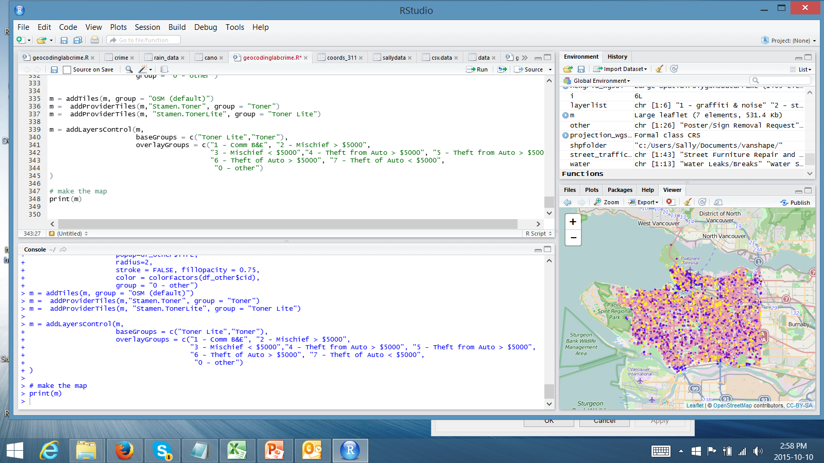
Represent

Slide 7
CARTO (formally CartoDB)
Go to Tutorial, CARTO and follow through!

Slide 8
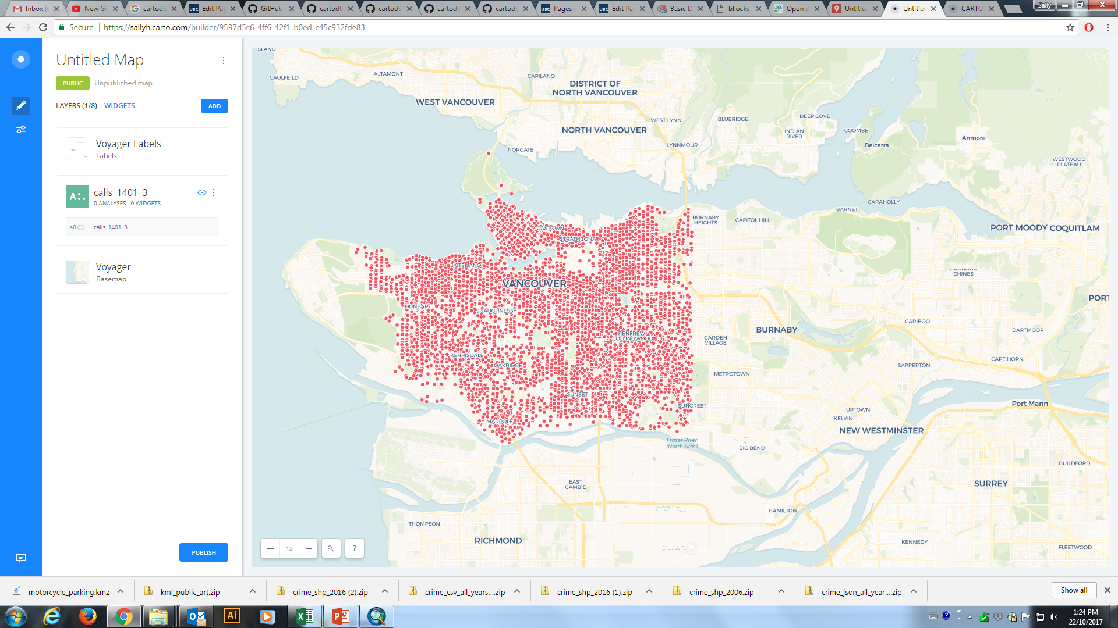

Slide 9
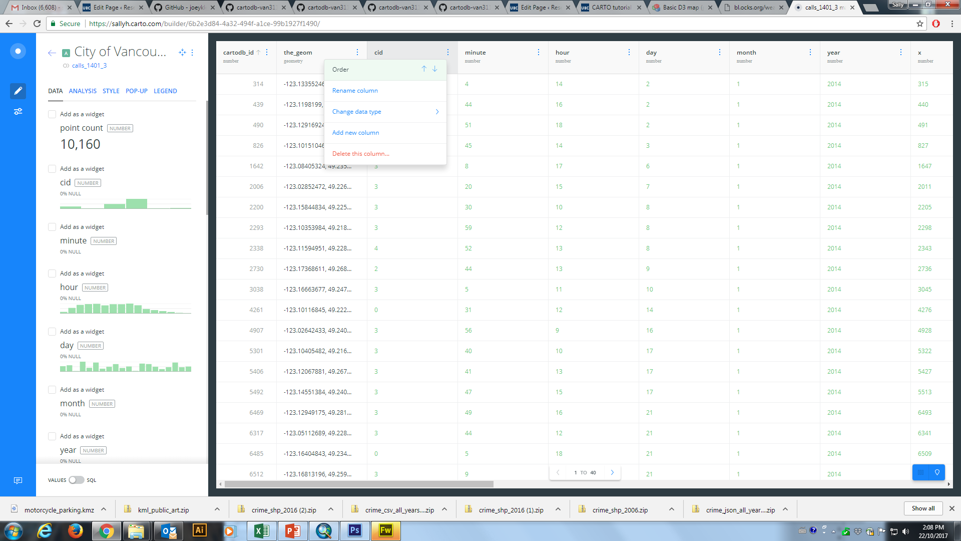

Slide 10
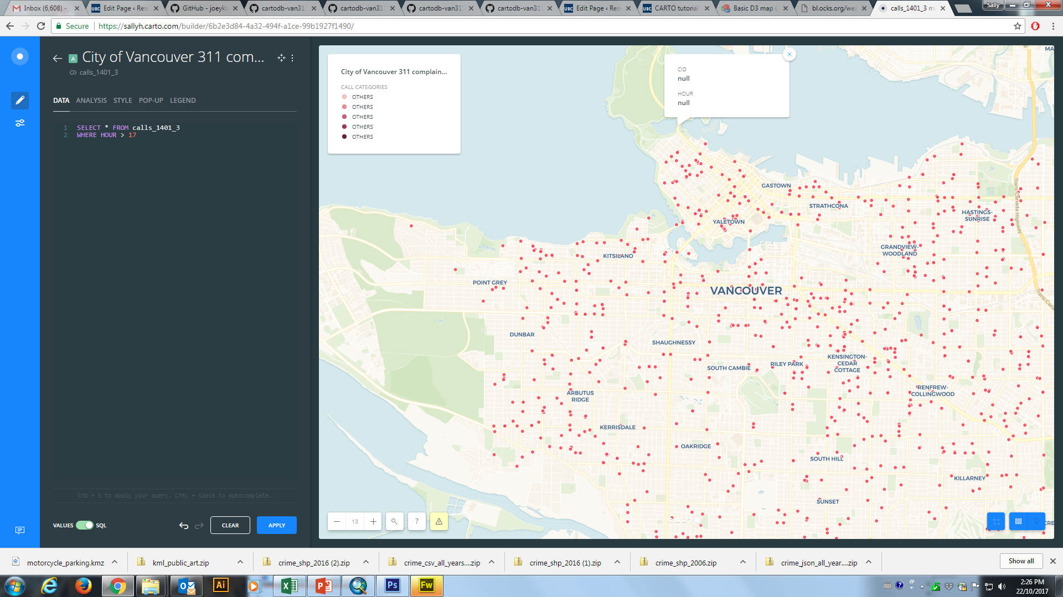

Slide 11
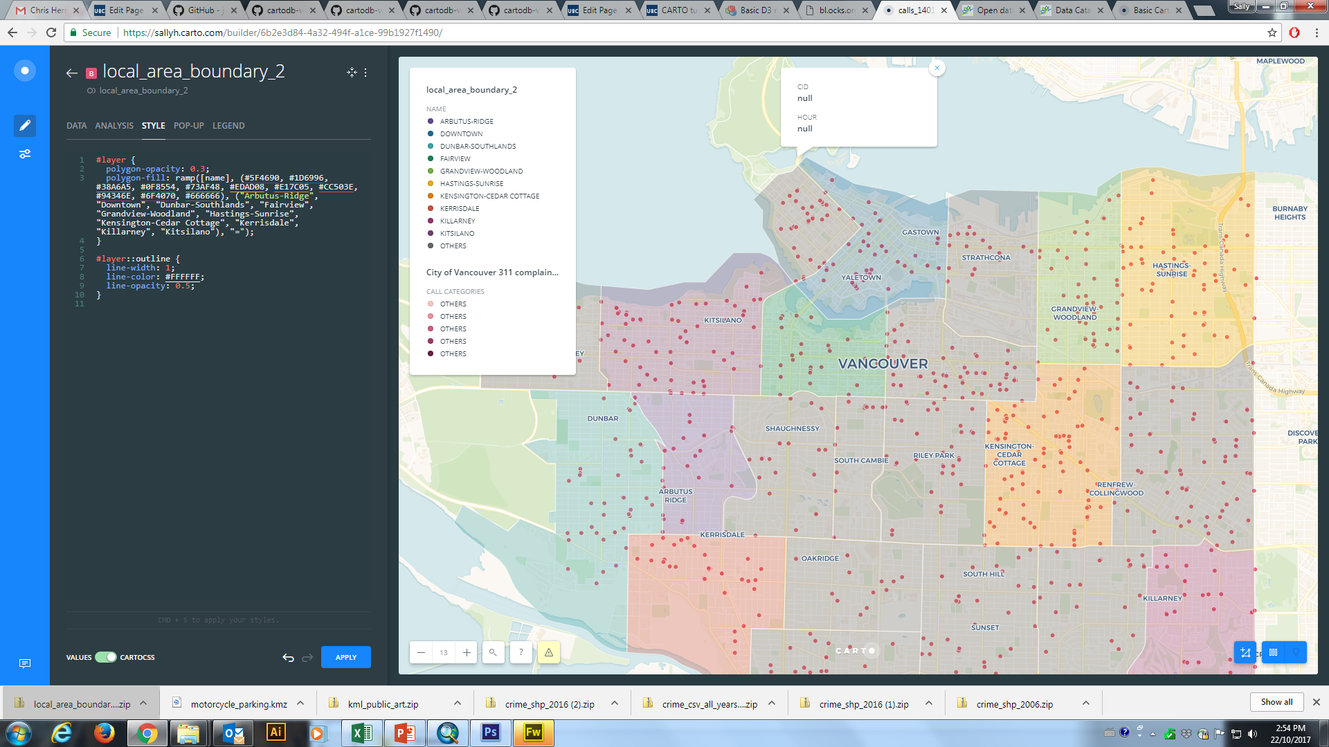

Slide 12
D3.js
http://blockbuilder.org/wearconverse/c1da00bb1127ef308966d8748bcc48ef
http://blockbuilder.org/wearconverse/f58ce3925bc4be42dd81277bc4f5af47

Slide 13
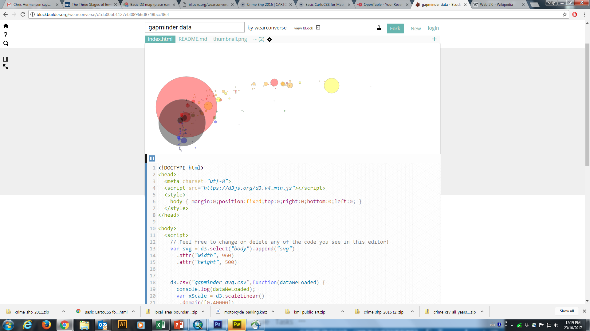

Slide 14
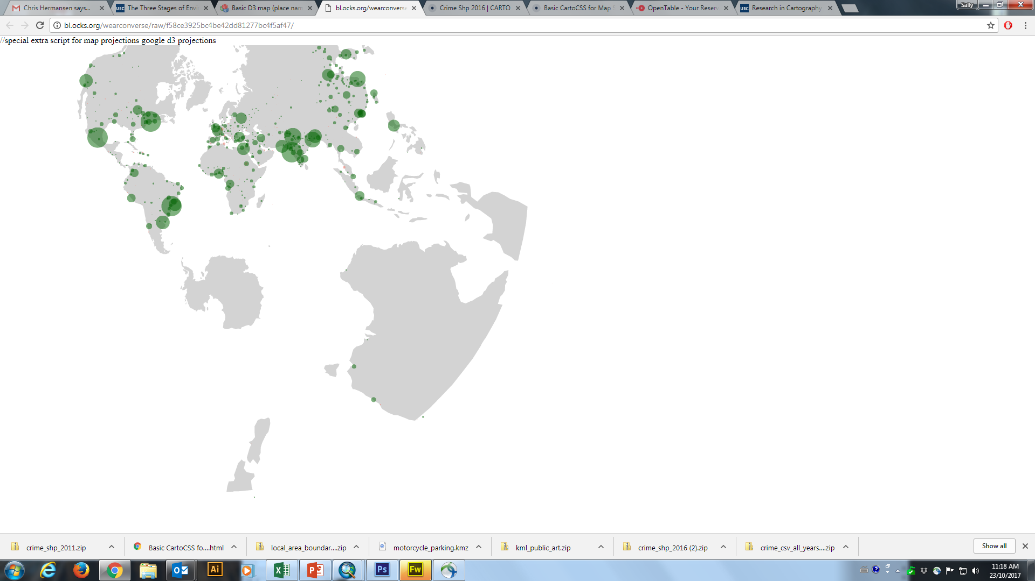

Slide 15
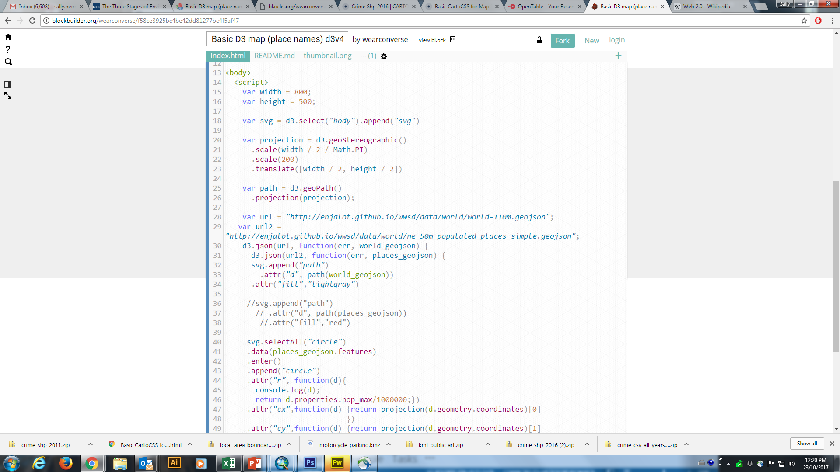

Slide 16
https://bl.ocks.org/wearconverse

