Slide 1
We should always ask the following questions when thinking about magic:
- how it works
- what makes it effective
who makes it effective

Slide 2
Terms:
Magical practitioners: Magic as an activity:
Magos/magus mageia/magica
(Modern: mage)
Who are the magi?

Slide 3
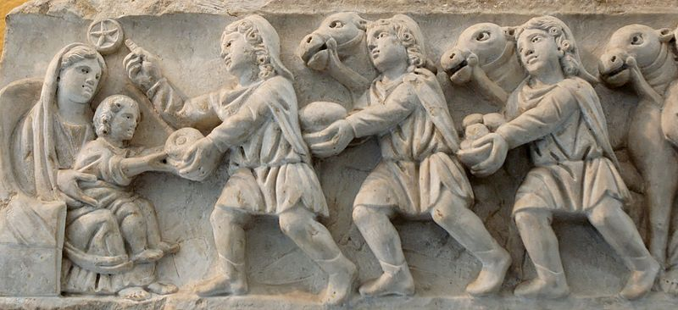
The magi
The adoration of the Magi, 4th century CE, City of Rome
Notes:
https://commons.wikimedia.org/wiki/File:Adoration_magi_Pio_Christiano_Inv31459.jpg

Slide 4
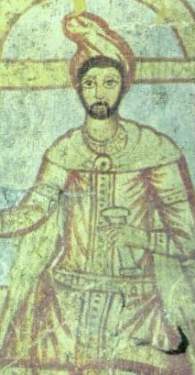
Drawing of priest of Mithras from the Roman fort of Dura-Europos in Syria once identified as Zoroaster (3rd century CE)
Mithras and Mithraism: religion
Notes:
Public Domain, https://commons.wikimedia.org/w/index.php?curid=11640335
CIMRM 44 (vI.67): Palmyrene pater of the Roman cult of Mithras at Dura Europos (Syria), 3rd century, imagined by Franz Cumont to be a depiction of "Zoroaster" (published posthumously in 1975, "The Dura Mithraeum", Mithraic Studies: Proceedings of the First International Congress of Mithraic Studies, pp. 151-214).

Slide 5
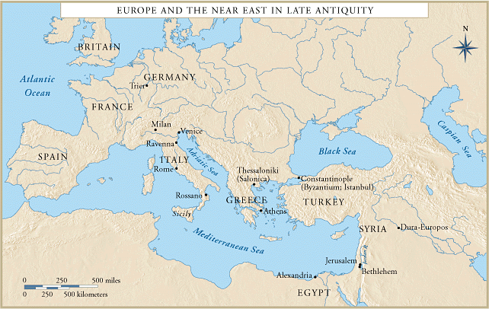

Slide 6
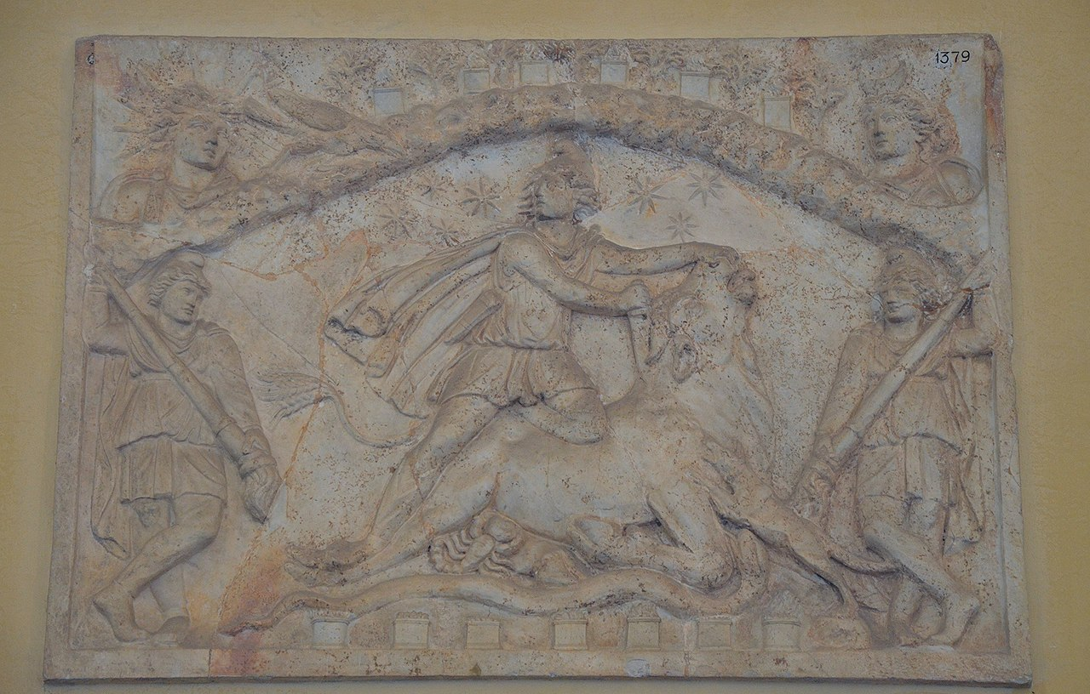
Mithras killing the cosmic bull, Esquiline Hill, Rome
Notes:
By Carole Raddato from FRANKFURT, Germany - Relief with Mithras sacrificing the bull (tauroctony), found in Rome on the Esquiline, Museo Chiaramonti, Vatican Museums, Rome, CC BY-SA 2.0, https://commons.wikimedia.org/w/index.php?curid=45895480

Slide 7
Ancient concepts of magic
Terms:
Magical practitioners: Magic as an activity:
Goes (Greek) goetia

Slide 8
Some words for magicians show their perceived connection to poisoning (sometimes accidentally)
Greek: Pharmakeus (m), pharmakides (f)
Latin: veneficus (m), venefica (f)
Pharmakon (pl: pharmaka: drugs, poison)
Veneficium (pl: veneficia: poison)
(Lex Cornelia de sicariis ex veneficis – 1st century BCE)

Slide 9
Spells and spell casting:
Greek: epaiode
Latin: carmen (plural: carmina)
Incantare/praecantare/excantare
(A lot of Latin words for spell casting are also works for singing or using any rhythmic speech)

Slide 10
Other words for magicians:
Lena: Madam, brothel keeper, witch
Saga: Wise woman, witch
Thessala, Thessalus: Thessalian
Other terms you need to know:
Ephesia gramatica/magicae voces
Katadeseis/ Defixio
Fascinare

