Slide 1
What you need to know about Greek and Roman religion
Do ut des
Gods are (sort of) associated with justice
Gods avenge insults to themselves and their property

Slide 2
What is a prayer for justice?
An address to a god or gods to punish someone who has wronged the author of the address, often with a specific request to redress and fix the harm (whatever it is)
What makes them different from other defixiones?
Why do they exist?

Slide 3
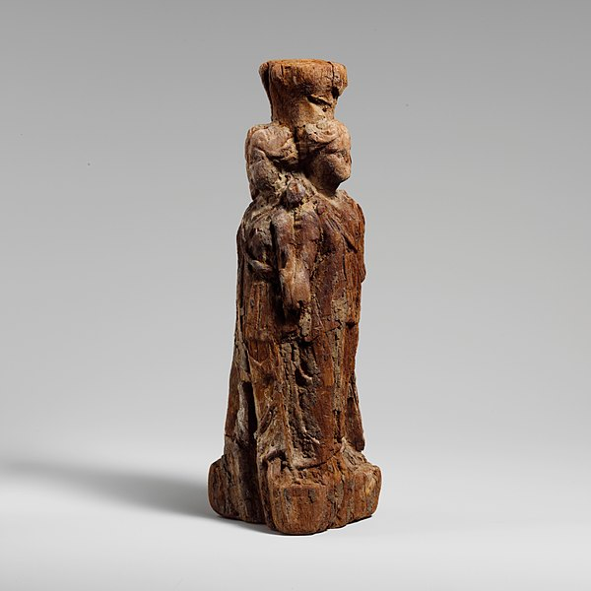
Wooden statue of Triform Hekate
(Graeco-Egyptian, Ptolemaic period (300-30 BCE)
Invoke a different range of deities
Notes:
https://www.metmuseum.org/art/collection/search/253575

Slide 4
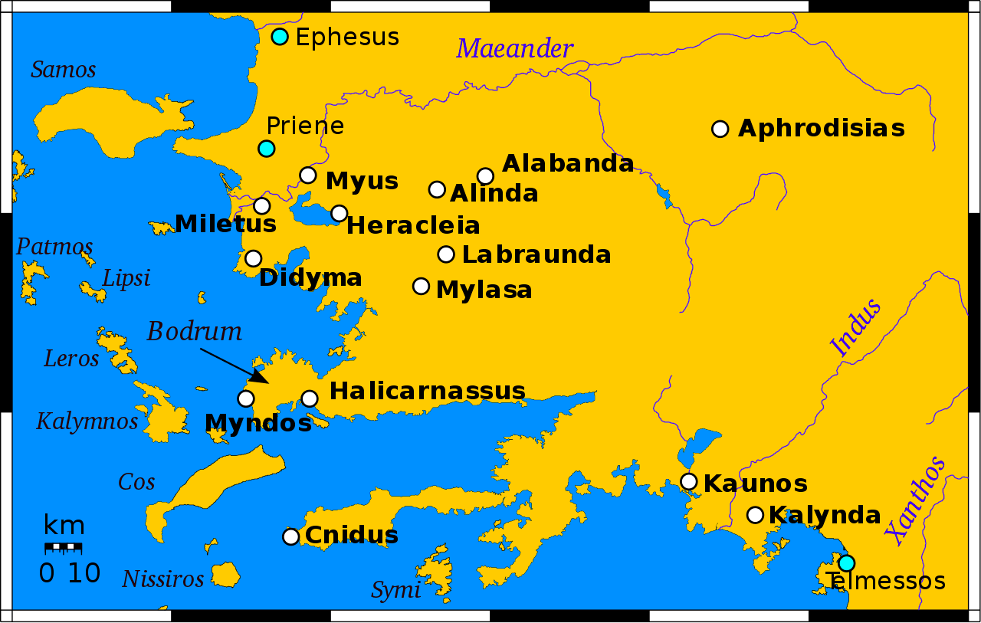
Deposited in temples, rather than graves: Temple of Demeter at Knidos (Gager 188-90)
Notes:
By Erp at English Wikipedia, CC BY-SA 3.0, https://commons.wikimedia.org/w/index.php?curid=25566359

Slide 5
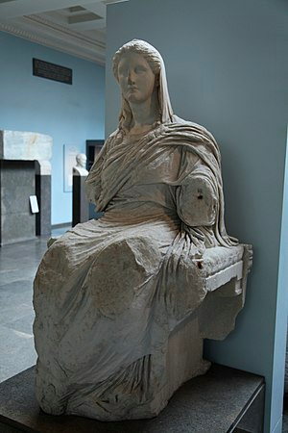
May be publicly displayed
(Demeter of Cnidos, c 350 BCE)

Slide 6
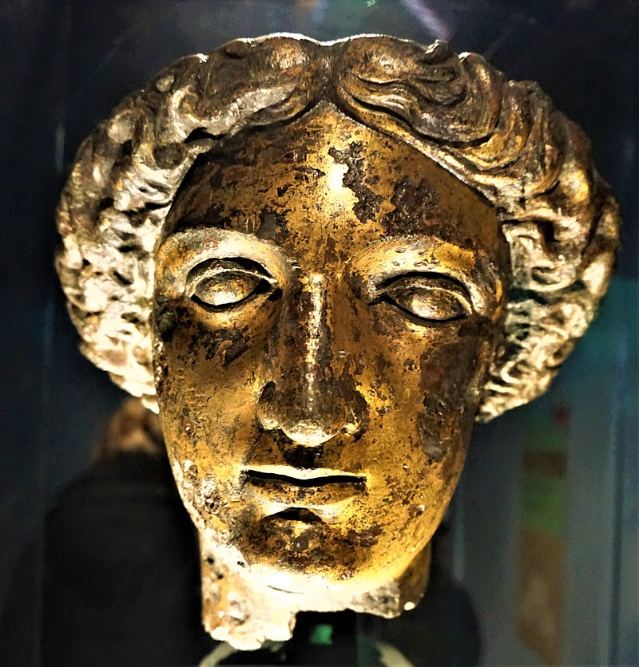
Minerva Sulis (Bath, UK
Appeal, don’t command
Notes:
By Joyofmuseums - Own work, CC BY-SA 4.0, https://commons.wikimedia.org/w/index.php?curid=65512328

Slide 7
^{Deities may be flattered:}
Lord, great and invincible, you who have received the body of Attis, please receive the body of the one who took away my baggage, who robbed me (by stealing it) from the house of Hispanus (or ‘the Spaniard’). His body (viz. the thief’s) and his soul I give (you), I confer on you in order that I may find my possessions. Then I vow to give you a four-footed sacrificial victim, Lord Attis, if I find that thief. Lord Attis, I implore you by your Nocturnus, that you make me obtain my wish as soon as possible.
Salacia, Portugal, 1st century CE
Translator, H. Versnel (Not in Gager)

Slide 8
Are not terribly specific about the body parts to be affected: Gager 168, 88
Head, soul, sinews, genitals and private parts, head to feet, toenails
See also:
Good, holy Att(h)is, Lord, help (me), come to Liberalis in anger. I ask you by everything, Lord, by your Castor (and) Pollux, by the cistae in your sanctuary, give him a bad mind, bad death, as long as he lives, so that he may see himself dying all over his body—except his eyes. Reverse: And may he not be able to redeem himself by money or any- thing else, either from you or from any god --- except a bad death. Grant this, I ask you by your majesty.
Temple of Isis and Magna Mater, Mainz 1st-2nd century CE; Trans. H. Versnel

Slide 9
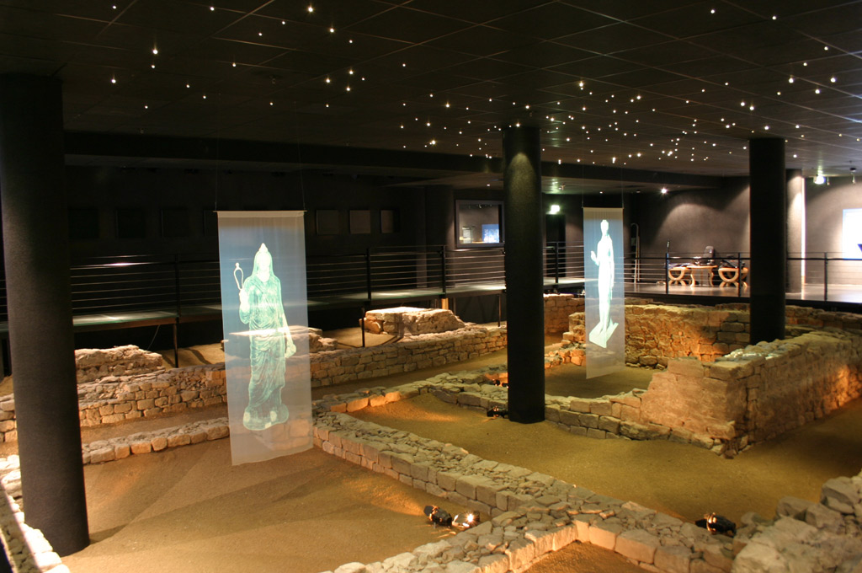
The Temple of Isis and Magna Mater, Mainz
Notes:
By Martin Bahmann - Own work, CC BY-SA 3.0, https://commons.wikimedia.org/w/index.php?curid=1817091

Slide 10
The caster often gives their name:
I, Crise, bequeath (amount uncertain) of gold. (S)he(?) asks and donates/legates to Iau the money that Heracla, my fellow slave, took from me, in order that his breast (sinus), his eyes be afflicted; may all his body functions become (sunt = sint) dry (viz. sick, powerless). I donate the money to the priest(ess) in return for her services.
Spain, Saguntum 1st-2nd century CE; ^{Trans. H. Versnel}
^{(Not in Gager)}

Slide 11
Are very concerned with justice:
O lord Oserapis and the gods who sit with Oserapis, I Artemisia the daughter of Amasis [direct a prayer?] to you, against the father of my daughter, who has deprived her of her funeral rites and burial. So if he has not treated me and his children rightly, indeed has treated me and his children wrongly, may Oserapis and the gods grant him that he does not receive burial from his children, and that he does not bury his own parents. While the cry for help lies here, may he and what is his be destroyed evilly on land and on sea by Oserapis and the gods who sit in the house of Oserapis, and may he not receive the favour of Oserapis or of the gods who sit with Oserapis.
Artemisia has deposited this appeal, begging Oserapis and the gods who sit with Oserapis to give judgement. While the appeal lies here, may the father of the young girl receive no favours at all from the gods. If anyone [removes] this document and wrongs Artemisia, may the god inflict punishment on him . . .
Curse of Artemisia, Serapeum (temple of Serapis), Memphis
Notes:
http://www.attalus.org/docs/select1/p198A.html

Slide 12
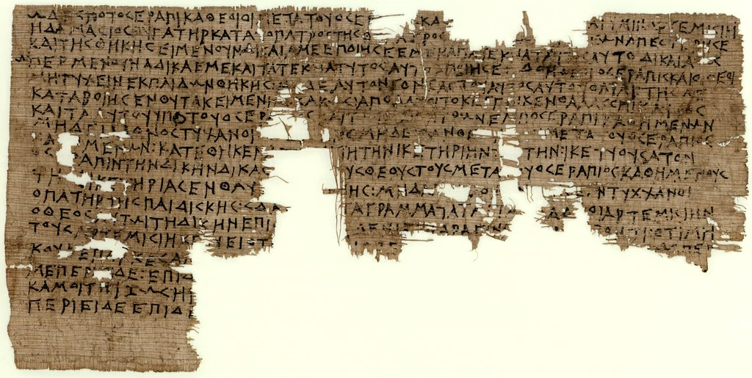
The curse
Notes:
https://www.wdl.org/en/item/4310/view/1/1/

Slide 13
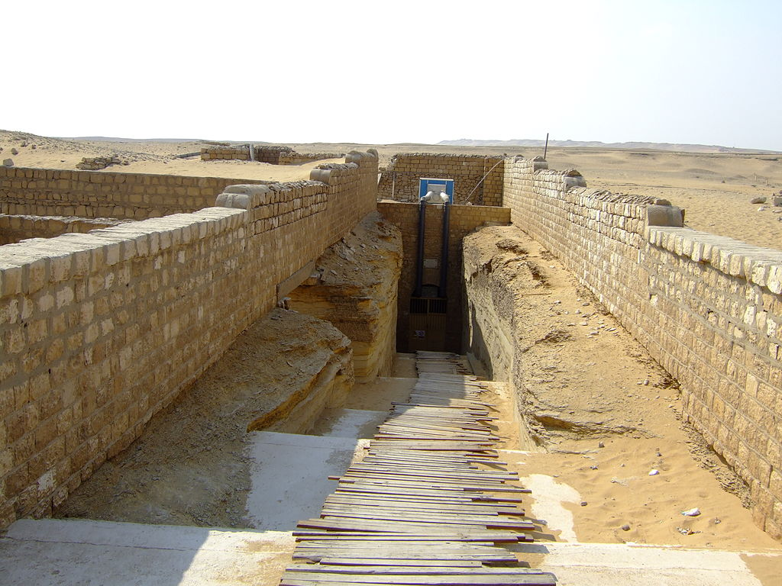
Serapeum, Memphis
Notes:
By User:LorisRomito - it.wikipedia, CC BY-SA 3.0, https://commons.wikimedia.org/w/index.php?curid=30950295

