Slide 1
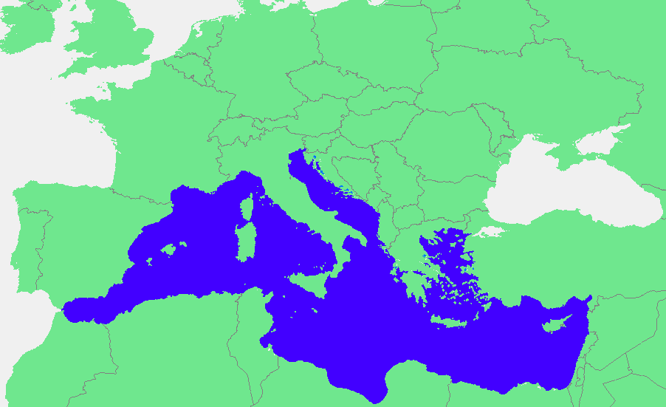
Mediterranean region (we will concentrate on the time period 300 BCE-300 CE)

Slide 2
Etic
Emic
Just don't write like this, please! (At least not for the class; if you get a job for the Daily Beast, I guess you might not have a choice.)

Slide 3
Magic is very, very had to define
What separates it from religion?
What separates it from science?
Do the people who practice it see it as magic? (and does that matter?)

Slide 4
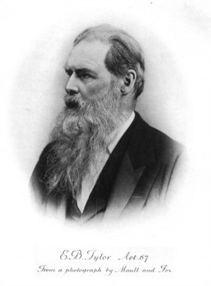
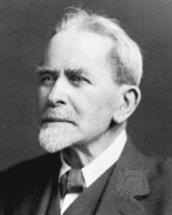
James Frazer
Tylor and Frazer: magic is false science

Slide 5
Creating principles of magic:
Law of sympathy
similarity
contagion

Slide 6
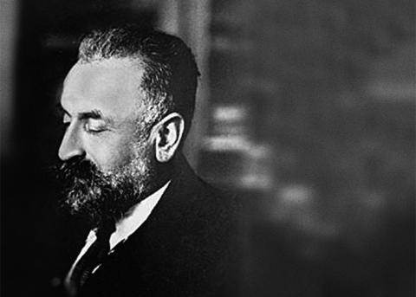
Marcel Mauss:
“magic should be used to refer to those things which society as a whole considers magical and not those qualified as such by a single segment of society only”

Slide 7
Other big names:
Emile Durkheim
Bronislaw Malinowski
Lucian Lévy-Bruhl
Edward E. Evans-Pritchard
Stanley Tambiah

Slide 8
We should always ask the following questions when thinking about magic:
- how it works
- what makes it effective
- who makes it effective
(We will develop this a bit more next class)

