Slide 1
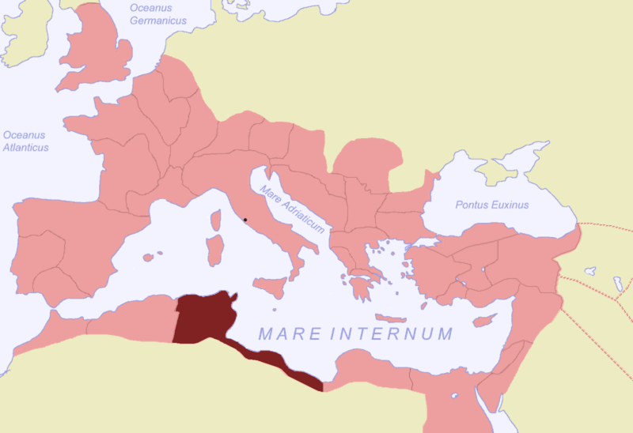
Africa proconsularis

Slide 2
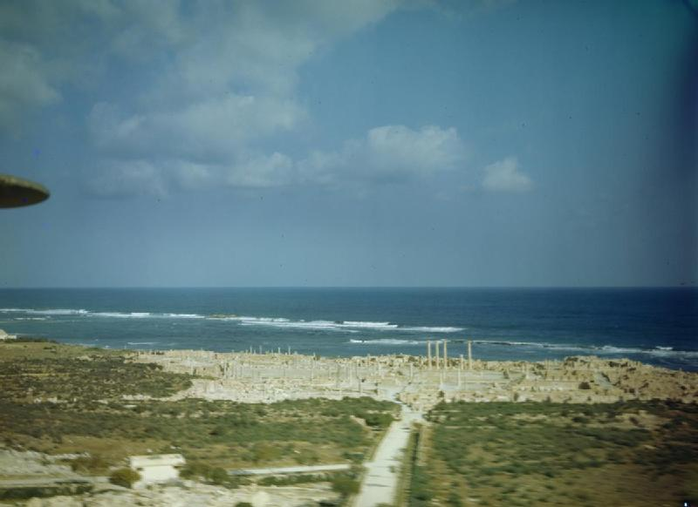
Sabratha as shot by the RAF in 1943
Notes:
By Royal Air Force official photographer - http://media.iwm.org.uk/iwm/mediaLib//7/media-7509/large.jpgThis is photograph TR 875 from the collections of the Imperial War Museums., Public Domain, https://commons.wikimedia.org/w/index.php?curid=24396515

Slide 3
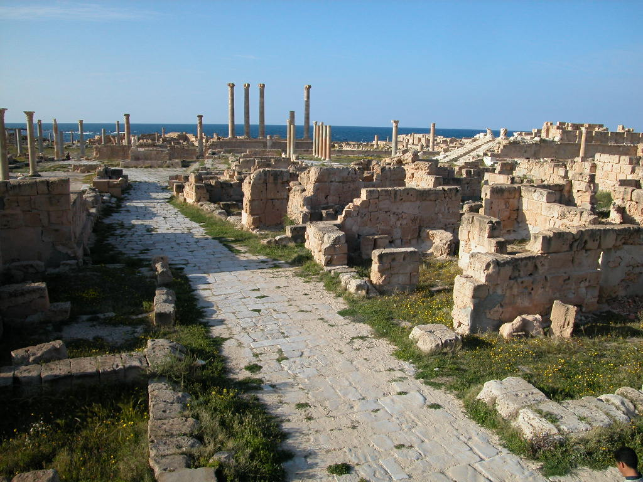
Sabratha
Notes:
By Giovanni Boccardi - This place is a UNESCO World Heritage Site, listed asArchaeological Site of Sabratha., CC BY-SA 3.0-igo, https://commons.wikimedia.org/w/index.php?curid=58154808

Slide 4
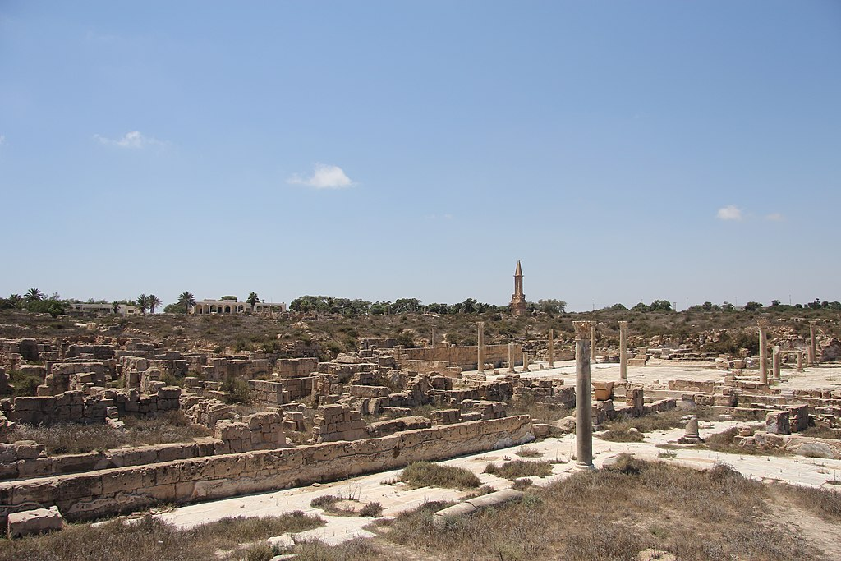
Notes:
By joepyrek from Richmond, Va, USA - Sabratha (30), CC BY-SA 2.0, https://commons.wikimedia.org/w/index.php?curid=78505017

Slide 5
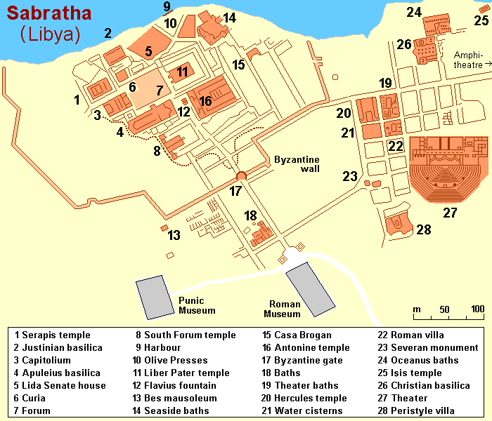
Notes:
By Hobe / Holger Behr - Own work, Public Domain, https://commons.wikimedia.org/w/index.php?curid=11420676

Slide 6
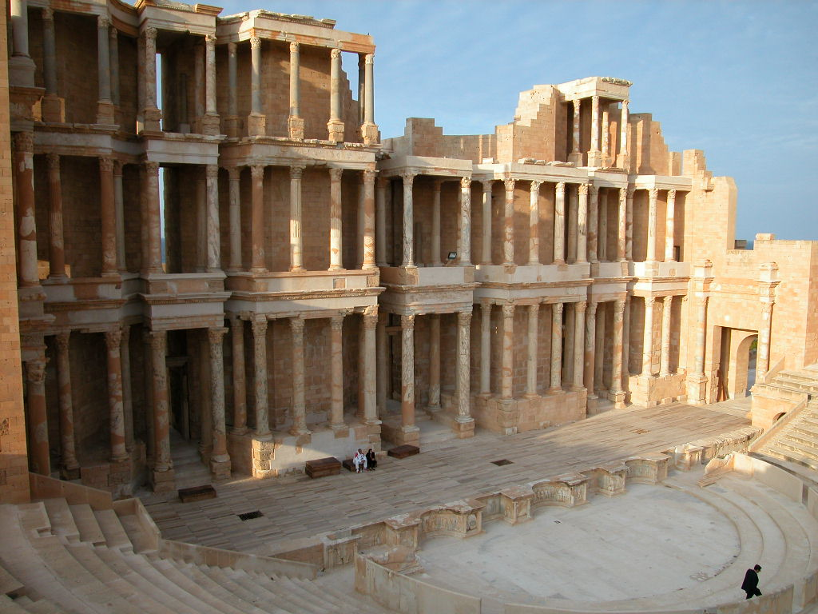
Notes:
By Giovanni Boccardi - This place is a UNESCO World Heritage Site, listed asArchaeological Site of Sabratha., CC BY-SA 3.0-igo, https://commons.wikimedia.org/w/index.php?curid=58154809

Slide 7
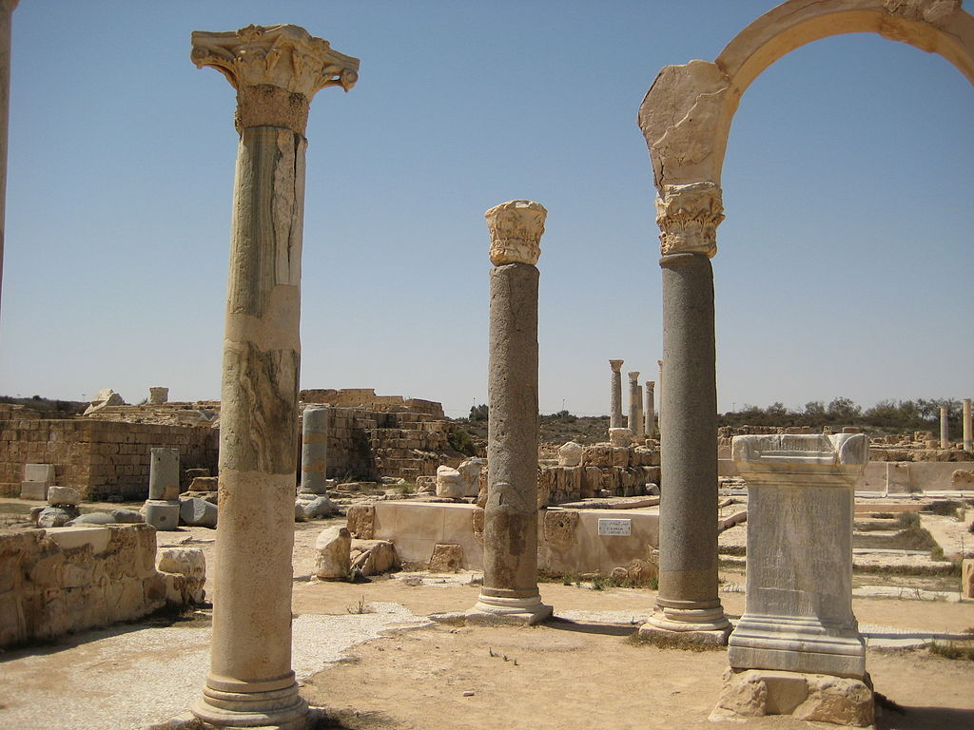
Forum, Sabratha
Notes:
By SashaCoachman - Own work, CC BY-SA 3.0, https://commons.wikimedia.org/w/index.php?curid=14690842

Slide 8
Creating an attraction spell or love charm: things to remember
Magic is formulaic
Magic is responsive to individual and cultural needs
Magic can be a form of therapy and fulfill psychological needs
Magic and religion and science and medicine may all overlap with each other
Literary magic and actual magic may or may not resemble each other, but one will inform expectations of the other

Slide 9
Magic starts with a magician and a client
Visualize what sort of magician you are and how the client/culture around you may perceive you
Are you an outsider? A respected member of the community? Something else?
What can you do without harm to yourself?
What can you do that the culture will accept?
How do the people around you see magic? Is it an accepted part of their daily lives or not?
Visualize your client
Where are they positioned in the community?
What are they seeking and what will they be satisfied with?
What risks are they willing to take?
What is the ultimate aim of their magic? (It might not be love…)

Slide 10
How to do this in steps:
Describe the magus or maga that you are
Describe the client
Devise the magic (including a list of ingredients and the technicalities: if this is a potion how will it be consumed? If an ointment where does it go? If an amulet what is made of and how and where is placed? Etc.)
Explain the magic
Profit! (Not actually a thing you have to include!)
Notes:
Refrigeration is not something the ancient world can do and magic doesn’t ever seem to try and cast magical cold spells so pretending you can magic it into existence is going to have to work hard to convince me that an ancient person would be convinced
People in antiquity were not stupid; they might believe in a mythical creature or item and and still wonder how you got it. Provenance is important, and it has to be believable.
The Celts might be magical and mystical to some cultures, but they were not to the Romans and the Greeks. They looked for that in cultures with written traditions – non-oral cultures

Slide 11
Places to look for ideas and elements:
Ingredients: Pliny the Elder Handout on course blog
Practicalities: Apuleius’ Apology/Defense Speech (Where did his accusers say he got the ingredients? Where is he accused of doing his magic? What is he accused of actually doing
Literary ideals of rituals: Theocritus (Luck 104-08 #6)
Virgil (Luck 114-115 #10 – translation of above
Horace (Luck 110—13 # 8 + 9)
Virgil (Luck 116-121 #11)
Seneca the Younger (Luck 121-126 #12 + 13)
Petronius (Luck 126-15 #14)
Other places?

