Slide 1

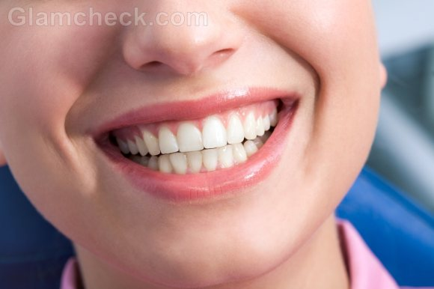

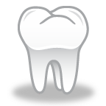
Resources
Aside from your local dentists, the clinics below are also available at your service. Feel free to contact them directly or speak to your local health authority for more information.
Reduced Cost Dental Clinic
Douglas College 700 Royal Avenue New Westminister V3L 5B2 Phone: 604-527-5464 | UBC Dental Clinic General Nobel Biocare Oral Health Centre 2151 Wesbrook Mall Vancouver V6T 1Z3 Phone: 604 822 2324
Vancouver General Hospital – Health Sciences Clinic 2775 Laurel Street Vancouver V5Z 1M9 Phone: 604 875 4006 | Vancouver Community Dental Clinic Grandview Woodland Community Health Centre 210-1669 East Broadway. 604-675-3981 Offers free preventive dental care for children younger than grade seven. There is a nominal fee for basic dental treatment.
Mid Main Community Health Centre 3998 Main Street Vancouver V5V 3P2 Phone: 604 873 3602 | Reach Clinic 1145 Commercial Drive Vancouver V5L 3X3 Phone: 604 254 1331
Overall Health
What goes on in your mouth can affect the rest of your body. What goes on in your body also can have an effect on your mouth!
Overall Wellness
Your Smile Matters
Emotional
Well Being
Functions
You need your teeth to:
Chew
Talk
Smile
A healthy, beautiful smile contributes to your emotional well-being
This pamphlet is brought to you by UBC Dental Hygiene class of 2012.

Slide 2

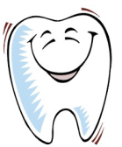
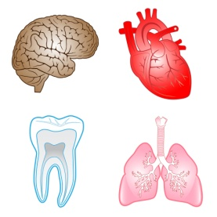

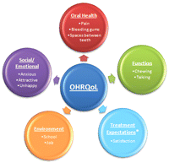

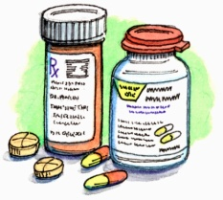
Emotional Well Being
Overall Health
Functions
Healthy gums and teeth More smiling!
Research has found that
people who have missing
teeth, receding gums, mobile teeth smile less.
During social interactions, one usually directs their attention towards the other person’s eyes and mouth.
This will influence and have an effect on:
-Finding a partner
-Making friends
-Sociable
-Self-confidence
-Self-esteem
Not brushing and flossing plaque and tartar buildup Bad Breath
Many diseases and conditions can affect your oral health and vice versa. These conditions may include:
Diabetes
Heart disease
Stroke
Respiratory disease
Premature birth
Medications can also affect the health of your mouth
Dry mouth is a common
side effect and may increase your risk of dental decay, oral yeast infections and may affect taste.
Maintaining good oral health contributes to good overall health!
Tongue
Has taste buds which are responsible for taste, helps with speech and pronunciation and breakdown of food with its mechanical movement
Teeth
Tears, chews, and grinds food for mechanical breakdown
Your oral health is related to your overall health!
Overall Well Being
She has a gorgeous smile
Overall Well Being
A healthy mouth can improve quality of life biologically and emtionally by protection from systemic problems and increasing confidence
When oral health is compromised, overall health and well being can be diminished.
Dental Hygiene Care & The Human Needs Model
States that people look for satisfcation with their facial features along with their breath and adequate function of their teeth

