Slide 1
Approximation Algorithms for Task Allocation with QoS and Energy Considerations
Bader N. Alahmad

Slide 2
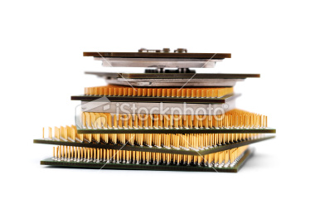
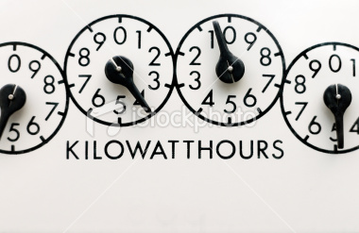
Problems we consider
Task allocation such that QoS score achieved & number of processors minimized
Variation 1: number of service classes (QoS levels) fixed, built into platform
Variation 2 : Minimum service class should be maintained, arbitrary number of service classes
Task Allocation such that QoS score achieved & Overall Energy minimized
Notes:
iartio

Slide 3
Problems are NP-Hard
Reduction from Bin-Packing and PARTITION
Bin-Packing (decision): STRONGLY NP-Complete
PARTITION (decision): NP-Complete in the ordinary (weak) sense

Slide 4
Approximability Everywhere !
$$SIZE\left(I\right): cn^{\frac{1}{ε^{2}}}log\left(\frac{1}{ε^{3}}\right),d{\left(\frac{1}{ε}\right)}^{2}n^{2^{1/ε}}$$
PTAS: running time poly in
FPTAS: running time poly in
$SIZE\left(I\right) \& \frac{1}{ε}: c{\left(\frac{1}{ε^{3.4}}\right)n}^{9}$
☺
$$I$$
$$ε$$
(Problem Instance)
(error Factor)
Algorithm
$$A$$
$$s$$
(solution)
$$\frac{\left|value\left(s\right)−OPT\left(I\right)\right|}{max (value\left(s\right), OPT(I))}≤ε$$

Slide 5
Quality of Service (QoS)
tolerable error minimum precision required
Service Level Agreement
The service will provide a response of within 300ms for 99.9% of its request for a peak client load of 500 requests per second
Service
provider
Client
Service Level Agreement

Slide 6
QoS example: Search Engines
“Woongki Baek and Trishul M. Chilimbi. 2010. Green: a framework for supporting energy-conscious programming using controlled approximation. In Proceedings of the 2010 ACM SIGPLAN conference on Programming language design and implementation (PLDI '10).”
Accept user query
Search index for matching docs
Rank docs, return the top N docs in ranked order
Tradeoff (Approximation)
Execute less cycles Ranking for faster response
QoS Loss metric: % of queries that return
Different set of top N docs
Same set of top N docs in different RANK order

Slide 7
Tasks can even have hard deadlines

Slide 8
Tasks are periodic
N tasks
Each invokes jobs periodically forever every period Pi

Slide 9
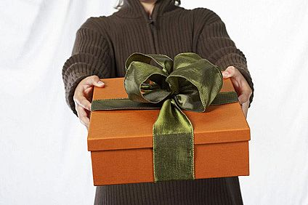
Quality of Service
A task comes equipped with service class specifications → (utilization, reward)
per processor
$$ε≤utilization≤1 ε≤reward≤1$$
1
1/4
Notes:
Examples of search engines, number of iterations.. DB apps, ….

Slide 10
Task Allocation with Service Classes (TASC)
Identical processors of unit capacity
1
Tasks associated with resource function.
$$\left(0.2, 0.3\right)$$
$$(0.3, 0.49)$$
$$(0.7, 1)$$
Task1
$$(0.567, 0.3)$$
Task2
$$\left(0.1, 0.6\right)$$
$$\left(0.8, 0.6021\right)$$
Task3
General Solution Method: Memoization

Slide 11
Fixed Service Classes
Variation 1: Service classes are fixed
Task2
Task3
$$(u_{1},q_{1})$$
Task1
$$(u_{2},q_{2})$$
$$(u_{3},q_{3})$$
$$(u_{4},q_{4})$$
$$(u_{6},q_{6})$$
$$(u_{8},q_{8})$$
$$(u_{k},q_{k})$$
$$(u_{5},q_{5})$$
$$(u_{k−1},q_{k−1})$$
$$(u_{7},q_{7})$$
Service classes (pool) predetermined by provider (platform)

Slide 12
FSC – Assign Tasks to Service Classes
$$n_{j}:number of tasks assigned to j−th service class$$
For each assignment of the form $〈n_{1},…, n_{k}〉$, verify that there is a set of tasks such that
$$n_{1}+…+n_{k}=n$$
There are $\left({n+k−1 \atop k−1}\right)$ such assignments (bins and balls)
Since $k$ is fixed → $\left({n+k−1 \atop n}\right)$ is poly in $n$ ☺

Slide 13
Verify Assignment – Max Flow in a bipartite graph for each assignment
Example assignment $〈5,0, …, 0〉$

Slide 14
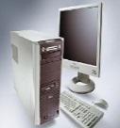
Minimum Makespan & Bin-Packing are DUAL problems
There exists a packing of items with execution times $e_{1},…e_{n}$ to bins with capacity t each iff there exists a schedule with makespan at most t.
$$e_{1}$$
$$e_{4}$$
$$e_{6}$$
$$e_{1}$$
$$e_{4}$$
$$e_{6}$$
$$e_{2}$$
$$e_{5}$$
$$e_{6}/t$$
$e_{1}$/t
$$\frac{e_{4}}{t}$$
Normalize
$$e_{5}/t$$
$$e_{2}$$
$$e_{5}$$
$$e_{3}$$
$$\frac{e_{2}}{t}$$
t
$$\frac{e_{3}}{t}$$
$$e_{3}$$
1
t
Scheduling
Makespan = t
Bin Packing:
bin capacity = t
Bin Packing:
bin capacity = 1

Slide 15
Find minimum number of bins for each assignment
Apply bin-packing PTAS for each assignment
n times. Why?
[bin packing: de la Vega and Lueker 81] →$C\left(ε\right)+Cnlog\left(1/ε\right)$
[minimum makespan: Hochbaum and Shmoys 88] →$O({\left(n/ε\right)}^{1/ε^{2}})$
Result
PTAS for TASC !

Slide 16
Minimum Service Class (MSC)
Variation 2: Relax fixed service classes
But: require minimum service class to be maintained. Why?
What is the maximum number of service classes ? Are they bounded?
Solution: Quantize !
Why??

Slide 17
Quantize Service Classes - qMSC
$$\left(u,q\right)→(ε+αε^{2}, ε+βε^{2})$$
Setting $α=\left\lceil \frac{u−ε}{ε^{2}}\right\rceil$ will do the trick !
$$at most \left\lceil \frac{1}{ε^{4}}\right\rceil service classes !$$
Results
PTAS for qMSC
$$Q≥\left(1−ε\right)OPT$$
Catch !
Processors may need to have capacity
$$(1+ε)$$

Slide 18
Incorporate Energy Expenditure and platform heterogeneity !

Slide 19
Platform
K heterogeneous processor types: AMD, INTEL , …
Distinct physical processors have different speed levels
Processor speeds dynamically adjustable
Processor1
$$s_{1,1}$$
$$s_{1,2}$$
K heterogeneous physical processor
types
Processor2
$$s_{2,1}$$
$$s_{1,2}$$
$$s_{2,3}$$
At most S speeds per processor
Logical Processors

Slide 20
Platform - Continued
Platform consists of M processor “slots” to be filled
Need to build platform with the available processors.
$\left({M+SK −1 \atop M}\right)$ possible platform configurations
M Logical processors
(physical processor/speed) pairs

Slide 21
Tasks look like this
$$processo{r type}_{1}$$
$[speed_{1,1}]$
$$(reward_{1,1}, util_{1,1})$$
$[speed_{1,2}]$
$$(reward_{1,2}, util_{1,2})$$
$[speed_{1,1}]$
$$(reward_{1,1}, util_{1,1})$$
Task1
$$processo{r type}_{2}$$
$[speed_{2,1}]$
$$()$$
$[speed_{2,2}]$
$$(reward_{2,2}, util_{2,2})$$
$$processo{r type}_{1}$$
$[speed_{1,1}]$
$$()$$
$[speed_{1,2}]$
$$(reward_{1,2}, util_{1,2})$$
$[speed_{1,3}]$
$$()$$
Task2
$$processo{r type}_{3}$$
$[speed_{4,1}]$
$$()$$
$[speed_{4,2}]$
$$(reward_{4,2}, util_{4,2})$$
$[speed_{4,3}]$
$$(reward_{4,3}, util_{4,3})$$
$[speed_{4,4}]$
$$()$$

Slide 22
Prior attempts related to our work
Closest to our efforts:
C.-Y. Yang, J.-J. Chen, T.-W. Kuo, and L. Thiele. An approximation scheme for energy-efficient scheduling of real-time tasks in heterogeneous multiprocessor systems. In DATE, pages 694–699, 2009
Energy Model is weak → utilization scales linearly with speed
Cannot capture holistic energy expenditure (devices)
Interpolates speed ! Might get very inaccurate

Slide 23
Linear Scaling of Utilization: I/O bound Tasks
f
2f
Task1
t (cpu)
t/2
Task2
t/2 (cpu)
t/2 (I/O)
t/4
t/2
Our work
Relax all previous assumptions
Completely discrete, arbitrarily structured setting

Slide 24
Worst Case Execution Cycles are NOT Constant with respect to speed !
I/O bound vs. CPU Bound Tasks
Our work
Relax all previous assumptions
Completely discrete, arbitrarily structured setting

Slide 25
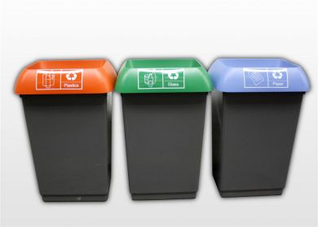
Forget about Uniprocessor task scheduling !
Earliest Deadline First → Utilizes processor up to 100% ☺
Tasks are matched only to processors on which they are defined
3/7
$$\frac{17}{19}$$
¾
$$\frac{1}{2}$$
1/4
½
$$\frac{1}{8}$$
Capacity = 1

Slide 26
Energy Model
Dynamic power consumption per (processor/speed)
Static power consumption per physical processor (independent of speed)
Idle power: when processor in dormant mode
Service Level Agreement
The service will provide a response of within 300ms for 99.9% of its request for a peak client load of 500 requests per second

Slide 27
Tasks have infinite job invocations, Is Energy finite ?
Yes, when unifying the energy measurement period
$$T_{1}(e_{1}=1, P_{1}=2)$$
$$T_{2}(e_{2}=1.5, P_{2}=3)$$
$$T_{1}$$
$$T_{2}$$
$$t=2$$
$$t=3$$
$$t=4$$
$$t=6$$
$$t=8$$
$$t=9$$
$$t=10$$
$$t=12$$
$$t=18$$

Slide 28
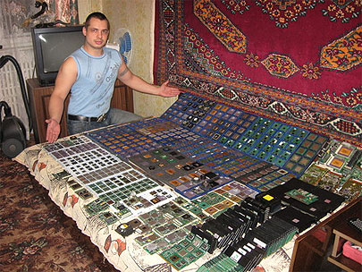
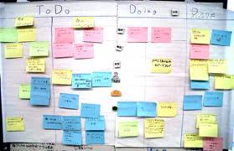
Objectives
Overall Energy Expenditure minimized
Quality of Service Score achieved

Slide 29
Offline Dynamic Program
Enumerate platform configurations
Iterate through tasks
Assign tasks to processors
Build state space per task from states of previous task
The solution is the state of last task

Slide 30
State space
Each task maintains a set of states
State is a partial feasible schedule up to current task across all processors.
T8
$$φ$$
$$ψ$$
$$1$$
$$1$$
T8
T7
T7
T5
T3
T8
T3
T5
T1
T1
T2
T6
T2
T6
T4
T4

Slide 31
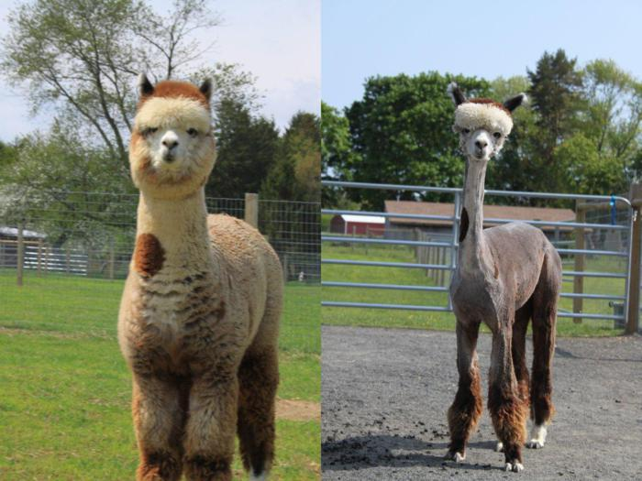
Trimming the state space
How to bring down the size of the state space to polynomial, while controlling the error propagation ?

Slide 32
Measure of nearness: Delta-close states
$${\frac{1}{Δ}{E_{j}}_{}^{ψ_{i}}≤E}_{j}^{φ_{i}}≤Δ{E_{j}}_{}^{ψ_{i}}$$
$$Need to choose Δ properly →\left(1+\frac{ε}{2N}\right)$$

Slide 33
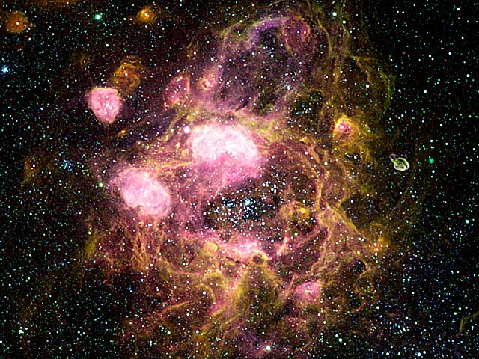
State Space partitioned into -Boxes
$$Δ$$
$$φ_{i,16}$$
$$φ_{i,9}$$
$$φ_{i,18}$$
$$φ_{i,19}$$
$$φ_{i,5}$$
$$φ_{i,11}$$
$$φ_{i,7}$$
$$φ_{i,13}$$
$$φ_{i,17}$$
$$φ_{i,4}$$
$$φ_{i,1}$$
$$φ_{i,10}$$
$$φ_{i,8}$$
$$φ_{i,22}$$
$$φ_{i,3}$$
$$φ_{i,14}$$
$$φ_{i,15}$$
$$φ_{i,13}$$
$$φ_{i,6}$$
$$φ_{i,20}$$
$$φ_{i,12}$$
$$φ_{i,2}$$
$$φ_{i,21}$$

Slide 34
Choose the dominating state in each -box
$$Δ$$
Dominating: has maximum Reward value

Slide 35
Results
Quality of Solution
$$Energy≤\left(1+ε\right)OPT$$
Running Time

Slide 36
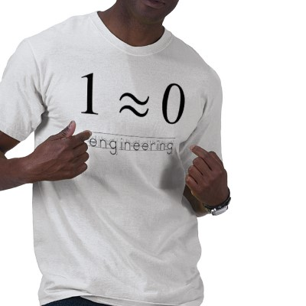
Approximation Schemes vs. Heuristics
Approximation Algorithms
Heuristics
Guaranteed worst case bounds on quality of solution
Running time might be too large to be used in practice
Stochastic Local Search, greedy, …
Hard to design “good” ones
Hard to obtain guarantees on quality of returned solution
Might converge quickly, depending on input

Slide 37
Heuristics for Bin Packing

Slide 38
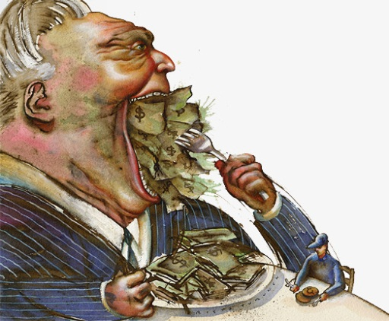
Heuristics were hard to analyze ☹
Go Greedy !
Compute Energy Per Processor $E_{i,j}$ for each task
Pack the task with the smallest
(ENERGY Per Processor / Reward per same processor ) first
if it fits that processor
$\frac{E_{1,1}}{r_{1,1}}≤\frac{E_{2,3}}{r_{2,3}}≤…$

Slide 39
Was it Fun?
Thank you

Slide 40
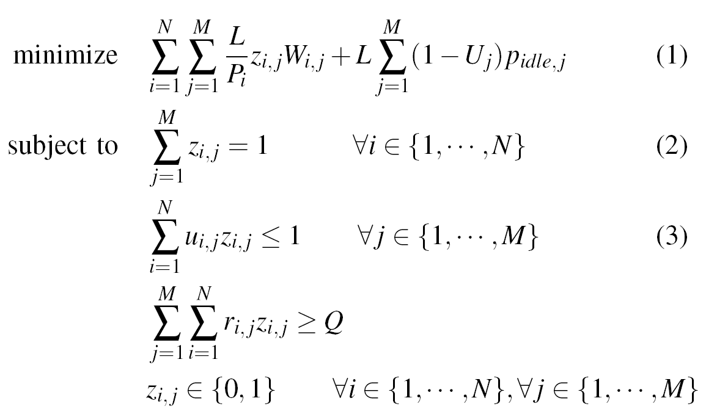
Mathematical Program

