Slide 1
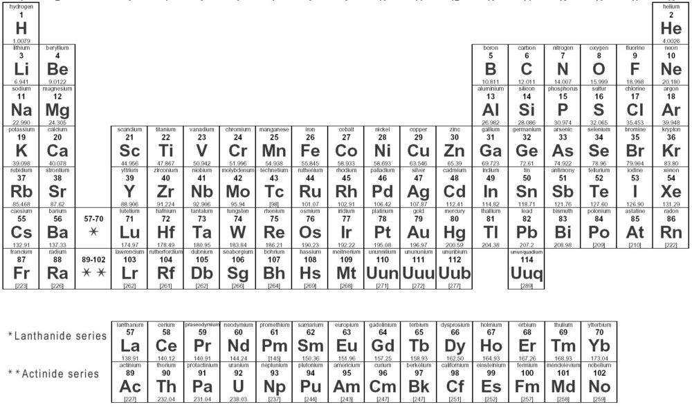
What are the elements made of?
Notes:
Hook?

Slide 2
The Atomic Structure
Chemistry

Slide 3
Atomic structure
Topics to be covered in this unit:
1. The Atom
2. The Mass Spectrometer
3. Electron Arrangement
4. Electronic Configuration
Notes:
This is the list of topics in this unit. But we shall only cover the atom today.

Slide 4
THE ATOM
What is an atom?
What does it look like?
Notes:
Let’s try to draw it together?

Slide 5
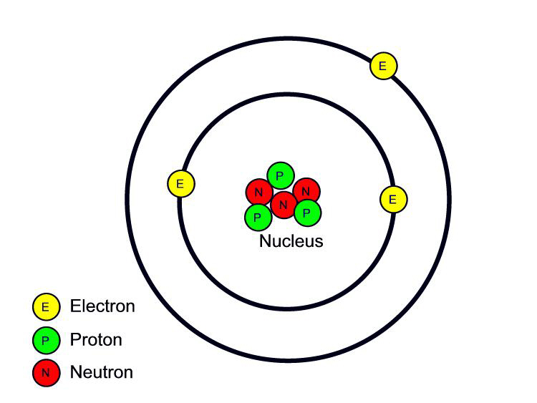
The atom
Notes:
Example of a lithium atom. It has 3 protons and 3 electrons. Protons and neutrons in the nucleus and electrons orbit the nucleus in 2 different energy levels. These electrons can move from one energy level to another only if the transition is “allowed” which we learn later in the Electromagnetic Spectrum.

Slide 6
THE ATOM
Who came up with this model?
Niels Bohr, 1913

Slide 7
The atom
John Dalton’s atomic theory: indivisible, indestructible atoms make up all matter (1807)
Niels Bohr: electrons have certain “allowed” motions, and the atom is mostly hollow (1913)
Notes:
In 1807, John Dalton proposed that all matter was made up of small indivisible and indestructible atoms of different kinds that would combine together in small numbers to make compounds.
Scientists later discovered that this did not always hold true, hence in 1913 Niels Bohr proposed what we call today the Bohr model of the atom. This model suggests that the proton and neutron inhabit the nucleus and are tightly bound together making up almost all the weight of the atom. The electrons orbit the nucleus in fixed energy levels far away from the nucleus. Hence, most of the atom is empty space.

Slide 8
The bohr atom
Notes:
Example of a lithium atom. It has 3 protons and 3 electrons. Protons and neutrons in the nucleus and electrons orbit the nucleus in 2 different energy levels. These electrons can move from one energy level to another only if the transition is “allowed” which we learn later in the Electromagnetic Spectrum.

Slide 9
The bohr atom
Particle | Proton | Neutron | Electron
Relative mass
Relative charge
Location in the atom

Slide 10
The bohr atom
Particle | Proton | Neutron | Electron
Relative mass | 1 | 1 | 1/1840
Relative charge | +1 | 0 | -1
Location in the atom | Nucleus | Nucleus | Energy shells

Slide 11
the Subatomic particles
Electrons, Protons, Neutrons make up the atom
Electrons: smallest and lightest; negatively charged
Protons: much larger and heavier; positively charged
Neutrons: as big and heavy as protons; no charge
What is the over all charge of the atom?
Notes:
An atom is made of the proton, the neutron and the electron. These are called the subatomic particles.

Slide 12
The atom
SWBAT:
1.1 Identify protons, neutrons and electrons in the atom as subatomic particles.
1.2 State the positions of the subatomic particles.
1.3 State the relative mass and charge of the subatomic particles.
1.4 Identify the commonly accepted model as the Bohr model and recognize there were other theories.

Slide 13
Closer to home
TRIUMF at UBC: Canada’s national laboratory for particle and nuclear physics
Involved in projects based at CERN
Nuclear medicine: “techniques used by subatomic physicists to peer “inside” the atom can be used to image and trace these agents inside the body to study human health and disease in research known as nuclear medicine.” (http://www.triumf.ca/research-program/research-topics/nuclear-medicine)
Notes:
TRIUMF is one of the world’s leading subatomic physics laboratories.
European Council for Nuclear Research
Other areas of research at TRIUMF: nuclear physics, particle physics, material science, accelerators

Slide 14
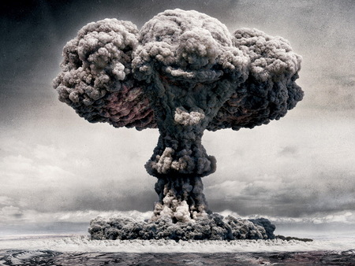
Notes:
If the person who came across the “technology” required to make an atomic bomb, had not shared his findings, it would not exist today, and the infamous Hiroshima-Nagasaki incident would not have taken place.

Slide 15
Theory of knowledge
If you possess knowledge, is it your responsibility to pass it on?
Is it ethical to work on something that may be potentially harmful?
Whose responsibility is it to control the outcome of an experiment/research, especially if it is harmful?

Slide 16
Questions

Slide 17
Thank you!
Binal Khakharia

