Slide 1
For Whom the Bell Tolls 2
Friday, November 24

Slide 2
Warm-up: For Whom the Bell Tolls
Make his fight on the hill in the early day
constant chill deep inside
shouting gun, on they run through the endless grey
on they fight, for they’re right
yes, but who’s to say?
For a hill, men would kill
Why? They do not know
stiffened wounds test their pride
men of five still alive through the raging glow
gone insane from the pain that they surely know
For whom the bell tolls
Time marches on
For whom the bell tolls
Take a look at the sky just before you die
it’s the last time he will
blackened roar, massive roar fills the crumbling sky
shattered goal fill his soul with a ruthless cry
stranger now are his eyes to this mystery
hears the silence so loud
crack of dawn, all is gone except the will to be
now they see what will be, blinded eyes to see.
Metallica, Ride and Lightening (1985)

Slide 3
John Donne’s Epigraph
“No man is an iland, intire of it selfe, every man is a peece of the Continent, part of the maine; if a clod bee washed up by the Sea, Europe is the less, as well as if a Promontorie were, as well as if a Mannor of thy friends or of thine owne were; any mans death diminishes me, because I am involved in Mankinde; And therefore never send to know for whom the bell tolls; it tolls for thee.”
John Donne
What theme does the epigraph, an excerpt from John Donne's Devotions XVII, convey from For Whom the Bell Tolls? Is that theme the central one of the book? Why or why not?
What scenes in the novel develop the sentiment of the epigraph?
Notes:
John Donne was a 16th-17th century poet, whose works are remembered for their strong statements.
-Human unity – when does it work, when do we run into issues? -

Slide 4
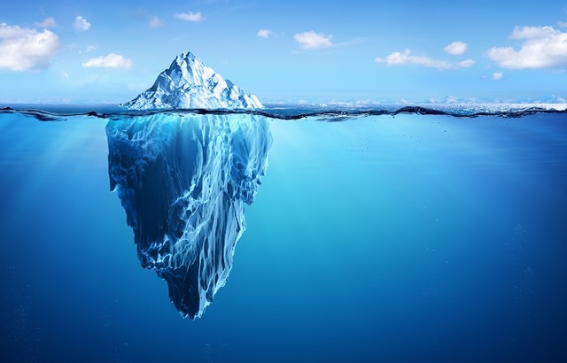
The Iceberg Theory and Hemingway’s Writing
Language,
dialogue
Emotions, feelings, elaborations,
psychological effects of events on characters.
“He would write a book when he got through with this. But only
about the things he knew, truly, and about what he knew. But I will have to be a much better writer than I am now to handle them, he thought. The things he had come to know in this war were not so simple” (For Whom the Bell Tolls 248).

Slide 5
The Iceberg Theory at Work
1) On the piece of paper I gave all of you, you have one minute to write one brief example of how Hemingway puts the Iceberg Theory to work in his novel to bring forth an important idea that he expects us to elaborate on through our own thoughts and impressions. Specific quotes are great, but if you can’t find them, paraphrased ideas will work as well.
2) Once you have your contribution, pass yours to the person to the right of you, then stand up, and turn to your left and speak to this classmate about the ideas you have in hand for two minutes.
3) Then, stay together, and together, find another pair of people to talk to in a group of four. This time, highlight anything your ideas/concepts/quotes have in common.
4) Then, each group of four will join with another group of four to make a group of 8. There, you will report back what you talked about in the first group and come up with any new idea combinations from the newly formed group.
From these groups, each of you must choose the strongest example and we will report back to the class about this one and any other supporting ones that you have discussed together.

Slide 6
Discussion Questions
1. Is Pablo opposed to blowing the bridge because he is a coward, as Pilar says, or is Pablo, himself, correct when he says he "has a tactical sense"? Why does Jordan agree with Pablo's reference to "the seriousness of this" (54)? Is Agustín correct when he calls Pablo "very smart" (94)?
2. Was the communist effort to eliminate God successful? What does Anselmo's view of killing suggest about the limitations of dogma? What does he mean when he says of the bridge sentries, "It is only orders that come between us" (192-193)? What is implied when Anselmo says soldiers should atone and cleanse themselves after the war?
3. "Time" is a major theme in For Whom the Bell Tolls. How does Pilar's awareness of time affect her attitude toward Robert Jordan's and Maria's relationship? What conclusions does Robert Jordan draw about his own life during the very short time he spends with Maria?
4. Pablo calls his compatriots "illusioned people" (215). Does this remark prove to be true? Does Jordan expose illusions? Does For Whom the Bell Tolls suggest that because of their illusions and vulnerability to exploitation the victims of the war were the entire Spanish people?

Slide 7
Discussion Leader Session
https://www.playfactile.com/forwhomthebelltolls

