Slide 1
Nellie Campobello’s Cartucho (1931)
“The Men of the North”
This presentation is licensed under Creative Commons CC by 4.0

Slide 2
Warm-up: What do you remember?
With a partner, decide whether the following statements about the Mexican Revolution and its precursors and key players are T (true) or F (false).
1. T F Pancho Villa is remembered today as the “rebel of the South” for his leadership of peasants in the Morelos region of Mexico.
2. T F Diego Rivera was the dictator that reigned in Mexico prior to the start of the Revolution.
3. T F The Mexican Revolution lasted for 10 years, but the problems that sparked it continue to plague Mexico today.
4. T F The two main revolutionary factions mentioned in the first part of Cartucho are the zapatistas and the villistas.
5. T F Speaking of “cartucho,” a “cartucho” is Spanish for a type of rifle used during the Mexican Revolution.
Emiliano Zapata: Rebel of the South;
Porfirio Díaz: El porfiriato (1876-1910)
Poverty, corruption, lack of recognition of peasant and indigenous groups’ rights…
The villistas and the carranzistas (followers of Venustiano Carranza (1917-1920))
Cartucho: bullet cartridge
30-30: rifle
Notes:
#4 – False –villistas and carrancistas – Venustiano Carranza was elected president of Mexico in 1917 (1917-1920) and was a supporter of Francisco Madero when he lost to dictator Porfirio Díaz (falsely) in the 1910 elections.

Slide 3
“He”
Why does Campobello title the first chapter “He”? Who is “he”? Is he important or not? How do we know?
In class on Friday, we determined that a narrator is the voice that tells a story in a written work.
What type of narrator/story-teller does Campobello have and how do you know? What clues are available to readers to determine the type of narrator?

Slide 4
Picturing the “Men of the North”
The narrative style of a child is very visual, vivid, and emotional, similar to how we use/interpret social media in our lives everyday (instagram, snapchat, facebook, twitter).
Each group will re-create the image of the man described in the assigned chapter in one of the three ways. For all options, it will be necessary to share your thoughts on the whiteboard.
1)Instagram it! Draw a picture, according to the narrator’s description, of the “man of the north” in your chapter on the whiteboard. Include the symbols of the revolution mentioned in the description (30-30s, sombrero, etc.) and put a short caption under your image.
2) Tweet it! Combine a series of #hashtags that best reflect the situation described in your chapter. Be prepared to justify your selection of the hashtags ☺
3) Post it! Write a Facebook post that best reflects the personality of the man described in your chapter. You can accompany your post with an image and/or a theme song if you want too!
You have 10 minutes total to discuss, draw, and caption your images on the board, so work quickly!!!!!

Slide 5
Distribution of chapters for groups
Groups 1/2: Elías
Group 3/4: El “Kirilí”
Group 4/5: Colonel Bustillos
Group 6/7: Bartolo from Santiago
Group 8/9: Agustín García

Slide 6
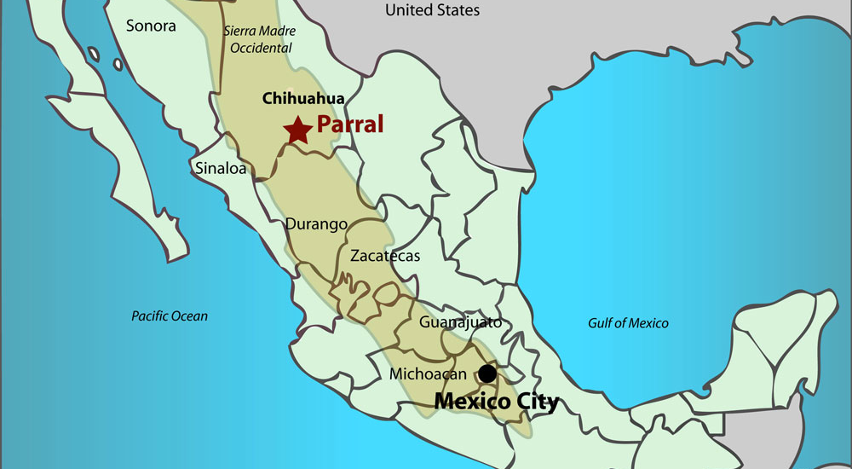
Antonio Silva’s Sword Whippings

Slide 7
Conclusions: Childlike Perspective
We are going to divide the class into five groups of 3 people each. Each group will be assigned a chapter from today’s reading and will be asked to answer the following questions in relation to their chapter:
1) What aspects of this chapter reflect Campobello’s childlike perspective? What aspects(if any) seem to indicate the presence of a more mature narrator?
2) How does Campobello introduce the idea of “Revolution” in your chapter?
3) What strategies does she use to draw the reader in (or to repulse us)?

Slide 8
For Wednesday…
The Executed:
“Executed without bullets”
“Babis’ sentence”
“Nacha Ceniceros”
“Martin López’s Snapshots”
“Nacha Ceniceros”

