Slide 1
The end of Plato and The Myth of Er
Friday, September 29

Slide 2
Warm-up: Plato Comics
Last Friday, we created our own comic strips, based on certain segments of Plato’s Republic.
Let’s take a look at them again!
Now, we will take a look at some other comic strips related to Plato and his Republic.
I will give the groups two minutes with each image – you will pass your image to the group to the right of you when I say PASS - and then we will share our thoughts.
Some questions to think about while you look at them:
What theme(s) are present?
Do you agree with the artist’s depiction of Plato and his ideas? Why or why not?
Anything else you thought about when you saw this image?

Slide 3
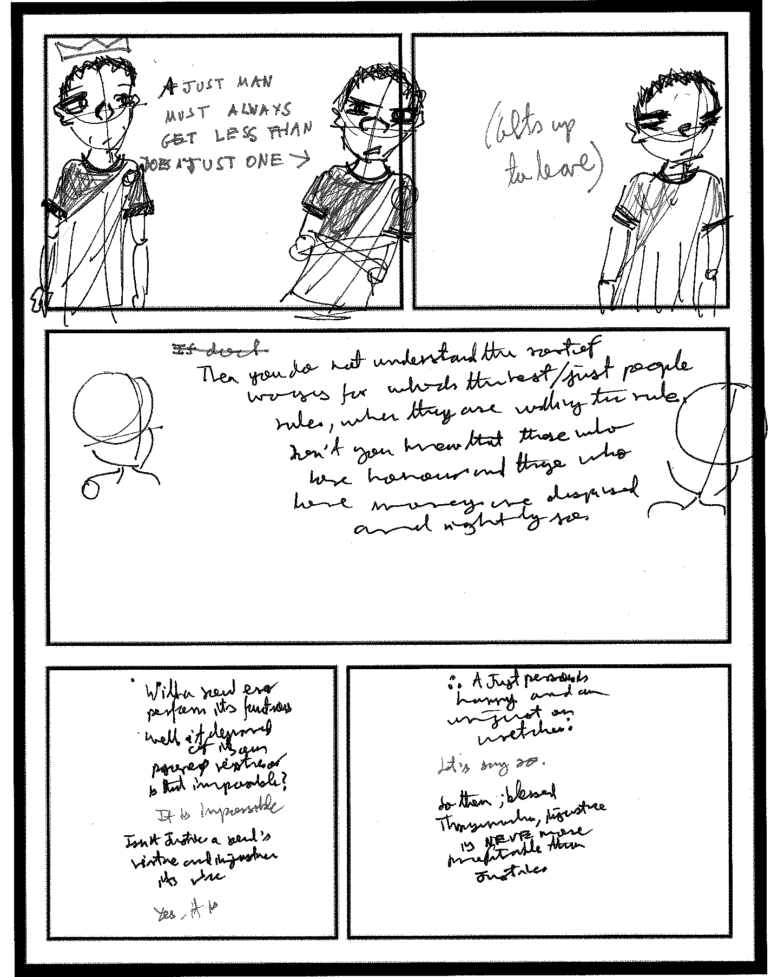

Slide 4
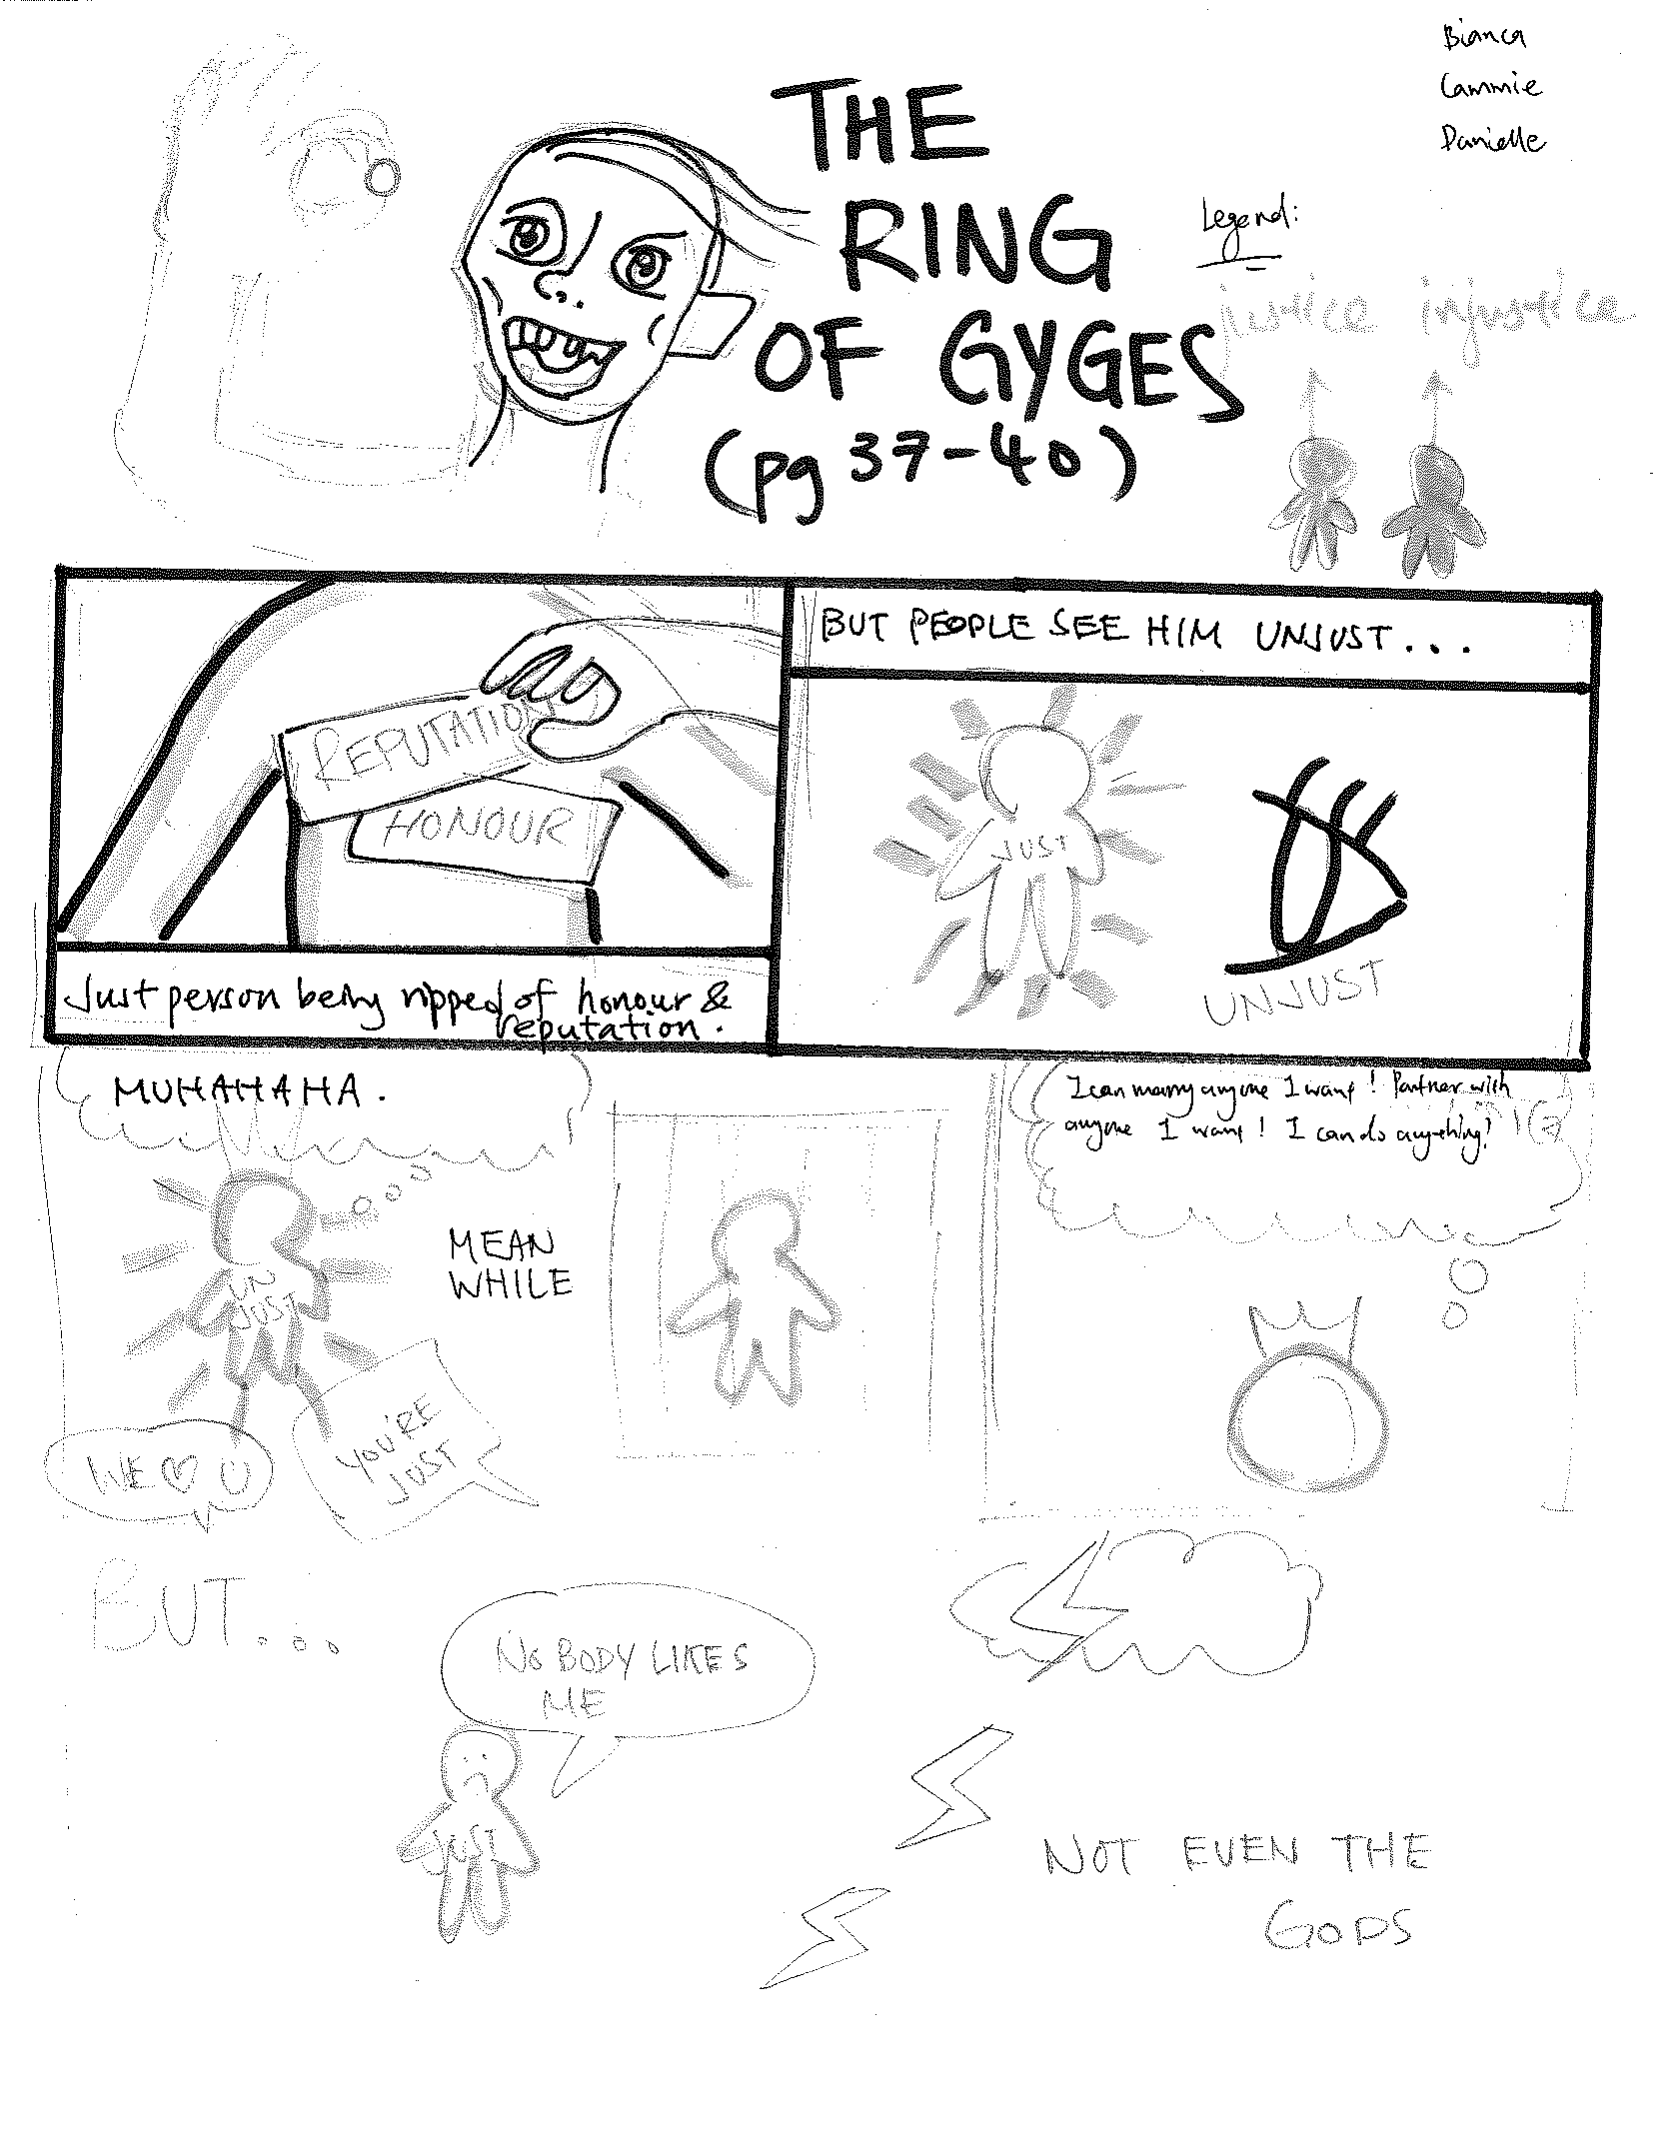

Slide 5
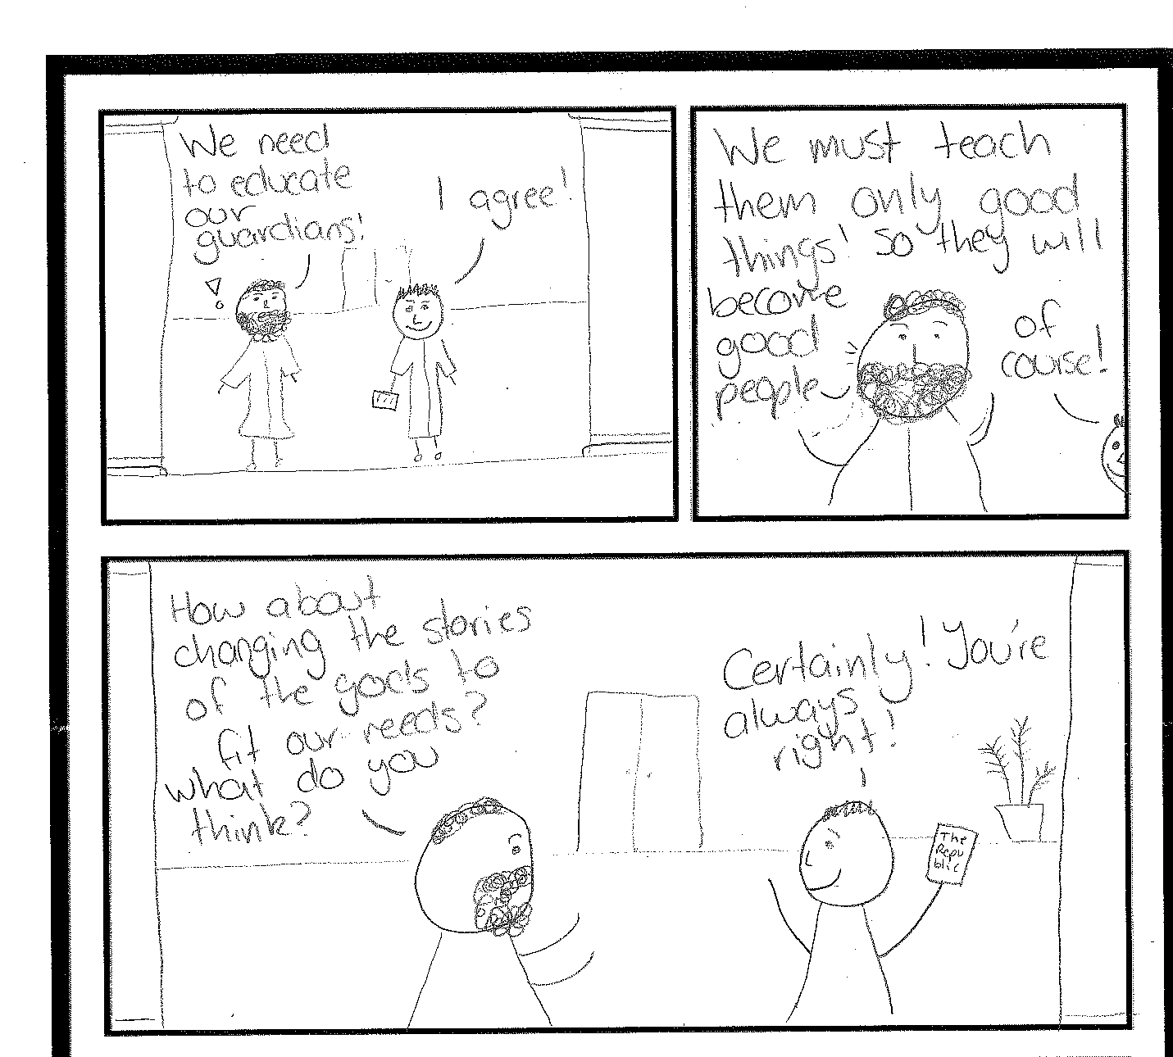

Slide 6
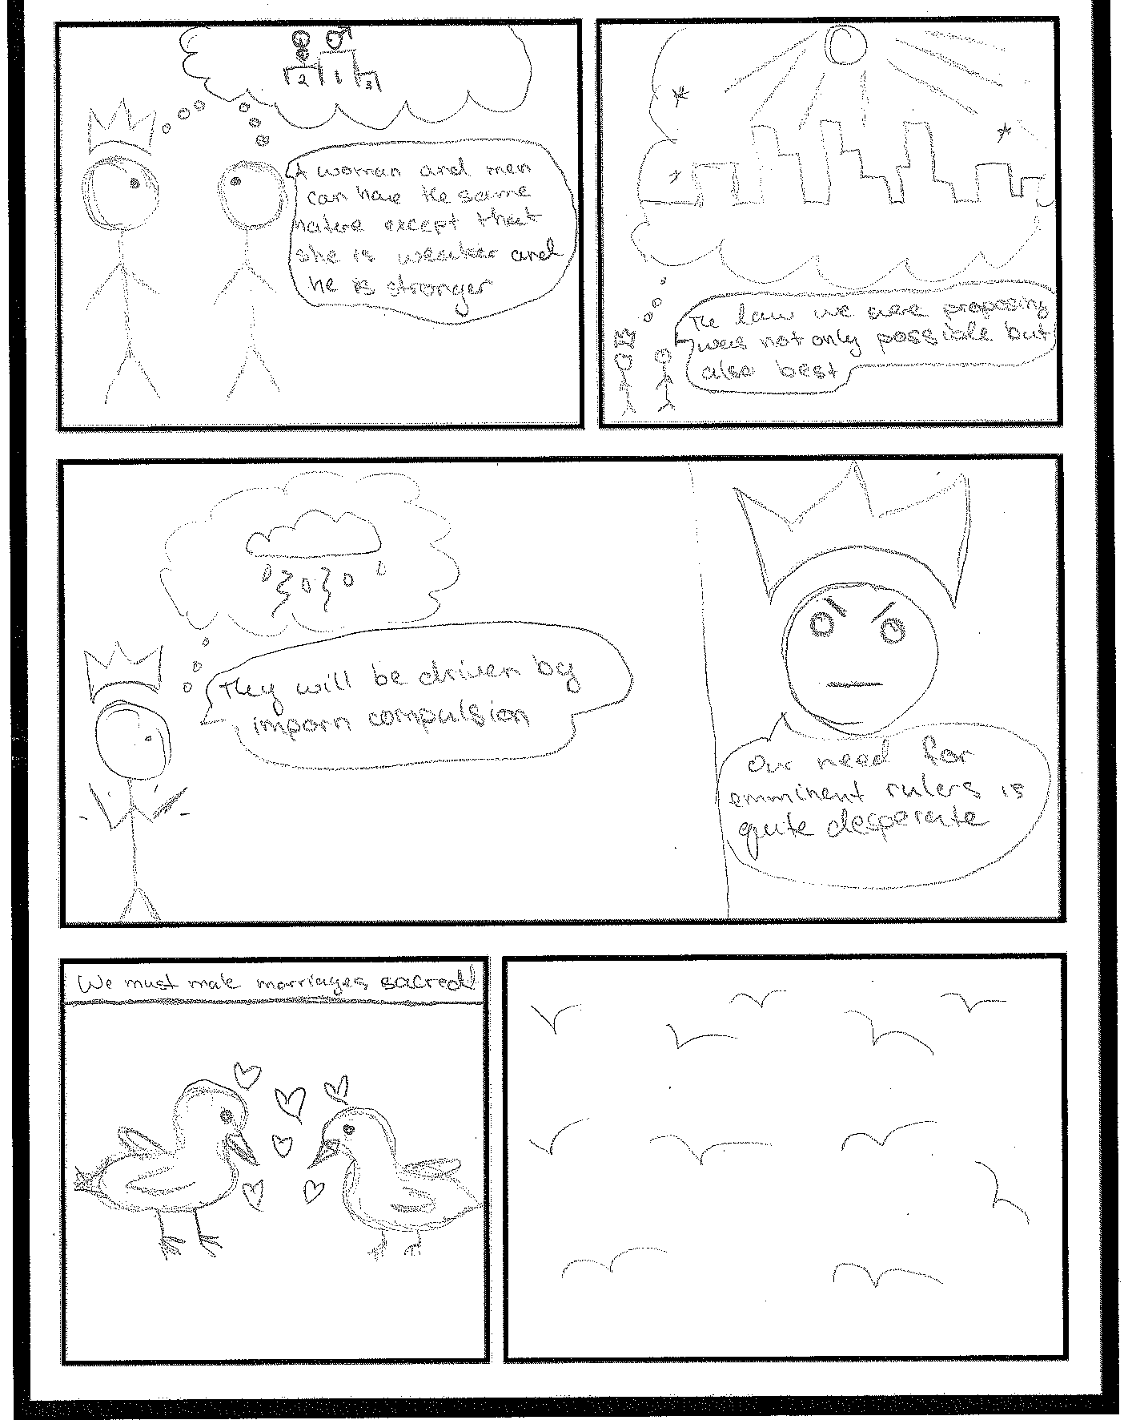

Slide 7
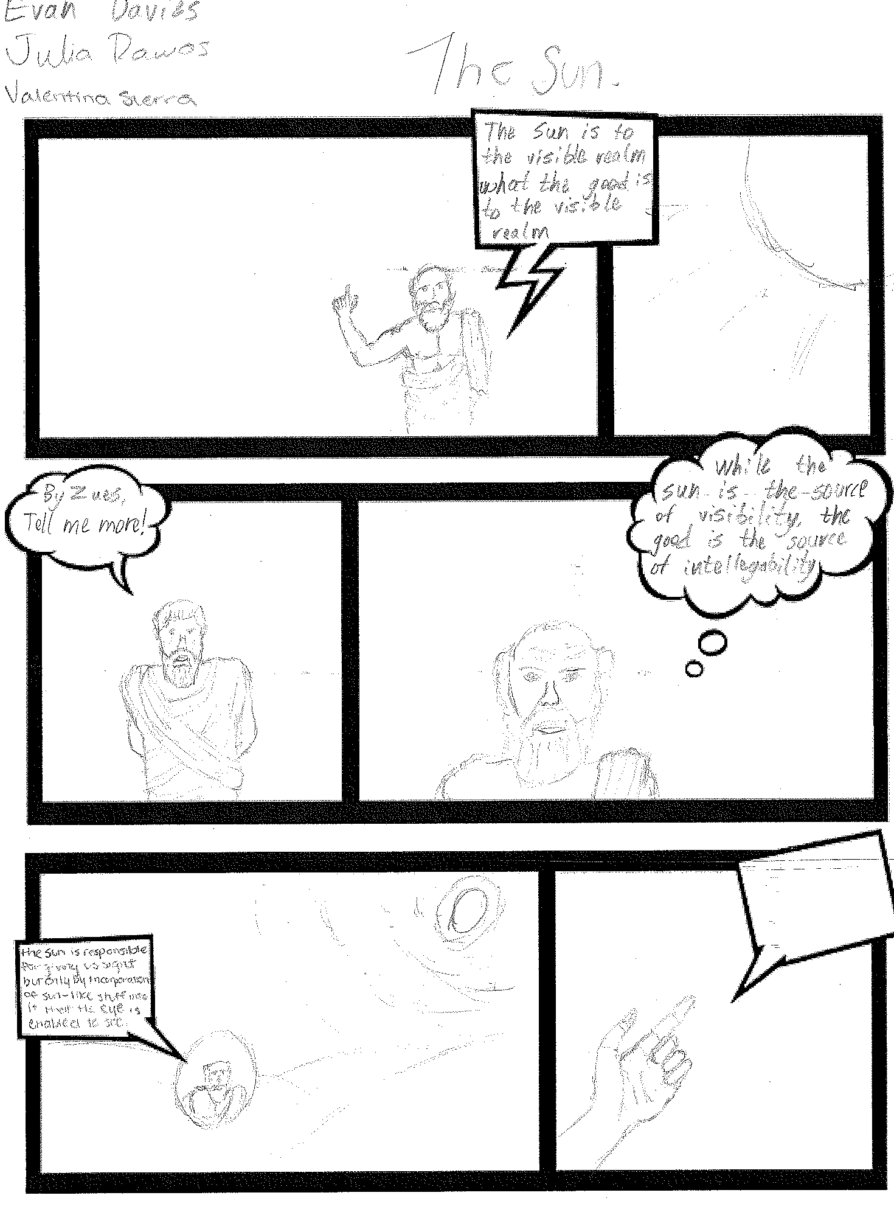

Slide 8
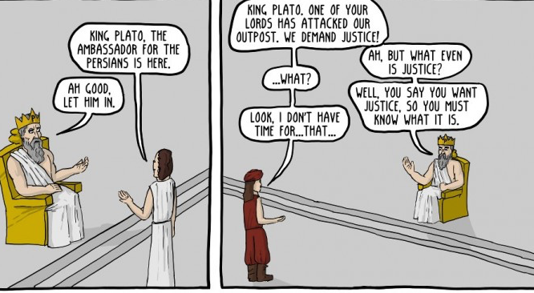
1

Slide 9
2

Slide 10
3
Man: “You don’t want kids”?
Woman: “Why do you have to sound so shocked”?
Woman: “you sound just like my mother, my sisters, the nuns at St. Mary’s school for girls…”?
Woman: “… My coworkers, the therapist, the stranger on the subway, Plato…”?
Man- “Maybe you just haven’t given it enough thought”.
Woman: “Society needs to get out of my ovaries?

Slide 11
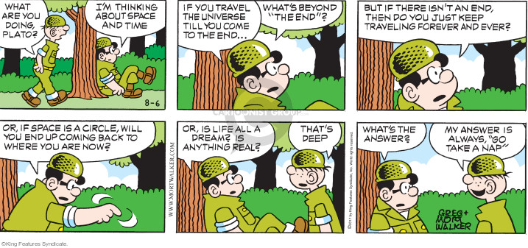
4

Slide 12
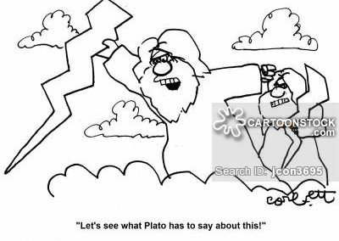
5

Slide 13
Your takeaways from Wednesday
What were your take-aways from Wednesday’s general overview of Republic?
Go here: https://padlet.com/borralvarez/nhbxfolx626g
And include your answers on my Padlet wall!

Slide 14
Plato’s Big Picture
Justice
varied definitions
We think/we know
Humanity (good/evil)
Hierarchies
(city/soul)
Allegories, “types,” imitators/ makers
Plato thinks/Plato knows
Forms/Good/Truth
Virtues
Education
Storytelling
He appeals to what we know through dialogue, examples, and stories to get his points across and show us what
makes a Philosopher King so unique, and so cursed, at the same time.
Is this different from what Homer does? What Picasso does? What Sophocles does?

Slide 15
The Myth of Er
1) What is the Myth of Er?
2) Why do you think Plato ended his Republic in this way?
3) Do you notice anything different in this book from the
other ones?
4) Is this an “effective” ending to a book about justice?
Why or why not?

Slide 16
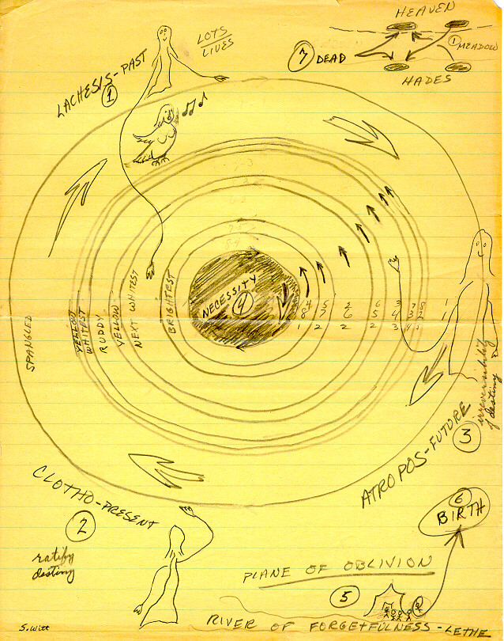
http://www.skidmore.edu/~switt/ER.html

Slide 17
Discussion Leader Session!
All of you have a feedback form! Please take a moment to fill it out at the end of the session!

Slide 18
Before reading Exodus
1) Have you ever read the Bible before (King James or other editions)?
2) In what context did you read it?
3) Was it read as a text – something that can be interpreted - or scripture – the sacred writings of Christianity?
4) Do you know what an exodus is? If you haven’t read the Bible before, can you anticipate what the Book of Exodus may talk about, given the meaning of the common word (exodus)?
5) Some “key words/concepts” we will talk about in relation to Exodus are: “slavery”, “exile”, “Yahweh” (God), “prophet”, “promised land”. Have we seen any of these concepts-in some shape or form- before in other readings this term?

