Slide 1
Taking Making Into Our Schools
Musings on Design Thinking , Making and Trades & Technology
Industry Training Authority (ITA) – Youth Day
Vancouver, BC November 20, 2013

Slide 2
Is the Maker Movement the next, best thing?
Might it be the Internet of things and people and ideas?
Are schools ready to become early adopters of the Maker Movement or once again, might we lag behind?

Slide 3
A definition
To use our hands and imaginations together
To engage in creative play – Frank Lloyd Wright
To make things and then make those things better

Slide 4
A bit of history …
Movement officially started 2006 in Menlo Park, CA
Tech Shop – Mark Hatch
Collective experience – sharing tools, tips, & technologies
Access to information – Internet
Access to expertise & tools – MakerSpaces
Increasingly important as 1 in 9 of us live in condos

Slide 5
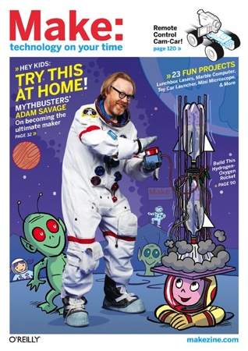
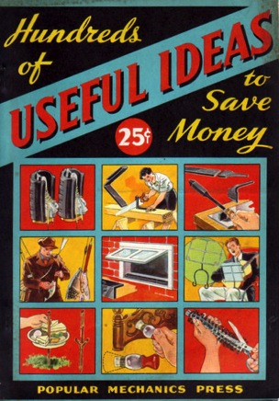
Reviving Popular Mechanics
Makezine
http://makezine.com/

Slide 6
Just an example
http://www.cbsnews.com/8301-18560_162-57612678/the-recyclers-from-trash-comes-triumph/
The landfill philharmonic
http://www.youtube.com/watch?v=fejU3E0I-vE
Notes:
This is the Recycled Orchestra of Cateura.
The violins are fashioned from oven trays, the cellos from oil barrels. Even the strings are recycled.
The saxophones and trumpets are made from old drain pipes, the keys were once coins and bottle caps. This drum skin used to be an X-ray plate, the guitar from dessert tins.
The idea came from environmental technician Favio Chavez. When he came to Cateura and saw the kids working and playing on this miserable hill, he came up with the idea of starting a music school to lift the kids' lives out of the trash.

Slide 7
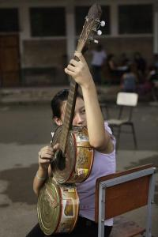
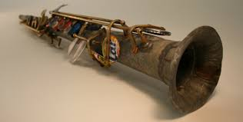
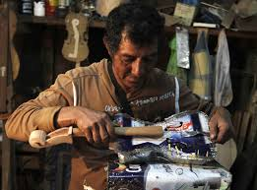
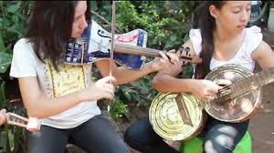

Slide 8
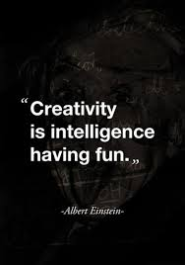
Notes:
We have a need to make. It stems from our curiosity with the world and our basic human desire to tinker - make things and then make those things better – iterating the design …finding the problem that needs to be solved
Using the Maker Movement to encourage creativity and innovation and maximize the critical and creative thinking to release our imaginations which are necessary to engage in authentic, meaningful inquiry

Slide 9
Making requires design, empathy, & imagination Stanford d.School https://dschool.stanford.edu/

Slide 10
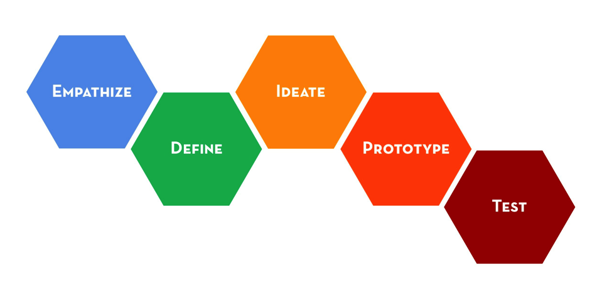

Slide 11
Think about William Kamkwamba … http://www.ted.com/talks/william_kamkwamba_on_building_a_windmill.html
Notes:
William Kamkwamba (born August 5, 1987) is a Malawian inventor and author. He gained fame in his country when, in 2002, he built a windmill to power a few electrical appliances in his family's house in Masitala using blue gum trees, bicycle parts, and materials collected in a local scrapyard. Since then, he has built a solar-powered water pump that supplies the first drinking water in his village and two other windmills (the tallest standing at 39 feet) and is planning two more, including one in Lilongwe, the political capital of Malawi.
Kamkwamba was born in a family of relative poverty and relied primarily on farming to survive. According to his biography, The Boy Who Harnessed the Wind, his father had been a rough fighting man who changed after discovering the Christian God. A crippling famine forced Kamkwamba to drop out of school, and he was not able to return to school because his family was unable to afford the tuition fees. In a desperate attempt to retain his education, Kamkwamba began to frequent the library. It was at the local library where Kamkwamba discovered his true love for electronics. Before, he had once set up a small business repairing his village's radios, but his work with the radios had been cheap.

Slide 12
It’s all about access to information, ideas, expertise & opportunities …
Notes:
With ubiquitous access to the Internet, information about most everything is at our finger tips … so holding facts is less important than using and creating with them … our schools must help students to do just that! We’ve seen our libraries move from collections of print to digital commons for learning … we’ll see them transition again to maker spaces because that’s what librarians do … they keep us ahead of the curve … but its up to use as educators to move our practices along as well …
What’s common among the architects Frank Lloyd Wright, LeCorbusier, Buckminster Fuller --- architects and architects that went to kindergartens w building blocks … to make thinking / imagination concrete and tangible … to see one’s thinking in action and reaction …

Slide 14
Traits of a Design Thinker
Empathy – Ability to image the world from multiple perspectives
Integrative thinking - Exploit opposing ideas & opposing constraints to create new solutions
Optimism – Assume no matter how challenging the constraints of a given problem, at least one potential solution is better than the existing alternatives
Experientialism - Pose questions & explore constraints in creative ways that proceed in entirely new directions
Collaboration - Complex problems require an enthusiastic interdisciplinary collaborator
Thanks Shane Austin & d.School

Slide 15
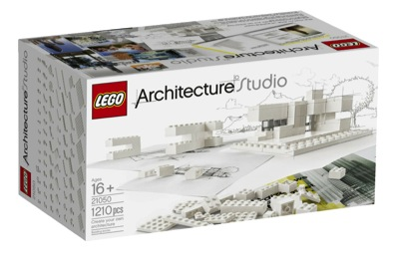

Slide 16
GARY MASON
Oct. 18, 2013
Where did all our skilled workers go?
Once upon a time, shop class was mandatory in most high schools. There was a belief that even if a student wasn’t intent on becoming a mechanic or carpenter, having some basic life skills in these areas wasn’t a bad thing.
Over time, however, shop began to look dated and irrelevant and was given less status. Somewhere along the way, it was drilled into students that the only way to get ahead in life was to go to university and earn a degree.
http://www.theglobeandmail.com/globe-debate/where-did-all-our-skilled-workers-go/article14909494/

Slide 17
They are in kindergarten+ … just waiting for us!
Notes:
Globe article --- where are our skilled workers … I’d say Kindergarten but it depends on us to encourage them into the trades and professions that elevate Canada from simple manufacturing, in which we are steady losing a competitive place to advanced manufacturing that requires our best thinker, tinkers and imagination … a return to the time when North America held the majority of patterns for innovation
K – 12, we (teachers, parents, friends) all must recognize the promise and potential of Trades and Technology and our roles in encouraging kids to stay in programs and courses that form core competencies – too think about different pathways and careers that will add meaning to their lives and to our CDN society … we need our students to be adding skill set not narrowing electives and avenues - narrowing choices … reductionists … to be a fluid and nimble as possible in a changing world
Time for educators to reclaim trades and makers …
Making – forces us to tinker to learn and to improve both of which are at the heart of professional practice in STEM and STEMx fields – as Gehry said “its letting one’s intuition express itself but in a knowledgeable way, not a haphazard way … to be mindful and thoughtful and considered … to engage in playful curiosity …

Slide 18
For a bit of inspiration
stephanos greek resturant vancouve

Slide 19
How a Radical New Teaching Method Could Unleash a Generation of Geniuses
http://www.wired.com/business/2013/10/free-thinkers/
Education as a self organizing system – Sugata Mitra
Access to a world of infinite information has changed how we communicate, process information, and think.
Innovation, creativity, and independent thinking are increasingly crucial to the global economy.
Mitra argues that the information revolution has enabled a style of learning that wasn’t possible before

Slide 20
Host a Maker Day
Engage the teachers first – we can only give what we’ve got!

Slide 21
Work with colleagues …
Talk with ITA for potential support
Connect w/ local colleges (Okanagan College – Women in Trades)
Use the UBC Okanagan / ITA resources
Invite good people to a good day

Slide 22
Start with design thinking …
Design thinking is a process … allow ample time
Work on a problem worth solving

Slide 23
Create a supportive environment
Create an affordable basic kit
Supplement the kit if you can
Allow ample time for starts, false starts, tinkering, & redesign

Slide 24
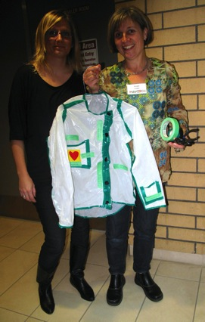
It’s all about process …
Collaboration
Empathy
Need
Design
Prototype
… and then a bit of magic might happen

Slide 25
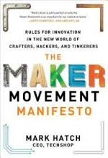
Two core references
Plus the wonderful design thinking workshop guides from Stanford’s d.School
… and Maker Day toolkit http://blogs.ubc.ca/centre/category/maker/

Slide 26
“ … collectively use our goodness & opportunity to address issues in our civil society & make the world just that little bit better.” Hatch (2014) The Maker Movement Manifesto

