Slide 1
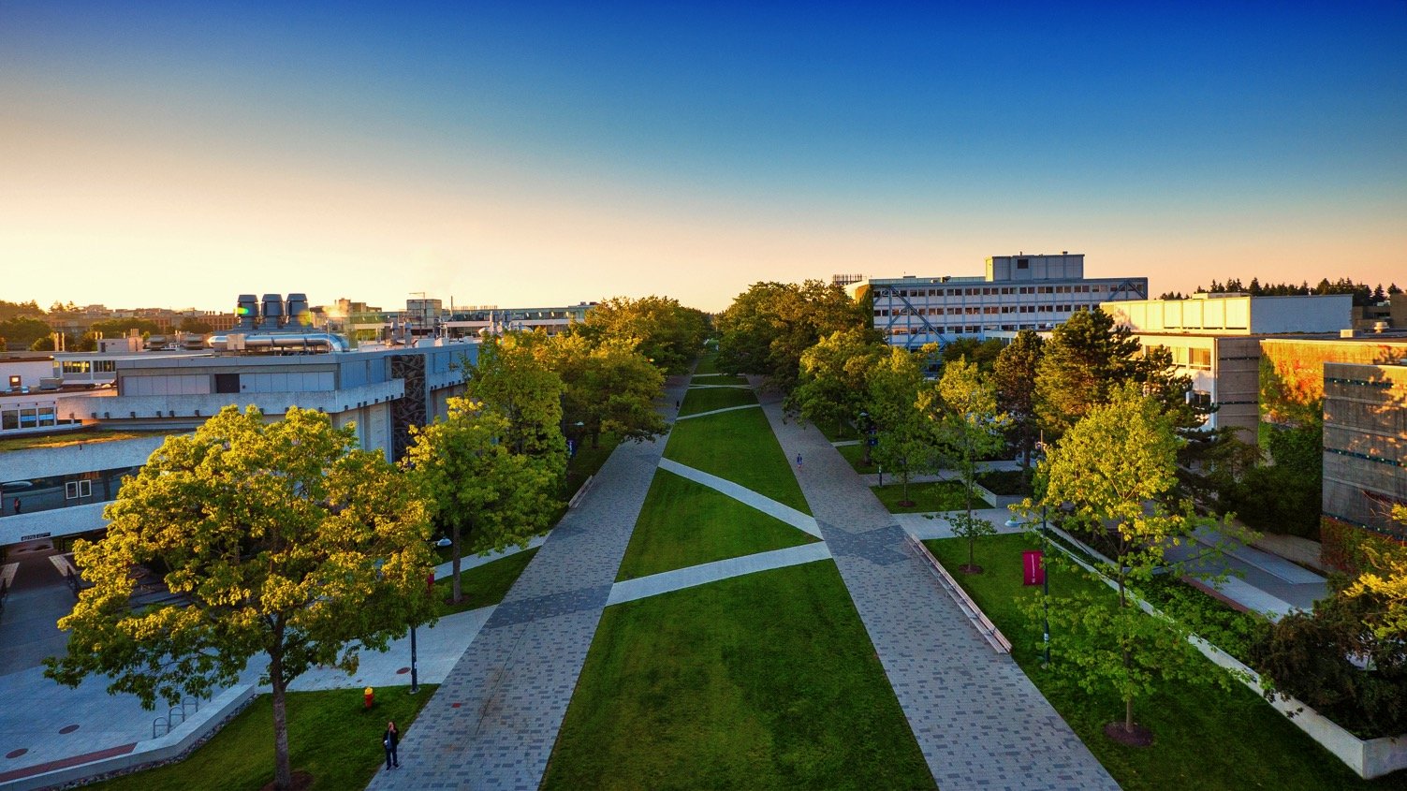
UBC BACHELOR OF EDUCATION PROGRAM
Teach in BC and Canada | Teach the World

Slide 2
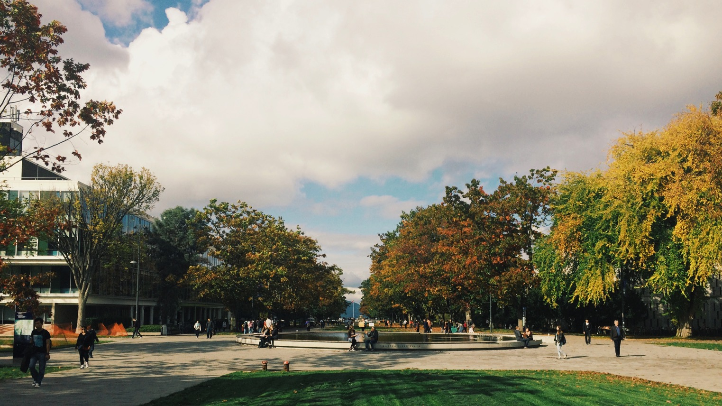
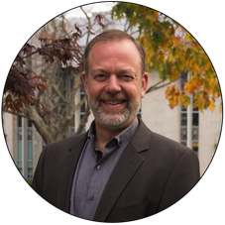
Dr. Keith McPherson
Program Coordinator
Faculty of Education
keith.mcpherson@ubc.ca
BEd International Student advisor
Community Field Experience Coordinator
Recruiting
Young Children New Home Literacies
Provincial Mentoring Programs

Slide 3
UBC BEd Program Options
ELEMENTARY & MIDDLE YEARS | Kindergarten to Grade 7
SECONDARY | Grades 8 to 12 | Dual Degree Option
WKTEP | West Kootenay Teacher Education Program
NITEP | Indigenous Teacher Education Program

Slide 4
The Program
PROGRAM LENGTH: 1 year (12 months) from September to August
No. of CREDITS: 60 credits (intensive)
COURSEWORK: Introduces teacher candidates to educational theory and practices
PRACTICUM: 3-month in-school practicum
COMMUNITY FIELD EXPERIENCE (CFE): 3-week CFE (local, rural, international) | cfe.educ.ubc.ca
GRADING: Pass/Fail (76%) — one chance to redo assignment
NO EXAMS!
PROGRAM EMPHASIS: Improving yourself as a teacher through actively engaging with content
Notes:
1 year (12 month) program Sept – August
120 credits – intensive
Coursework introduces teacher candidates to educational theory and practices
3 months in practicum or field experience
Pass/Fail – 76% - 1 chance to redo assignment
No Exams
Emphasis on improving as a teacher through actively engaging with content

Slide 5
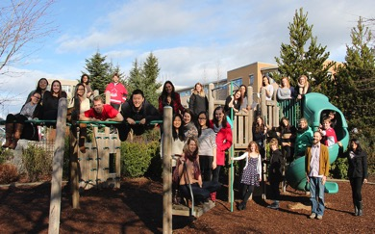
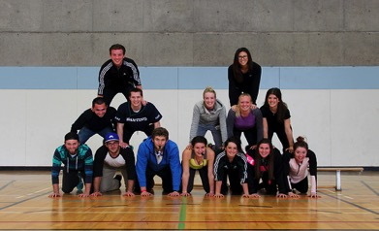
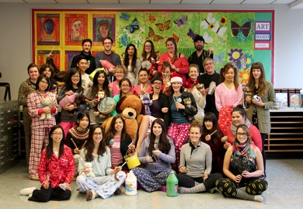
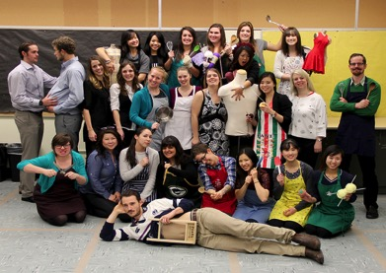
Program Options
~300 Elementary/Middle Year Teacher Candidates in 11 Cohorts
~400 Secondary Teacher Candidates
in 17 specializations
Notes:
11 cohorts Work together in cohorts/specializations created according to a theme/topic

Slide 6
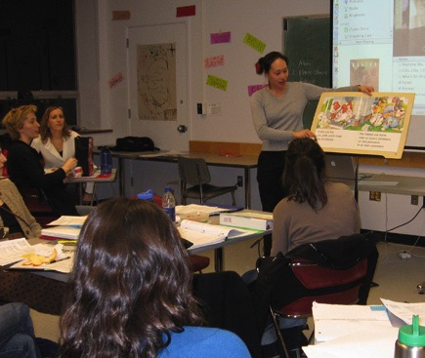
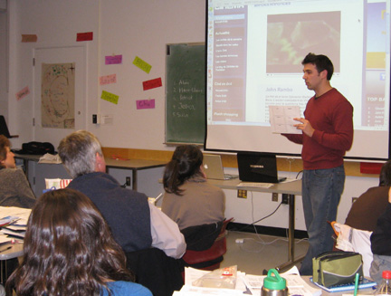
Learning How to Teach
Notes:
Teacher candidates learn instructional skills and strategies and encouraged to practice in the safety of their peers.
Teacher candidates are exposed to a wide variety of materials resources and instructional approaches.

Slide 7
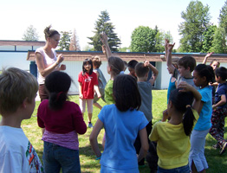
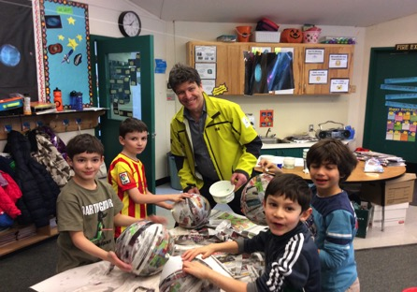
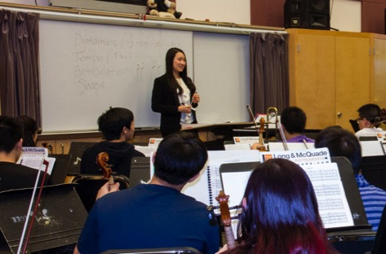
Teaching in Schools – Practicum
3 months of in-school practicums
Notes:
3 months of practicums

Slide 8
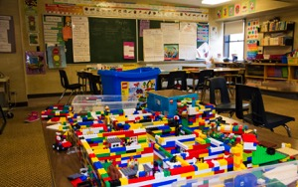
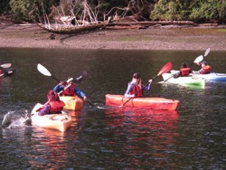
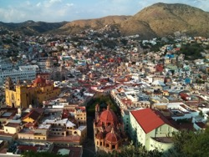
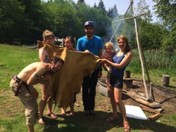
Community Field Experience (CFE)
3-WEEK COMMUNITY FIELD EXPERIENCE | cfe.educ.ubc.ca
Immediately follows the 3 months of practicum work
Local, rural, national, and international opportunities
K-12 Schools
Non-K-12 Contexts
International
Rural BC
Notes:
3 week community field experience follows 10 week practicum
Can be local, provincial (rural), national and international
Many are in non K-12 contexts such as Aquariums, Museums, Community Services, Outdoor programs, Youth at Risk, etc.
International and rural take place in classrooms and non K-12 contexts
Emphasis is on expanding their concept of potential learning sites, and how they might get involved, either as a career option, or as a classroom teacher with an understanding of educational community connections.

Slide 9
International CFE – Goals
Assist International partner meet their objectives
Develop students’ global awareness
Develop students’ sensitive to unique cultural learning/teaching practices

Slide 10
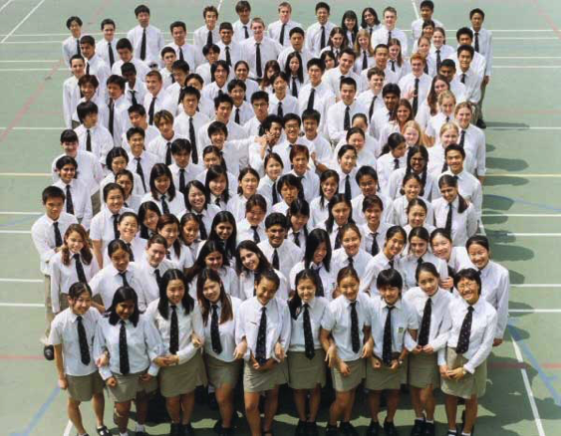
International CFE – What UBC Students do
Observe & Teach in K-12 Schools
Volunteer with local community partners
Work with Faculty Advisor in reflecting upon and understanding what they are seeing and experiencing

Slide 11
International CFE - Dates
Secondary: April 24 – May 12, 2017
Elementary: June 5 – June 24, 2017

Slide 12
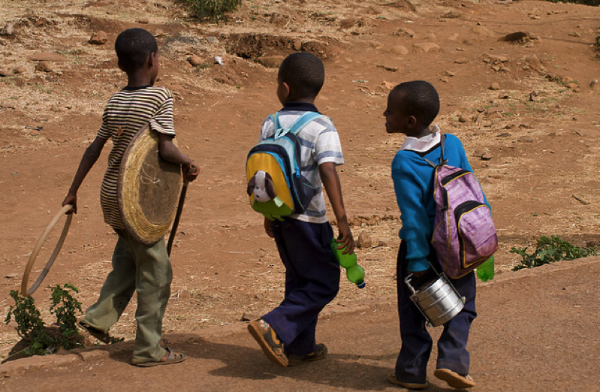
International CFE – 2016 Exchange Partners
Addis Ababa, Ethiopia
Freiburg, Germany
Guanacaste, Costa Rica
Hong Kong, China
Kampala, Uganda
London, England
Melbourne, Australia
Qindao, China
Santa Clara, Cuba
Strasbourg, France
Tokyo, Japan
Zurich, Switzerland
Puebla, Mexico
Mexico City, Mexico
Santa Fe, Mexico
Querétaro, Mexico

Slide 13
International CFE – 2016 Self Initiated
Berlin, Germany
Dundee, Scotland
Edinburgh, Scotland
Galapagos, Ecuador
Hartland, United Kingdom
Helsinki, Finland
Hsinchu, Taiwan
Jerusalem, Israel
Nijmegan , Netherlands
Perth, Australia
San Francisco, United States of America
Athens, Greece
Coimbatore, India
Conwy, Wales
Hamburg, Germany
Kalambaka, Greece
Kihei, United States of America
Kula, United States of America
Los Angeles, United States of America
Ruatoria, New Zealand
Vienna, Austria

Slide 14
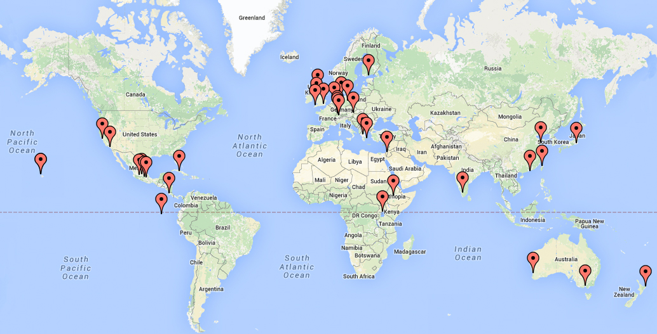
International CFE – 2017 All locations
Notes:
17 specializations Work together in cohorts/specializations created according to a theme/topic

Slide 15
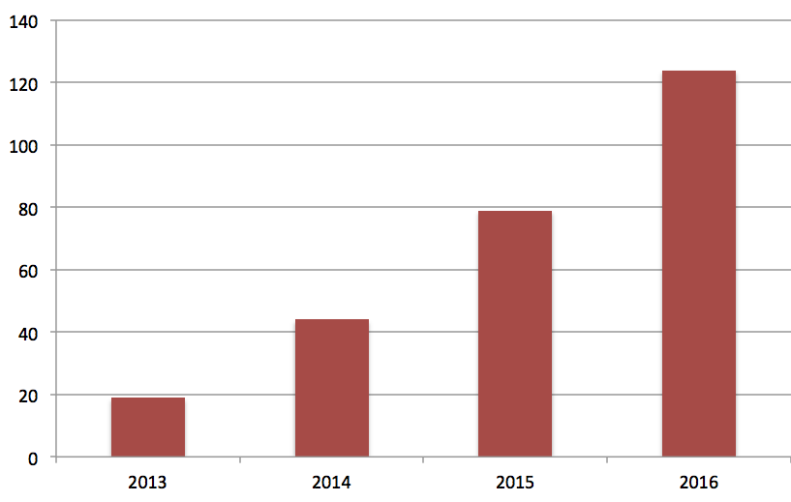
International CFE – Trend
# of Students Enrolled in an International CFE
Year
Notes:
17 specializations Work together in cohorts/specializations created according to a theme/topic

Slide 16
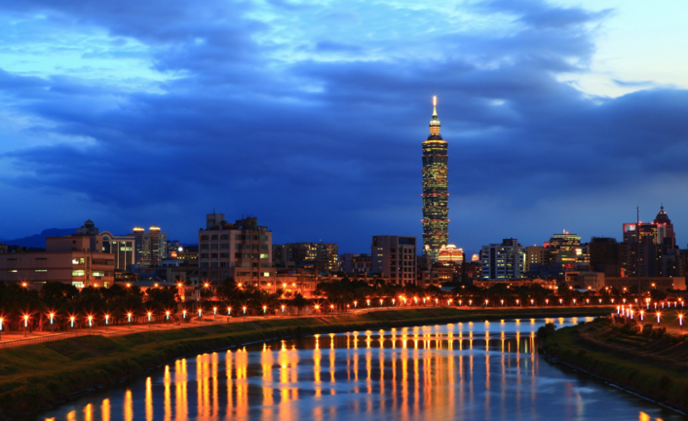
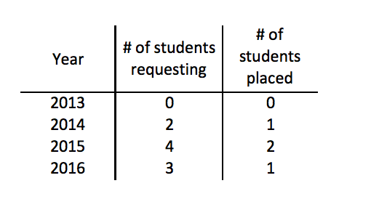
International CFE – Taiwan
Up until 2016, no university exchange partner
2 to 4 students interested in going to Taiwan each year
Notes:
Image from http://www.thousandwonders.net/Taiwan
9 have wanted to go but only 4 have gone.

Slide 17
International CFE – Questions and Answers
What are the expectations of the international university?
Assist UBC teacher candidate acquire accommodations
Provide student a placement in local school
Ensure school meets UBC’s Expectations for school
What are the expectations for the international schools?
Provide UBC students 15 days of time in classroom for 5-8 hours a day
Ensure teacher candidates acts and dresses professionally
Completes a feedback form (4 questions) at end of CFE
Full list of CFE expectations are located here: http://blogs.ubc.ca/ubcfe/goals-expectations/
Notes:
Image from http://www.thousandwonders.net/Taiwan
9 have wanted to go but only 4 have gone.

Slide 18
International CFE – Questions and Answers
What will it cost the university and schools hosting UBC students?
UBC and the UBC students are expected to pay for all travel, accommodation and food costs.
Full list of CFE expectations are located here: http://blogs.ubc.ca/ubcfe/goals-expectations/
Notes:
Image from http://www.thousandwonders.net/Taiwan
9 have wanted to go but only 4 have gone.

Slide 19
Your questions / Discussion
Notes:
Image from: http://centerfornewmusic.com/calendar/composer-meetup-member-party-2/

