Slide 1
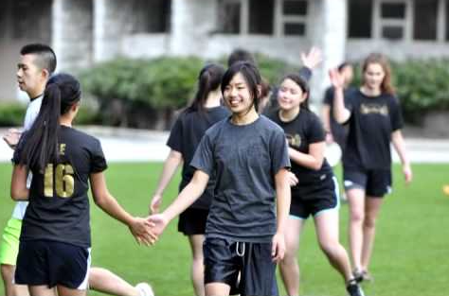
BC Practicum Schools for visiting NTNU teacher candidates

Slide 2
Secondary school contacts & arrival times
Gladstone - Mr. Chris Parker – 8:20 AM
University Hill - Tim McGeer - 8:20 AM
Prince of Wales – Mr. Dave Derpak – 8:40 AM

Slide 3
Prince of Wales Secondary
Gold
Mini School
TREK

Slide 4
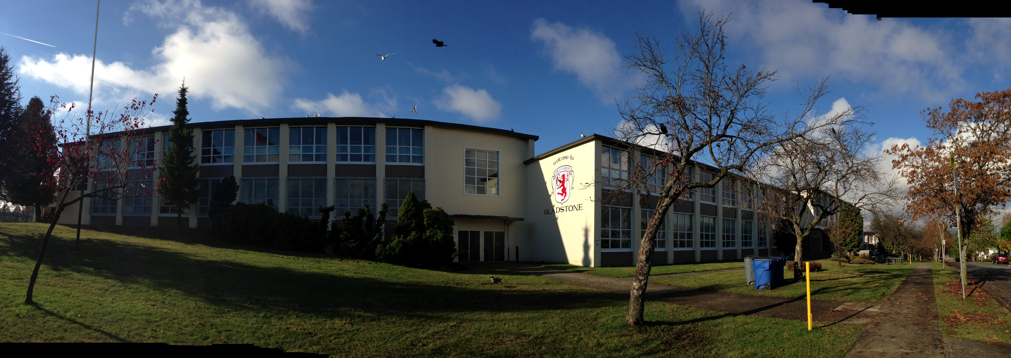
Gladstone Secondary
Mandarin
Mini School
Success Towards Employment Program (STEP)

Slide 5
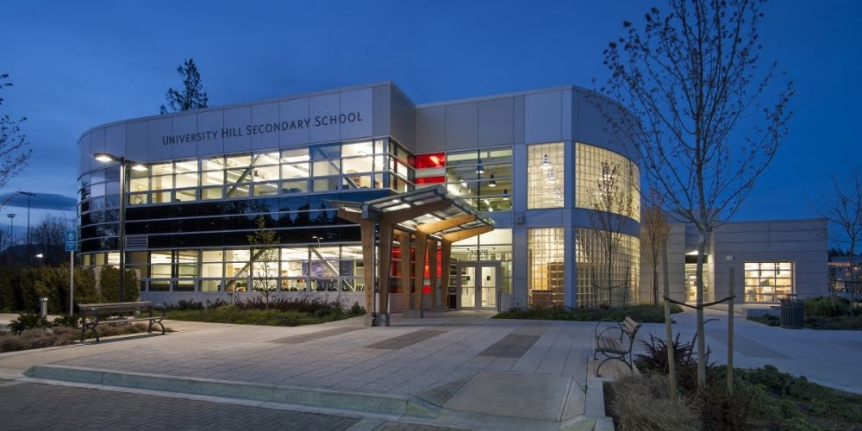
University Hill Secondary
ACE IT
Diverse Learners
Transition Program

