Slide 1
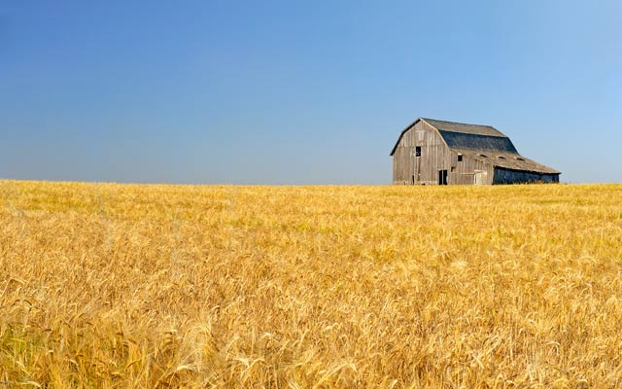
Education in Canada
Dr. Keith McPherson
Teacher Education Office
University of BC
keith.mcpherson@ubc.ca
Notes:
http://www.country-magazine.com/wp-content/uploads/2013/07/Barley_Barn.jpg

Slide 2
Goals:
Overview of UBC
Give you a feel of how learning may be similar/different from your own
Canadian Geography lesson
Visit to assessment lecture
Dr. Keith McPherson
Teacher Education Office
University of BC
keith.mcpherson@ubc.ca
Notes:
http://www.country-magazine.com/wp-content/uploads/2013/07/Barley_Barn.jpg

Slide 3
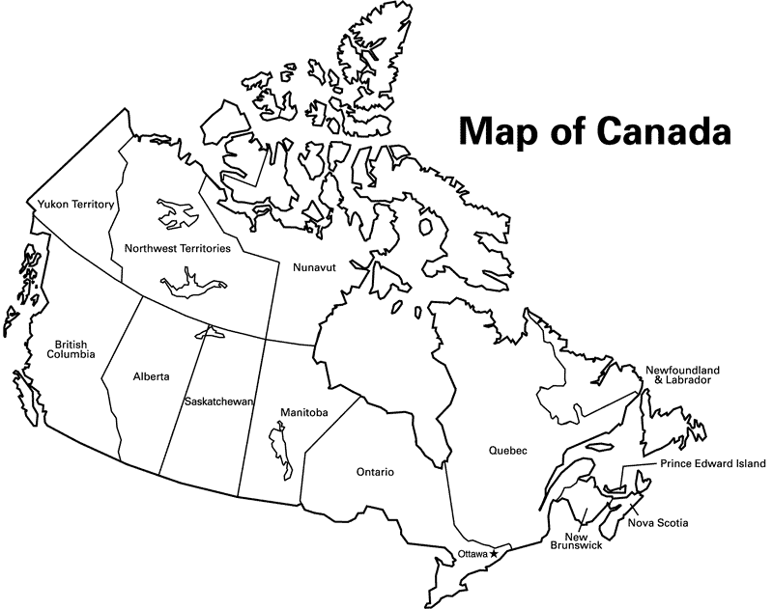
5000 km (3200 miles)
Notes:
Second largest country in the world 10,000 sq kilomters
5,000 km (3200 miles) from coast to coast and from us border to
4600 km (3000 miles) from north to south
10 hours to fly across Canada 3 or 4 more hours than flying from Mexico to Vancouver
Each province has its own education system and although they are similar in many ways they are also different. It would take a whole course to cover the different education systems in Canada.

Slide 4
4600 km (300 miles)
Notes:
Second largest country in the world 10,000 sq kilomters
5,000 km (3200 miles) from coast to coast and from us border to
4600 km (3000 miles) from north to south

Slide 5
Notes:
10 hours to fly across Canada 3 or 4 more hours than flying from Mexico to Vancouver
Each province has its own education system and although they are similar in many ways they are also different. It would take a whole course to cover the different education systems in Canada.

Slide 6
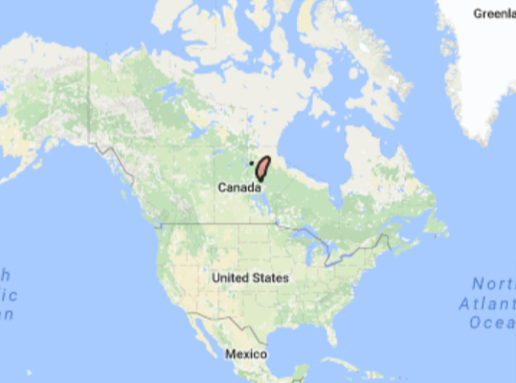
Size of Country Comparing China to Canada
Taiwan- 35,980 km² Canada – 9,964,670 km²
Notes:
Canada 278 tim es igger

Slide 7
Taiwan- 35,980 km²
Vancouver Island – 32, 134km²
Taiwan- 35,980 km² Canada – 9,964,670 km²

Slide 8
Taiwan- 23,000,000 people
Vancouver Island – 748,937 people
Taiwan- 35,980 km² Canada – 9,964,670 km²

Slide 9
Education is a Provincial
Responsibility
Notes:
10 provinces and 3 territiries
Each province has its own education system and although they are similar in many ways they are also different. It would take a whole course to cover the different education systems in Canada.

Slide 10
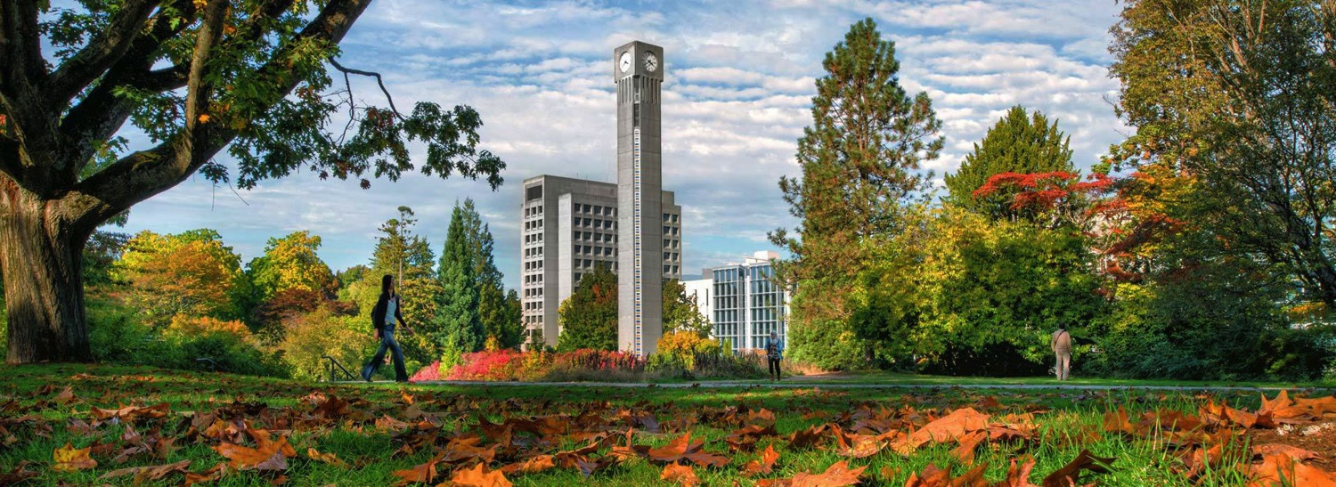
UBC is Largely Funded Provincially

Slide 11
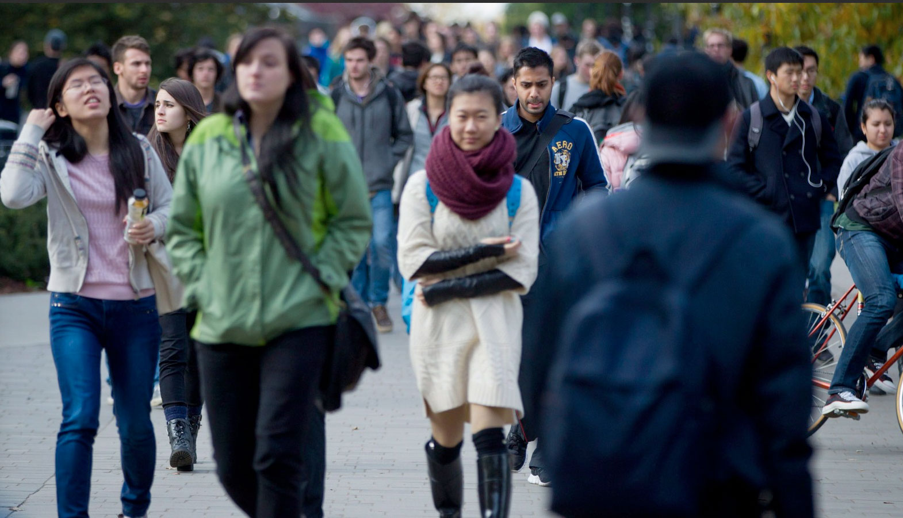
55,000 students
21% International

Slide 12
UBC has 2 sessions and 4 terms
Winter Session
Summer Session
T1
T2
T1
T2
Sep-Dec
Jan-Apr
May-Jun
Jul-Aug
Vacation:
13 Statutory days
2-3 weeks Christmas

Slide 13
Vacation/Study Time
13 Statutory days
2-3 weeks Winter Vacation
1 Week Reading Break (Winter T2)
2-3 weeks Summer Vacation

Slide 14
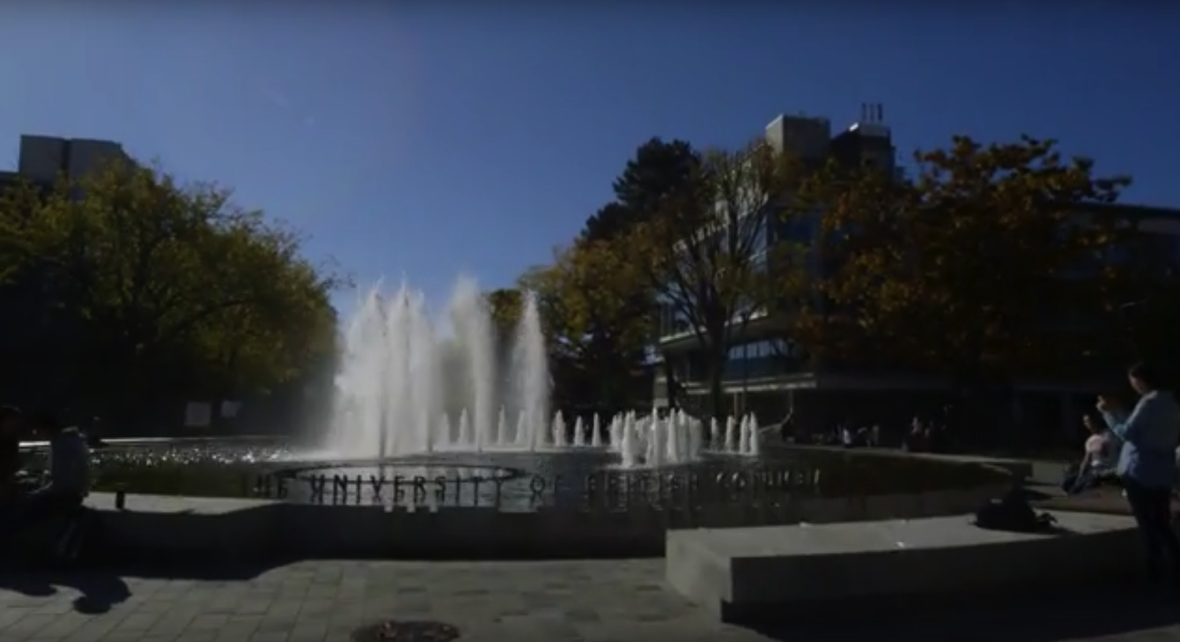
Faculty of Education
https://youtu.be/m8UVAeYSaPQ

Slide 15
Bachelor of Education
500 Undergraduates
200-300 Graduates

Slide 16
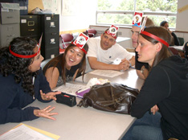
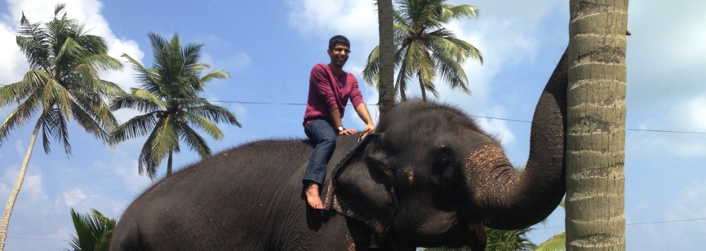
Bachelor of Education
Learn how to teach
5-18 year olds

Slide 17
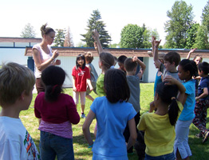
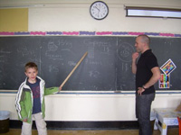
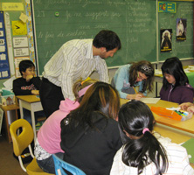
BEd at UBC - practice-teaching in schools
teach.educ.ubc.ca
Notes:
10 week practicum
Take what you’ve learned at UBC and actively integrate/apply in classrooms in the school
Gradual process from one day a week, to two week practicum in late fall, to 10 week practicum gradually move towards 80%
All done with support of classroom teacher, a UBC FA, and your peers.
(picture on right: teacher candidate demonstrates what they have learned about the gradual release of responsibility in their BED program, by encouraging students to take more control of their own learning).

Slide 18
B.Ed & BC Teaching Certificate
Teaching in BC schools
Teaching in schools across Canada
Teaching internationally
Opportunities for career development (Dept. Head, School & District Administration, etc.)
Educational programs for government, non-profit societies, industry
Adult education
Online education

Slide 19
Education in BC
Education in Canada
Dr. Keith McPherson
Teacher Education Office
University of BC
keith.mcpherson@ubc.ca
Notes:
So in essence, this presentation will only be aroudn BC’s education system
http://www.country-magazine.com/wp-content/uploads/2013/07/Barley_Barn.jpg

Slide 20
Where in Canada?
Notes:
http://www.country-magazine.com/wp-content/uploads/2013/07/Barley_Barn.jpg

Slide 21
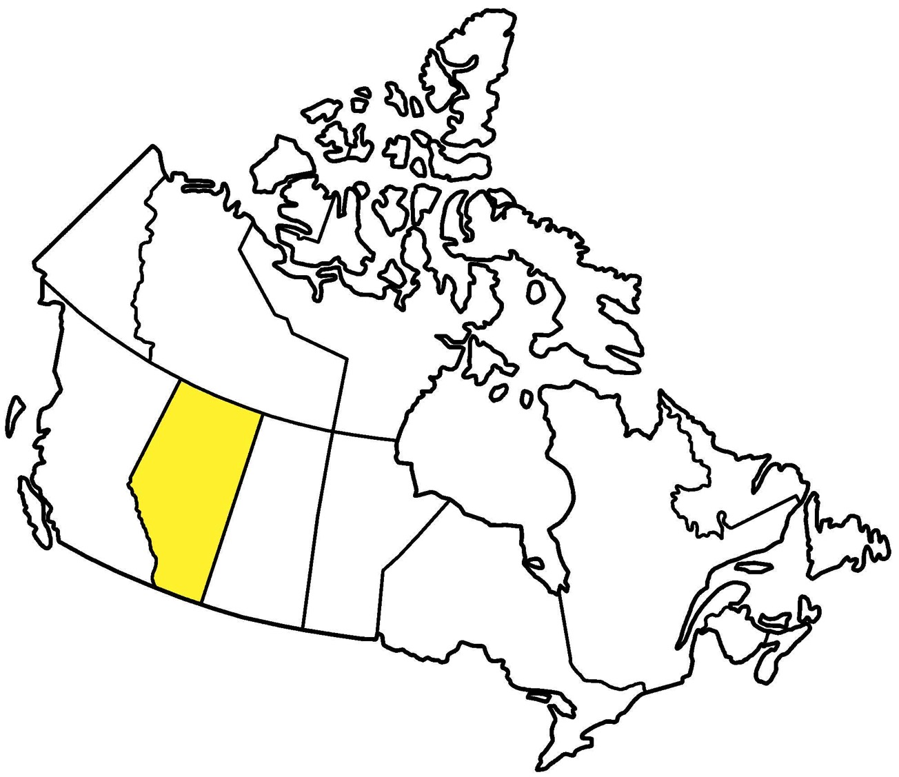
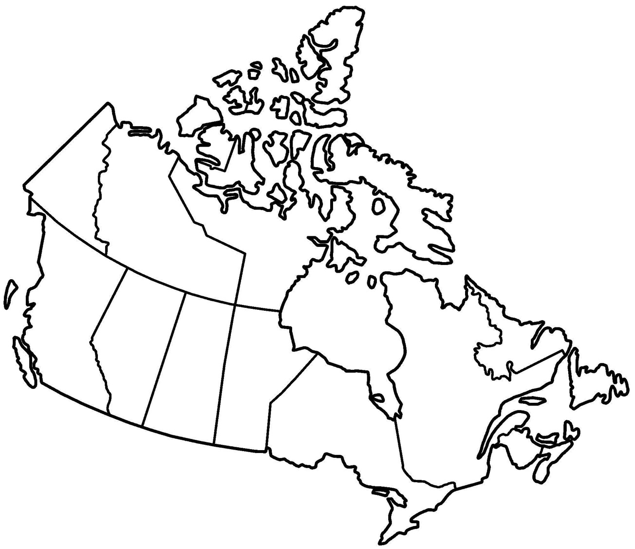
Alberta

Slide 22
Schedule
Where in Canada?
Avatars & Critical Literacy
Break
Cooperative Games
Notes:
http://www.wediscovercanada.ca/img/beach_pei.jpg Prince Edward Island

Slide 23
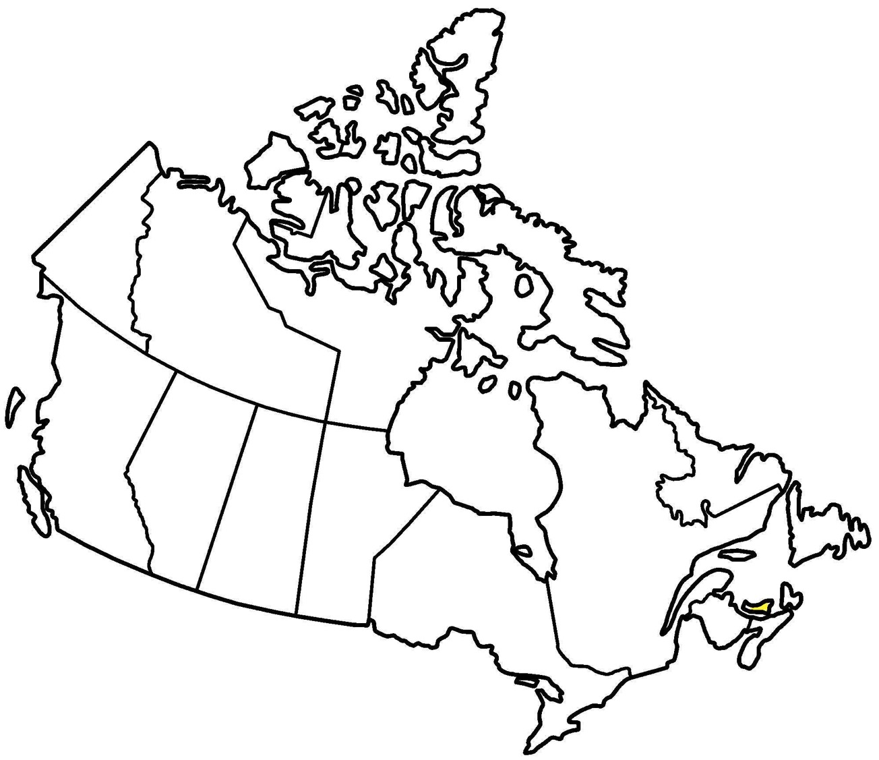
Prince Edward Island

Slide 24
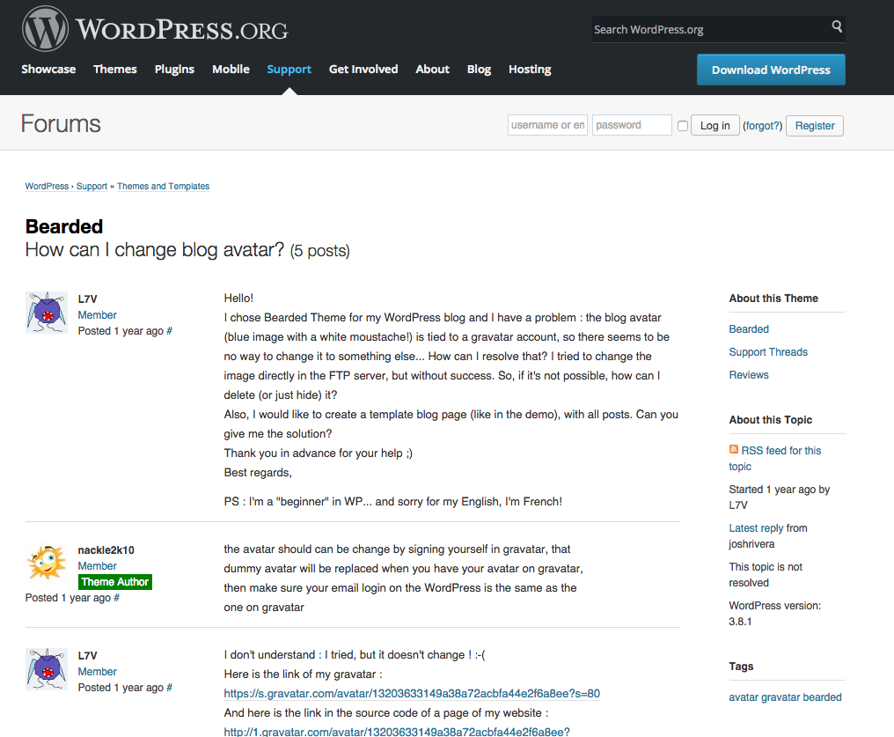
What’s Your Avatar?
Notes:
Property of https://3d-avatar-store.com/sites/default/files/images/StarTrekAvatar3.jpg

Slide 25
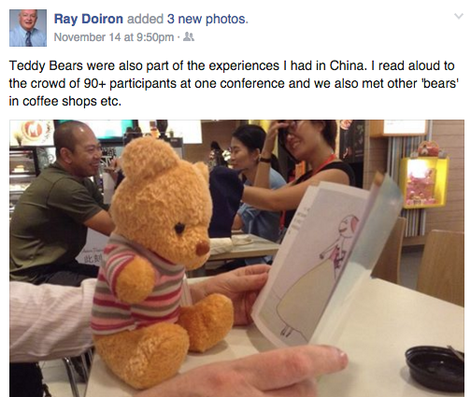
What’s Your Avatar?
Notes:
Property of https://3d-avatar-store.com/sites/default/files/images/StarTrekAvatar3.jpg

Slide 26
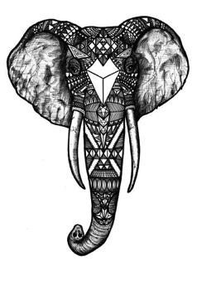
What’s Your Avatar?
drawing
icon
photo
Notes:
Property of https://3d-avatar-store.com/sites/default/files/images/StarTrekAvatar3.jpg

Slide 27
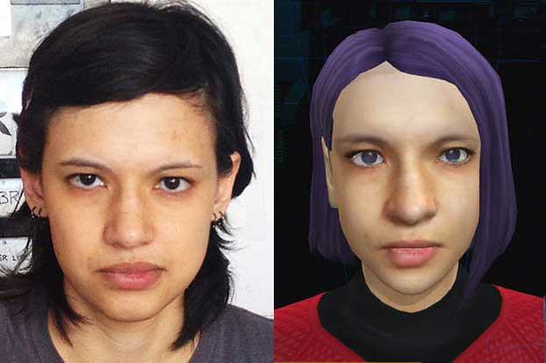
What’s Your Avatar?
Notes:
Property of https://3d-avatar-store.com/sites/default/files/images/StarTrekAvatar3.jpg

Slide 28
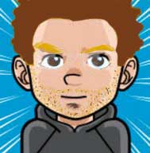
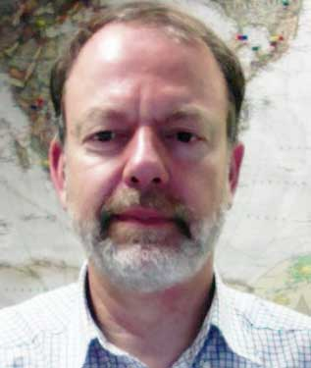
What’s Your Avatar?

Slide 29
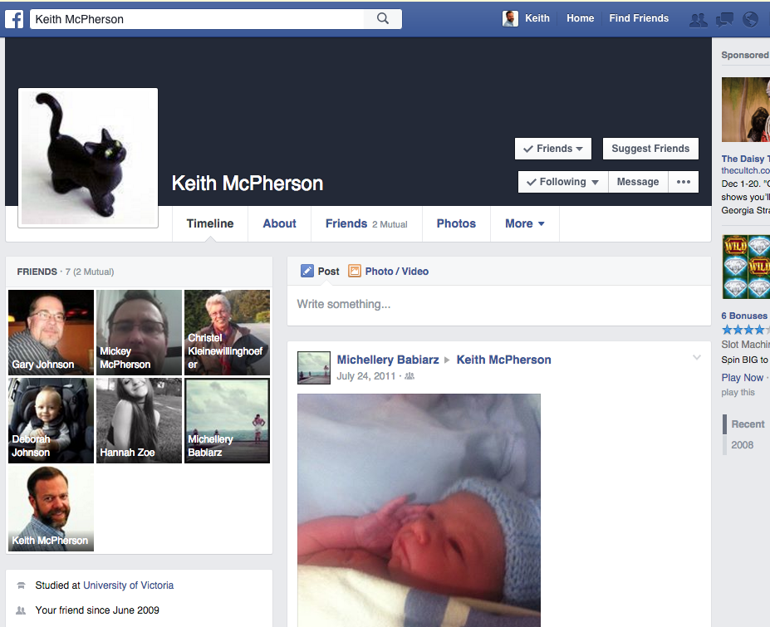
What does this avatar say about me?
1) Animal Lover & environmentalist
2) I love Lego and playing board games
3) I am independent but love being around others

Slide 30
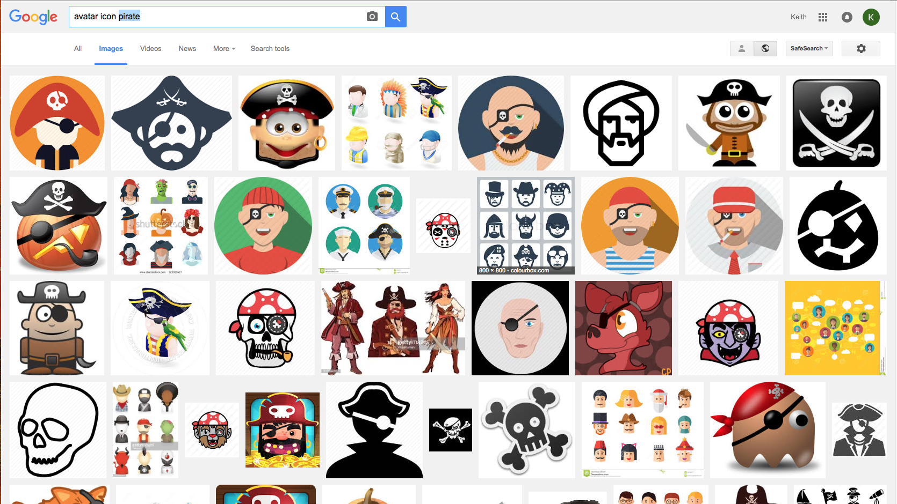
How to find an avatar

Slide 31
Activity: What’s Your Avatar?
What does your avatar say about you?
In groups of five (2 min),
Draw or select an avatar that represents you (10 min)
Tell group what your avatar says about you (15 min)
Each group shares out one persons avatar and 1 thing it says about the person (15 min)
drawing
photo
icon

Slide 32
Foundations of Education in BC
People communicate differently
and with different ‘languages’
Verbal
Non-Verbal
Writing
Drawing
Dancing
Singing
Many others…
& combinations of these
Notes:
Previous activity demonstrated the importance of visual literacy – comic books, graphic novels online advertising all sophisticated ways of communicting . Also muluplways fo knowing, means the curriculum is very individualized

Slide 33
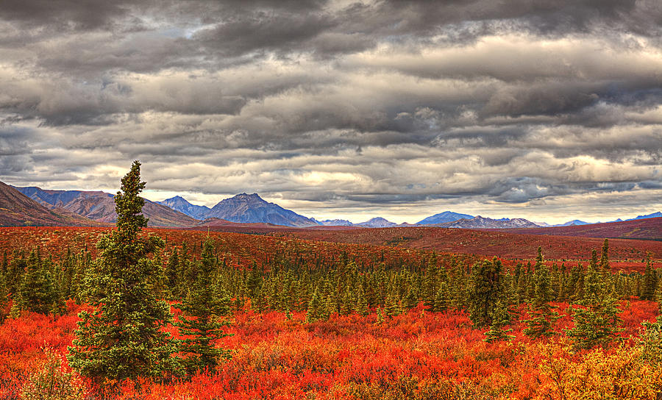
Where in Canada?

Slide 34
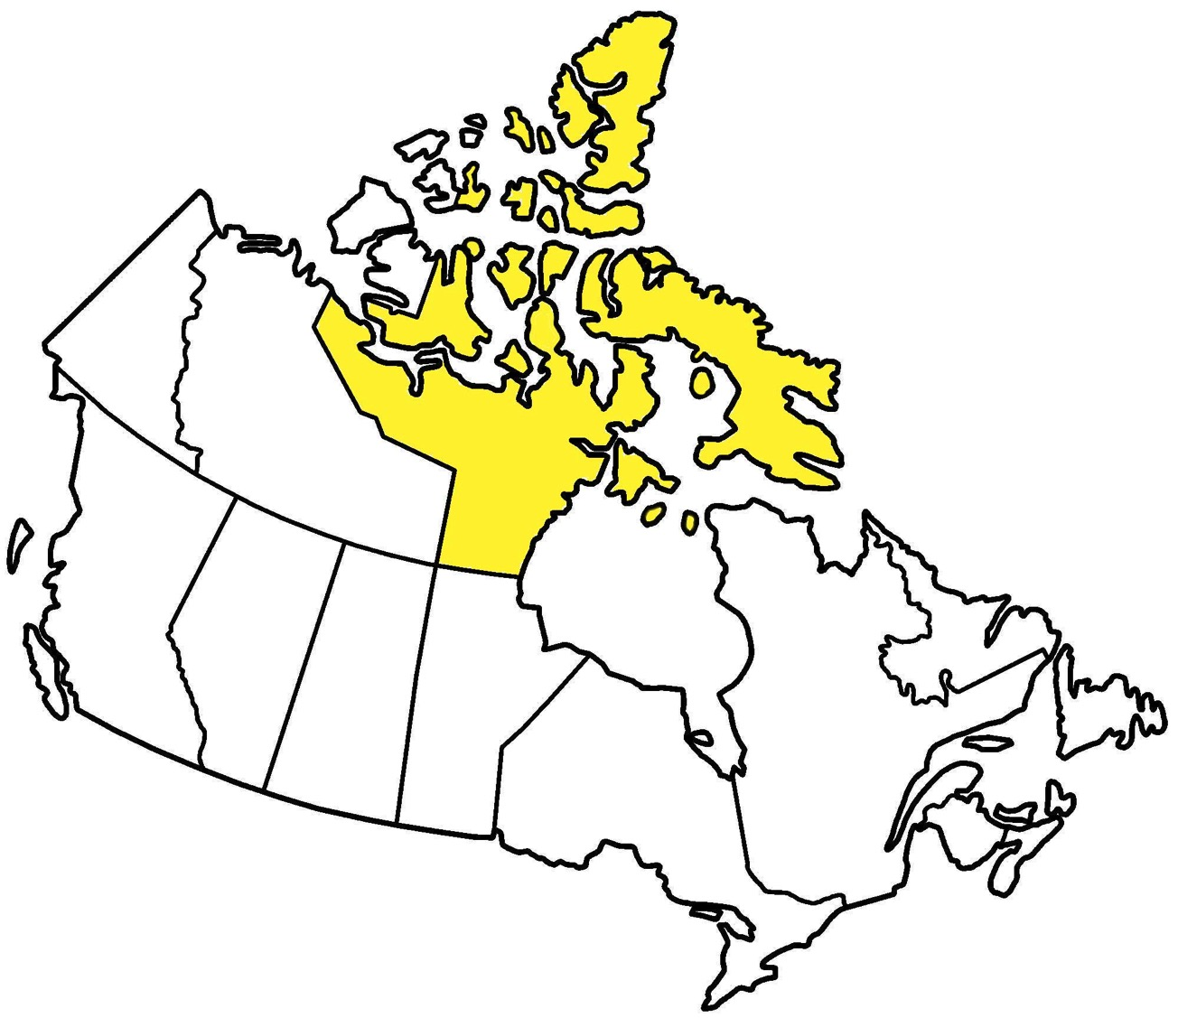
Nunavut

Slide 35
Critical Visual Literacy

Slide 36
Greg Apodaca’ Digital Portfolio
http://www.gregapodaca.com/resources/-portfolio/-prepress/

Slide 37
What do these touch ups say about what we value or see as being important?
before
after

Slide 38
Which one is real?
http://www.dhmo.org
http://zapatopi.net/treeoctopus/
http://www.rythospital.com
http://www.hetracil.com
http://www.clowndating.com
http://whitehouse.org

Slide 39
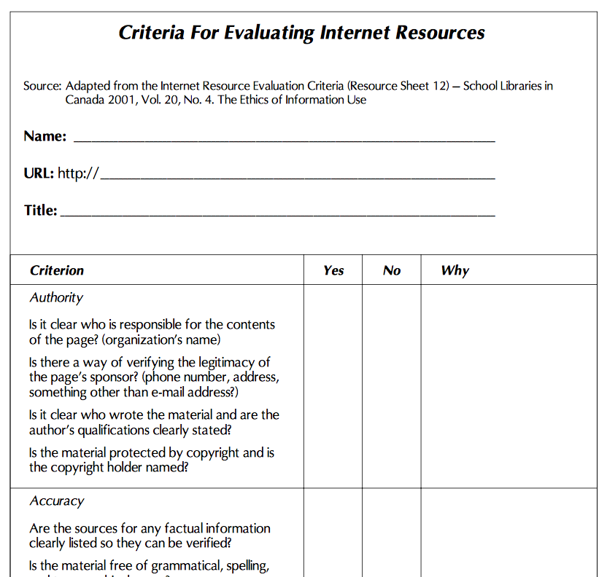
Tool for evaluating online websites
https://www.pembrokepublishers.com/data/ff/Online%20Critical%20Literacy.pdf

Slide 40
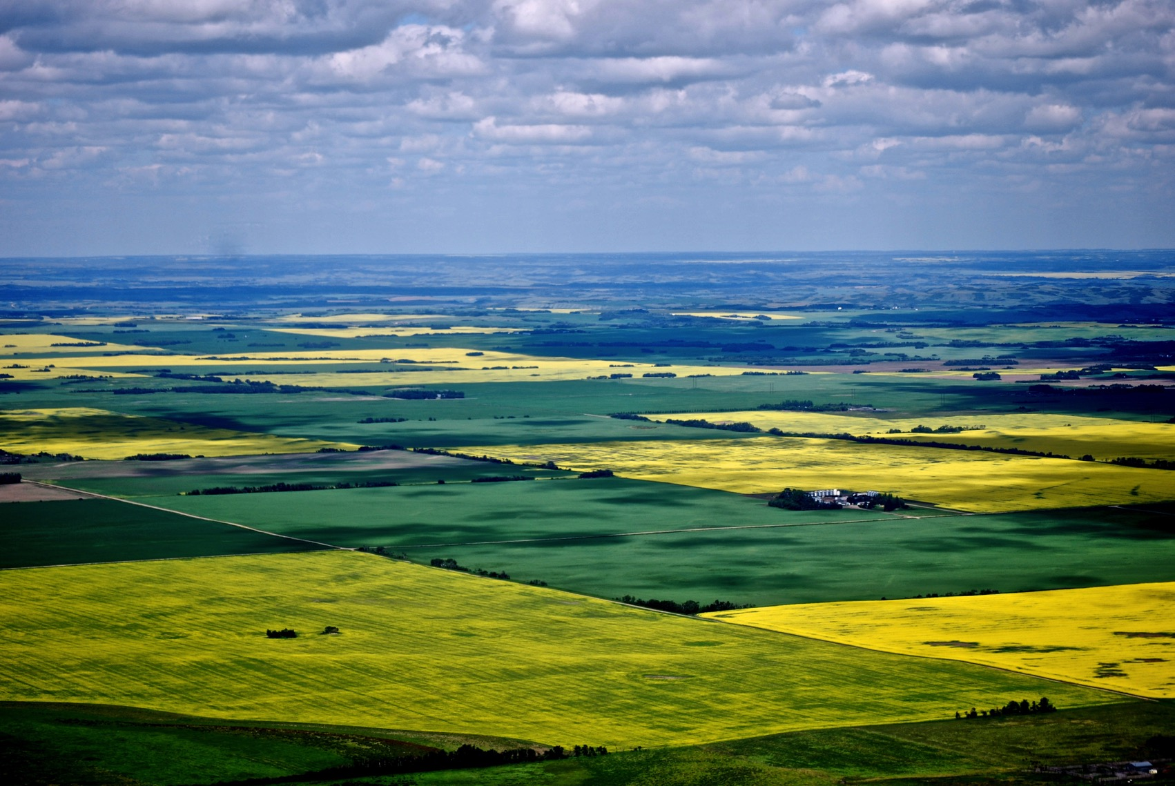
Where in Canada?
Notes:
Saskatchewan

Slide 41
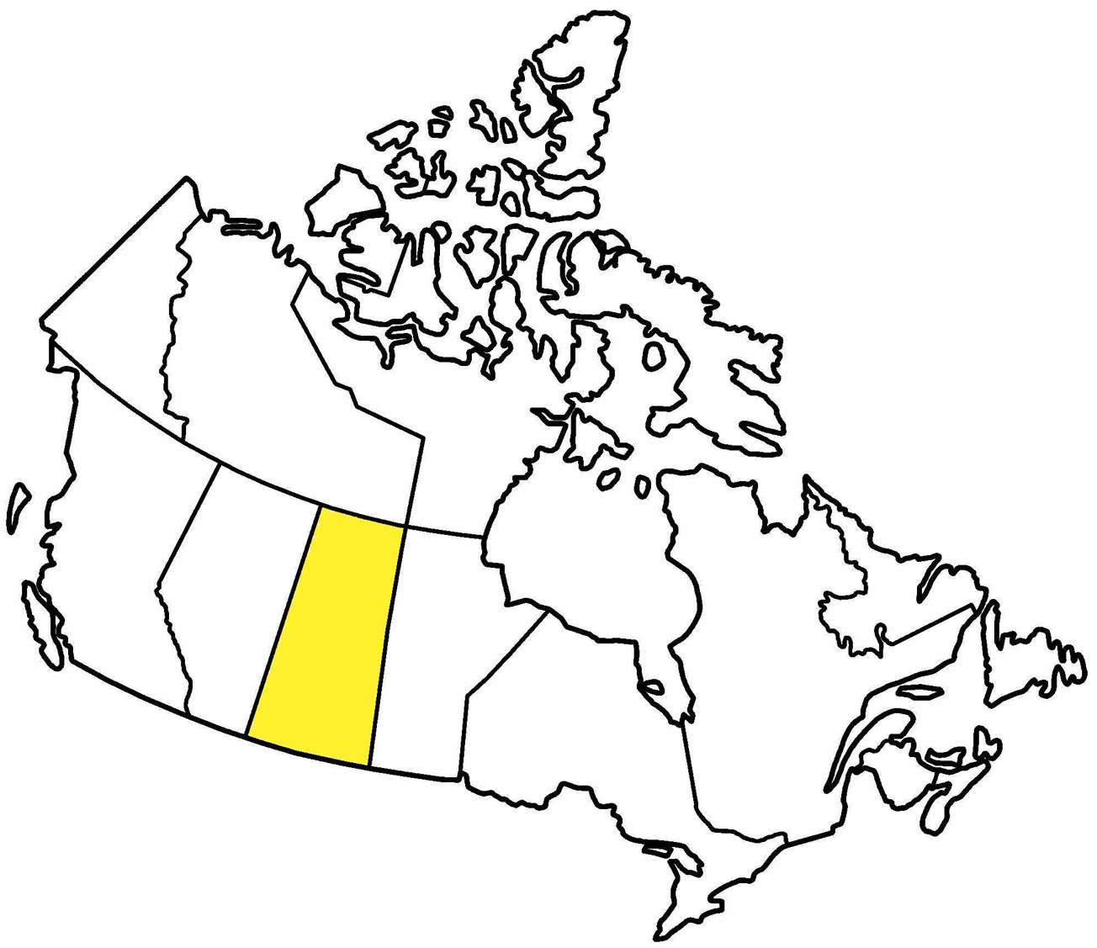
Saskatchewan

Slide 42
Foundations of Education in BC
Critical visual literacy
Question assumptions
Be open to other viewpoints
What are the motives?
Move beyond opinion
Move beyond yes/no

Slide 43
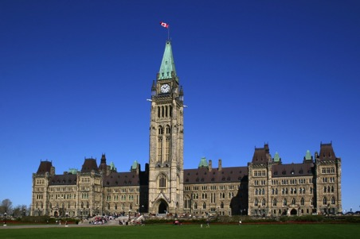
Break
Where in Canada?
Notes:
http://blog.caasco.com/wp-content/uploads/2013/06/Killarney-Provincial-Park-Ontario.jpg

Slide 44
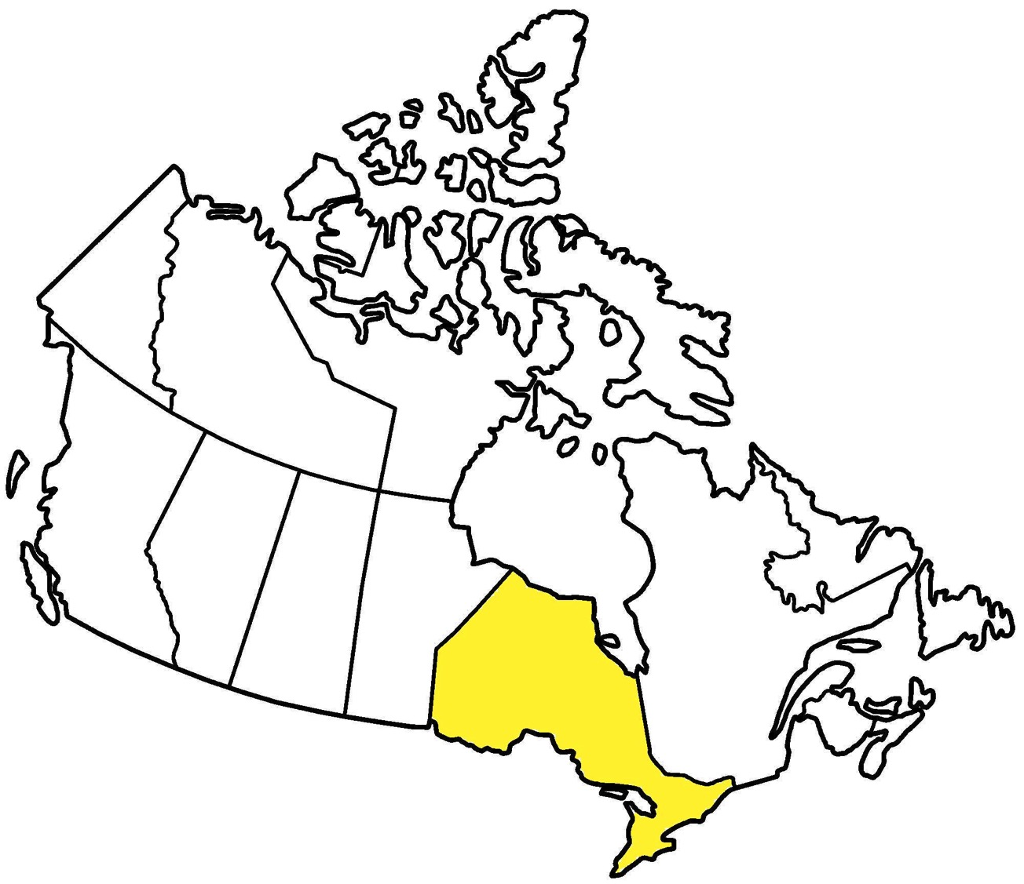
Ontario

Slide 45
Cooperative Games
“Competitive games sometimes result in poor self-esteem for students who are on the losing end and not all students have the competitive edge needed in order to win.
Co-operative games are [where] all students will benefit since no one is left out and the focus is on the success of the team as a whole”.
Loriana Romano, Lisa Papa, and Elita Saulle
http://www.teachhub.com/6-awesome-cooperative-classroom-games

Slide 46
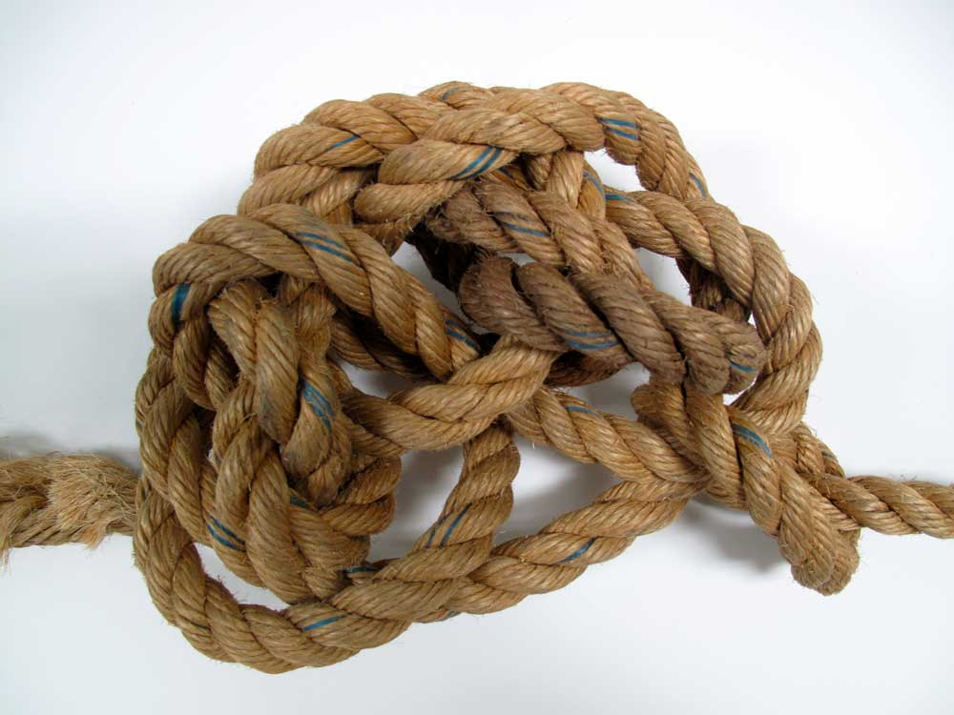
Human Knots
Get into groups of 6-8 people.
Form a large circle
Standing within the circle, cross arms at the wrist.
Next, grasp hands with 2 different people across from them.
Work together to try and untangle the knot without letting go of any hands.

Slide 47
Balloon Balance
stand in a circle of 5-8 people, holding hands with balloon in middle.
Without releasing hands pick up balloon and bounce it.
You may tap the balloon with hands, arms, heads, shoulders, chests, or knees—but NO feet, keeping it up in the air, without losing connection (all students must continue holding hands)
How many times can you bounce it?
Can you bounce it from one end of the room to the other?

Slide 48
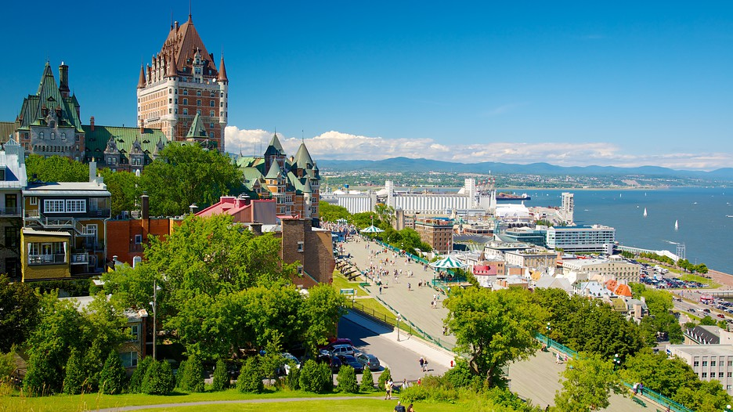
Where in Canada?
Notes:
https://images.trvl-media.com/media/content/shared/images/travelguides/destination/180017/Quebec-City-48987.jpg

Slide 49
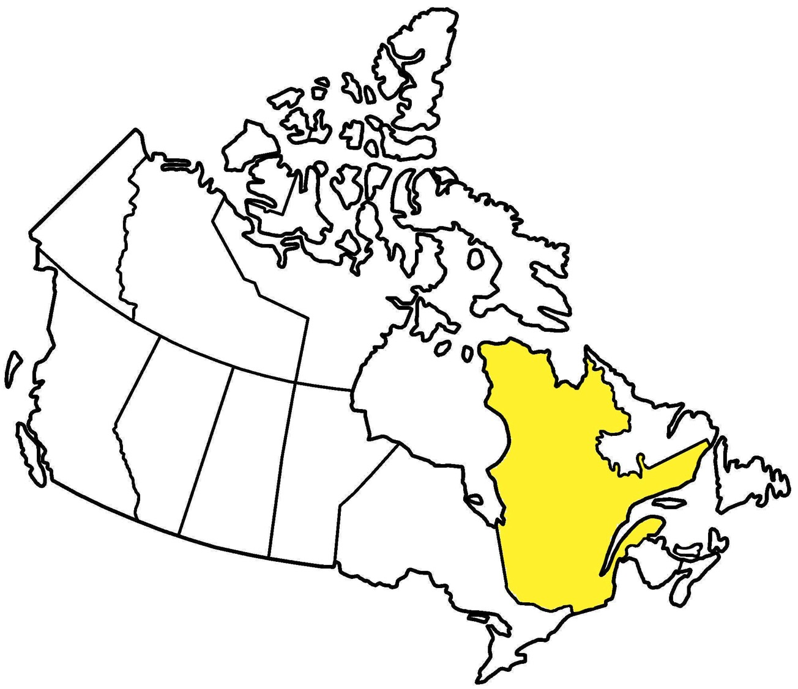
Quebec

Slide 50
Paper Puzzle
Each member of a group-of-four is given four pieces.
The aim is for the group is to start with the square filled like so.

Slide 51
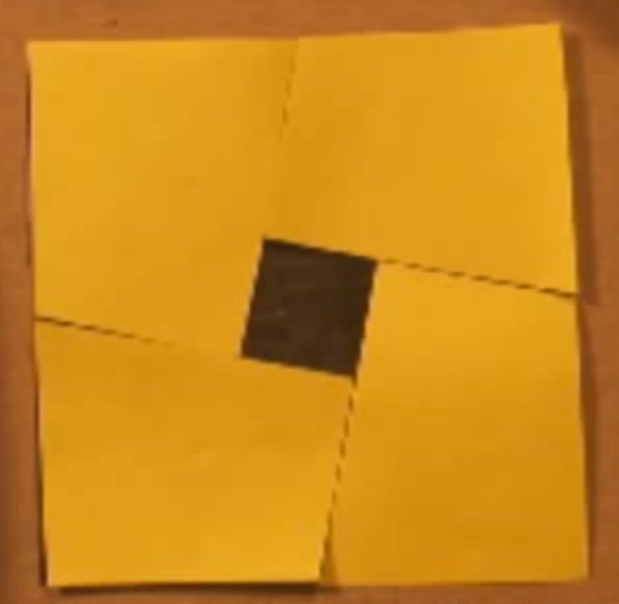

Slide 52
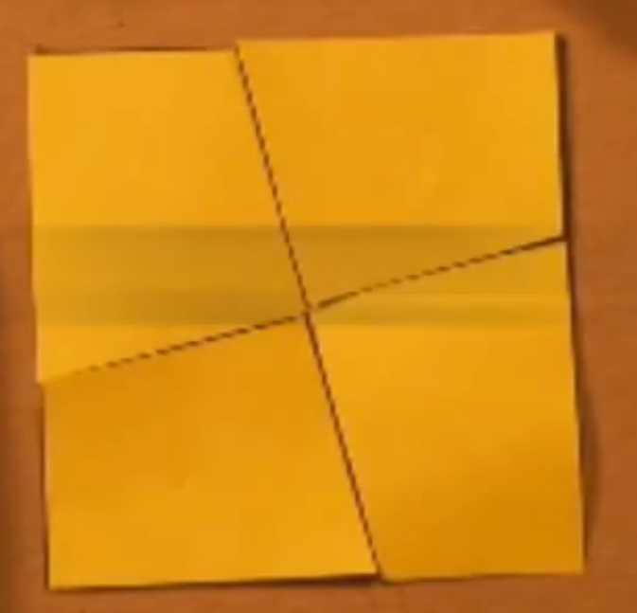

Slide 53
Other examples of collaborative and cooperative learning
Collaborative writing using blogs
Solving math problems as teams
Partnering with local shelter to feed locals
Debates/discussions on current topics

Slide 54
Foundations of Education in BC
Personal & Social competencies
Understand oneself
Take care of oneself and others
Develop skills to work with others
Develop an awareness of global web of life
Be responsible for your actions, and be knowledgeable and active in local-global issues
Notes:
Personal and social competency encompasses the abilities students need to thrive as individuals, to understand and care about themselves and others, and to find and achieve their purposes in the world.

Slide 55
Foundations of Education in BC
Notes:
Personal and social competency encompasses the abilities students need to thrive as individuals, to understand and care about themselves and others, and to find and achieve their purposes in the world.

Slide 56
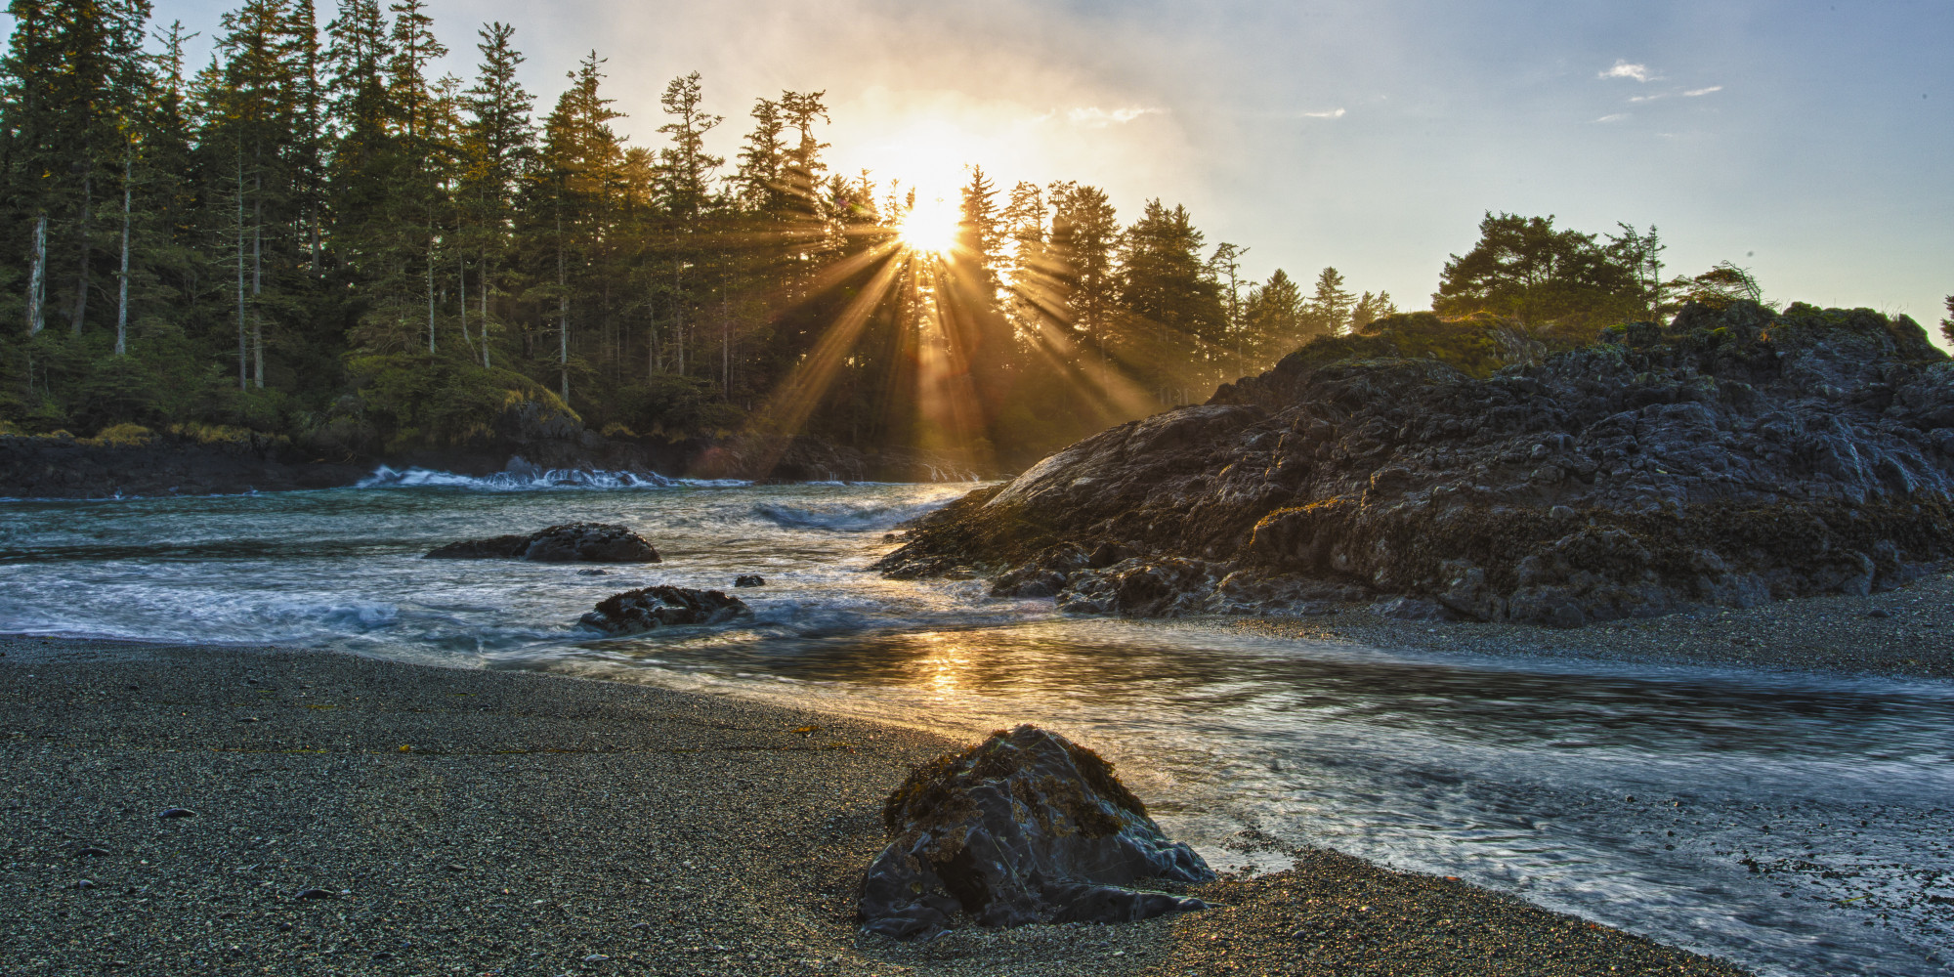
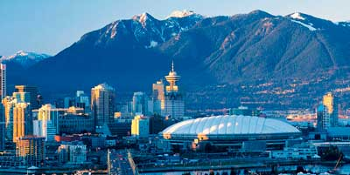
Where in Canada?
Notes:
https://images.trvl-media.com/media/content/shared/images/travelguides/destination/180017/Quebec-City-48987.jpg

Slide 57
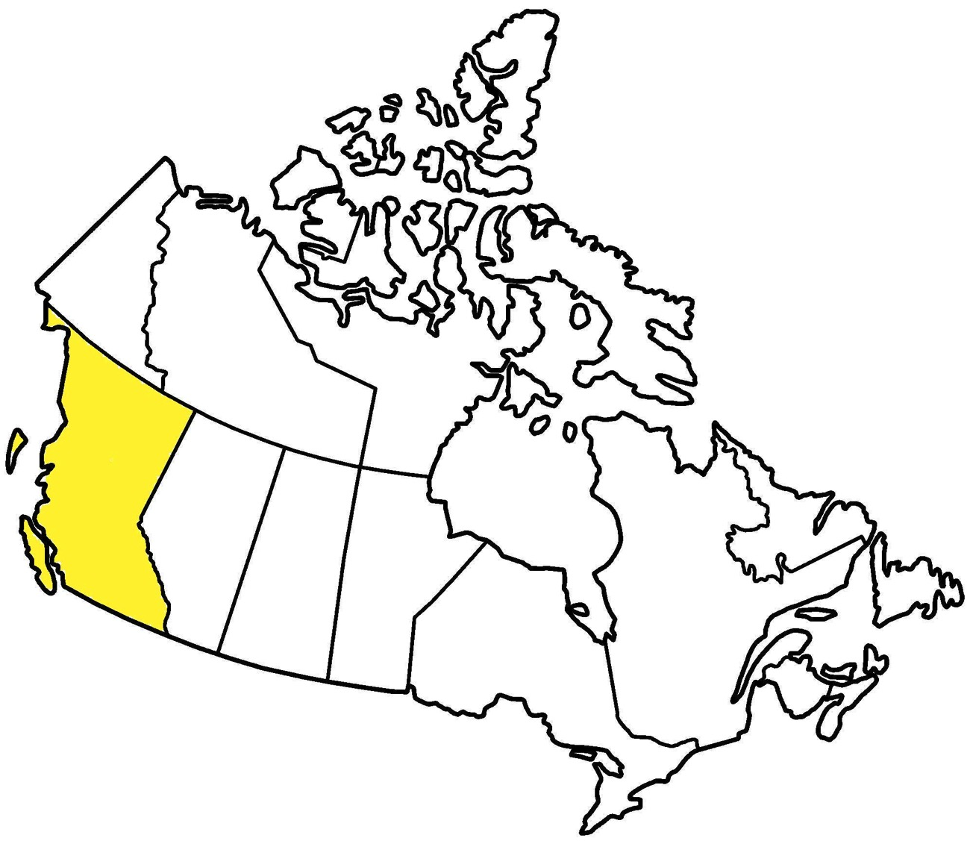
British Columbia

Slide 58
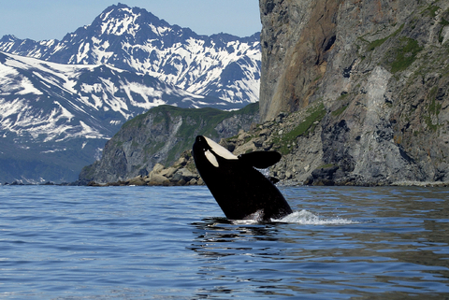
Enjoy your time in Vancouver!

