Slide 1
UBC’s International Community Field Experience EDUC 430
September 2016
Keith McPherson
Program Coordinator, CFE International
UBC Faculty of Education

Slide 2
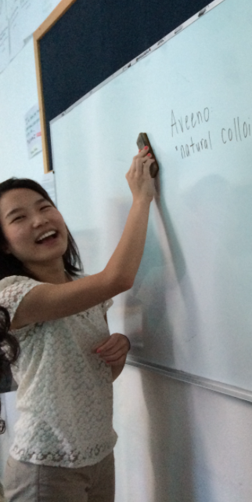
Goals of Presentation
What is an international CFE?
Why an international CFE?
Where can I do an international CFE?
How do I register for my international CFE?
How am I assigned an
international CFE?
Costs and funding?
UBC TC in Querétaro, Mexico

Slide 3
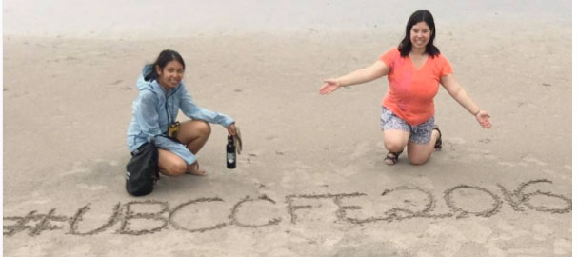
What is an International
Community Field Experience (CFE)?
3 week field experience in a country outside of Canada’s borders
Brasalito,
Costa
Rica

Slide 4
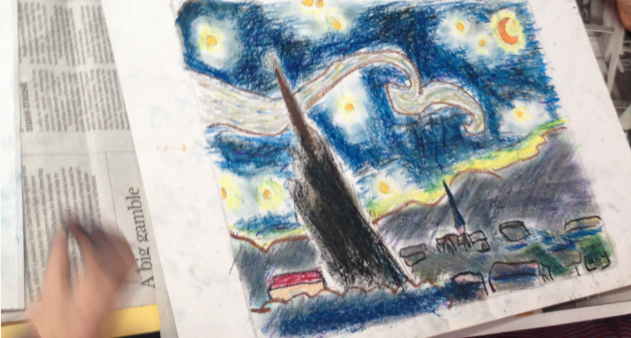
Why an International CFE?
“This [international CFE] has had a huge impact on how I view early childhood education. I will definitely use this new-found knowledge in my teaching practice in the future.”
Stephanie Sammartino, Zurich CFE
Student’s Art Work
Sha Tin Elementary
Hong Kong
Notes:
The CFE is guided by research and based on beliefs that teacher candidates, community partners and students all benefit.

Slide 5
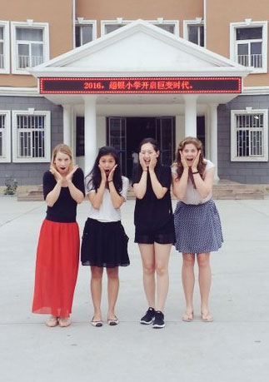
Where can I do an International CFE?
Practically anywhere where Canadians are welcomed and are safe, and where you have an opportunity to observe teaching and learning in local schools or community contexts
Qingdao, China
Notes:
The CFE is guided by research and based on beliefs that teacher candidates, community partners and students all benefit.

Slide 6
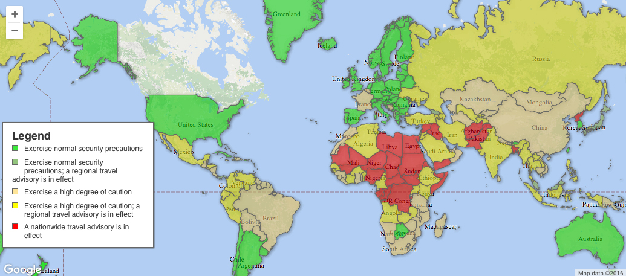
Sep 16, 2016 Government of Canada Travel Advisories
https://travel.gc.ca/travelling/advisories
Notes:
Anything in Red, Is not safe you can not go. Gov of Canada (Government Electronic Directory Services (GEDS)) will not come and get you.
Green normal travel caution.
Yellowshihg or extreme cuation and travel plans must be approved by Go Global/Isl or set up by Go Global or Isl
Go Global

Slide 7
Two placement options
Notes:
Manila Philipines

Slide 8
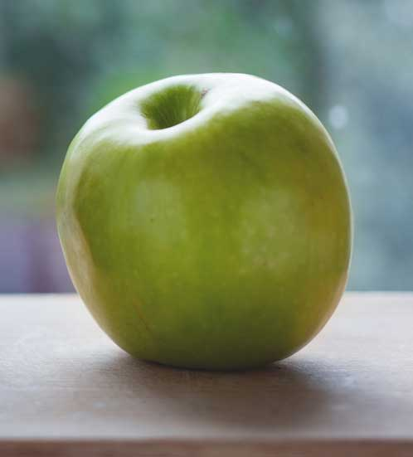
We place you (~80 placements)
Hong Kong
Zurich
Freiburg Strasbourg Mexico
Uganda
London
Tokyo
Uttarakhand, India
Taipie, Taiwan
Qingdao, China
Chongqing, China
Costa Rica
Ethiopia
Notes:
Manila Philipines

Slide 9
2) Self-Placement (20 Elem + 20 Sec)
Athens, Greece
Coimbatore, India
Hamburg, Germany
Kalambaka, Greece
Maui, Hawaii
Kula, Hawaii
Melbourne, Australia
Nijmegan, Netherlands
Perth, Australia
Berlin, Germany
Dundee, Scotland
Edingburgh , Scotland
Galapagos , Ecudaor
Hartland, United Kingdom
Helsinki, Finland
Hsinchu, Taiwan
San Francisco, USA
Notes:
Manila Philipines

Slide 10
What is the difference?
We Place You
___
We do much of the work
You Place You
___
You do much of the work
Notes:
Manila Philipines

Slide 11
Approximately what will it cost me
to do an international CFE?
Flight
Accommodation
Travel
Food
Total:
$1,000 – $4,000
$500 – $1,500
$200 – $300
$400 – $750
$2100 – $6550
Notes:
Depends on where you go. But on average:
Some locations accomodation is taken care of or

Slide 12
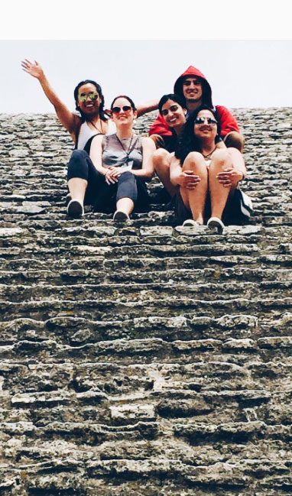
Is there funding available?
Yes!
Cholula Mexico
Notes:
Department of Foreign Affairs, Trade and Development Canada (DFATD)

Slide 13
UBC’s Go Global funds
Go Global & Self Placed
Award
1000.00
Fees
407.00
Total Funds
593.00
Notes:
Regardless

Slide 14
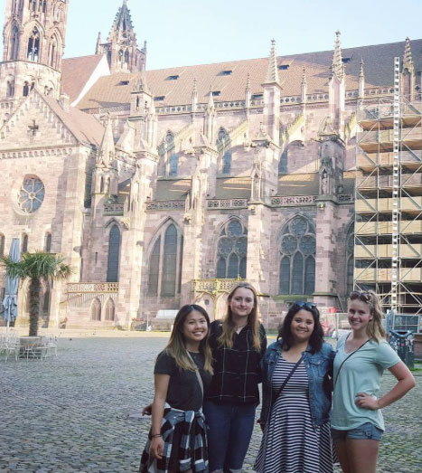
Are there any other cost savings?
There just may be!
Freiburg Germany
Notes:
Department of Foreign Affairs, Trade and Development Canada (DFATD)

Slide 15
Are there any other cost savings?
Location
Airfare
Accommodation
Food
Mexico
0.00
0.00
0.00
Qindao, China
400.00
provided
Breakfast & Lunch provided
Chongqing, China
2500.00
Notes:
Department of Foreign Affairs, Trade and Development Canada (DFATD)

Slide 16
Do I have to find my own accommodation ?
It depends.
Costa Rica – No
London, England - Possibly
Self Placements - Yes

Slide 17
Where do I find more information about costs, accommodation, etc. for UBC-arranged placements?
cfe.educ.ubc.ca

Slide 18
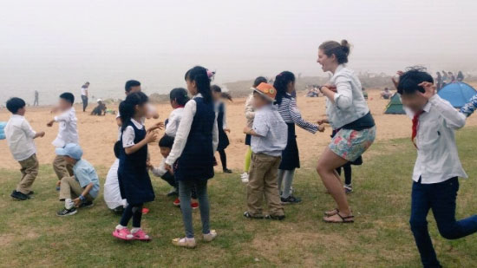
How do I register ?
There are two UBC forms,
and two registries to complete.
Hong Kong
Notes:
You will be told when your CFE is assigned to you.

Slide 19
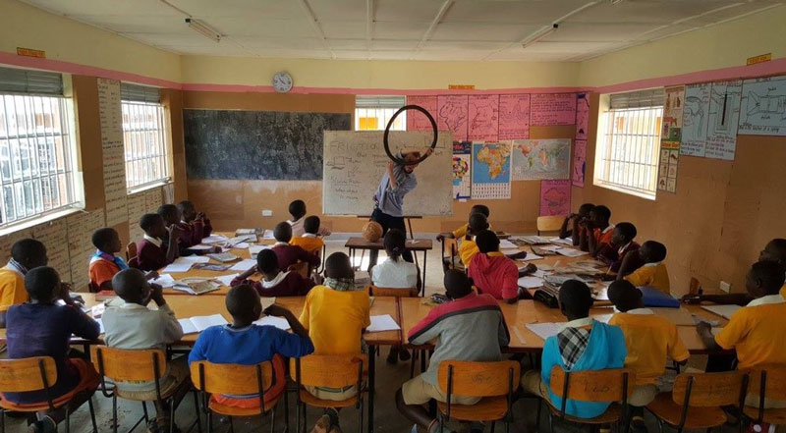
Two Forms
Kampala Uganda
Notes:
You will be told when your CFE is assigned to you.

Slide 20
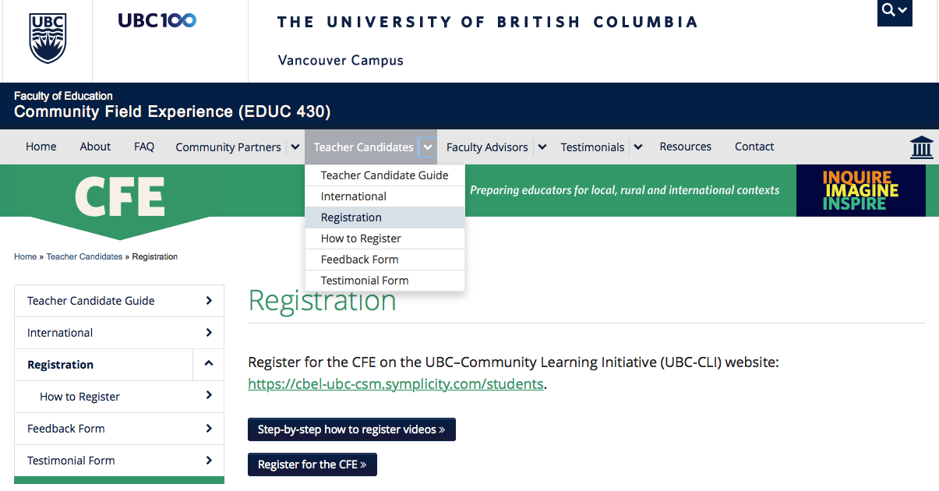
FORM 1: General CFE registration
Notes:
You will be told when your CFE is assigned to you.

Slide 21
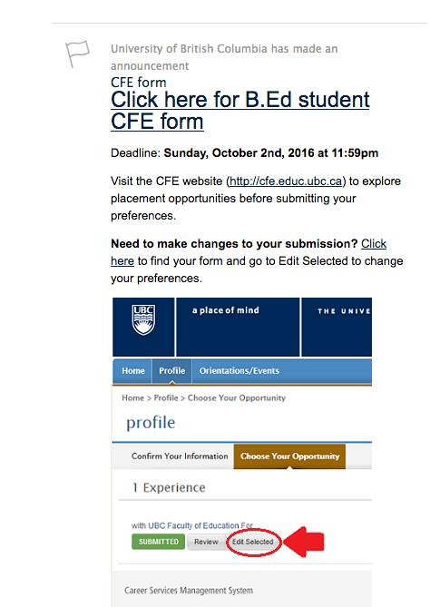
Notes:
You will be told when your CFE is assigned to you.

Slide 22
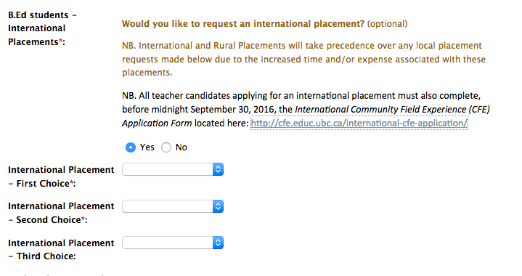
Notes:
You will be told when your CFE is assigned to you.

Slide 23
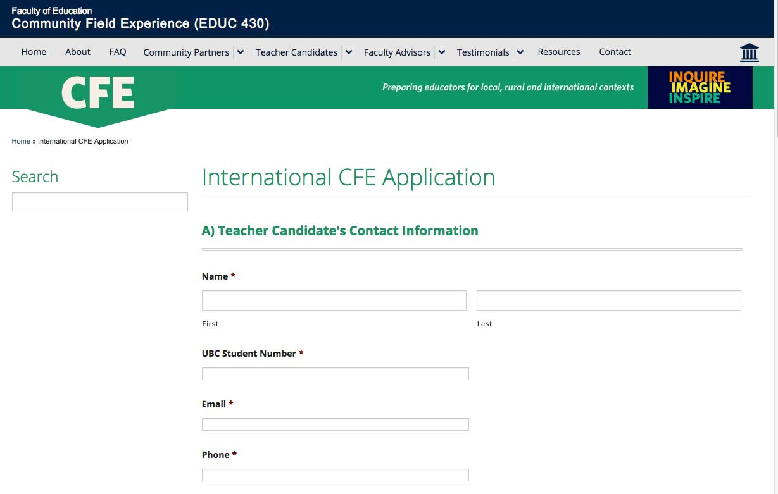
FORM 2: International CFE application

Slide 24
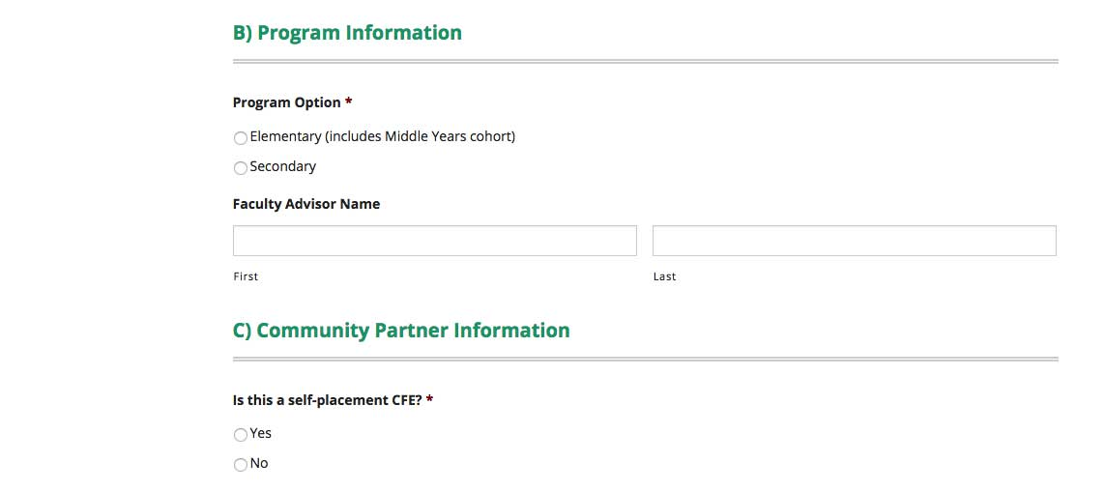

Slide 25
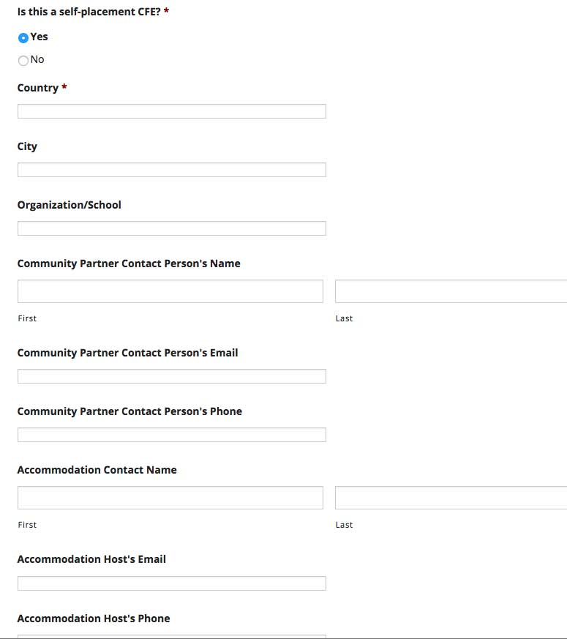
Notes:
If no teacher canddates skip by this section and the essay on to E conditions.

Slide 26
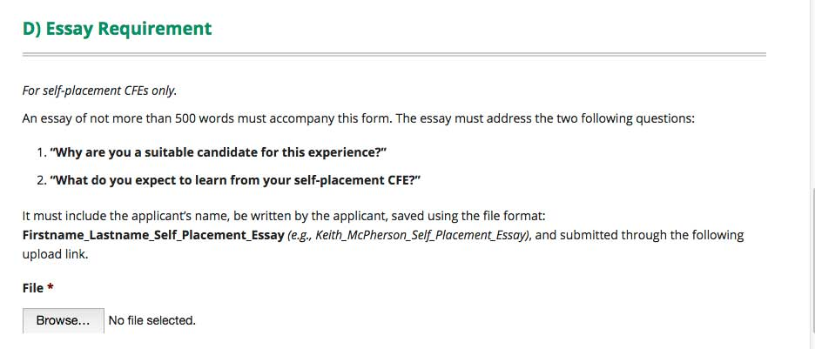

Slide 27
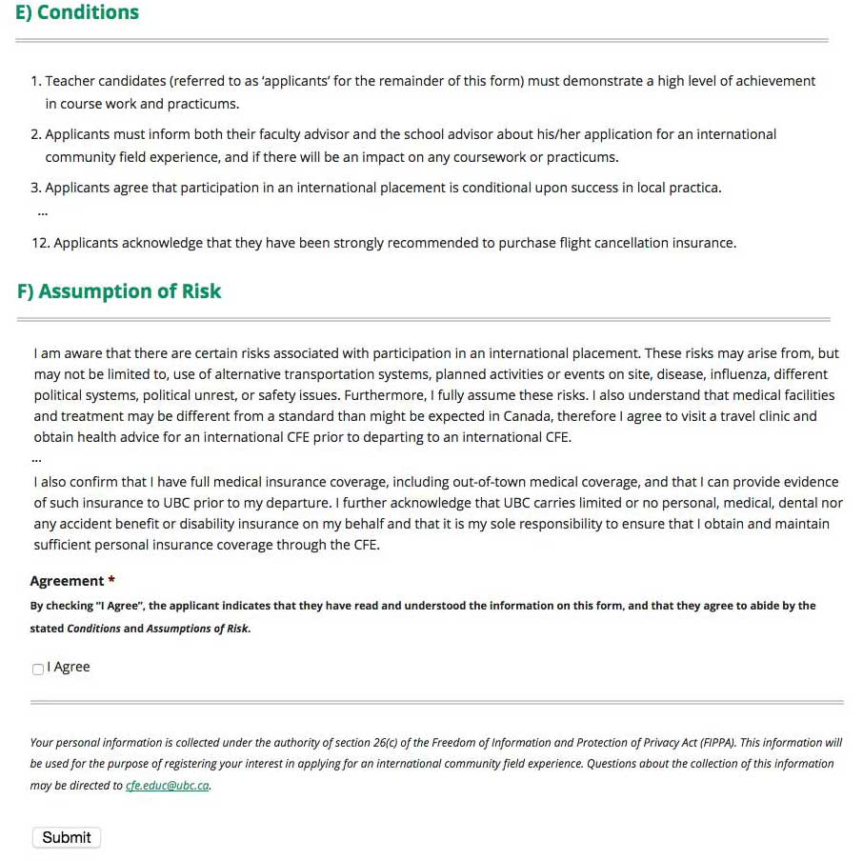

Slide 28
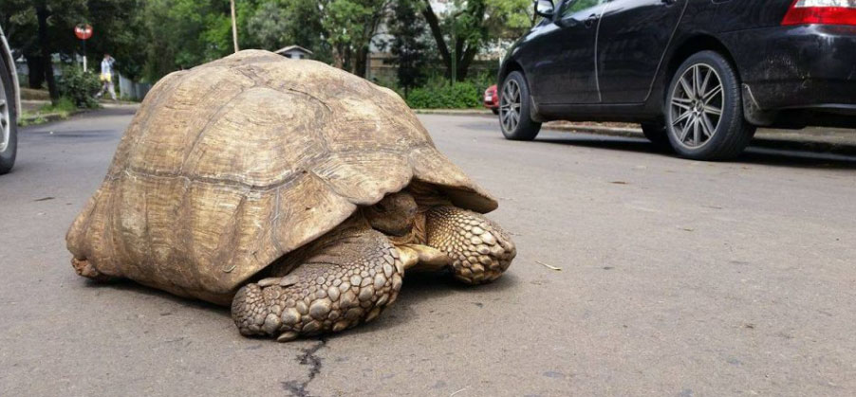
Two Registries
Parking Woes – CFE Addis Ababa, Ethiopia
Notes:
You will be told when your CFE is assigned to you.

Slide 29
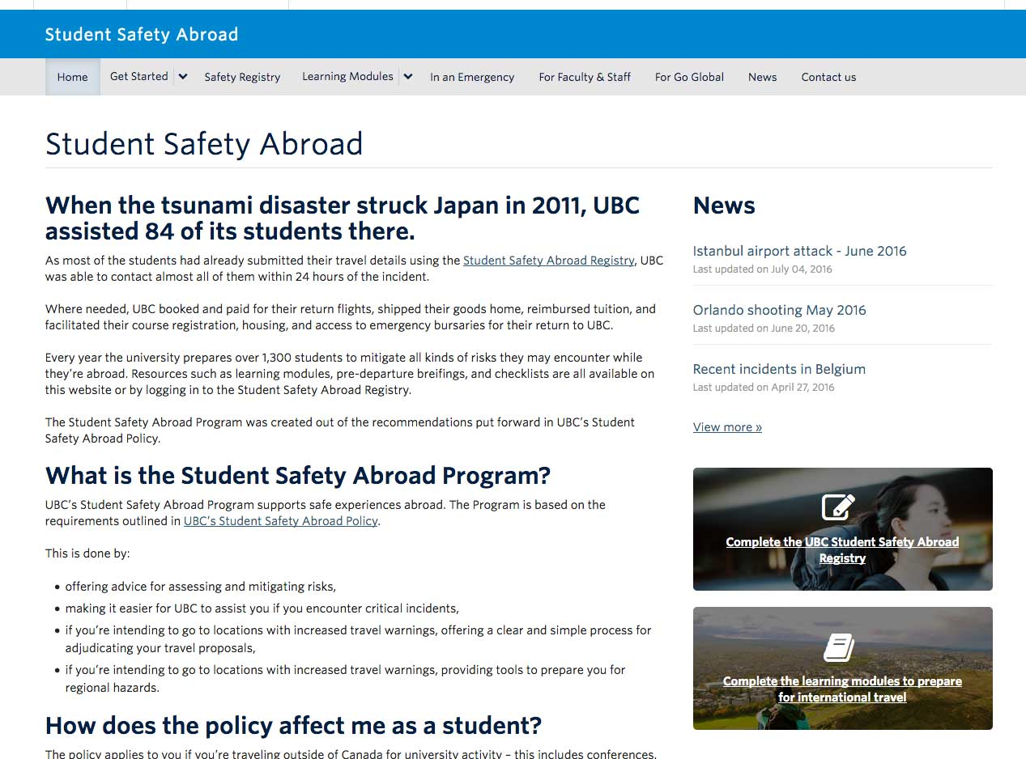
1) Go Global registry
c
c

Slide 30
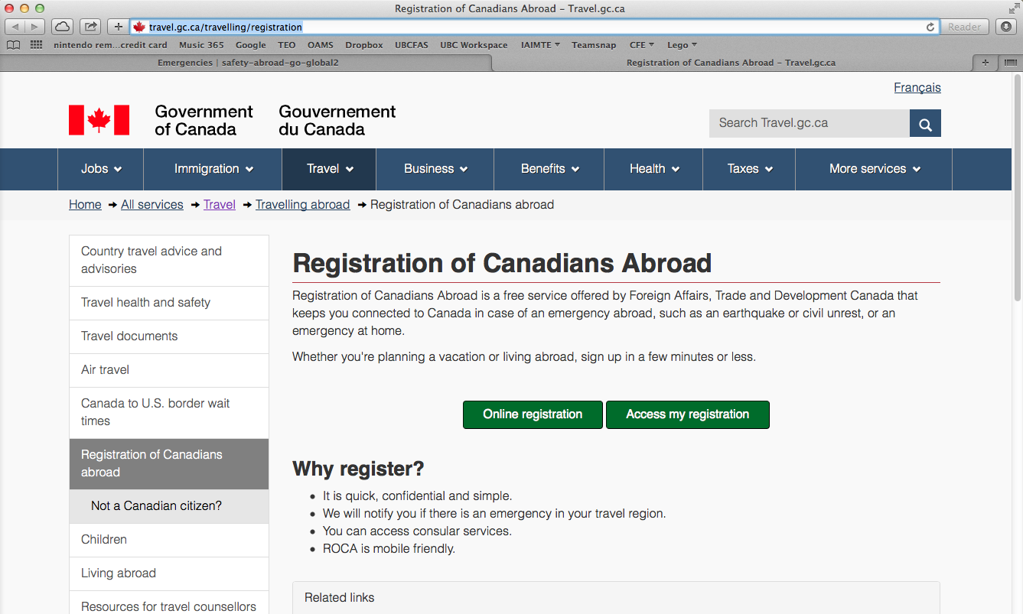
2) Canadians Abroad registry

Slide 31
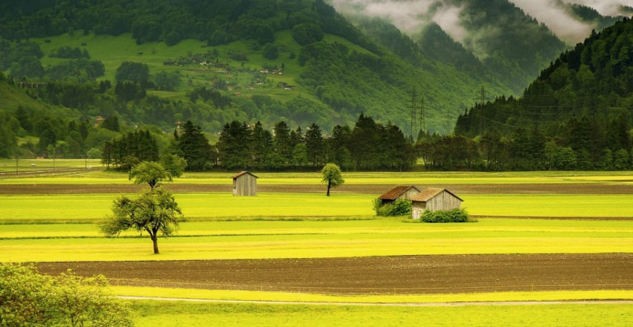
Questions
Zurich, Switzerland
Notes:
The CFE is guided by research and based on beliefs that teacher candidates, community partners and students all benefit.

Slide 32
How are applicants selected for an international placement?
Self placements – 1) Essay matches CFE goals. 2) Random selection
UBC Placements – 1) Partner’s preferences. 2) Random selection.
Notes:
The CFE is guided by research and based on beliefs that teacher candidates, community partners and students all benefit.

Slide 33
When will I find out if I have been selected for an international placement?
~ End of October
Notes:
The CFE is guided by research and based on beliefs that teacher candidates, community partners and students all benefit.

Slide 34
Important Reminder!
There are only 120 international placements.
Last year there were 260 applications.
Therefore, the odds of obtaining a first choice is limited. Moreover, please realize that there is only a 40-50% chance of obtaining any international placement.
Notes:
The CFE is guided by research and based on beliefs that teacher candidates, community partners and students all benefit.

Slide 35
Is there a pre-departure session?
Definitely! This session is mandatory:
Thursday November 24, 2017
5:00 – 7:00 PM
Go Global fee
Meet with students, partners and coordinators
General Q & As.
Notes:
The CFE is guided by research and based on beliefs that teacher candidates, community partners and students all benefit.

Slide 36
If I am selected, when can I buy my plane ticket?
Strong recommendation:
Not until 5th week in your 10 week practicum
Alternately:
Whenever there is a savings that offsets the cost of an UNLIMITED trip cancellation insurance.
Notes:
The CFE is guided by research and based on beliefs that teacher candidates, community partners and students all benefit.

Slide 37
Important Reminder!
Teacher candidates must pass all course and practicum work to move onto their CFE.
Those struggling on their practicum may be required to withdraw from an international CFE.
Notes:
The CFE is guided by research and based on beliefs that teacher candidates, community partners and students all benefit.

Slide 38
Can I leave my practicum early to
attend to my CFE?
NO.
With the one exception of those teacher candidates travelling to
Africa or India.
Notes:
Must get permission from FA and SA

Slide 39
Can elementary teacher candidates adjust their CFE dates?
Only if approved by your partners
and your faculty advisor.
Sadly, secondary TCs do not have a week off after their CFE so they can not adjust their CFE dates…

Slide 40
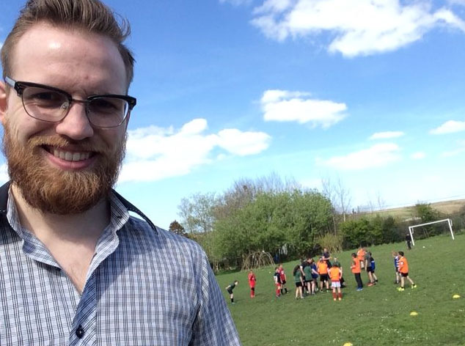
Your Questions?
PE Class
Hartland,
England
Notes:
Keith meets with groups before you go on 10 week practicum

