Slide 1
OER and advocacy on campus
Christina Hendricks
Student Union Development Summit, UBC
August 19, 2018
Except for elements licensed otherwise, these slides are licensed CC BY 4.0

Slide 2
Slides available:
https://is.gd/oer_suds_2018

Slide 3
About me
Professor of Teaching, Philosophy
Academic Director, Centre for Teaching, Learning & Technology
BCcampus Open Textbook Fellow (2014-2015)
OER Research Fellow, Open Education Group (2015-2016)
Open textbook editor: Introduction to Philosophy

Slide 4
About you
?
Where are you from?
What do you know already about OER?
OER logo by Markus Büsges for Wikimedia Deutschland, licensed CC BY-SA 4.0 on Wikimedia Commons

Slide 5
What’s the issue?
Every good solution needs a problem

Slide 6
Cost

Slide 7
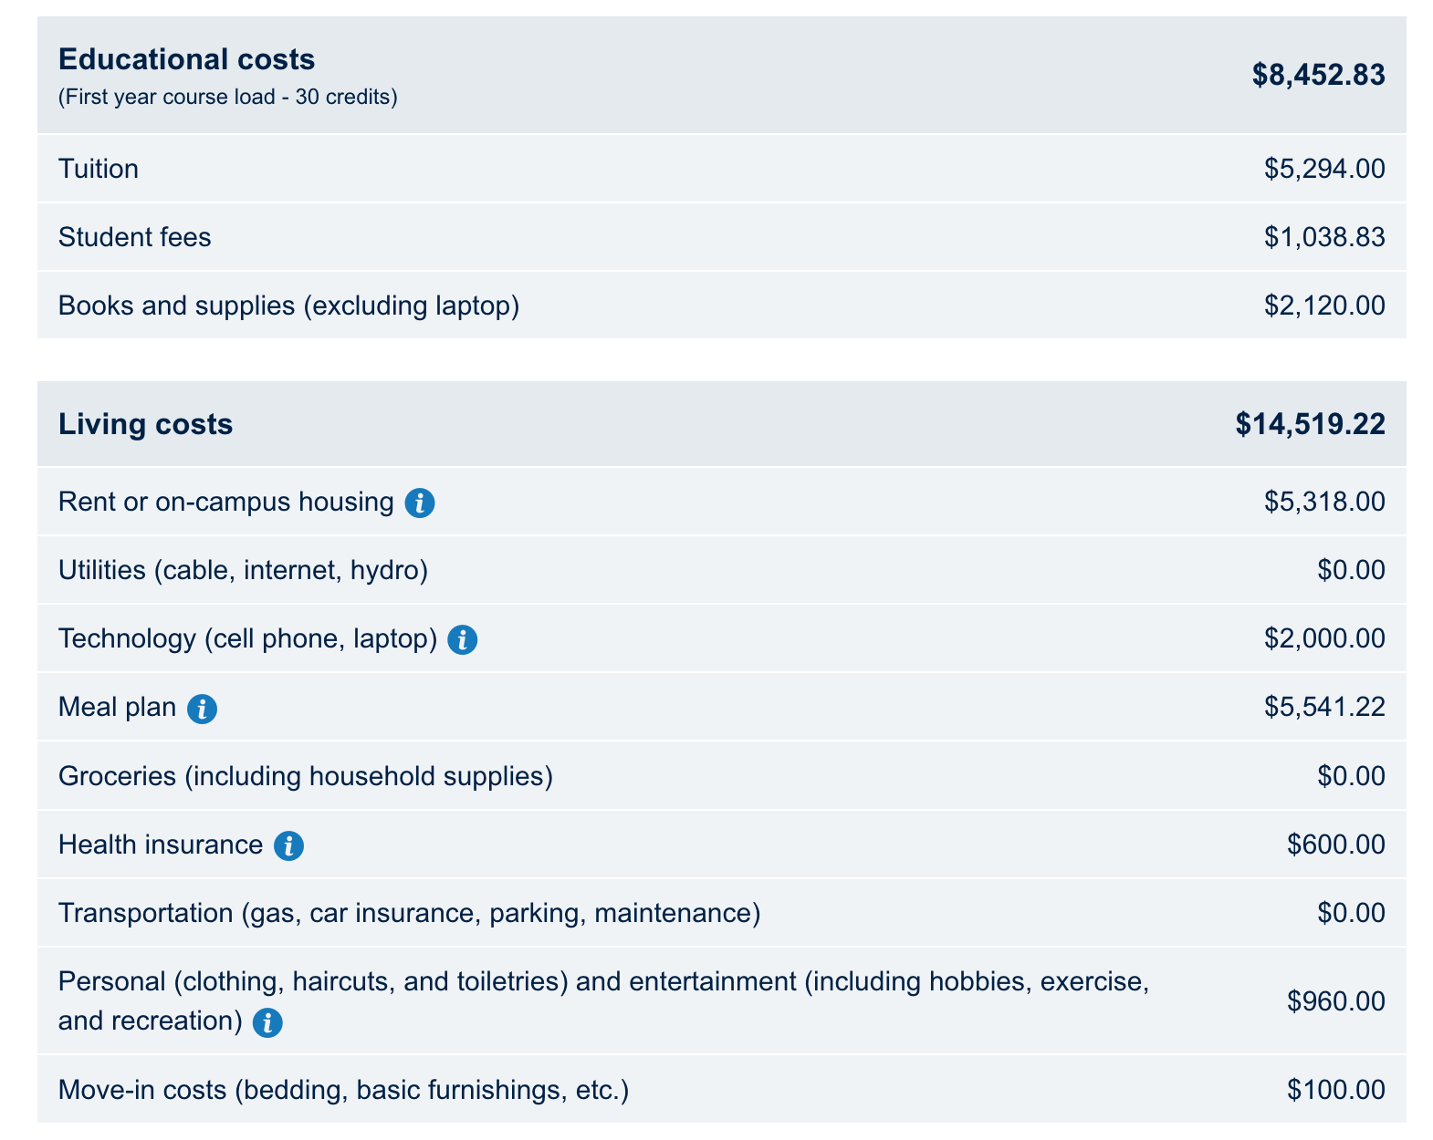
Cost of first year at UBC
From UBC first year cost calculator (Aug 2018)

Slide 8
Many hours of work
$22972.05 at $12.65/hr
(minimum wage in BC)
= 1816 hours
= 35 hours/week

Slide 9
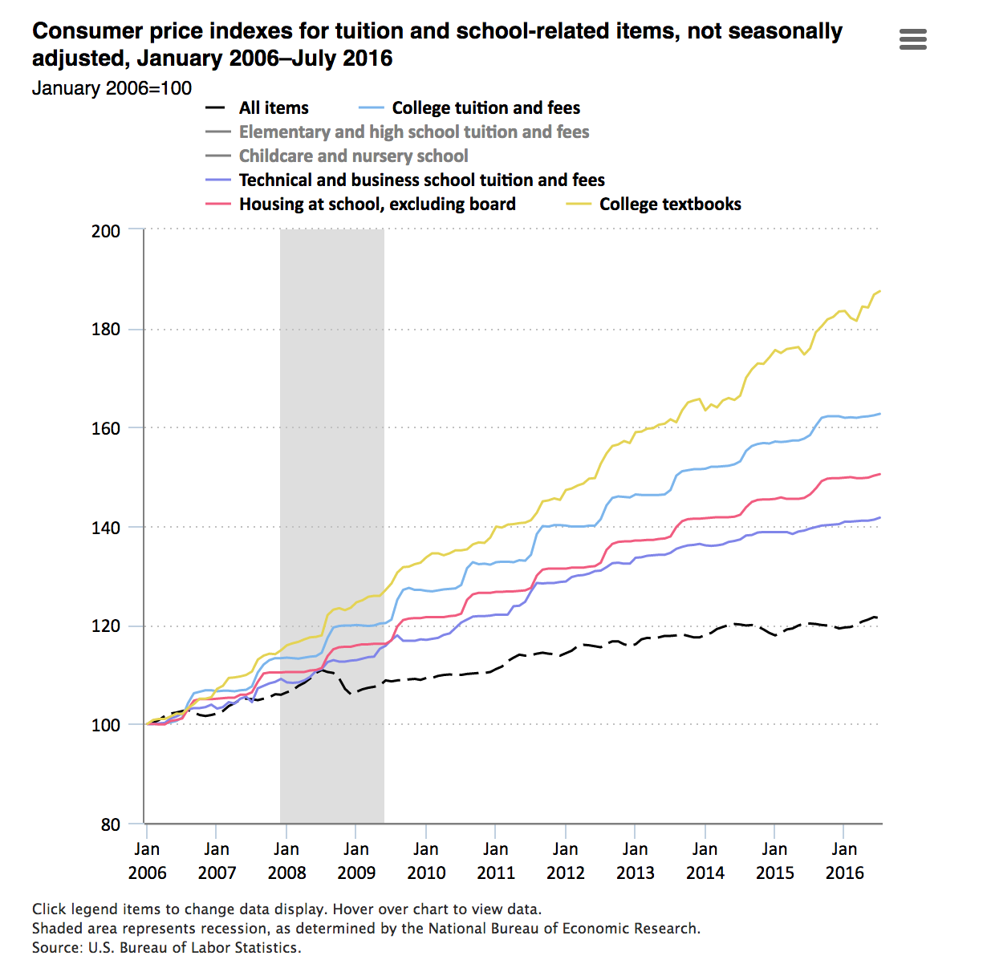
Rising cost of textbooks
Textbook prices
College tuition & fees
Housing at school, excluding board
Source: US Bureau of Labor Statistics

Slide 10
UBC students
66% | Have gone w/o required texts in a course b/c of cost, at least rarely (32% said often or frequently)
44% | Report spending $500 or more per year on textbooks; mean cost per year reported: $760
43% | Report experiencing financial hardship related to tuition & other expenses
38% | Worry about how to pay for books & other course materials
AMS Undergraduate Experience Survey 2018 results. Numbers above are from responses by over 2200 undergraduates.
Notes:
AMS Academic Experience Survey 2018 results: https://www.dropbox.com/s/a8vu7budsmef74s/AES%20Report%202018.pdf?dl=0
3023 n, full time and part time, undergrad and grad
Over 2200 undergrads in sample reporting the following:
43% report experiencing financial hardship related to tuition & other expenses
44% report spending $500 or more per year on textbooks; mean spend per year is $760
44% report replying on part-time employment for finances to support them
38% report worrying about how to pay for books & other course materials (down from 43% last year, and 44% 2016)
16% report might need to abandon studies at UBC for financial reasons
66% they have gone without a textbook in course due to cost (from rarely 14%, to sometimes 22%, to often 15%, to frequently 17%); 54% at least sometimes; 32% often or frequently.

Slide 11
BC post-secondary
students
54% | Didn’t purchase a required textbook at least once in past 12 months
27% | Took fewer courses b/c of cost of materials: rarely, sometimes, often or very often
26% | Didn’t take a particular course b/c of cost of materials: rarely, sometimes, often or very often
Jhangiani, R. S., & Jhangiani, S. (2017). Investigating the Perceptions, Use, and Impact of Open Textbooks: A survey of Post-Secondary Students in British Columbia. The International Review of Research in Open and Distributed Learning, 18(4). http://www.irrodl.org/index.php/irrodl/article/view/3012
Notes:
“The present study involves a survey of 320 post-secondary students in British Columbia enrolled in courses using an open textbook during the Spring 2015, Summer 2015, and Fall 2015 semesters.”
“The final sample consisted of 320 undergraduate students2 enrolled in 19 courses at 12 B.C. post- secondary institutions that had adopted an open textbook.”
“When asked about how the cost of textbooks had influenced their course enrolment and persistence, 27% of respondents indicated that they had taken fewer courses, 26% had not registered for a course, and 17% reported dropping or withdrawing from a course, all at least once. Although in every case the sum of those who reported these outcomes "often" and "very often" amounted to less than 5% (see Table 1), those who reported working more hours per week were more likely to drop or withdraw from a course due to the cost of textbooks [r(251) = .13, p = .04].
Thirty percent of respondents reported earning a poorer grade in a course because of textbook costs. These individuals were more likely to self-identify as a member of a visible minority group [r_{pb}(252) = .14, p = .03], hold a student loan [r_{pb}(305) = .14, p = .02], and be working more hours per week [r(253) = .15, p = .02].”

Slide 12
What other issues are there with course materials?
Notes:
E.g.,
Buy textbooks and then hardly use them (if at all)not (all) used
updated editions: have to buy an entirely new book
bundled texts and digital resources
The people who make the choices (faculty) aren’t the ones who have to buy the books, so there isn’t as much of an incentive to keep costs low; students have to buy to take a course

Slide 13
What about digital books?
Notes:
E.g.,
Buy textbooks and then hardly use them (if at all)not (all) used
updated editions: have to buy an entirely new book
bundled texts and digital resources

Slide 14
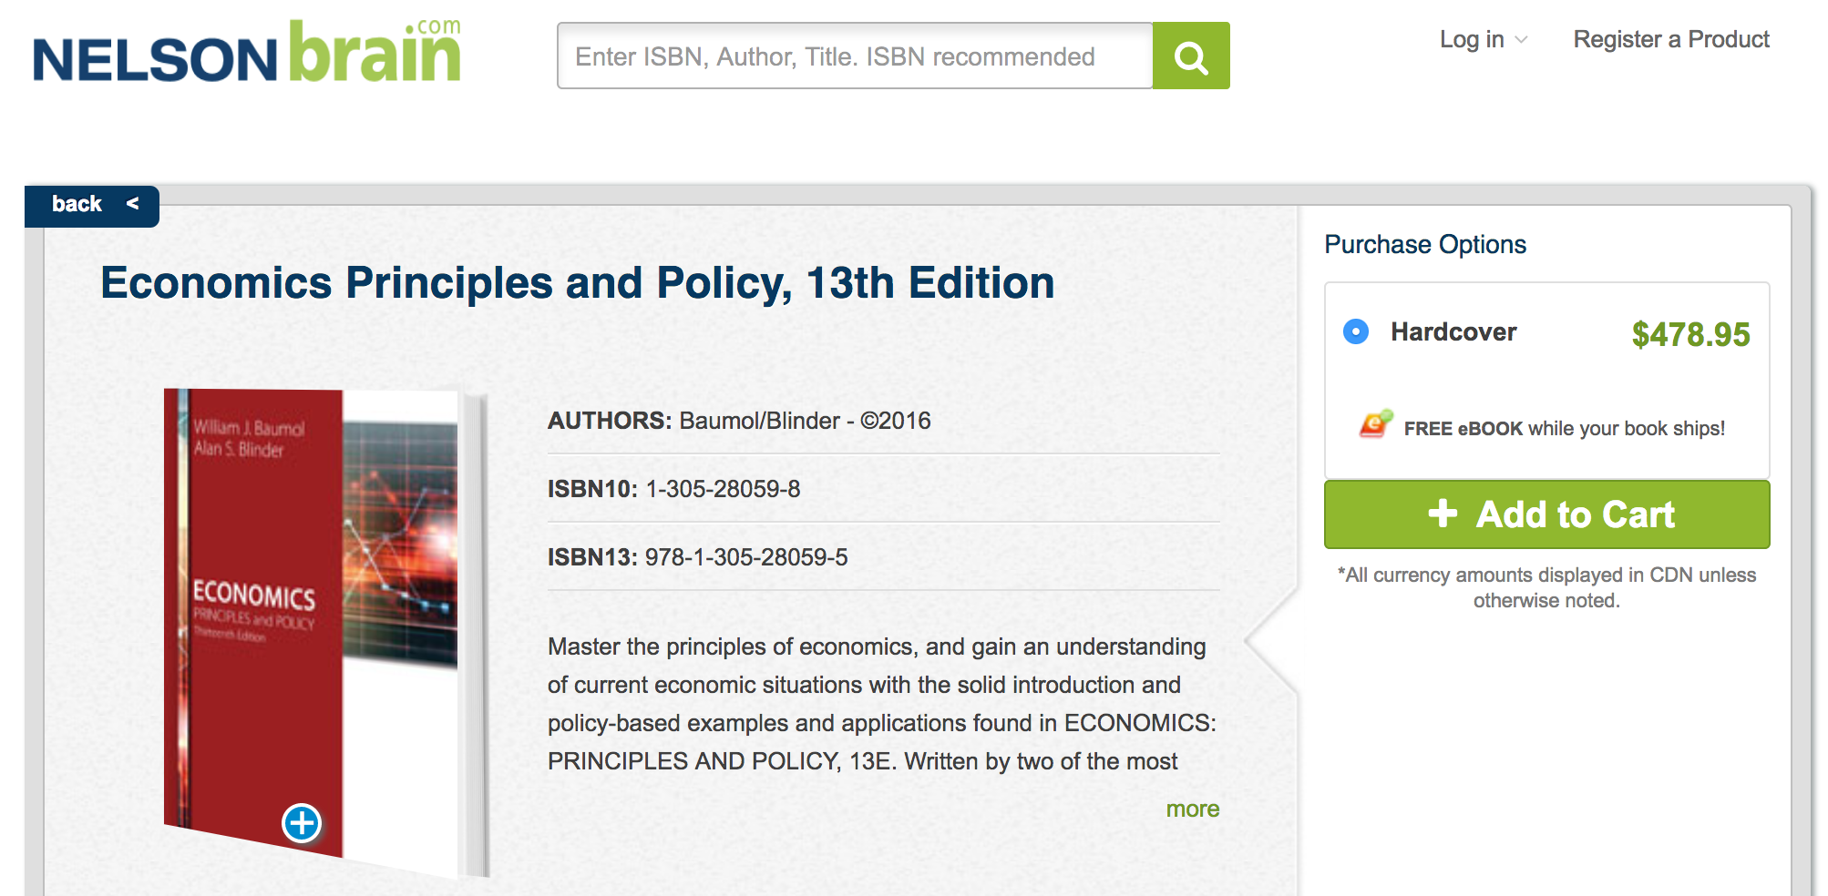
Print book price
From NelsonBrain.com, Aug 2018

Slide 15
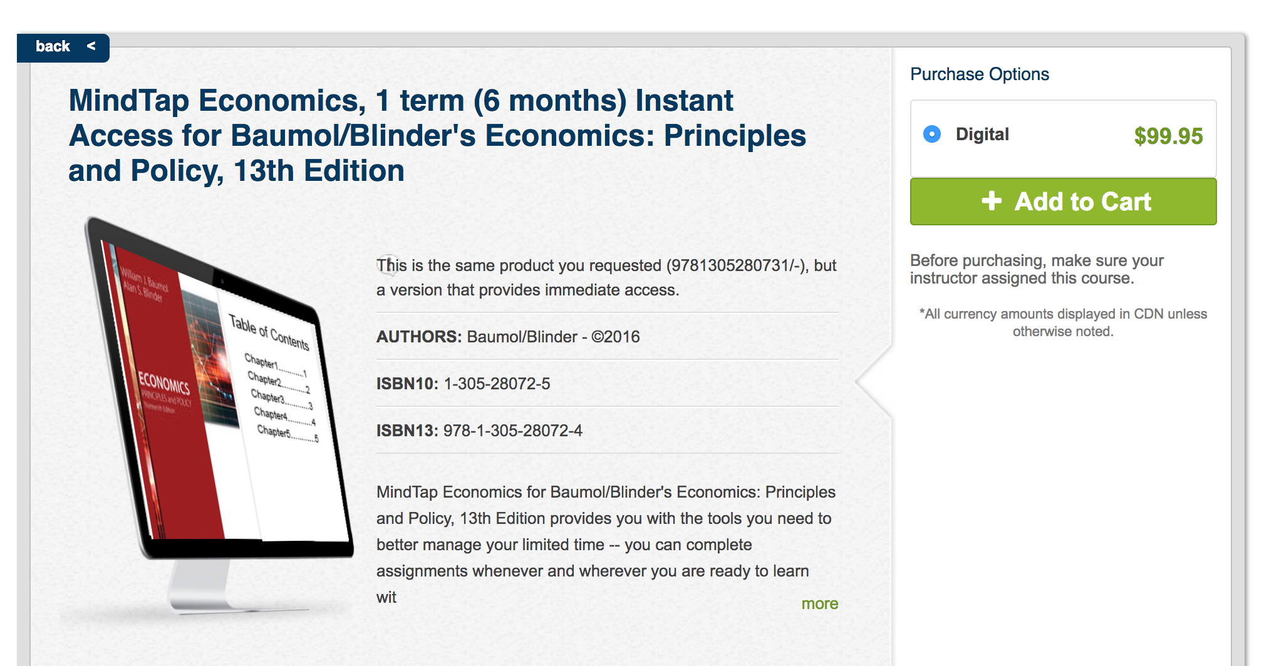
Ebook price for 6 months
From NelsonBrain.com, Aug 2018
Notes:
Lose all your notes and highlights

Slide 16
What about “inclusive access”?
Notes:
From: http://open.lib.umn.edu/affordablecontent/chapter/inclusive-access-who-what-when-where-how-and-why/
“While the details may vary by publisher, vendor, retailer, or institution, inclusive access generally works like this: Students receive access to digital course materials on or before the first day of class. Content is usually linked in the campus learning management system (LMS). Access for enrolled students is free during a brief opt-out period at the beginning of the course; if students opt out of buying the inclusive access content by the deadline, their access disappears. If they do not opt out, access continues and they are automatically charged for the content. Because opt-out rates tend to be low, publishers say they can afford to offer volume discounts at substantial savings (“as much as 70 percent” [Dimeo, 2017, Michael Hale section, para. 8]). Student access to purchased materials ends at a length of time negotiated with the publisher.”

Slide 17
Opt-out
“The access is complimentary through the add/drop date, but you will see a charge on your tuition account. …. You will be required to pay the course material cost as part of your tuition payment, but if you chose to opt-out of the Inclusive Access course material offering you will be refunded that charge.”
-- From University of Utah bookstore inclusive access page
Notes:
Have to opt out within first 10 days for many places; have to find information on how to opt out: UC Davis Stores says opt out info will be emailed to you.
If add late, sometimes you only have 48 hours to decide to opt out (e.g, UC Davis Stores)
Requires that you have reliable access to wifi or data to read (or possibly download) the course materials on the LMS
Also allows more digital surveillance as instructors can see how often you’re accessing the text and for how long.

Slide 18
The solution
Open Educational Resources: What?

Slide 19
UNESCO definition of OER: “any type of educational materials that are in the public domain or introduced with an open license. The nature of these open materials means that anyone can legally and freely copy, use, adapt and re-share them.”

Slide 20
David Wiley, 5 R’s
Reuse
Revise
Remix
Retain
Redistribute
From Wiley’s open content definition

Slide 21
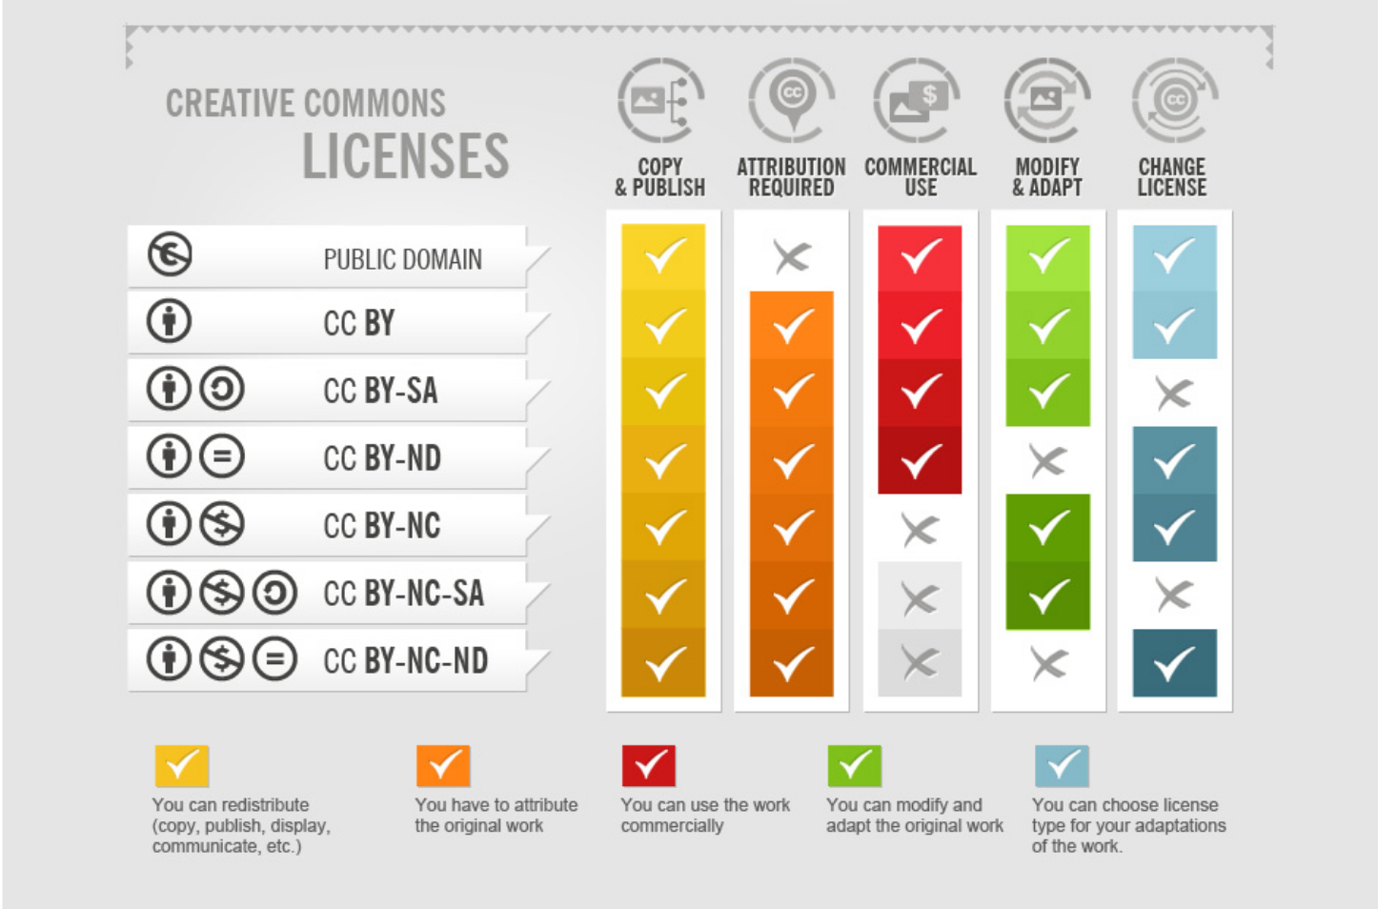
Creative Commons licenses
How to Attribute CC photos, by fotor.com, licensed CC BY-SA 3.0

Slide 22
OER: Why?
?

Slide 23
Equity
?
Improving access to education:
Financially
Ability to access resources needed
Accessibility of resources to people with disabilities
E.g., OER accessibility toolkit

Slide 24
Customizability
?
Ability for faculty, staff and students to alter the materials

Slide 25
PHYS 100 at UBC
?
94% | The readings were customized to this particular course: somewhat or very important
92% | The textbook didn’t cost any money: somewhat or very important
86% | I could access the textbook anywhere with an internet connection: somewhat or very important
Hendricks, C., Reinsberg, S. A., & Rieger, G. W. (2017). The adoption of an open textbook in a large physics course: An analysis of cost, outcomes, use, and perceptions. The International Review of Research in Open and Distributed Learning, 18(4). http://www.irrodl.org/index.php/irrodl/article/view/3006
Notes:
143 respondents who took PHYS 100 in Fall 2015 or Spring 2016

Slide 26
Non-disposable assignments
?
“… assignments that are sustainable or not disposable, assignments that would have benefit to others beyond the limited course time and space” (Maha Bali, 2017)
David Wiley on disposable assignments (2013)
Images licensed CC0 on pixabay.com: trash can & icon for “no”
Notes:
Wiley: “They’re assignments that add no value to the world – after a student spends three hours creating it, a teacher spends 30 minutes grading it, and then the student throws it away. Not only do these assignments add no value to the world, they actually suck value out of the world.”

Slide 27
Students as producers
?
“Students should not be merely consumers of knowledge but producers, engaged in meaningful, generative work alongside the university’s faculty.”
-- Derek Bruff, “Students as Producers: An Introduction”
Notes:
Examples:
Wikipedia assignments
Open Textbooks, e.g.
Annotations with hypothes.is

Slide 28
Examples
?
Wikipedia assignments
Students contributing to or writing open textbooks
Students creating slides, videos, & more
Wikipedia logo, licensed CC BY-SA 3.0 on Wikimedia Commons
Notes:
See, e.g.,
A Guide to Making Open Textbooks with Students (Rebus Community)
UBC Open Case Studies
UBC Geography student-created resources on sustainability
Also, students annotating works on the web with hypothes.is

Slide 29
OER: Why?
?
Any other ideas on why OER?

Slide 30
OER: How?
Campus advocacy

Slide 31
Student voices powerful
Contributions to OER in tenure & promotion at UBC
OER as priority area for Teaching & Learning grant at UBC
#textbookbrokeBC

Slide 32
Stakeholders & allies
Faculty
Students
Librarians
Administrators
Teaching & Learning Centre
Bookstore
Parents & others in public
Government

Slide 33
Activity
20 minutes
What could you do to advocate that would NOT work, and why?
How could you talk to one of these in a way that would turn them off? Faculty, staff, students, government, the public
From this, any ideas on what you could do that would work?

Slide 34
OER elevator pitch
Hook: Statistic, fact, story to grab attention
Problem: What’s wrong with status quo?
Solution: How OER can address the problem
Call to action: What audience can do to move towards solution--focus on specific audience
Adapted from Nicole Allen, #NOERSummit18 OER Advocacy Workshop slides, licensed CC BY 4.0

Slide 35
Some challenges
Finding relevant, high quality OER
Time to find & implement OER
Course materials chosen by some other authority

Slide 36
Activity 2
15 minutes
Choose a stakeholder group and create an elevator pitch for increased adoption (and/or creation) of OER, and what they can do to help.

Slide 37
Suggested steps
Collect data: student behaviours re: course materials
Advocate to faculty: listening tours, dept. & articulation meetings, Senate meetings
Ask for training, workshops on OER for faculty
Ask to put OER into library catalogue, create Lib. Guide
Try to get OER grant or other recognition program, campus statement or policy re: OER
Work to create campus OER working group
Adapted from Rajiv Jhangiani, 2017 Student Union Development Summit, licensed CC BY 4.0

Slide 38
Useful resources
College Libraries Ontario OER Toolkit
BCcampus Open Edu OER Student Toolkit
Rebus Community Guide to Making Open Textbooks with Students
SPARC advocacy plan for students
SPARC OER mythbusting
7 things you should know about OER policies (Educause)
Finding OER:
OER Library guides (e.g., UBC guide, UAlberta guide)
BCcampus and eCampus Ontario open textbook libraries
BCcampus OER collections list

Slide 39
Thanks!
Any questions ?
You can find me at
@clhendricksbc
christina.hendricks@ubc.ca

Slide 40
Credits
Special thanks to all the people who made and released these awesome resources:
Presentation template (Viola) by SlidesCarnival, licensed CC BY 4.0
Icons purchased with a subscription to The Noun Project:
all except the megaphone, check mark, exclamation point, pushpin, and thumbs up icons; those came from the above slide template by Slides Carnival.
A number of slides inspired by/adapted from Coolidge & Wright, Be the Change. Open Education.

Slide 41
Presentation design
This presentation uses the following typographies and colors:
Titles: Lora
Body copy: Quattrocento Sans
Yellow #ffcd00 | Blue #76e3f7

